Slide 1

At the Cross
Alas! and did my Savior bleed
Isaac Watts - Ralph E. Hudson • 1707 / 1885 gospel-song form
Primary Scripture: Galatians 2:20
Prepared for teaching and small group use - hymninfo.com

Slide 2

Teaching Aim
What this lesson should form in heart and practice
Understand the cross as Christ's saving self-giving love.
Feel holy sorrow over sin joined with grateful assurance.
Practice repentance, faith, and surrendered discipleship.
✚
♥
→
Understand
Feel
Practice
Prepared for teaching and small group use - hymninfo.com

Slide 3

Hymn Identity
A classic cross-centered text in gospel-song form
Title
At the Cross
First line
Alas! and did my Savior bleed
Text
Isaac Watts, 1707
Refrain and tune
Ralph Erskine Hudson, 1885
Tune
HUDSON
Meter
Common Meter with refrain
Prepared for teaching and small group use - hymninfo.com

Slide 4

Historical Background
Watts first published the text in 1707 under the heading Godly Sorrow Arising from the Sufferings of Christ.
The familiar gospel-song form came later when Hudson added the refrain and tune.
The hymn joins English devotional hymnody with American revival-song testimony.
Prepared for teaching and small group use - hymninfo.com

Slide 5
The Cross and the Conscience
The hymn begins where Christian faith must begin: at Calvary.
Prepared for teaching and small group use - hymninfo.com

Slide 6
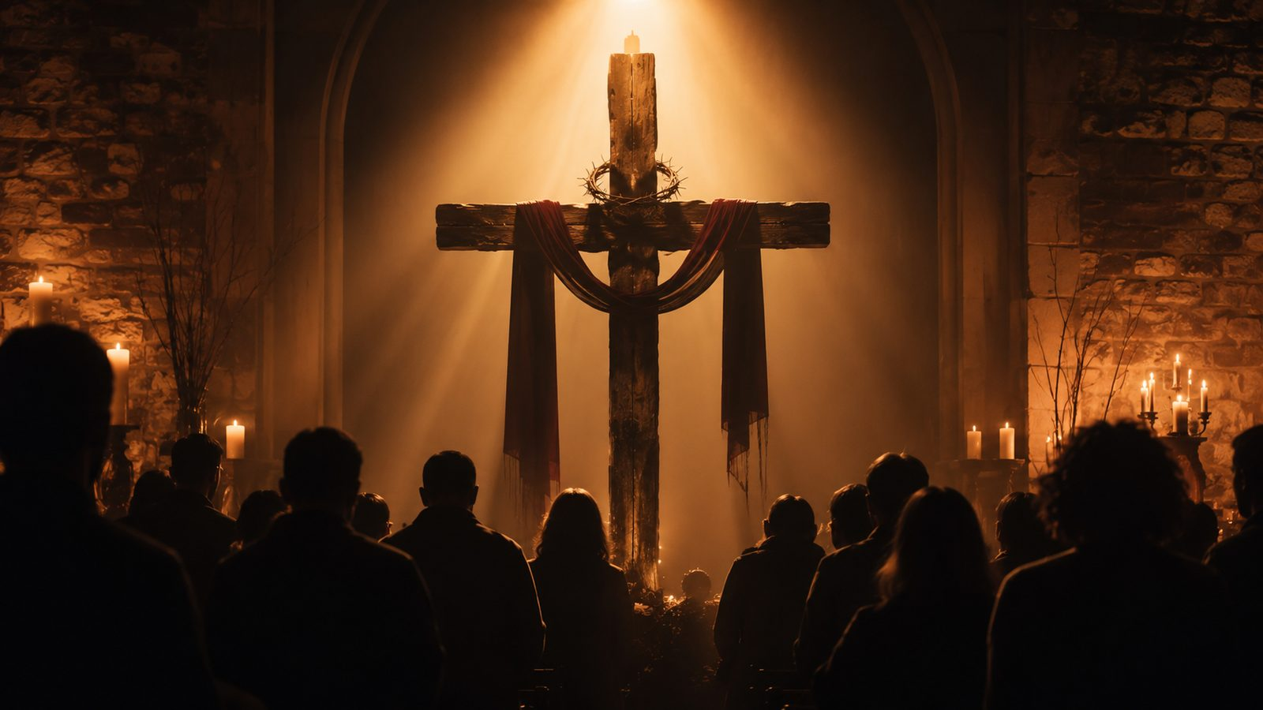
Why This Hymn Matters Today
It gives worshipers words for repentance without despair.
It teaches that assurance rests on Christ's finished work, not human merit.
It helps congregations sing both grief over sin and joy in grace.
Prepared for teaching and small group use - hymninfo.com

Slide 7
Biblical Foundation
Five texts that frame the hymn
Galatians 2:20 — Christ loved me and gave himself for me.
Isaiah 53:4-5 — The suffering servant bears our griefs and wounds.
Romans 5:8 — God shows love while we are still sinners.
1 Peter 2:24 — Christ bears sins so we might live to righteousness.
Colossians 2:13-14 — The record against us is nailed to the cross.
Prepared for teaching and small group use - hymninfo.com

Slide 8

Galatians 2:20
The cross is personal without becoming private.
Paul speaks of Christ's love and self-giving as the ground of his new life.
The hymn leads the singer to say: this mercy is not abstract; it has claimed me.
Prepared for teaching and small group use - hymninfo.com

Slide 9
Isaiah 53: The Wounded Servant
The hymn's sorrow makes sense only because Scripture says sin is serious.
Christ bears what sinners could not bear.
The Savior's wounds become the place where healing begins.
Prepared for teaching and small group use - hymninfo.com

Slide 10

Romans 5:8: Love Proven at the Cross
The cross is God's public demonstration of love.
The hymn does not flatter the worshiper; it magnifies the Savior.
Grace meets sinners before they can make themselves worthy.
Prepared for teaching and small group use - hymninfo.com

Slide 11
The Hymn's Devotional Movement
Wonder - Conviction - Gratitude - Surrender
Prepared for teaching and small group use - hymninfo.com

Slide 12
Stanza Movement 1: Wonder
The opening question is not cold doctrine; it is astonished worship.
The singer stands before the suffering Savior and asks why such mercy should be given.
Teaching emphasis: begin with holy wonder before moving to explanation.
Prepared for teaching and small group use - hymninfo.com

Slide 13
Stanza Movement 2: Creation Responds
Watts uses creation imagery to underline the weight of Calvary.
The darkened sun and shaken creation echo the seriousness of sin and the glory of redemption.
Teaching emphasis: the cross is the turning point of the world, not merely a private religious moment.
Prepared for teaching and small group use - hymninfo.com

Slide 14
Stanza Movement 3: Personal Conviction
The hymn moves from Christ's suffering to the worshiper's own need.
True cross-centered worship includes repentance, not vague admiration.
Teaching emphasis: conviction is a doorway to grace, not a dead end.
Prepared for teaching and small group use - hymninfo.com

Slide 15
Stanza Movement 4: Gratitude and Surrender
Tears alone cannot repay redeeming love.
The fitting response is the whole self offered to God.
Teaching emphasis: grace does not end at feeling; it forms a surrendered life.
Prepared for teaching and small group use - hymninfo.com

Slide 16
The Gospel Refrain
Hudson's refrain gives the hymn a testimony-shaped climax.
The cross becomes the place where spiritual sight is given and guilt is lifted.
In congregational singing, the refrain turns meditation into shared confession.
Prepared for teaching and small group use - hymninfo.com

Slide 17

Theological Themes
The doctrine carried by the song
Atonement
Christ bears sin for sinners.
Grace
Mercy comes before merit.
Repentance
The heart turns honestly toward God.
Assurance
Forgiveness rests on Christ.
Discipleship
The redeemed life is offered back.
Prepared for teaching and small group use - hymninfo.com

Slide 18
Literary and Musical Observations
Watts uses questions to awaken conscience and wonder.
The older stanzas are reflective and tightly theological.
Hudson's tune and refrain add gospel-song warmth, memorability, and congregational lift.
Prepared for teaching and small group use - hymninfo.com

Slide 19
Pastoral and Worship Use
Strong for Lent, Good Friday, Communion, evangelistic services, and calls to repentance.
Useful with learners who need assurance that forgiveness rests on Christ's work.
Choirs can help the congregation sing the refrain with grateful confidence, not haste.
Prepared for teaching and small group use - hymninfo.com

Slide 20

Questions for Teaching
Move from observation to response
What does the cross reveal about sin?
What does the cross reveal about God's love?
How does the hymn move from sorrow to assurance?
What would surrendered gratitude look like this week?
Application
Come to Christ honestly, receive grace gladly, and offer yourself fully.
Prepared for teaching and small group use - hymninfo.com

Slide 21

Suggested Lesson Flow
Two usable formats
30 minutes
- Read Galatians 2:20
- Teach hymn identity
- Trace the stanza movement
- Discuss one application
60 minutes
- Add Isaiah 53 and Romans 5
- Compare Watts and Hudson
- Use group questions
- Close with prayer and singing
Prepared for teaching and small group use - hymninfo.com

Slide 22
Closing Summary and Prayer
The cross is where sorrow becomes grace-filled hope
Lord Jesus Christ, keep our eyes fixed on your cross. Give us honest repentance, grateful faith, and a life surrendered to your redeeming love. Amen.
© HymnInfo.com. Free for personal, church, classroom, and small-group teaching use. Please do not sell, repost, or redistribute as downloadable files without permission.
Prepared for teaching and small group use - hymninfo.com

