Slide 1

Something Beautiful
A hymn study on grace, restoration, and new creation
First line: “Something beautiful, something good”
Words: Gloria Gaither
Music: William James Gaither • 1971
Primary Scripture: 2 Corinthians 5:17
Prepared for teaching and small group use - hymninfo.com

Slide 2

Teaching Aim
Move from brokenness to grace-filled witness.
✦
♡
→
Understand
Feel
Practice
God does not merely improve appearances; in Christ, He makes a new creation.
Grace gives hope to people who know guilt, shame, confusion, or failure.
A restored life becomes a testimony that points to God’s mercy, not human achievement.
Prepared for teaching and small group use - hymninfo.com

Slide 3
Hymn Identity
Title
Something Beautiful
Tune
SOMETHING BEAUTIFUL
First line
Something beautiful, something good
Form
Brief gospel chorus / irregular meter
Lyricist
Gloria Gaither
Date
1971
Composer
William James Gaither
Primary themes
Grace, forgiveness, restoration, new creation, testimony
Prepared for teaching and small group use - hymninfo.com

Slide 4

Historical Background
A short gospel chorus that gave ordinary believers testimony language.
Written in the early 1970s by Gloria Gaither, with music by William J. Gaither.
Associated with the Bill Gaither Trio and the wider Gaither music ministry.
Known both as a brief chorus and in relation to a longer testimony text printed in some songbooks.
Received into many evangelical and denominational hymnals as a simple song of grace and restoration.
Prepared for teaching and small group use - hymninfo.com

Slide 5
Why This Song Matters Today
For wounded people
It names the honest starting point of guilt, shame, confusion, and need.
For congregations
It gives a gentle response after confession, testimony, or preaching on renewal.
For teachers
It opens a clear path into new creation, grace, and God’s workmanship.
Prepared for teaching and small group use - hymninfo.com

Slide 6
Scripture and Grace
The chorus rests on the biblical promise that God renews what is broken.
Prepared for teaching and small group use - hymninfo.com

Slide 7
Biblical Foundation
Isaiah 61:3
God gives beauty, joy, and praise in place of ashes and heaviness.
2 Corinthians 5:17
In Christ, the old has passed; new creation has come.
Ephesians 2:8–10
Grace saves, and grace reshapes believers as God’s workmanship.
Ecclesiastes 3:11
God makes all things beautiful in His time.
Prepared for teaching and small group use - hymninfo.com

Slide 8
The Honest Starting Point
The song begins where many testimonies begin: with need.
The chorus does not begin with religious success. It begins with human limits.
Guilt and shame are not problems we can decorate away. They must be brought into the light of grace.
For pastoral teaching, this is a doorway into confession without despair.
Prepared for teaching and small group use - hymninfo.com

Slide 9

God Understands and Receives
Grace is not surprised by the truth about us.
Isaiah 61 speaks of exchange: ashes for beauty, heaviness for praise.
The song’s pastoral power is the assurance that God sees clearly and still acts mercifully.
Teaching emphasis: honest confession becomes possible because God’s mercy is stronger than shame.
Prepared for teaching and small group use - hymninfo.com

Slide 10
Grace Makes New
2 Corinthians 5:17
The gospel does not merely rename the old life; it brings a new creation in Christ.
The beauty God makes is not cosmetic. It is redemptive and creative.
This song works best when connected to the finished work of Christ and the new life He gives.
Prepared for teaching and small group use - hymninfo.com

Slide 11
Saved by Grace, Remade for Purpose
Ephesians 2:8–10
Grace
Faith
New Life
Good Works
Witness
Grace is God’s gift, not human achievement.
God’s workmanship becomes visible in a life that now walks in prepared works.
Testimony should point to the Maker more than to the material He remade.
Prepared for teaching and small group use - hymninfo.com

Slide 12
Beauty in God’s Time
Ecclesiastes 3:11
The Bible does not promise that every wound is instantly explained.
It does testify that God can work with time, weakness, repentance, and mercy.
This song is most faithful when it lets God’s timing remain God’s timing, while still proclaiming His restorative grace.
Prepared for teaching and small group use - hymninfo.com

Slide 13
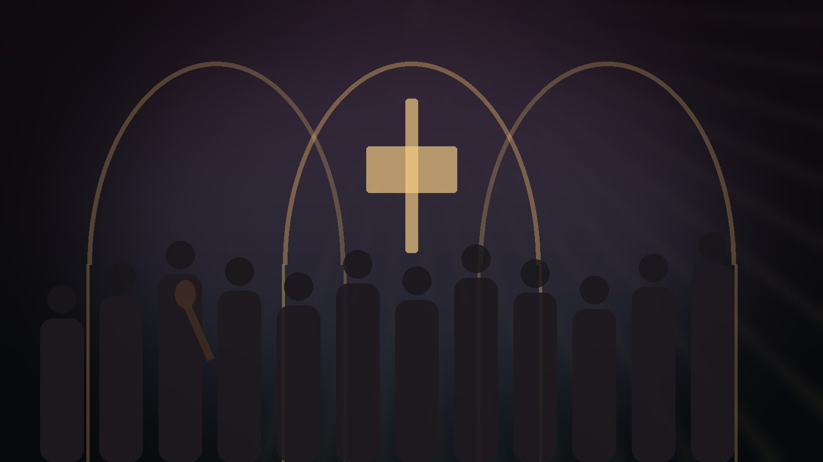
Theological Themes
Six teaching windows into the song
Grace
Forgiveness
Restoration
God acts first in mercy.
Shame is answered by Christ.
Brokenness is not the final word.
New Creation
Assurance
Testimony
The old gives way to life in Christ.
The sinner may come honestly.
The story points to God’s mercy.
Prepared for teaching and small group use - hymninfo.com

Slide 14
Literary and Musical Observations
Short form: the song works as a concentrated testimony rather than a developed hymn argument.
Movement: human insufficiency gives way to God’s gracious rebuilding work.
Melody: simple, reflective, and easy to sing as a response after prayer or confession.
Leadership: use a gentle tempo and avoid turning the song into a performance piece.
Prepared for teaching and small group use - hymninfo.com

Slide 15
Pastoral and Worship Use
Best used as a prayerful response of assurance.
After confession
After testimony
Grace answers shame with mercy.
The focus remains on God’s restoring work.
After preaching
In care settings
A fitting response to new creation or grace.
Gentle language for those rebuilding trust and hope.
Prepared for teaching and small group use - hymninfo.com

Slide 16
Teaching Questions
Where do people usually look for beauty, worth, or a new beginning?
What does 2 Corinthians 5:17 say God does in Christ?
How does Ephesians 2:8–10 protect us from boasting and despair?
How can testimony honor Christ without centering the self?
What pastoral care is needed when someone’s restoration feels unfinished?
Prepared for teaching and small group use - hymninfo.com

Slide 17
Suggested Lesson Flow
A ready path for 30 or 60 minutes
30-minute plan
60-minute plan
Open with 2 Corinthians 5:17
Give brief song background
Teach three movements: need, grace, restoration
Discuss one question
Close with prayer
Add Isaiah 61:3 and Ephesians 2:8–10
Invite testimony-shaped reflection
Discuss pastoral uses in worship
Plan a concrete act of encouragement
Close with a sung or spoken response
Prepared for teaching and small group use - hymninfo.com

Slide 18
Closing Summary and Prayer
God can make a restored life into a testimony of grace.
Lord Jesus, receive what is broken, ashamed, and confused in us.
Make us new by Your grace.
Teach us to live as Your workmanship and to bear witness to Your mercy. Amen.
© HymnInfo.com. Free for personal, church, classroom, and small-group teaching use. Please do not sell, repost, or redistribute as downloadable files without permission.
Prepared for teaching and small group use - hymninfo.com

