Slide 1

Soon and Very Soon
Teaching Guide
Christian hope, resurrection promise, and the joy of seeing Christ the King
Andraé Crouch • 1976 • Revelation 22:20
Prepared for teaching and small group use - hymninfo.com

Slide 2

Teaching Aim
What this lesson should form in the church
U
H
P
Understand
Hope
Practice
Learners will understand the biblical hope of Christ’s return, resurrection, and the end of sorrow.
Learners will feel the courage of Christian hope without denying grief, pain, or waiting.
Learners will comfort one another and live as people who belong to Christ’s coming kingdom.
Prepared for teaching and small group use - hymninfo.com

Slide 3
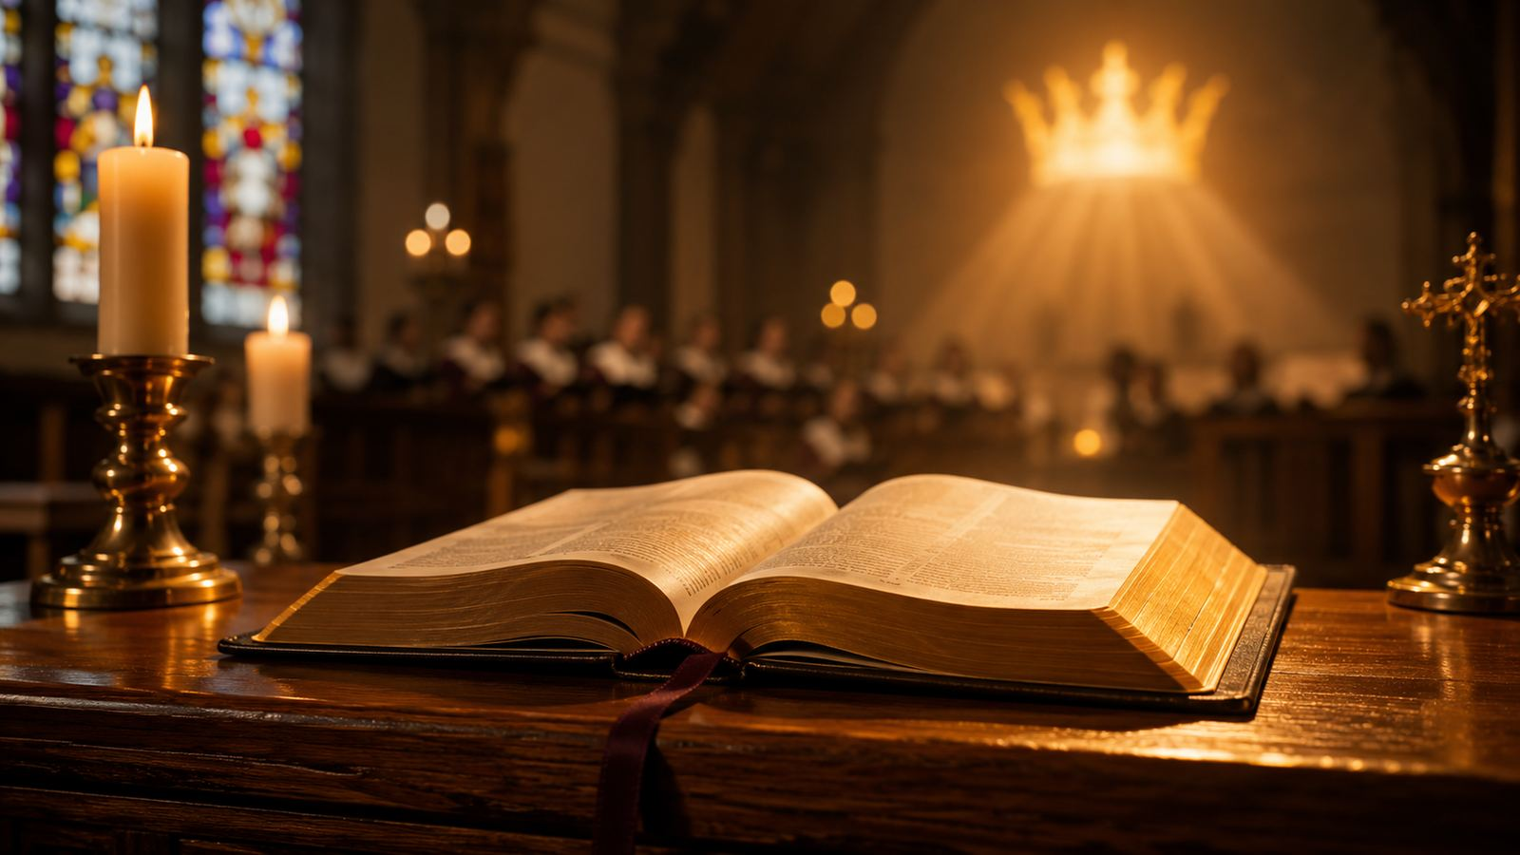
Hymn Snapshot
Identity and worship placement
Title: Soon and Very Soon
Ministry uses
First line: Soon and very soon, we are going to see the King
Advent hope
Writer and composer: Andraé Crouch (1942-2015)
Funeral and memorial worship
Year: 1976
Eastertide and resurrection themes
Tradition: contemporary gospel, congregational praise
Gospel choir ministry
Main Scripture: Revelation 22:20
Congregational praise and witness
Prepared for teaching and small group use - hymninfo.com

Slide 4
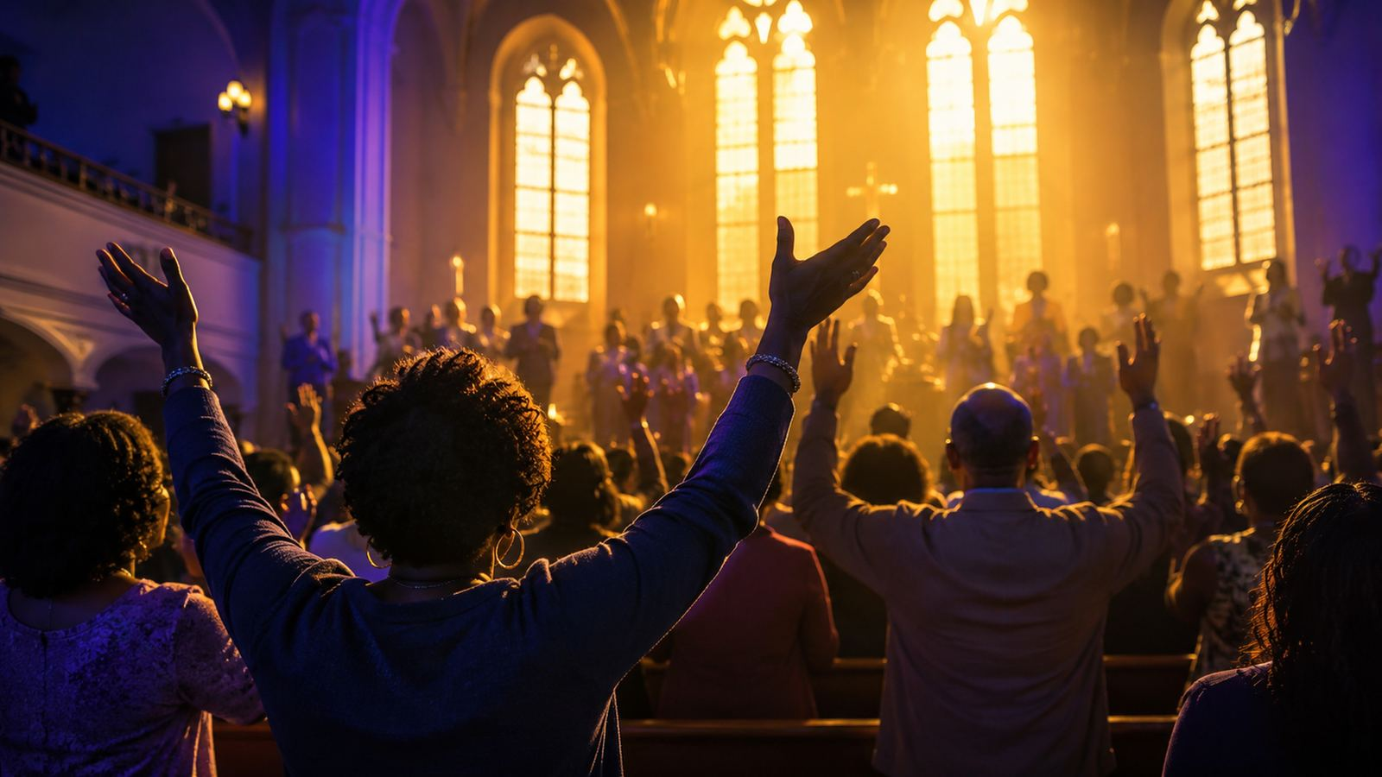
Historical Background
A modern gospel hymn that crossed church traditions
Andraé Crouch wrote and composed the song in the mid-1970s. His music helped bring modern gospel language, rhythm, and testimony into many congregational worship settings. The hymn’s direct refrain and call-and-response feel made it usable in choirs, praise teams, and congregations beyond its original setting.
Its spread into denominational hymnals showed that gospel music could carry both theological depth and congregational accessibility. The song remains especially strong where the church needs to sing hope in the face of grief.
Gospel witness: praise that carries a people through sorrow toward promise.
Prepared for teaching and small group use - hymninfo.com

Slide 5
Why This Hymn Matters Today
Hope sung aloud is pastoral care
It gives the church a simple, memorable confession of future hope.
It lets mourners sing resurrection promise without denying sorrow.
It places Christ at the center: the goal is seeing the King.
It reminds worshipers that tears, death, and pain are temporary before God’s final renewal.
It joins joy and longing in a way that fits Advent, funerals, and gospel praise.
Prepared for teaching and small group use - hymninfo.com

Slide 6

Biblical Hope
The song sings what Scripture promises
Prepared for teaching and small group use - hymninfo.com

Slide 7

Biblical Foundation
The promise beneath the song
Primary texts
Revelation 22:20 — “Come, Lord Jesus.”
Revelation 21:3-4 — no more tears, death, mourning, crying, or pain.
1 Thessalonians 4:16-17 — the Lord descends; the dead in Christ rise.
John 14:3 — Jesus receives his people to himself.
Philippians 3:20-21 — our citizenship and bodily hope.
Christian hope is not vague optimism. It is anchored in the promise, presence, and return of Christ.
Prepared for teaching and small group use - hymninfo.com

Slide 8
Revelation 22:20
“Yes, I come quickly.”
Christ’s promise gives the song its urgency.
The repeated language becomes a prayer of readiness.
The church’s answer is not fear but prayer: Come, Lord Jesus.
Waiting is not passive; it is faithful longing.
Prepared for teaching and small group use - hymninfo.com

Slide 9
John 14 and 1 Thessalonians 4
The King receives and raises his people
Jesus receives his people
The Lord raises his people
“I will come again, and will receive you to myself.” Jesus makes the future personal: believers are brought to him.
Paul tells the church to comfort one another: the Lord comes, the dead in Christ rise, and we will be with the Lord forever.
John 14:3
1 Thessalonians 4:16-17
Prepared for teaching and small group use - hymninfo.com

Slide 10

Revelation 21:3-4
God dwells with his people. Tears are wiped away. Death is no more. The first things pass away.
The hymn is joyful because God’s future is stronger than grief.
Prepared for teaching and small group use - hymninfo.com

Slide 11
Hymn Movement
Seeing the King, ending sorrow, defeating death
Prepared for teaching and small group use - hymninfo.com

Slide 12
Hymn Section Study: Seeing the King
The center of hope is Christ himself
The repeated hope is face-to-face: the church will see Christ the King.
This is more than a wish for a better place; it is longing for the Lord himself.
Teach this section from John 14:3 and Revelation 22:20.
Pastoral emphasis: the future is personal because Jesus is personal.
Prepared for teaching and small group use - hymninfo.com

Slide 13
Hymn Section Study: Tears Ended
Christian hope does not scold grief
Tears are real now
Scripture does not deny mourning. It promises God’s own hand will wipe away tears. The song gives the grieving church a way to sing the future while still living in the present.
Revelation 21:4
Prepared for teaching and small group use - hymninfo.com

Slide 14
Hymn Section Study: Death Defeated
Resurrection comfort for the whole church
The hymn’s comfort belongs especially at gravesides and memorial services.
Its promise rests on Christ’s resurrection and return.
Paul says the church should comfort one another with this hope.
Faith does not erase loss; it names death as a defeated enemy.
1 Thessalonians 4:16-17
Prepared for teaching and small group use - hymninfo.com

Slide 15
Hymn Section Study: Sorrow Turned to Praise
The gospel makes room for joy
This is not shallow cheerfulness.
The song’s joy comes from the victory of Christ. It can be sung in a sanctuary, at a funeral, with a choir, or by a small group because it carries a promise larger than the present pain.
Hallelujah becomes a word of faith while the church waits.
Prepared for teaching and small group use - hymninfo.com

Slide 16
Theology and Worship
How the hymn forms Christian imagination
Prepared for teaching and small group use - hymninfo.com

Slide 17
Theological Themes
Six truths the hymn places on the church’s lips
Christ’s Return
Kingdom Hope
Resurrection
The King is coming.
God’s future rules.
Death will lose.
End of Tears
Eternal Life
Corporate Praise
God will comfort.
Life with Christ endures.
The church sings together.
Prepared for teaching and small group use - hymninfo.com

Slide 18
Literary and Musical Observations
Simple words, strong communal power
Textual movement
Musical character
Direct repetition creates memory.
Gospel rhythm carries energy and assurance.
Short phrases invite participation.
Call-and-response can be led by choir or cantor.
The “we” makes hope corporate.
The repeated refrain builds congregational courage.
The language moves from seeing Christ to the end of grief.
Sing with joy, not speed; the words need weight.
Prepared for teaching and small group use - hymninfo.com

Slide 19
Pastoral and Worship Use
When and how to place the hymn
Advent: longing for the returning King.
Funerals and memorials: resurrection hope joined with honest grief.
Easter season: the risen Christ will raise his people.
Gospel choir Sundays: call-and-response praise rooted in biblical promise.
Sermon response: after teaching on Revelation 21, Revelation 22, or 1 Thessalonians 4.
Pastoral care: a congregational way to say what hurting hearts need to hear together.
Prepared for teaching and small group use - hymninfo.com

Slide 20
Teaching Questions
Guide the class toward Scripture-rooted hope
What does this hymn say the church is waiting for?
Why is “seeing the King” a stronger hope than simply “going somewhere better”?
How does Revelation 21 help believers face tears without denial?
How can a joyful song be pastorally appropriate in a funeral setting?
What does the repeated “we” teach about the church’s shared hope?
Prepared for teaching and small group use - hymninfo.com

Slide 21
Suggested Lesson Flow
Two ready-to-use teaching paths
30-minute lesson
60-minute lesson
Read Revelation 22:20 and 21:3-4 (5 min)
Opening testimony or lament prayer (5 min)
Hymn background and gospel setting (5 min)
Scripture study: Revelation, John, Paul (18 min)
Teach the three core promises (12 min)
Hymn movement and gospel music form (15 min)
Group reflection and prayer (8 min)
Discussion questions (12 min)
Congregational application and prayer (10 min)
Prepared for teaching and small group use - hymninfo.com

Slide 22
Application: Singing Hope in a Waiting World
Practice the promise before the promise is fully seen
This week
Congregational response
Pray, “Come, Lord Jesus.”
A church that sings this hymn well learns to hold grief and joy together. It becomes a people who wait, worship, and witness until the King appears.
Comfort someone with a specific promise of Scripture.
Name one sorrow before God without hiding it.
Practice praise as a discipline of hope.
Prepared for teaching and small group use - hymninfo.com

Slide 23
Closing Summary and Prayer
Christ is coming. The church will see the King. Tears will end, death will be defeated, and God’s people will be with the Lord forever.
Lord Jesus, fix our hope on your promise. Comfort the grieving, steady the anxious, strengthen the weary, and teach your church to sing with courage until we see you face to face. Amen.
© HymnInfo.com. Free for personal, church, classroom, and small-group teaching use. Please do not sell, repost, or redistribute as downloadable files without permission.
Prepared for teaching and small group use - hymninfo.com

