Slide 1

HYMN TEACHING GUIDE
Spirit of God, Descend upon My Heart
First line: “Spirit of God, descend upon my heart”
George Croly • MORECAMBE by Frederick C. Atkinson • 1851
Primary Scriptures: Romans 5:5; Ezekiel 36:26-27; Galatians 5:22-23
Prepared for teaching and small group use - hymninfo.com

Slide 2
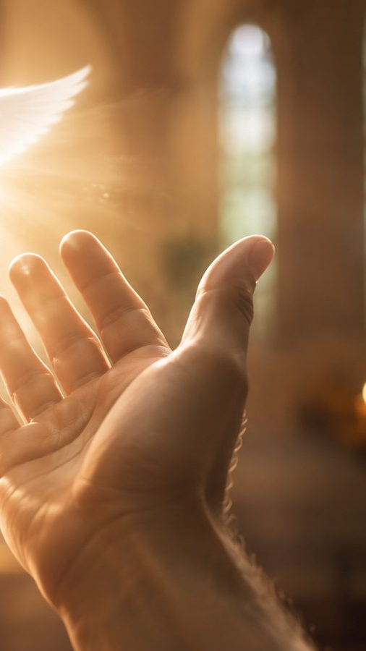
LESSON PURPOSE
Teaching Aim
Understand
the hymn as a prayer for the Spirit’s sanctifying work in the heart.
Feel
the weight of holy love, patient prayer, and inward surrender.
Practice
Spirit-dependent prayer that leads to obedience and renewed desire.
Prepared for teaching and small group use - hymninfo.com

Slide 3

HYMN IDENTITY
Hymn Identity
Text: George Croly, first published in 1851 as a devotional poem titled “Holiness Desired.”
Tune: MORECAMBE, composed by Frederick Cook Atkinson in 1870.
Meter: 10.10.10.10, supporting broad and prayerful congregational singing.
Core purpose: a prayer for the Holy Spirit to renew desire, will, patience, and love.
Prepared for teaching and small group use - hymninfo.com

Slide 4
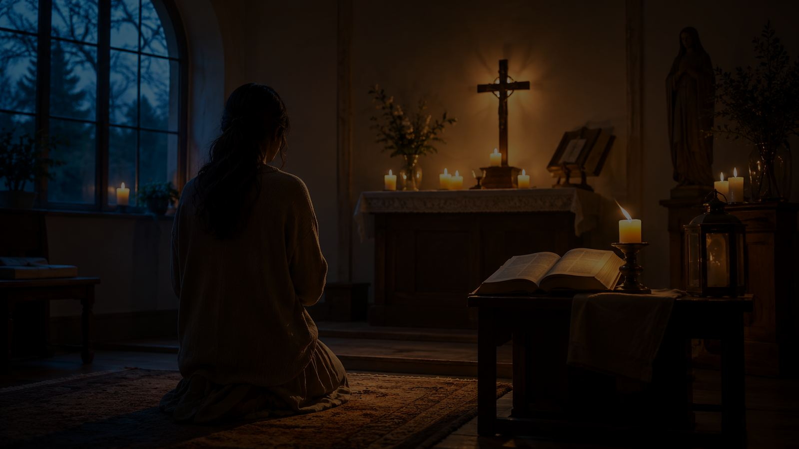
SECTION
Historical Setting
An Anglican devotional text shaped by prayer for holiness and inward renewal.
Prepared for teaching and small group use - hymninfo.com

Slide 5
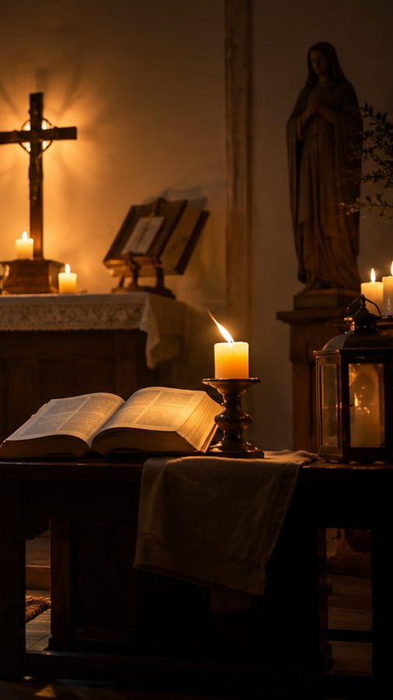
HISTORICAL BACKGROUND
Croly and the Prayer for Holiness
George Croly was an Irish-born Anglican clergyman, poet, novelist, and hymn writer.
The hymn emerged as a personal prayer, not as a public slogan or triumphal anthem.
Modern hymnals usually print five stanzas, preserving the poem’s devotional movement.
The language is older, but the spiritual need remains immediate: “Lord, change the heart.”
Prepared for teaching and small group use - hymninfo.com

Slide 6
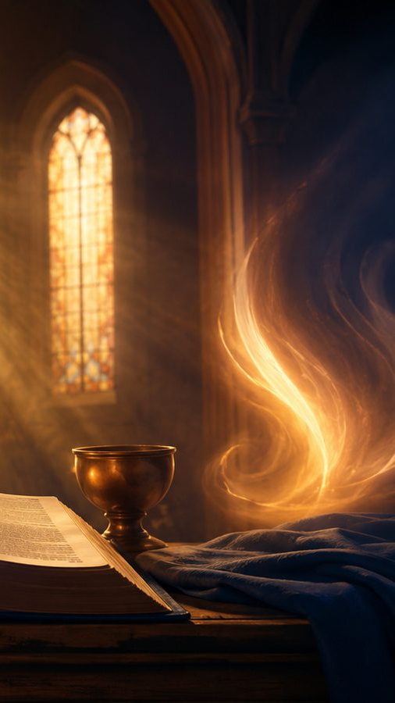
SCRIPTURE
Biblical Foundation
Romans 5:5
Ezekiel 36:26-27
God’s love is poured into the heart through the Holy Spirit.
God gives a new heart and puts his Spirit within his people.
Galatians 5:22-23
2 Corinthians 3:18
The Spirit forms fruit such as love, patience, gentleness, and self-control.
Believers are transformed into the Lord’s image by the Spirit.
These passages frame the hymn as a biblical prayer for sanctification, not vague spiritual longing.
Prepared for teaching and small group use - hymninfo.com

Slide 7

SECTION
Stanza-by-Stanza Study
A prayer that moves from the heart toward holy love.
Prepared for teaching and small group use - hymninfo.com

Slide 8
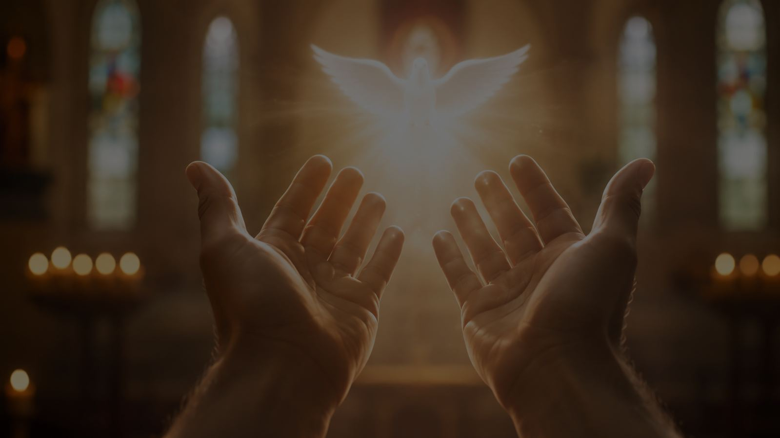
HYMN SECTION 1
The heart brought before God
The opening request is inward: the Spirit must reach the center of desire and loyalty.
The prayer asks God to loosen lesser loves and move through the whole person.
Teaching emphasis: sanctification begins with honest surrender, not self-improvement.
Prepared for teaching and small group use - hymninfo.com

Slide 9
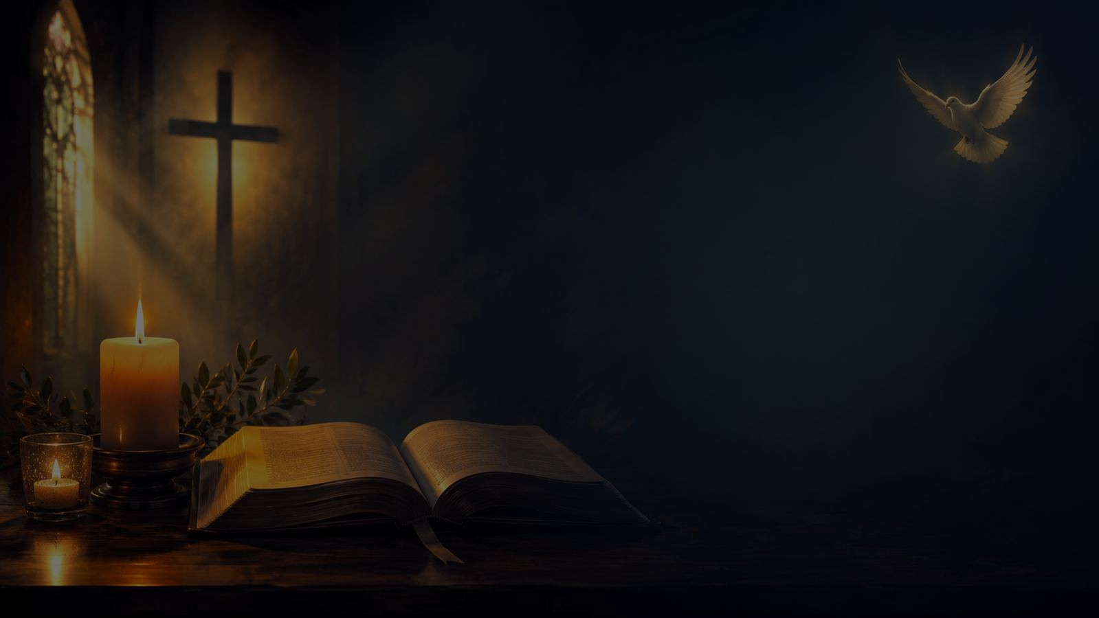
HYMN SECTION 2
Clear sight over spectacle
The hymn does not chase spiritual drama as an end in itself.
It asks for dimness to be removed so the soul may see truth clearly.
Teaching emphasis: mature faith values holiness and clarity more than religious excitement.
Prepared for teaching and small group use - hymninfo.com

Slide 10
HYMN SECTION 3
The will offered to God
Passion, strength, and will are not rejected; they are gathered and consecrated.
The Spirit does not erase personality but reorders it for God’s service.
Teaching emphasis: discipleship means bringing the whole self under God’s loving rule.
Prepared for teaching and small group use - hymninfo.com

Slide 11
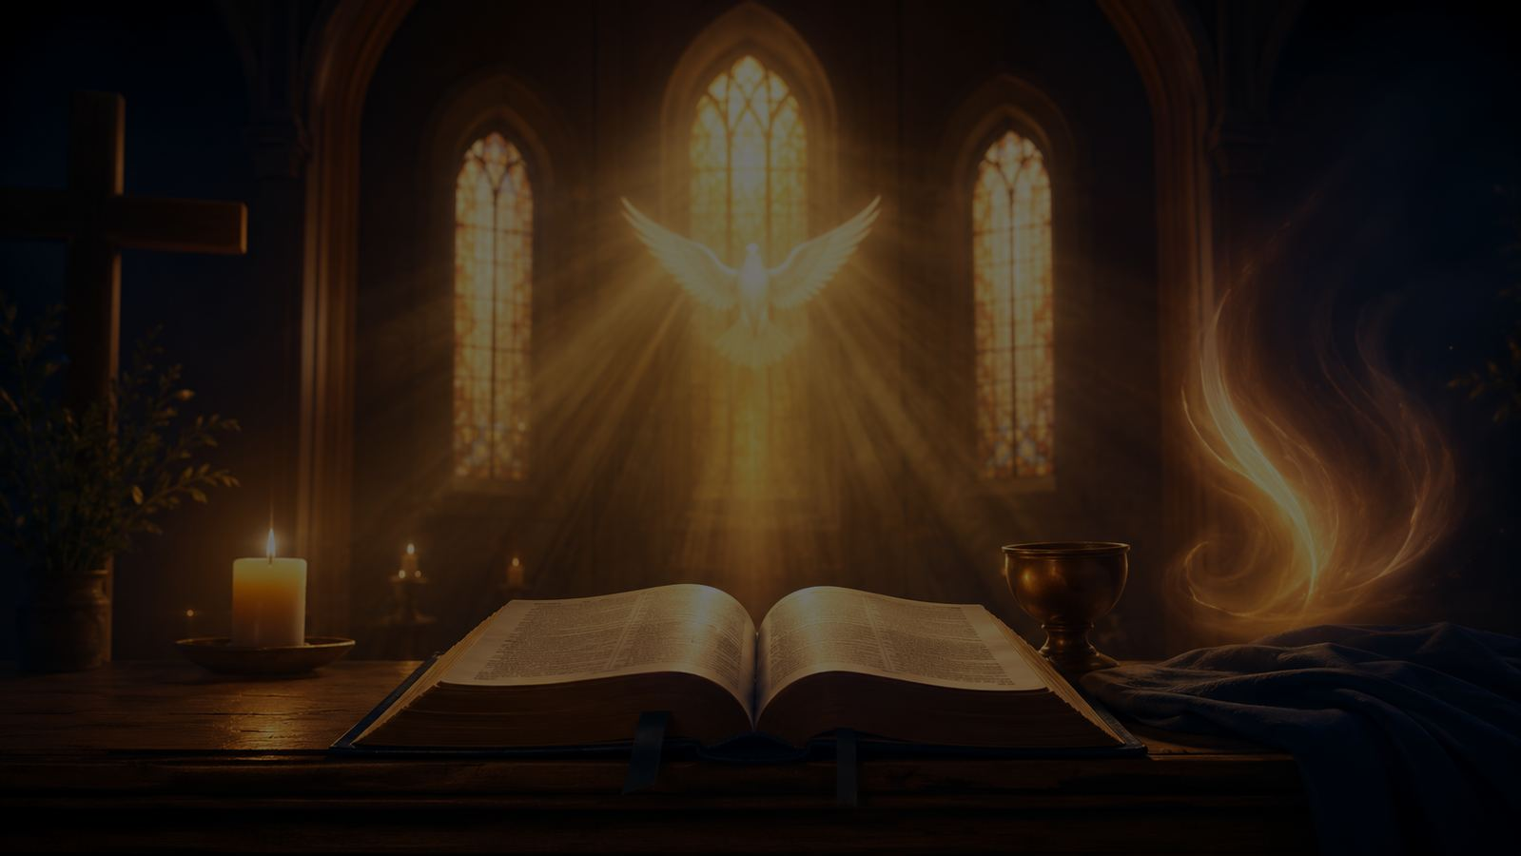
HYMN SECTION 4
Patience in unanswered prayer
The hymn names the struggles of the soul: doubt, resistance, and waiting.
Patience is not passivity; it is fruit of the Spirit under pressure.
Teaching emphasis: God may be forming trust even when answers are slow.
Prepared for teaching and small group use - hymninfo.com

Slide 12
HYMN SECTION 5
The heart as an altar of love
The final movement asks for one holy passion: love for God.
The altar image turns inward renewal into worship and consecration.
Teaching emphasis: the Spirit’s goal is holy love that fills the life.
Prepared for teaching and small group use - hymninfo.com

Slide 13
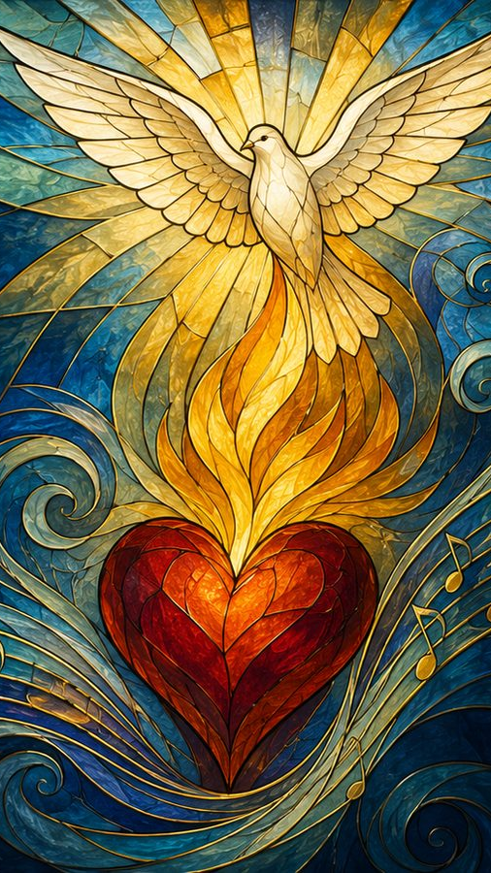
DOCTRINE
Theological Themes
Holy Spirit
Sanctification
God’s inward presence and power
the whole person renewed
Holy Love
Prayer
affections reordered toward God
honest dependence in weakness
Patience
Consecration
endurance when answers delay
desire, strength, and will offered
Prepared for teaching and small group use - hymninfo.com

Slide 14
THEOLOGY
Sanctification: Whole-Person Renewal
The hymn prays over the heart, weakness, passion, strength, will, doubt, and desire.
This is not mere moral polishing; it is the Spirit’s deep work of reordering the person.
The church can sing it as confession, consecration, and petition all at once.
A strong teaching question: What part of my inner life am I still withholding from God?
Prepared for teaching and small group use - hymninfo.com

Slide 15
SCRIPTURE CONNECTION
The Fruit of the Spirit
Galatians 5 names love, patience, gentleness, and self-control as Spirit-formed life.
The hymn makes those fruits concrete through prayer: teach me, wean me, use me, fill me.
Spiritual growth is not instant theater; it is the Spirit’s patient cultivation of Christlike character.
Prepared for teaching and small group use - hymninfo.com

Slide 16

OBSERVATION
Literary Movement
Descent
Renewal
Illumination
Surrender
Patience
Holy Love
The poem moves from a request for the Spirit’s descent to the final image of a heart aflame with divine love. It is both personal and deeply theological.
Prepared for teaching and small group use - hymninfo.com

Slide 17
MUSICAL NOTES
Musical Character: MORECAMBE
MORECAMBE uses broad, measured phrases that fit the hymn’s inward prayer.
The tune should not be rushed; the congregation needs room to carry each petition.
Piano, organ, or a cappella singing can all serve the text when tempo and phrasing remain clear.
Choir leaders can shape the hymn as a prayer, not merely a hymn number.
Prepared for teaching and small group use - hymninfo.com

Slide 18
CHOIR & WORSHIP
Teaching the Tune in Worship
Before singing, connect the hymn to Romans 5:5 or Ezekiel 36:26-27.
Use a calm introduction; let the congregation hear the hymn’s prayerful tone.
Emphasize clear vowels and sustained phrases so the text is understandable.
Invite the final stanza to be sung as a shared act of consecration.
Prepared for teaching and small group use - hymninfo.com

Slide 19
MINISTRY USE
Pastoral and Worship Use
Pentecost and Holy Spirit services
Confirmation, ordination, and renewal services
Retreats, prayer meetings, and personal consecration
Sermons on sanctification, spiritual formation, and holy love
Quiet moments before confession, intercession, or commitment
Prepared for teaching and small group use - hymninfo.com

Slide 20
DISCUSSION
Teaching Questions
What does the hymn teach us to ask from the Holy Spirit?
Why might the removal of spiritual dimness be a deeper gift than dramatic experience?
How does love for God relate to holiness and obedience?
Where do doubt, impatience, or divided desire appear in the life of prayer?
How can a congregation practice this hymn rather than merely sing it?
Prepared for teaching and small group use - hymninfo.com

Slide 21
RESPONSE
Application: Pray the Hymn
Name one lesser love that needs to be loosened.
Ask the Spirit to make one unclear area of your life honest before God.
Practice patience in one unanswered prayer without resentment.
Offer one strength, gift, or desire for God’s use this week.
Let love for God become the aim of obedience, not guilt or performance.
Prepared for teaching and small group use - hymninfo.com

Slide 22
TEACHING PLAN
Suggested 30-Minute Lesson Flow
5 min
Open with Romans 5:5 and a brief prayer.
5 min
Give hymn identity and historical setting.
10 min
Walk through the five stanza movements.
5 min
Discuss one question about sanctification.
5 min
Close with silent prayer and the hymn’s main petition.
Prepared for teaching and small group use - hymninfo.com

Slide 23
TEACHING PLAN
Suggested 60-Minute Lesson Flow
10 min
Scripture reading: Romans 5:5; Ezekiel 36:26-27; Galatians 5:22-23.
10 min
Hymn story and tune character.
20 min
Stanza-by-stanza study with Scripture connections.
10 min
Group discussion: holiness, patience, and holy love.
10 min
Personal prayer response and closing summary.
Prepared for teaching and small group use - hymninfo.com

Slide 24
Closing Summary and Prayer
The hymn leads the church to ask for the Spirit’s inward work: renewed love, clearer sight, surrendered will, patient prayer, and holy devotion.
Holy Spirit, descend upon our hearts. Make us love the Lord as we ought to love. Amen.
© HymnInfo.com. Free for personal, church, classroom, and small-group teaching use. Please do not sell, repost, or redistribute as downloadable files without permission.
Prepared for teaching and small group use - hymninfo.com

