Slide 1

Steal Away to Jesus
Prayer, Lament, Freedom, and Resurrection Hope
A hymn study resource for teaching, worship planning, and pastoral reflection
Primary Scripture: 1 Corinthians 15:51-52
Prepared for teaching and small group use - hymninfo.com

Slide 2
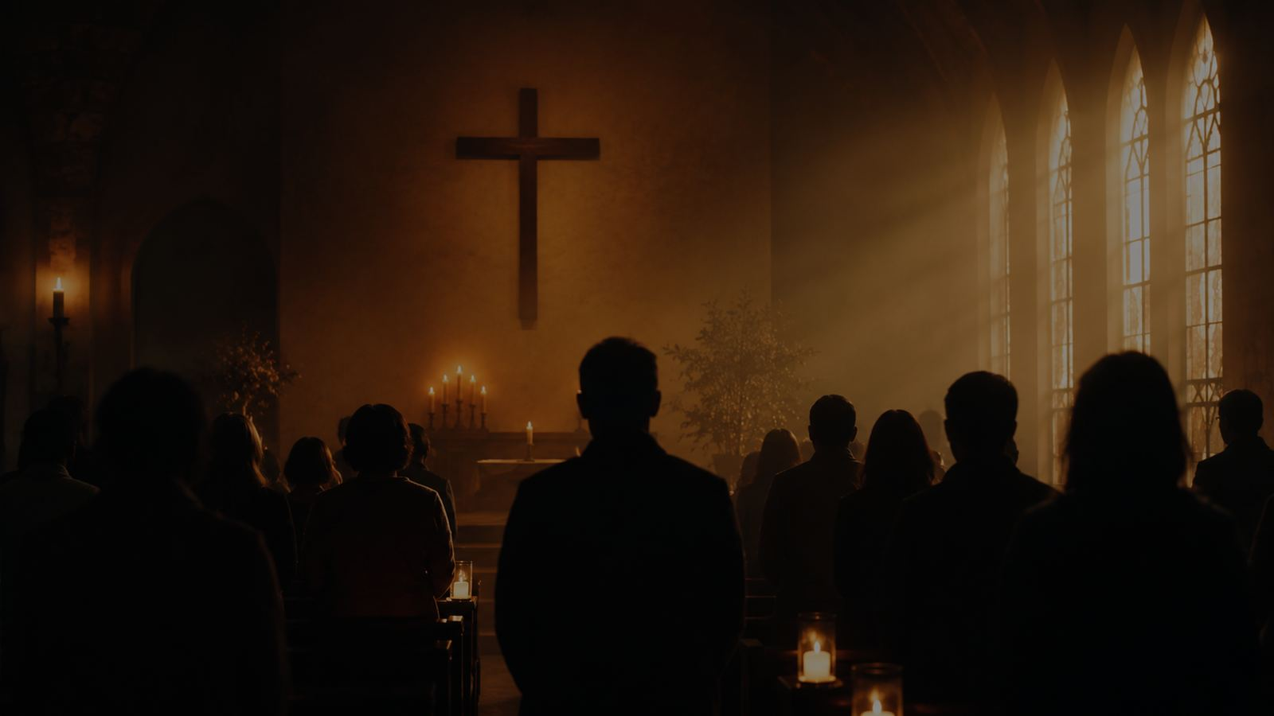
Teaching Aim
1
2
3
Understand
Feel
Practice
A spiritual formed by sorrow and Christian hope
• Trace the song’s Gospel themes of divine summons, judgment, death, resurrection, and homecoming.
• Honor the African American spiritual tradition with reverence, historical care, and pastoral humility.
• Lead people toward prayerful communion with Jesus and hope that outlasts suffering.
Prepared for teaching and small group use - hymninfo.com

Slide 3

Hymn Identity
Title
Tune name
Steal Away to Jesus
STEAL AWAY
First line
Meter
My Lord, he calls me
5.7.8.7 with refrain
Text and tune
Common use
African American spiritual
Prayer, funerals, lament, hope, spirituals
Prepared for teaching and small group use - hymninfo.com

Slide 4
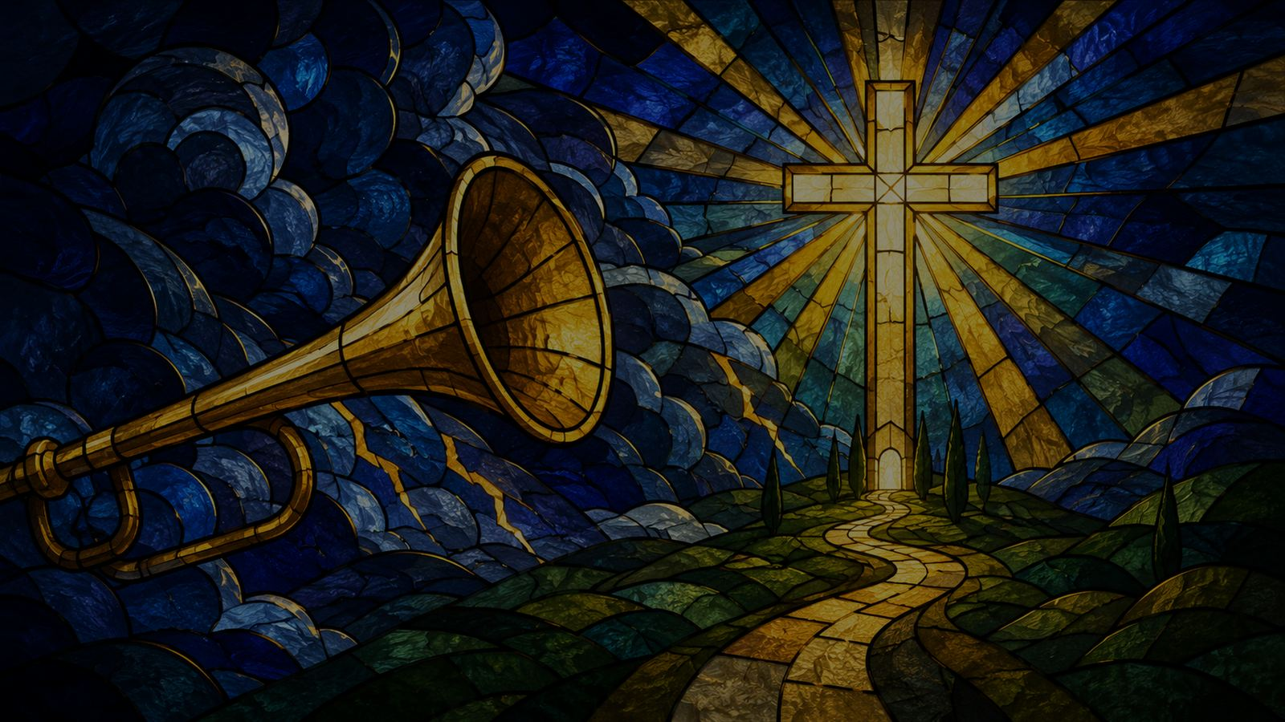
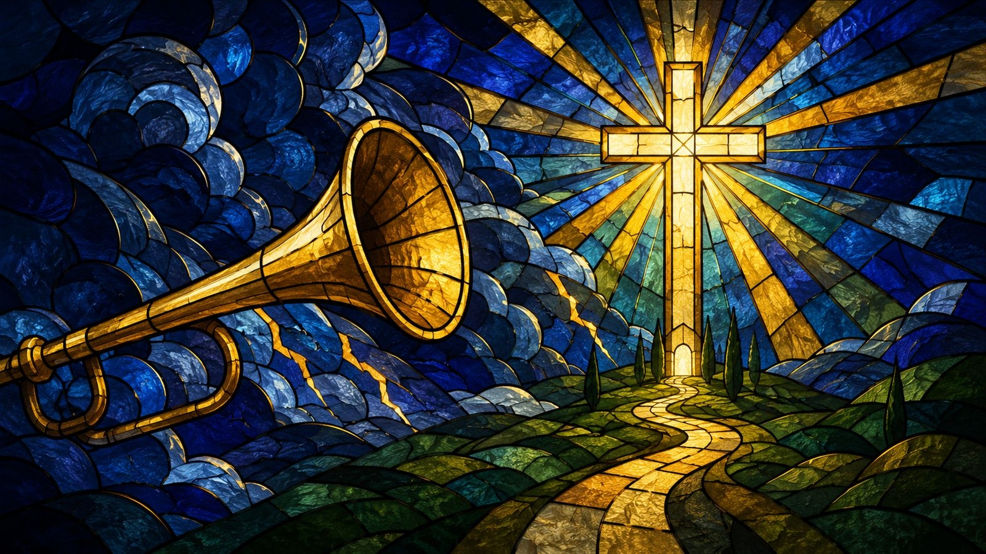
Historical Background
• The exact date and authorship are not firmly documented; hymnals commonly identify it as an African American spiritual.
• Wallace Willis is often associated with the song in historical accounts, but the spiritual was shaped by oral transmission and communal singing.
• The Fisk Jubilee Singers helped carry this spiritual into wider public awareness in the 1870s.
• Modern arrangements may carry their own copyrights even when the traditional spiritual is in the public domain.
Prepared for teaching and small group use - hymninfo.com

Slide 5
Why This Hymn Matters Today
• It teaches prayer as withdrawal toward Jesus, not escape from compassion or responsibility.
• It gives the church language for lament without surrendering hope.
• It helps believers face death and judgment in the light of resurrection.
• It calls congregations to sing spirituals with respect for the Black church and the history that shaped them.
Prepared for teaching and small group use - hymninfo.com

Slide 6
Biblical Foundation
The trumpet sounds, the Lord calls, and hope looks beyond the present world.
Prepared for teaching and small group use - hymninfo.com

Slide 7
Primary Scripture: 1 Corinthians 15:51-52
• Paul speaks of a final trumpet, resurrection, and transformation.
• The song’s sense of urgency fits this biblical hope: the present life is brief, but resurrection is coming.
• Christian hope is not vague optimism; it rests in God’s promise to raise the dead in Christ.
Prepared for teaching and small group use - hymninfo.com

Slide 8

Supporting Scriptures
• Psalm 29:3-4: God’s majestic voice is heard in thunder and over the waters.
• 1 Thessalonians 4:16: the Lord descends, the trumpet sounds, and the dead in Christ rise.
• Hebrews 11:13-16: God’s people live as pilgrims seeking a better country.
• Together, these passages frame the hymn as summons, longing, judgment, and homecoming.
Prepared for teaching and small group use - hymninfo.com

Slide 9

Hymn-Section Study
A compact spiritual where prayer, lament, freedom, and resurrection hope meet.
Prepared for teaching and small group use - hymninfo.com

Slide 10


Refrain: Turning Toward Jesus
• The repeated movement is toward Jesus as refuge, home, and final hope.
• The spiritual does not treat prayer as passivity; it names Jesus as the one who receives the weary and summons the faithful.
• For teaching: help learners hear the refrain as both prayer and pilgrimage.
Prepared for teaching and small group use - hymninfo.com

Slide 11
Divine Call: Thunder and Lightning
• The Lord’s call is pictured through creation: thunder, lightning, and sound within the soul.
• Psalm 29 helps listeners recognize thunder not as random terror but as a sign of divine majesty.
• The image is sobering, but also personal: the Lord calls his people by name.
Prepared for teaching and small group use - hymninfo.com

Slide 12
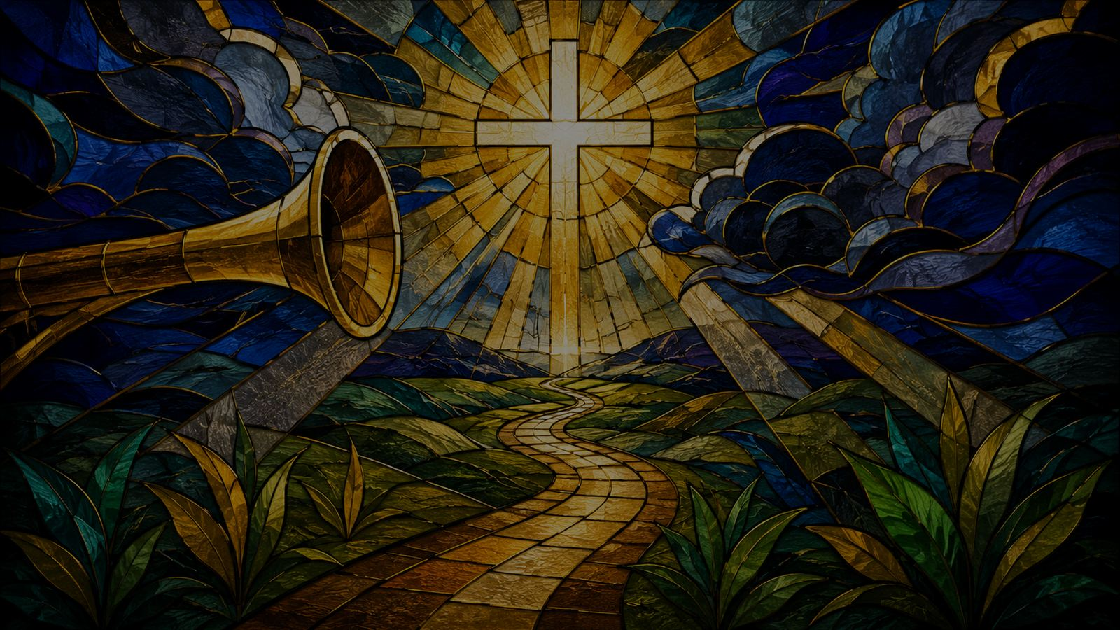
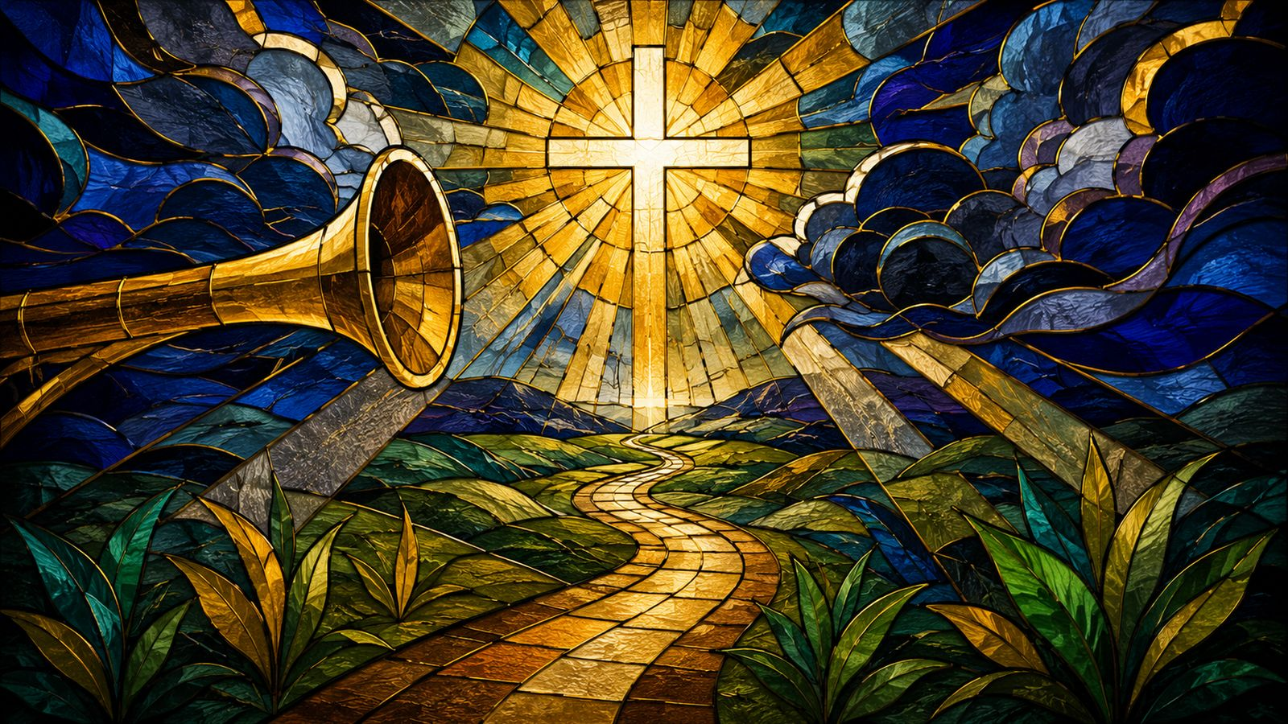
Trumpet and Judgment
• The trumpet image carries resurrection hope and judgment seriousness.
• The song faces mortality honestly: earthly time is short, and the soul must answer God.
• In Christian teaching, this summons should lead to repentance, trust, and hope in Christ.
Prepared for teaching and small group use - hymninfo.com

Slide 13
Freedom and Homecoming
• The longing to “steal away” can be heard as prayer, spiritual resistance, and hope for final home with God.
• Claims about hidden escape codes should be handled carefully; the song has carried layered meanings in different settings.
• The deeper pastoral truth is clear: bondage, grief, and death do not have the final word.
Prepared for teaching and small group use - hymninfo.com

Slide 14
Theological Themes
• Prayer: withdrawing toward Jesus for communion and strength.
• Lament: naming suffering without pretending it is small.
• Resurrection: waiting for the trumpet and the victory of God.
• Freedom: longing for liberation under God’s justice.
• Pilgrimage: living as those whose true home is with Christ.
Prepared for teaching and small group use - hymninfo.com

Slide 15

Literary and Musical Observations
• The spiritual is compact, repetitive, and deeply memorable.
• Its imagery moves between personal devotion, cosmic signs, and final hope.
• STEAL AWAY should be sung prayerfully and spaciously, never rushed or treated as light decoration.
• Call-and-response or solo-and-congregation leadership can honor the song’s expressive shape.
Prepared for teaching and small group use - hymninfo.com

Slide 16
Pastoral and Worship Use
• Funerals and memorial services: resurrection hope in the face of death.
• Prayer services: withdrawal into communion with Jesus.
• Lent and Holy Week: judgment, lament, and longing for deliverance.
• Services on justice and freedom: remembrance of faith formed under oppression.
• Choir settings: teach historical context before performance.
Prepared for teaching and small group use - hymninfo.com

Slide 17

Teaching Questions
• What kind of “home” does the spiritual long for?
• How do thunder, lightning, and trumpet shape the song’s spiritual mood?
• How does resurrection hope change the way Christians face death?
• What should churches remember when singing African American spirituals?
• How can prayer become an act of courage and hope?
Prepared for teaching and small group use - hymninfo.com

Slide 18
Application: Practice This Week
• Set aside one quiet time to “steal away” into prayer with Jesus.
• Read 1 Corinthians 15:51-52 slowly, then pray for those grieving death or loss.
• Listen to an African American spiritual with historical attention and gratitude.
• Ask where Christ is calling you to hope, repentance, courage, or compassion.
• Encourage someone who needs to hear that sorrow is not the end of the story.
Prepared for teaching and small group use - hymninfo.com

Slide 19
Suggested Lesson Flow
30-minute plan
60-minute plan
• 5 min: Open with 1 Corinthians 15
• 8 min: Historical and musical context
• 10 min: Refrain and main images
• 7 min: Prayer and response
• 10 min: Scripture foundation
• 15 min: Background and spiritual tradition
• 20 min: Hymn-section study
• 10 min: Discussion
• 5 min: Closing prayer
Prepared for teaching and small group use - hymninfo.com

Slide 20
Closing Prayer
Lord Jesus, call us home to hope, courage, and resurrection life.
Prepared for teaching and small group use - hymninfo.com

Slide 21
Closing Summary
• “Steal Away to Jesus” holds together suffering and hope, mortality and resurrection, prayer and freedom.
• It should be taught with Scripture, sung with care, and received as a witness from the African American spiritual tradition.
• The final word of the hymn is not fear, bondage, or death, but Jesus.
Prepared for teaching and small group use - hymninfo.com

Slide 22
Prayer
Lord Jesus, when thunder shakes us and grief surrounds us, draw us near to you. Teach us to pray with courage, to hope in the resurrection, and to honor the witness of those who sang faith under suffering. Call us away from despair and toward your life. Amen.
© HymnInfo.com. Free for personal, church, classroom, and small-group teaching use. Please do not sell, repost, or redistribute as downloadable files without permission.
Prepared for teaching and small group use - hymninfo.com

