Slide 1

Just As I Am
Coming to Christ by Grace
A Teaching Guide for Pastors, Teachers, Choir Directors, and Worship Leaders
Charlotte Elliott • William B. Bradbury • WOODWORTH • John 6:37
Prepared for teaching and small group use - hymninfo.com

Slide 2

Teaching Aim
What this lesson helps learners receive and practice
Understand
Feel
Practice
Christ receives sinners who come to him in faith.
The relief of grace that does not wait for self-repair.
Honest confession, humble trust, and open-handed discipleship.
Grace does not invite the prepared; grace prepares those who come.
Prepared for teaching and small group use - hymninfo.com

Slide 3

Hymn Identity
A classic invitation hymn of grace and assurance
Title: Just As I Am
First line: Just as I am without one plea
Text: Charlotte Elliott, commonly dated to 1835
Tune: WOODWORTH, by William B. Bradbury
Key biblical promise: John 6:37
Primary themes: grace, repentance, faith, confession, and assurance
Prepared for teaching and small group use - hymninfo.com

Slide 4

Historical Background
Responsible notes for teaching
Charlotte Elliott was an English hymn writer whose devotional writing often voiced weakness, trust, and dependence on grace.
The hymn is closely associated with John 6:37 and with the promise that Christ will not cast out those who come to him.
William B. Bradbury later paired Elliott’s text with WOODWORTH, the tune familiar to many congregations.
Some details in popular accounts of the hymn’s origin are best told with care rather than overstatement.
Prepared for teaching and small group use - hymninfo.com

Slide 5

A Hymn of Invitation
From self-defense to surrender before Christ
Prepared for teaching and small group use - hymninfo.com

Slide 6
Biblical Foundation
The promise beneath the hymn
John 6:37 anchors the invitation: Christ receives those who come to him.
Romans 5:8 shows grace arriving while we are still sinners.
Isaiah 1:18 names the cleansing only God can provide.
Matthew 11:28 offers rest to the weary and burdened.
Ephesians 2:8-9 guards the gospel from boasting and self-reliance.
Prepared for teaching and small group use - hymninfo.com

Slide 7
John 6:37
The welcome that steadies the whole hymn
Jesus’ promise does not begin with human achievement.
Coming to Christ is the movement of faith, not a performance of worthiness.
The phrase “I will in no way throw out” gives assurance to the guilty, weak, and uncertain.
A teacher can ask: What would change in our worship if we believed this promise deeply?
Prepared for teaching and small group use - hymninfo.com

Slide 8

Hymn Section 1
No claim of merit
The opening movement strips away self-defense.
The worshiper does not come with a spiritual resume.
The ground of confidence is Christ’s shed blood and his invitation.
Teaching emphasis: grace rests on Christ’s work, not on our preparation.
Prepared for teaching and small group use - hymninfo.com

Slide 9
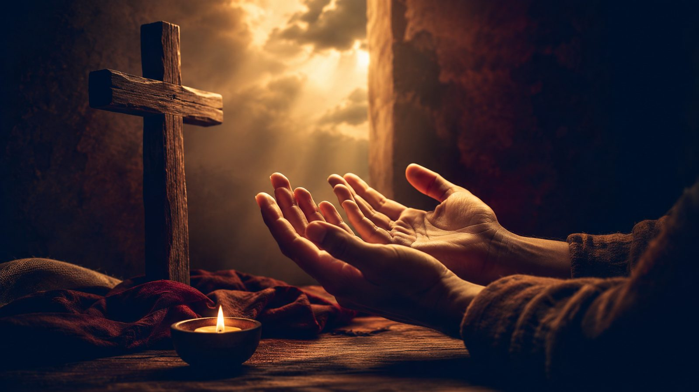
Hymn Section 2
No delay for self-repair
The hymn refuses the idea that we must cleanse ourselves before coming to Christ.
The worshiper comes with need still present and guilt still confessed.
Isaiah 1:18 helps explain the promise of cleansing from sin.
Pastoral emphasis: the Savior welcomes honest sinners, not polished appearances.
Prepared for teaching and small group use - hymninfo.com

Slide 10
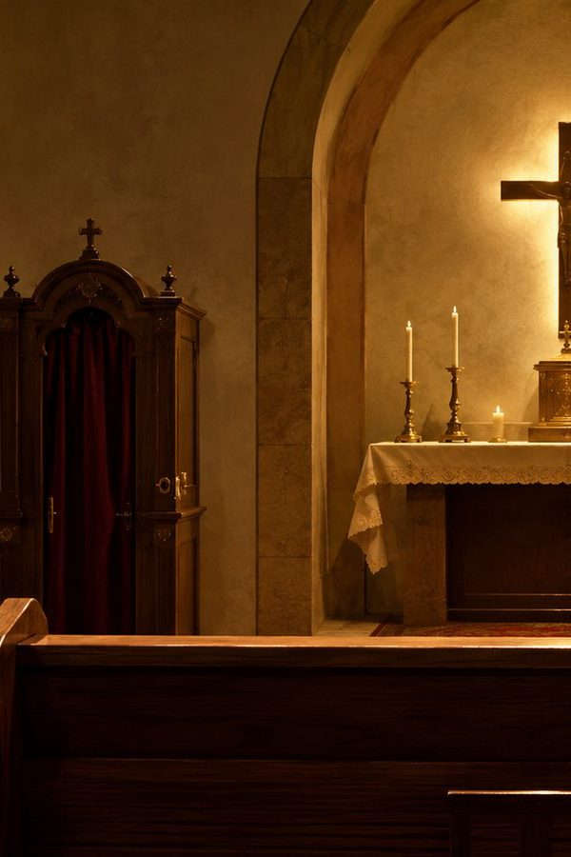
Hymn Section 3
Weakness, conflict, and need
The hymn gives language to inward struggle rather than hiding it.
Doubt, fear, and spiritual weariness are brought into the presence of Christ.
Matthew 11:28 connects this movement to Jesus’ invitation to the burdened.
Teaching emphasis: honest need is not a barrier to grace.
Prepared for teaching and small group use - hymninfo.com

Slide 11
Hymn Section 4
Christ receives and welcomes
The hymn turns from confession to confidence in Christ’s welcome.
The invitation is personal, but it is not merely private; it forms a people of grace.
Romans 5:8 shows that divine love meets sinners before they can claim worthiness.
Pastoral emphasis: assurance is grounded in Christ’s promise.
Prepared for teaching and small group use - hymninfo.com

Slide 12
Hymn Section 5
Love disarms fear
The text moves toward assurance, not because sin is small, but because Christ is sufficient.
Fear gives way to trust as the believer rests in divine mercy.
This connects naturally with 1 John’s language of perfected love casting out fear.
Teaching emphasis: grace creates reverence without despair.
Prepared for teaching and small group use - hymninfo.com

Slide 13
Hymn Section 6
Grace receives and renews
The final movement looks beyond first response to belonging, transformation, and praise.
Coming to Christ is not a finish line for discipleship; it is the beginning of life in him.
Ephesians 2:8-10 helps hold gift and obedience together.
Pastoral emphasis: the One who welcomes also makes new.
Prepared for teaching and small group use - hymninfo.com

Slide 14

Theological Themes
Grace, confession, assurance, and the sufficiency of Christ
Prepared for teaching and small group use - hymninfo.com

Slide 15
Theological Themes
Four truths to teach carefully
Grace
Confession
Salvation is received, not earned.
Need is named without excuse.
Assurance
Renewal
Christ does not cast out those who come.
The welcomed sinner becomes a disciple.
Prepared for teaching and small group use - hymninfo.com

Slide 16
Literary Movement
How the hymn leads the heart
The repeated act of coming gives the hymn a prayerful, processional quality.
Each section adds a different aspect of need, mercy, or assurance.
The “Lamb of God” language keeps the invitation tied to Christ’s sacrifice.
The hymn’s simplicity is part of its strength: it allows the congregation to pray while singing.
Prepared for teaching and small group use - hymninfo.com

Slide 17
Musical Notes
Why WOODWORTH serves the text well
The tune is restrained, steady, and well suited to reflective congregational singing.
Its simple contour supports humility rather than display.
The repeated closing phrase gives worshipers space to respond personally and prayerfully.
Choirs can support the congregation best with clarity, warmth, and a tempo that allows the text to breathe.
Prepared for teaching and small group use - hymninfo.com

Slide 18
Pastoral and Worship Use
Places where this hymn can serve the church
Invitation to faith after gospel preaching
Prayer of confession in a worship service
Assurance after a reading of God’s promise
Pastoral counseling around guilt, fear, or unworthiness
Communion preparation when the emphasis is grace and welcome
Prepared for teaching and small group use - hymninfo.com

Slide 19
Teaching Questions
For Sunday school, choir rehearsal, or class discussion
What false “pleas” do people bring when they try to justify themselves before God?
How does John 6:37 comfort a person who feels too guilty to come?
What is the difference between coming honestly and coming casually?
How can a church make invitations to faith both clear and gentle?
Where does this hymn move from confession toward assurance?
Prepared for teaching and small group use - hymninfo.com

Slide 20

Application
Responding to grace this week
Pray honestly: name one burden you usually hide from God.
Read John 6:37 aloud each morning as a promise of Christ’s welcome.
Practice confession without self-punishment or self-defense.
Extend grace to someone who fears they are too broken to be received.
Let gratitude move you toward obedience and humble service.
Prepared for teaching and small group use - hymninfo.com

Slide 21
Suggested Lesson Flow
Two ready-to-use teaching paths
30-Minute Lesson
60-Minute Lesson
5 min - Read John 6:37
7 min - Hymn story and identity
10 min - Three central movements
5 min - Discussion
3 min - Prayer response
8 min - Opening reflection
10 min - Historical and musical context
20 min - Section-by-section study
12 min - Scripture connections
7 min - Application
3 min - Closing prayer
Prepared for teaching and small group use - hymninfo.com

Slide 22
Closing Prayer
Lord Jesus Christ, Lamb of God, receive us in mercy. Teach us to come without disguise, without boasting, and without despair. Let your grace cleanse, comfort, and renew us, until our lives bear witness to the welcome we have received. Amen.
Prepared for teaching and small group use - hymninfo.com

Slide 23
Just As I Am
A hymn of grace, confession, and Christ’s receiving welcome.
© HymnInfo.com. Free for personal, church, classroom, and small-group teaching use. Please do not sell, repost, or redistribute as downloadable files without permission.
Prepared for teaching and small group use - hymninfo.com

