Slide 1

The God of Abraham Praise
A hymn study on covenant faith, pilgrimage, and heavenly praise
Thomas Olivers • Tune: LEONI • c. 1770 • Primary Scripture: Exodus 3:6-15
Prepared for teaching and small group use - hymninfo.com

Slide 2

Teaching Aim
What learners should understand, feel, and practice
1
Understand God’s covenant name and faithfulness in Exodus 3.
2
Feel the weight of holy majesty joined to saving grace.
3
Practice pilgrim faith: trust, obedience, and doxology.
Session Focus
This lesson helps the church sing the hymn as more than a historic text. It teaches worshipers to praise the God who reveals his name, keeps his promise, sustains pilgrims, and gathers his people into the praise of heaven.
Prepared for teaching and small group use - hymninfo.com

Slide 3
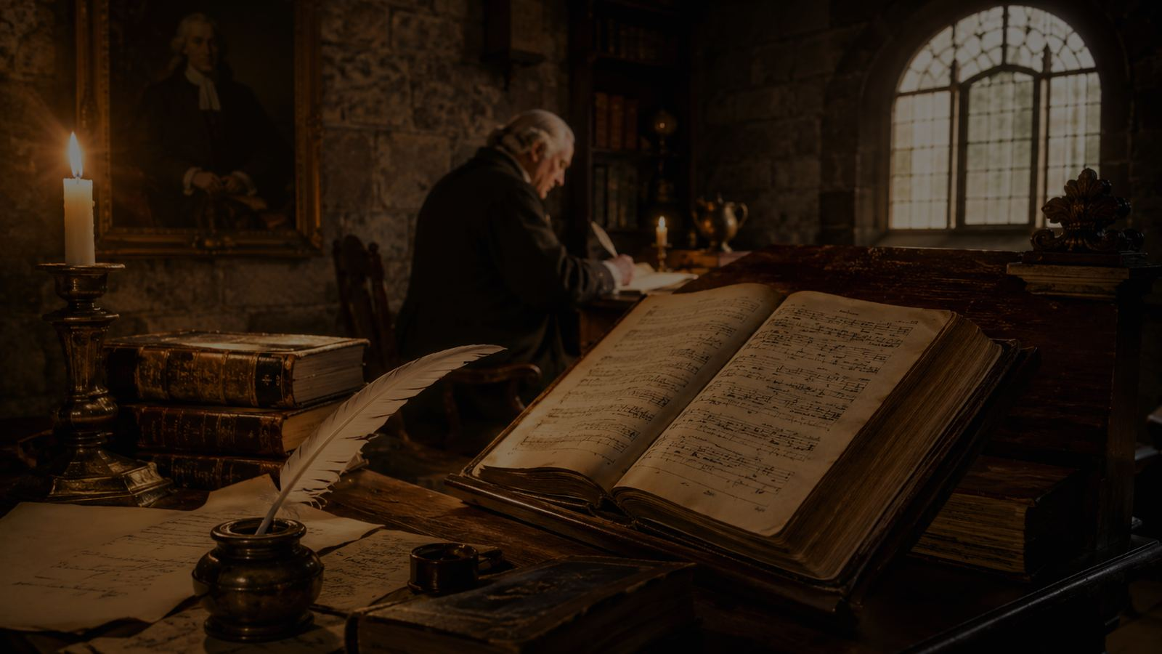

Hymn Identity
A covenant hymn shaped by Scripture and worship history
Title: The God of Abraham Praise
First line: The God of Abraham praise
Text: Thomas Olivers
Tune: LEONI
Melody: associated with Meyer Lyon
Meter: 6.6.8.4 D
Approximate date: 1770
Prepared for teaching and small group use - hymninfo.com

Slide 4
Historical Background
Thomas Olivers, Yigdal, and the tune LEONI
A Methodist hymn with Jewish liturgical roots
Teach with care
Thomas Olivers, a Welsh Methodist preacher, likely wrote this hymn after hearing Meyer Lyon sing Yigdal at the Great Synagogue in London. Olivers reshaped the material into a Christian hymn of adoration, covenant faith, pilgrimage, grace, and heavenly praise.
The hymn should be taught with gratitude and respect for the Jewish worship tradition connected with Yigdal. It is not a simple translation, but a Christian adaptation that preserves a striking musical and historical connection.
Prepared for teaching and small group use - hymninfo.com

Slide 5
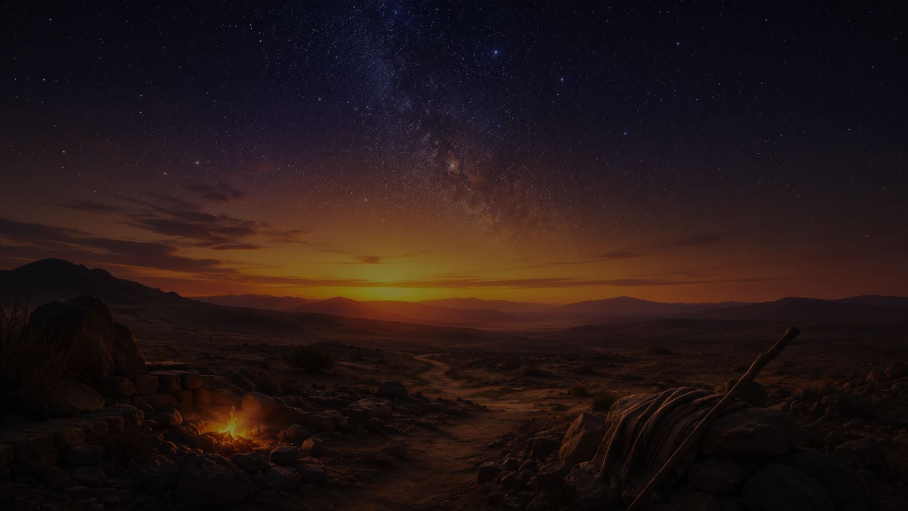
I. The Covenant Name
The God of Abraham, Isaac, and Jacob reveals himself.
Prepared for teaching and small group use - hymninfo.com

Slide 6
Biblical Foundation
The hymn’s worship language grows from covenant Scripture
Main Text: Exodus 3:6-15
Supporting Scriptures
God reveals himself to Moses as the God of Abraham, Isaac, and Jacob and as the great I AM. The hymn begins with this same reverent confession of God’s eternal name and covenant faithfulness.
Genesis 15:1 — God as shield and reward
Genesis 22:16-17 — God’s sworn promise
Hebrews 11:8-16 — pilgrims seeking a better country
Revelation 4:8-11 — heavenly worship before the eternal God
Prepared for teaching and small group use - hymninfo.com

Slide 7

Stanza 1: Majesty and Name
God is praised before the singer speaks of self
Teaching Emphasis
The opening stanza sets worship on the right foundation: God’s eternal being, holy name, love, and majesty. The phrase “Great I AM” points worshipers back to Exodus 3 and teaches that praise begins with God’s self-revelation, not our spiritual mood.
Prepared for teaching and small group use - hymninfo.com

Slide 8

Stanza 2: Pilgrim Obedience
Faith rises at God’s command
From security to trust
Like Abraham, the believer leaves behind lesser claims of wisdom, fame, and power. The stanza is not contempt for ordinary life; it is a confession that God alone is the sure portion, shield, and tower of his people.
Prepared for teaching and small group use - hymninfo.com

Slide 9


Stanza 3: Grace for the Unworthy
The majestic God draws near in Christ
The shock of grace
The hymn moves from awe to mercy. The great God calls the weak his friend and pledges to save to the end. This is where Olivers’s Christian adaptation becomes especially clear: covenant majesty is joined to grace through Jesus Christ.
Prepared for teaching and small group use - hymninfo.com

Slide 10


Stanza 4: Promise and Heavenly Hope
God’s oath steadies the pilgrim road
A promise stronger than feeling
The stanza depends on God’s oath and looks toward beholding God’s face. Hebrews 11 helps explain this hope: pilgrims do not possess everything now, but they trust the God who has prepared a better country.
Prepared for teaching and small group use - hymninfo.com

Slide 11
Stanza 5: The Praise of Heaven
The hymn ends in doxology
From earth to heaven
The final movement joins the worshiping church to the triumphant host. The hymn’s last note is not private success, but endless praise to the Father, Son, and Holy Spirit.
Prepared for teaching and small group use - hymninfo.com

Slide 12
Theological Themes
What the hymn teaches the church to confess
N
Name — God reveals himself
C
Covenant — God keeps promise
G
Grace — God saves the weak
P
Pilgrimage — Faith walks by promise
H
Hope — God prepares a city
D
Doxology — Praise completes the journey
Prepared for teaching and small group use - hymninfo.com

Slide 13
Literary and Musical Observations
A strong tune carrying weighty praise
Text movement
Tune character
The hymn moves from God’s eternal name to pilgrim surrender, then to grace, promise, ascent, and heavenly praise. Its poetry is dense, but the movement is clear: God calls, sustains, saves, and receives worship.
LEONI has a solemn, modal strength. It should be sung with dignity and forward motion. A dragging tempo can make the hymn heavy; a steady pulse lets the words carry their grandeur.
Prepared for teaching and small group use - hymninfo.com

Slide 14
II. The Pilgrim People
Faith seeks the joy of God’s right hand.
Prepared for teaching and small group use - hymninfo.com

Slide 15
Pastoral and Worship Use
Where the hymn can serve the church well
• Call to worship or opening hymn for services centered on God’s majesty
• Teaching on Abraham, Moses, covenant, pilgrimage, or heavenly hope
• Trinity Sunday or services ending with doxology and adoration
• Choir-led congregational singing when the tune is less familiar
• Bible study on Hebrews 11 and the life of faith
Prepared for teaching and small group use - hymninfo.com

Slide 16
Teaching Questions
Guide the class from observation to response
Questions for discussion
1. What does the hymn teach about God before it teaches about us?
2. How does calling God “the God of Abraham” shape Christian faith?
3. What lesser securities compete with God as your portion?
4. Why is it important to speak respectfully about the hymn’s Jewish liturgical roots?
5. How does heavenly praise reshape ordinary worship this week?
Prepared for teaching and small group use - hymninfo.com

Slide 17
Application
Responding to the hymn in faith
Trust
Forsake
Praise
Lean on God’s oath and promise when assurance feels weak.
Hold worldly wisdom, fame, and power more lightly.
Let worship end in doxology, not self-focus.
Prepared for teaching and small group use - hymninfo.com

Slide 18
Suggested Lesson Flow
Two ready-to-use teaching plans
30-Minute Plan
60-Minute Plan
5 min — Sing or listen to one stanza
7 min — Read Exodus 3:6-15
8 min — Teach the hymn’s historical setting
7 min — Discuss pilgrim faith in Hebrews 11
3 min — Closing prayer
10 min — Opening prayer and hymn overview
15 min — Biblical foundations
15 min — Stanza-by-stanza teaching
10 min — Worship and music discussion
7 min — Application commitments
3 min — Closing doxology
Prepared for teaching and small group use - hymninfo.com

Slide 19
Closing Summary and Prayer
The hymn teaches the church to praise the eternal God, trust his covenant promise, walk as pilgrims, and join the worship of heaven.
Eternal God of Abraham, strengthen our faith, loosen our grip on lesser things, and gather our lives into the praise of your holy name. Through Jesus Christ our Lord. Amen.
Prepared for teaching and small group use - hymninfo.com

Slide 20
For Church Teaching Use
© HymnInfo.com. Free for personal, church, classroom, and small-group teaching use. Please do not sell, repost, or redistribute as downloadable files without permission.
Prepared for teaching and small group use - hymninfo.com

