Slide 1

The Gift of Love
A hymn study on love, spiritual gifts, and the way of Christ
First line: “Though I may speak with bravest fire”
Text: Hal H. Hopson, 1972 • Tune: O WALY WALY / THE GIFT OF LOVE
Primary Scripture: 1 Corinthians 13
Prepared for teaching and small group use - hymninfo.com

Slide 2

Teaching Aim
What this session should form in learners
Understand
Feel
Practice
how 1 Corinthians 13 tests speech, gifts, faith, and sacrifice by love.
holy concern that impressive ministry can become hollow without Christlike love.
patient, humble, truthful love in worship, service, family, and church life.
Mind
Heart
Hands
Prepared for teaching and small group use - hymninfo.com

Slide 3

Hymn Identity
Key facts for teaching
Title
First line
The Gift of Love
Though I may speak with bravest fire
Writer / arranger
Date
Hal H. Hopson
1972
Tune
Biblical anchor
O WALY WALY / THE GIFT OF LOVE
1 Corinthians 13
Prepared for teaching and small group use - hymninfo.com

Slide 4

Historical Background
Hal Hopson and a biblical hymn for the church
Hal H. Hopson was a Presbyterian church musician, composer, arranger, teacher, and advocate for congregational song. The Gift of Love first appeared in 1972 and became one of his best-known works. It is closely associated with 1 Corinthians 13 and uses Hopson’s adaptation of the traditional English melody O WALY WALY, a tune many worshipers know through its gentle folk character.
Prepared for teaching and small group use - hymninfo.com

Slide 5

Why This Hymn Matters Today
Love as the measure of Christian maturity
The hymn is often heard at weddings, but its reach is wider. It asks every Christian community a searching question: Are our words, service, gifts, and faith governed by love? It helps worshipers move beyond sentiment toward patient, truthful, humble, enduring love in daily life.
Prepared for teaching and small group use - hymninfo.com

Slide 6
Biblical Foundations
Love is not decoration; it is the shape of life in Christ.
Prepared for teaching and small group use - hymninfo.com

Slide 7
Biblical Foundation
1 Corinthians 13 and John 13
1 Corinthians 13
John 13:34-35
Paul places love above eloquence, spiritual gifts, knowledge, faith, generosity, and costly sacrifice. The point is not that gifts lack value, but that gifts detached from love become spiritually empty.
Jesus gives love as the visible mark of discipleship. The church’s witness is not only what it says, but how the people of Christ love one another.
Prepared for teaching and small group use - hymninfo.com

Slide 8

How to Study the Hymn
Three movements from Scripture to song
Because the hymn is a compact paraphrase, teach it through its biblical movement: 1) gifts without love, 2) the character of love, and 3) the permanence of love. Each movement asks the church to bring speech, service, and relationships under the lordship of Christ.
Prepared for teaching and small group use - hymninfo.com

Slide 9
Movement 1: Gifts without Love
The danger of impressive emptiness
Paul begins with speech and gifts that look strong from the outside. The hymn turns that warning into worship: eloquence, inspiration, faith, and generosity must be animated by love. Teaching emphasis: ask learners to distinguish ability from Christlike character.
Prepared for teaching and small group use - hymninfo.com

Slide 10
Movement 2: Love in Practice
Patient, kind, truthful, humble, enduring
Biblical love is not vague warmth. It takes form in patience, kindness, humility, truthfulness, and endurance. In a church setting, this means how we speak in conflict, how we serve when unnoticed, and how we bear with one another.
Prepared for teaching and small group use - hymninfo.com

Slide 11
Movement 3: Love that Remains
More than a wedding sentiment
The hymn is fitting for marriage, but it belongs to the whole church. Paul’s point is covenantal and communal: love remains when performance, applause, and visible success fade. Teaching emphasis: connect love to lifelong discipleship, not merely ceremony.
Prepared for teaching and small group use - hymninfo.com

Slide 12
The Hymn’s Central Prayer
Let love give meaning to every gift
speech • service • faith • sacrifice
All are tested by love.
The hymn helps a congregation pray for the love that makes ministry faithful rather than hollow.
Prepared for teaching and small group use - hymninfo.com

Slide 13
Theological Themes
What the hymn teaches
Love
Gifts
Humility
the essential shape of Christian virtue
abilities are for service, not display
Christian action must reject self-display
Discipleship
Worship
Community
love marks those who belong to Christ
song becomes confession and prayer
church life is tested by patient kindness
Prepared for teaching and small group use - hymninfo.com

Slide 14
Literary Observations
A concise paraphrase of Paul’s argument
The hymn works by reduction and concentration. It does not explain every line of 1 Corinthians 13. Instead, it gives the church a memorable way to sing Paul’s central claim: without love, even impressive religious action becomes vain. The simplicity is pastoral; it puts a searching truth on the lips of the congregation.
Prepared for teaching and small group use - hymninfo.com

Slide 15
Musical Observations
O WALY WALY and congregational tenderness
The tune has a gentle folk-like contour that supports reflection rather than triumphalism. Its shape suits weddings, communion, choir settings, and services of reconciliation. Leaders should keep the tempo flowing, the tone prayerful, and the accompaniment supportive rather than sentimental.
Prepared for teaching and small group use - hymninfo.com

Slide 16
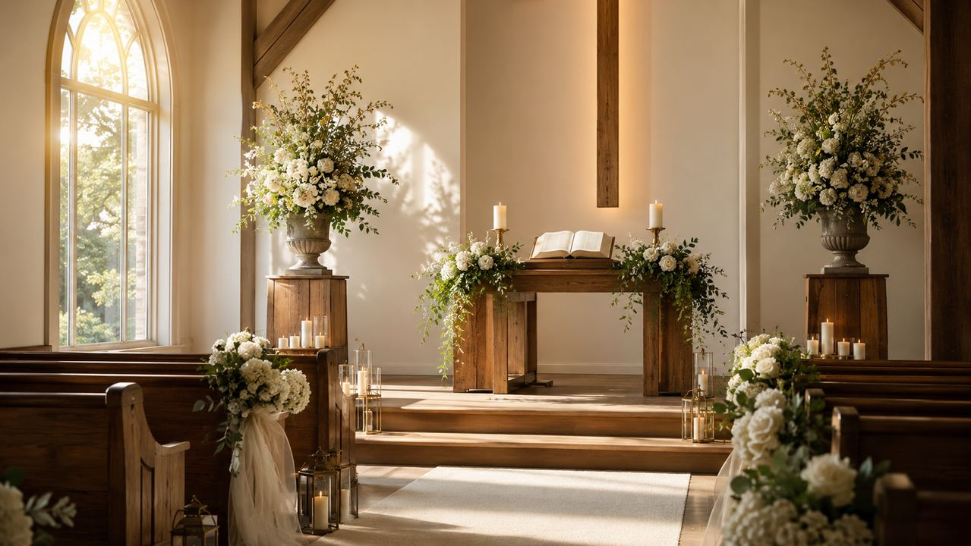
Pastoral and Worship Use
Love must be sung, taught, prayed, and practiced.
Prepared for teaching and small group use - hymninfo.com

Slide 17
Pastoral and Worship Use
Where the hymn serves the church
Weddings
Discipleship
Church Unity
Connect the hymn to covenant faithfulness, not simply romantic feeling.
Use with teaching on spiritual gifts, service, humility, and Christian character.
Pair with themes of reconciliation, patience, forgiveness, and love in the body.
Prepared for teaching and small group use - hymninfo.com

Slide 18
Choir and Music Leader Notes
Sing the theology clearly
The melody invites warmth, but the text requires moral seriousness. Encourage clear diction on the contrasts between impressive gifts and love. A choir can help the congregation hear the hymn as a prayer for transformed character, not merely a beautiful selection.
Prepared for teaching and small group use - hymninfo.com

Slide 19
Teaching Questions
For class or choir discussion
Why does Paul place love above eloquence, knowledge, faith, and sacrifice?
Where can churches confuse giftedness with maturity?
How does John 13 keep love connected to obedience to Christ?
What does patient love look like in ministry conflict?
How can this hymn speak to the whole church, not only to couples?
Prepared for teaching and small group use - hymninfo.com

Slide 20
Application
Practicing the gift of love
Before speaking
Before serving
ask if truth is being carried by love.
ask if the deed seeks God’s glory or applause.
Before leading
Before worship
ask if gifts are building people up.
ask if the heart is yielded to Christ.
Prepared for teaching and small group use - hymninfo.com

Slide 21
Suggested Lesson Flow
Two practical plans
30-minute plan
60-minute plan
5 min: Read 1 Corinthians 13
7 min: hymn identity and background
8 min: gifts without love
6 min: group discussion
4 min: closing prayer and practice step
10 min: Scripture reading and context
10 min: historical and musical background
20 min: three hymn movements
10 min: discussion in pairs
5 min: pastoral applications
5 min: prayer
Prepared for teaching and small group use - hymninfo.com

Slide 22
Sermon Connections
Preaching from the hymn’s biblical center
A sermon can move through Paul’s logic: love gives Christian sound to speech, proper purpose to gifts, true value to sacrifice, visible likeness to discipleship, and permanence to what would otherwise fade. The hymn gives the congregation a memorable way to carry that sermon home.
Prepared for teaching and small group use - hymninfo.com

Slide 23
Closing Prayer
Lord Jesus Christ, form in us the love that gives meaning to our words, our gifts, our service, and our sacrifice. Make our homes and churches places of patience, kindness, humility, truth, and endurance. Amen.
© HymnInfo.com. Free for personal, church, classroom, and small-group teaching use. Please do not sell, repost, or redistribute as downloadable files without permission.
Prepared for teaching and small group use - hymninfo.com

