Slide 1

The Strife Is O’er,
the Battle Done
A teaching guide for Easter hope, resurrection victory, and congregational praise
Teaching Guide
Prepared for teaching and small group use - hymninfo.com
1

Slide 2
Teaching Aim
By the end of the lesson, learners should be able to name what the hymn teaches and how it shapes worship.
✓
✦
→
Understand
Feel
Practice
Christ’s resurrection is victory over death, sin, and hostile powers.
Holy joy grows from a finished victory, not from vague optimism.
Sing and live as people whose Lord has conquered death.
Prepared for teaching and small group use - hymninfo.com
2

Slide 3
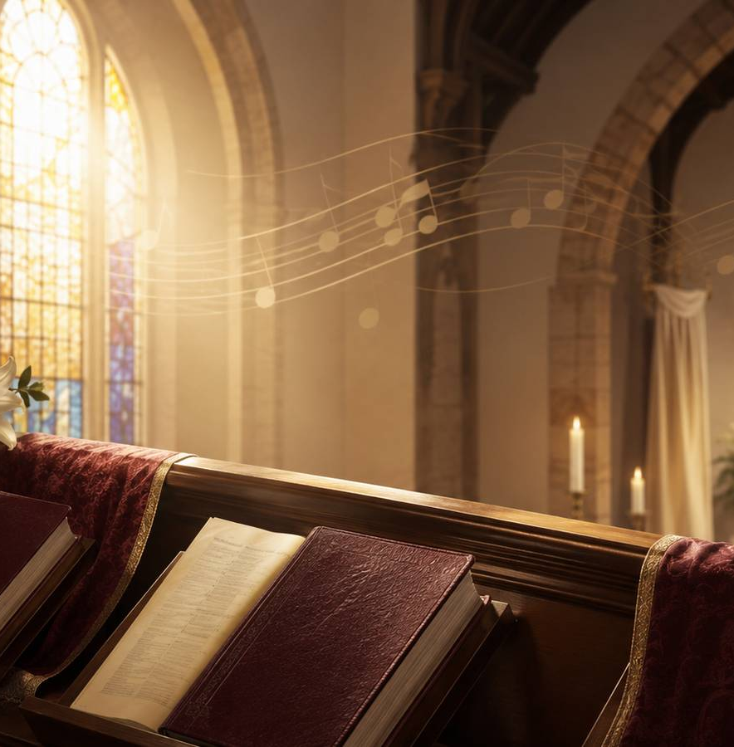
Hymn Identity
A compact profile for teachers, choir directors, and worship planners.
FIRST LINE
The strife is o’er, the battle done
ENGLISH TEXT
Francis Pott, 1861
LATIN TEXT
Finita iam sunt proelia
TUNE
VICTORY
MUSIC
Adapted by William Henry Monk from material associated with Palestrina
METER
8.8.8 with Alleluias
Prepared for teaching and small group use - hymninfo.com
3

Slide 4

Historical Background
Ancient Easter praise carried into English congregational song.
• The English hymn is Francis Pott’s 1861 translation of the Latin Easter hymn Finita iam sunt proelia.
• The Latin text is commonly linked with seventeenth-century printed collections, with some editors suggesting earlier roots.
• John Mason Neale printed the Latin hymn with his own translation in 1851. Pott’s wording became the familiar English form.
• Hymns Ancient and Modern helped place the hymn and VICTORY before English-speaking congregations.
Prepared for teaching and small group use - hymninfo.com
4

Slide 5
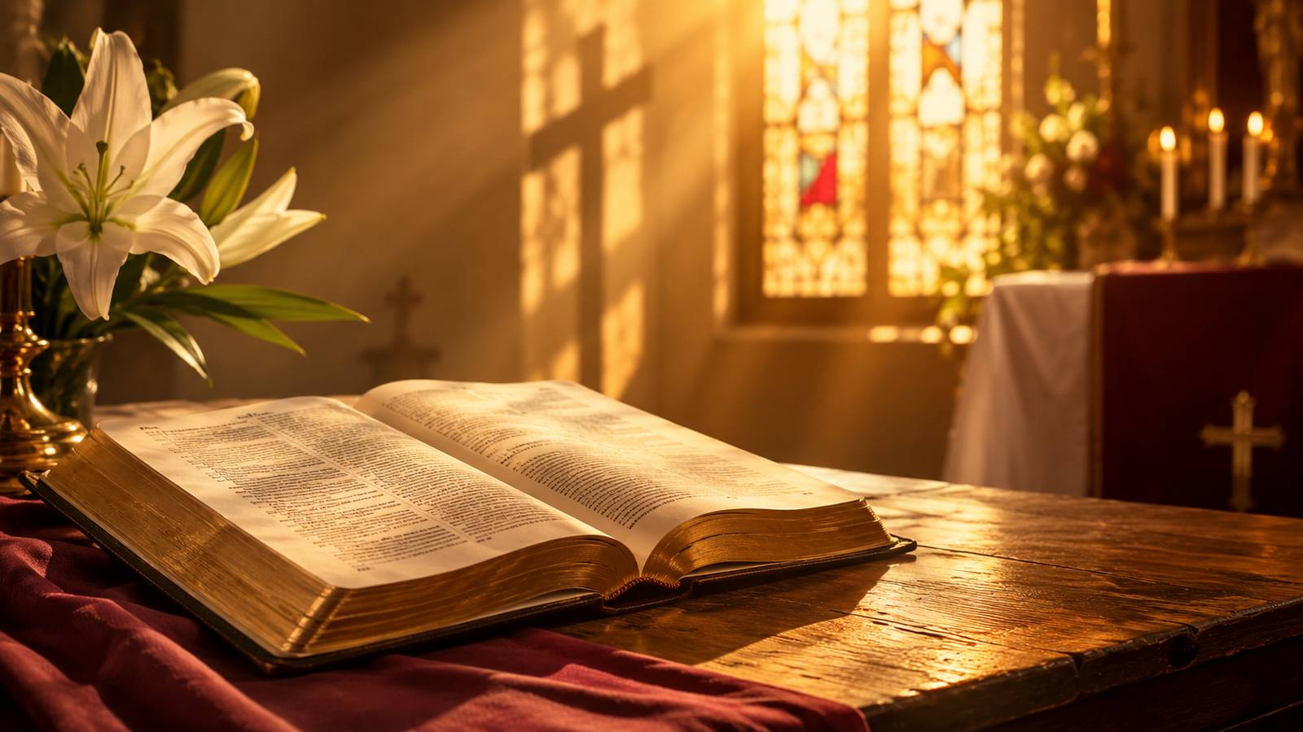
Biblical Foundation
The hymn’s victory language rests most firmly on Paul’s resurrection chapter.
Primary Text
1 Corinthians 15:54-57
“Death is swallowed up in victory.”
The hymn sings what Paul proclaims: God gives victory through our Lord Jesus Christ.
Supporting passages: Matthew 28:5-6 • Romans 6:9 • Revelation 1:18 • Colossians 2:15 • Isaiah 53:5
Prepared for teaching and small group use - hymninfo.com
5

Slide 6
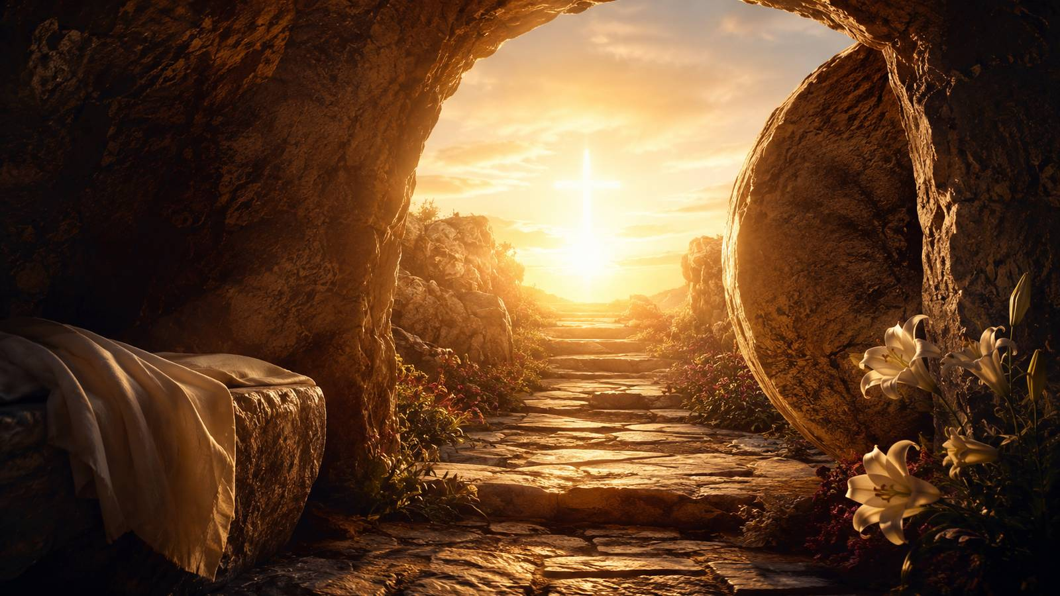
Christ Has Won the Victory
The hymn begins where the gospel leaves the enemies of God’s people: defeated.
Prepared for teaching and small group use - hymninfo.com
6

Slide 7

Section Study 1: The Finished Battle
The opening movement announces completion, not uncertainty.
The hymn begins with conflict already settled. The battle is not still hanging in the balance; life has won because Christ has risen.
For teaching: help the group hear the difference between Christian hope and positive thinking. The church sings from a victory already accomplished by Christ.
Scripture connection: 1 Corinthians 15:54-57.
Prepared for teaching and small group use - hymninfo.com
7

Slide 8

Section Study 2: Death Has Done Its Worst
The hymn refuses to minimize death, but it denies death the final word.
Death appears strong because it touches every household and every age. Easter does not pretend otherwise.
The risen Christ scatters the powers that seemed to gather against him. The proper response is holy joy: not shallow cheerfulness, but worship rooted in the empty tomb.
Scripture connection: Colossians 2:15.
Prepared for teaching and small group use - hymninfo.com
8

Slide 9
Section Study 3: The Three Days End in Glory
The sorrow of Good Friday gives way to the glory of the risen Head.
The hymn compresses the Easter story into a clear movement: suffering, waiting, rising, praise.
It is especially useful for helping worshipers place their own seasons of waiting within the larger story of Christ’s victory.
Scripture connection: Matthew 28:5-6.
Prepared for teaching and small group use - hymninfo.com
9

Slide 10

Section Study 4: Gates Broken Open
The hymn pictures Christ’s triumph as liberation.
The imagery is bold: barred gates fall, and the way to life stands open. This is resurrection as conquest and release.
For teaching: connect this picture with Revelation 1:18. The risen Lord holds authority over Death and Hades.
Prepared for teaching and small group use - hymninfo.com
10

Slide 11
Section Study 5: Wounds That Heal
The final movement turns victory into prayer.
The hymn does not separate Easter from the cross. The risen Christ is still the wounded Savior, and his wounds bring freedom from death’s sting.
This gives the hymn pastoral strength for funerals, illness, grief, and weary faith. The believer’s confidence rests in Christ’s death and resurrection together.
Scripture connection: Isaiah 53:5 and Romans 6:9.
Prepared for teaching and small group use - hymninfo.com
11

Slide 12
The Refrain: Alleluia as Proclamation
The repeated praise is not decoration; it is the church’s answer to resurrection victory.
Each Alleluia gathers the hymn’s message: Christ is risen, death is defeated, and the people of God may sing.
Ask learners: When does praise feel easy? When does it become an act of faith?
Choir note: keep the refrain full, confident, and unhurried so the congregation can join with strength.
Prepared for teaching and small group use - hymninfo.com
12

Slide 13
Theological Themes
The hymn teaches compact, sturdy Easter theology.
✦
Resurrection
✦
Victory
✦
Freedom
Christ lives beyond death.
The decisive battle is finished.
Death no longer rules Christ’s people.
✦
Praise
✦
Hope
✦
Healing
Alleluia answers the gospel.
Christian courage rests on a risen Lord.
The wounds of Christ bring life.
Prepared for teaching and small group use - hymninfo.com
13

Slide 14
Literary and Musical Observations
VICTORY gives the text a strong, festive shape for Easter singing.
• The battle language is direct and memorable, but the tone is worshipful rather than harsh.
• The tune’s repeated acclamations make the hymn feel processional and communal.
• Teach the congregation to sing with energy, clarity, and space for the Alleluias to ring.
• Avoid rushing. Joy has weight when the words are allowed to speak.
Prepared for teaching and small group use - hymninfo.com
14

Slide 15
Pastoral and Worship Use
This hymn serves the church whenever resurrection hope must be confessed aloud.
Strong settings:
• Easter Day and Eastertide
• Services centered on resurrection hope
• Funerals and memorial services
• Choir rehearsals on proclamation and tone
• Lessons on 1 Corinthians 15
Pastoral note: the hymn gives grieving people words that do not deny sorrow but confess Christ’s triumph over it.
Prepared for teaching and small group use - hymninfo.com
15

Slide 16
Suggested Lesson Flow
A 45-minute teaching path.
1
Open
2
Locate
3
Study
4
Sing
5
Apply
Read 1 Corinthians 15:54-57 and name the main promise.
Briefly introduce the hymn’s text, tune, and Easter setting.
Walk through the five movements of the hymn in summary.
Let the refrain become a spoken or sung confession.
Ask where the victory of Christ must be trusted this week.
Prepared for teaching and small group use - hymninfo.com
16

Slide 17
Closing Summary and Prayer
The strife is finished because Christ is risen.
Lord Jesus Christ, risen and reigning, teach us to live in the victory you have won. When death frightens us, steady our hope. When sorrow weighs on us, lift our eyes to your empty tomb. Make our Alleluia honest, strong, and full of faith. Amen.
© HymnInfo.com. Free for personal, church, classroom, and small-group teaching use. Please do not sell, repost, or redistribute as downloadable files without permission.
Prepared for teaching and small group use - hymninfo.com
17

