Slide 1

There's Within
My Heart a Melody
Teaching guide for He Keeps Me Singing
Luther B. Bridgers • 1910 • Gospel hymn
A hymn of resilient assurance: Christ gives songs in the night and keeps the heart singing through grace, trial, and hope.
HymnInfo teaching guide
01

Slide 2

Session Roadmap
How this guide moves from story to worship and response
1
Listen to the melody inside the text
2
Remember the story and gospel-song setting
3
Trace the Scriptures behind the images
4
Walk stanza by stanza through assurance
5
Apply the hymn as comfort, praise, and hope
HymnInfo teaching guide
02

Slide 3

Hymn Identity
Core facts from the attached hymn data
Key teaching idea
Full title: There's Within My Heart a Melody
Common title: He Keeps Me Singing
First line: There's within my heart a melody
Written in 1910
Words and music: Luther Burgess Bridgers
Christian joy is not the absence of grief or trouble; it is the presence of Christ who keeps speaking peace to the heart.
HymnInfo teaching guide
03

Slide 4
The Story Behind the Song
A hymn born from grief yet sung in assurance
The hymn is commonly connected with Luther B. Bridgers after a devastating 1910 family tragedy. The attached data presents it as a hard-won confession: even in the dark night of the soul, Christ remains the inner melody.
Teaching caution
Do not make the tragedy the whole message.
Center the lesson on Christ, comfort, and persevering faith.
Use the story pastorally, not sensationally.
HymnInfo teaching guide
04

Slide 5
Biblical Foundations
Four scriptural windows into the hymn
Psalm 40:3
Ephesians 5:19
The Lord gives a new song of praise, matching the hymn's image of a melody placed within the heart.
Believers make melody in the heart to the Lord, connecting worship with inner life.
Isaiah 43:2
Job 35:10
God promises presence through deep waters and threatening floods.
God gives songs in the night, validating praise in seasons of suffering.
Supporting texts in the attached data also include Christ's storm-calming peace, salvation that makes whole, and the blessed hope of Christ's return.
HymnInfo teaching guide
05

Slide 6
The Inner Melody
Christ speaks peace in life's ebb and flow
Fear not
I am with thee
Peace, be still
The opening stanza frames assurance as a voice before it becomes a song. Jesus speaks first; the believer sings because Christ has already whispered peace.
HymnInfo teaching guide
06

Slide 7
Stanza Movement
A complete spiritual journey in five scenes
1
2
3
4
5
Inner peace
Conversion
Grace
Deep waters
Future glory
Christ whispers peace amid ebb and flow
Jesus makes the discordant soul whole
The believer feasts under sheltering care
Trials remain, but Christ leads through them
The song moves toward Christ's return
Use this structure to teach the hymn as more than a cheerful chorus: it is a journey from Christ's voice to Christ's victory.
HymnInfo teaching guide
07

Slide 8
The Name at the Center
Why the refrain repeats “Jesus”
Jesus
Jesus
Jesus
The repetition is not filler. It is prayer, confession, and anchor. The hymn teaches that the sweetest name is not merely remembered in worship but becomes the sustaining center of the believer's inner life.
Fills longing
Keeps singing
Restores discord
Sustains through rough paths
HymnInfo teaching guide
08

Slide 9
Theology in the Hymn
Assurance, grace, suffering, and hope
Divine immanence
God is near enough to whisper within the heart.
Justification
Christ enters the wreckage of sin and makes the discord whole.
Sanctification
Grace becomes ongoing nourishment, rest, and communion.
Providence
God leads through deep waters, not only around them.
Eschatology
The final stanza looks toward Christ's welcome and reign.
HymnInfo teaching guide
09

Slide 10

Pastoral Use
How to teach this hymn with care
Name grief honestly without romanticizing it.
Let the refrain become a prayer for troubled hearts.
Connect “deep waters” to God's promised presence.
Make room for both tears and testimony.
Best moments
Services of assurance
Testimony gatherings
Funerals and memorials
Sermons on peace in suffering
Small group reflection on providence
HymnInfo teaching guide
10

Slide 11
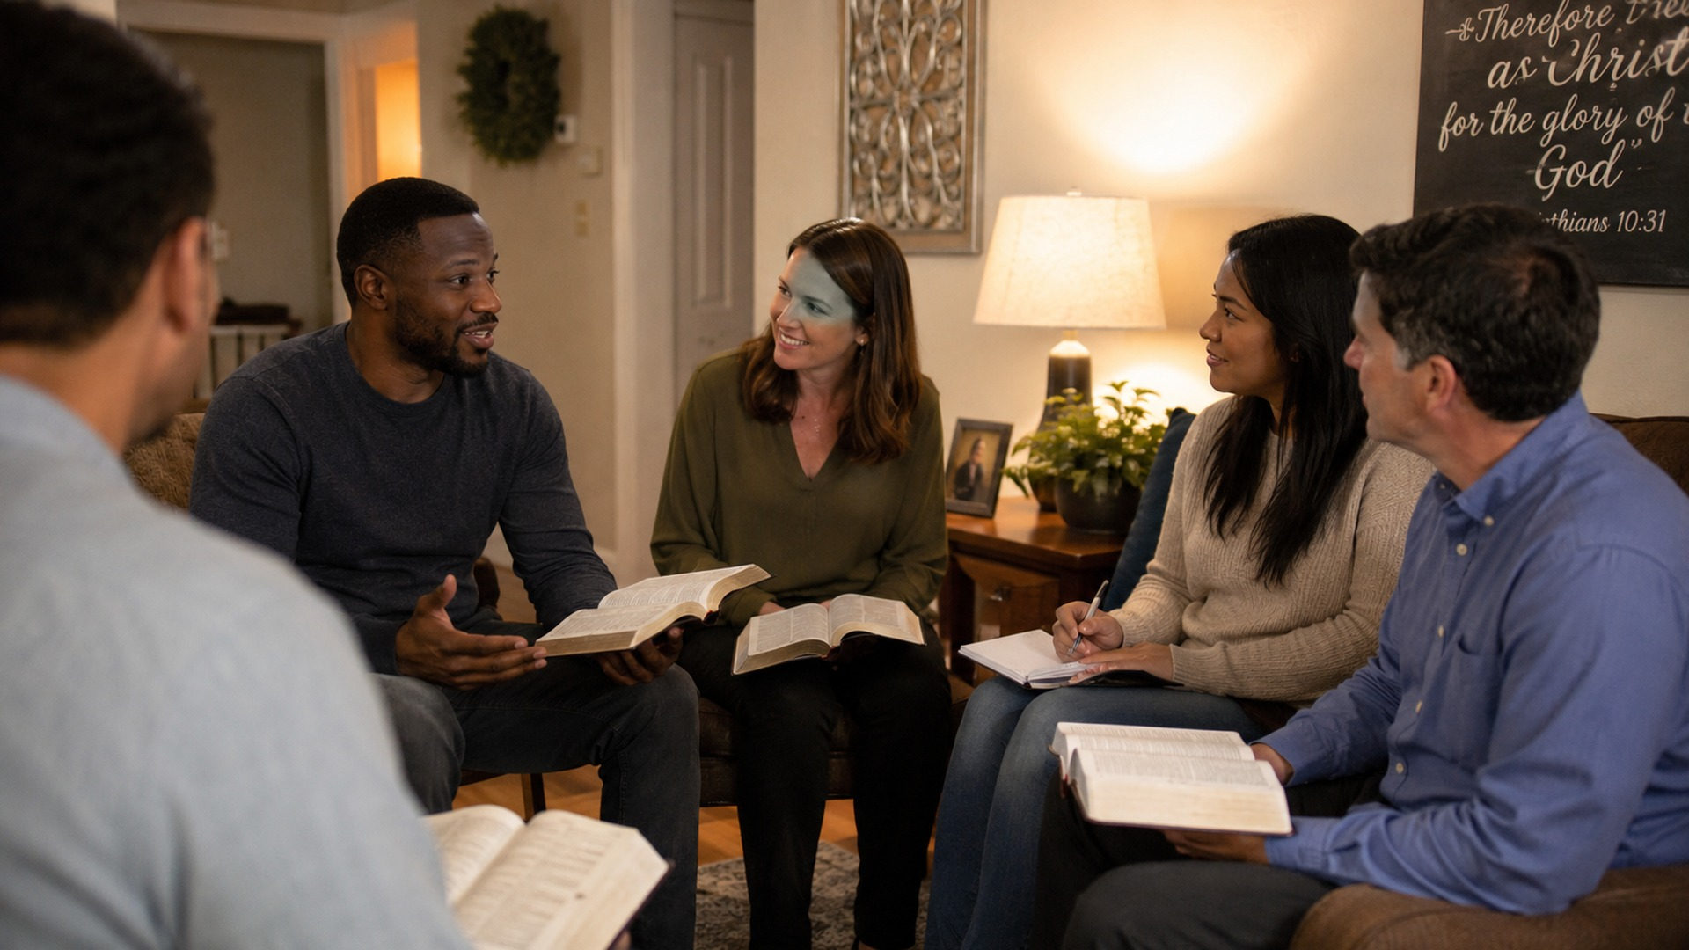
Small Group Flow
A 45-minute discussion plan
5 min
Opening prayer and reading Psalm 40:3
10 min
Share first impressions of the hymn title and refrain
12 min
Study Isaiah 43:2 and the “waters deep” stanza
10 min
Discuss application: where is Christ inviting trust?
8 min
Close by praying the refrain as a commitment
HymnInfo teaching guide
11

Slide 12
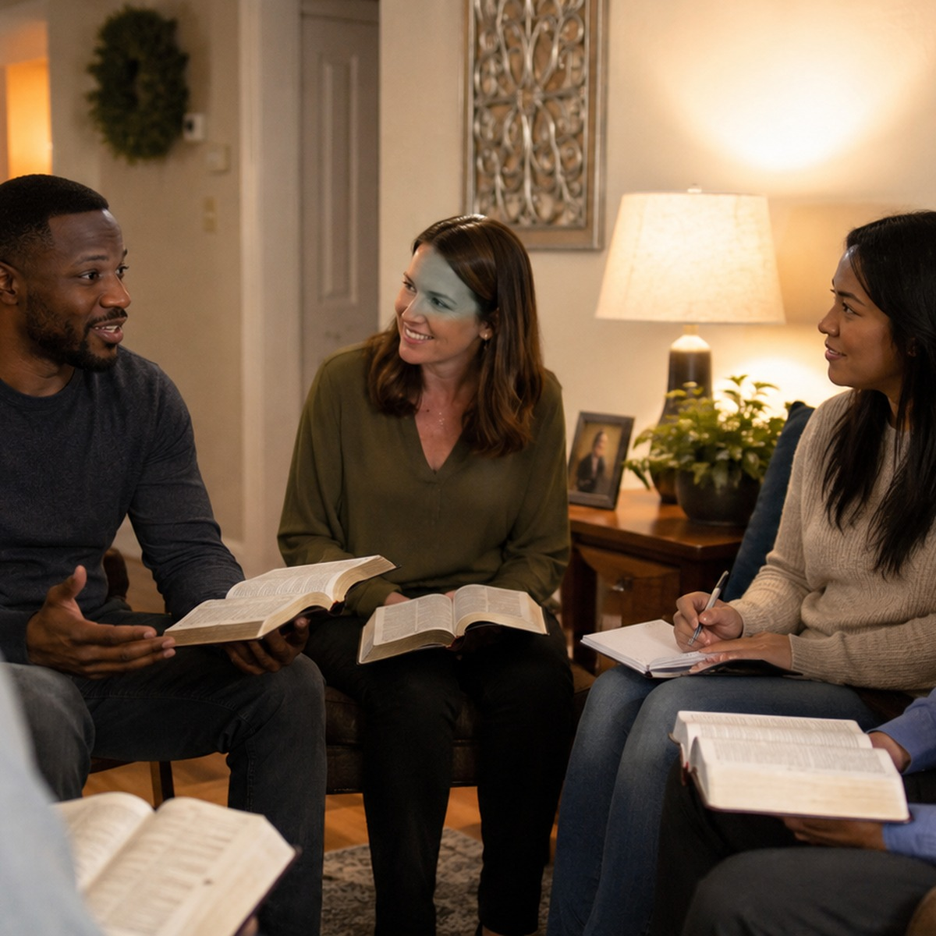
Discussion Questions
Invite testimony without pressure
How does the background story affect the way you hear “He keeps me singing”?
What is the difference between Christ's whisper and the world's noise?
Where has Christ made your “discord” whole?
How can grace nourish us when the path is steep and rough?
How does eternal hope reshape present suffering?
Leader note: allow silence. People in grief may need space more than answers.
HymnInfo teaching guide
12

Slide 13
Musical Teaching Notes
How the tune supports the text
Classic 4/4 gospel hymn style
Bright, walking tempo
Refrain functions as the heartbeat
Dynamic “ebb and flow” can mirror the text
Avoid rushing the repeated name of Jesus
Suggested rehearsal focus
Ask singers to shape the refrain like prayer rather than performance: warm tone, clear consonants, a supported line, and a confident but gentle lift on the final phrase.
HymnInfo teaching guide
13

Slide 14
Application: Practicing the Inner Melody
From hymn study to daily discipleship
Five minutes of silence to listen for Christ's peace
Use the refrain as a breath prayer during anxiety
Journal one grace that gave you reason to sing today
Remember a “deep waters” moment and name God's presence
Encourage someone whose song feels faint
The goal is not to manufacture cheerfulness. The goal is to keep turning the heart toward the Savior who sings over, with, and within his people.
HymnInfo teaching guide
14

Slide 15
Closing Prayer
Lord Jesus, speak peace to our hearts. Make the discord whole, sustain us with the riches of your grace, lead us through deep waters, and keep us singing until faith becomes sight.
Amen.
HymnInfo teaching guide
15

