Slide 1

This Is the Day the Lord Hath Made
Psalm 118:24 • Christ the Cornerstone • Resurrection Joy
Text: Isaac Watts (1719)
Tune: TWENTY-FOURTH • Lucius Chapin
Primary Scripture: Psalm 118:22-26
Prepared for teaching and small group use - hymninfo.com

Slide 2

Teaching Aim
What learners should understand, feel, and practice
Understand
Feel
Practice
Psalm 118 points to Christ as the rejected stone made cornerstone and to the day of resurrection rejoicing.
Receive Christian joy as gratitude rooted in God’s saving action rather than in changeable circumstances.
Let worship move from Scripture to Christ to praise, thanksgiving, and obedient trust.
Scripture
Joy
Praise
Prepared for teaching and small group use - hymninfo.com

Slide 3
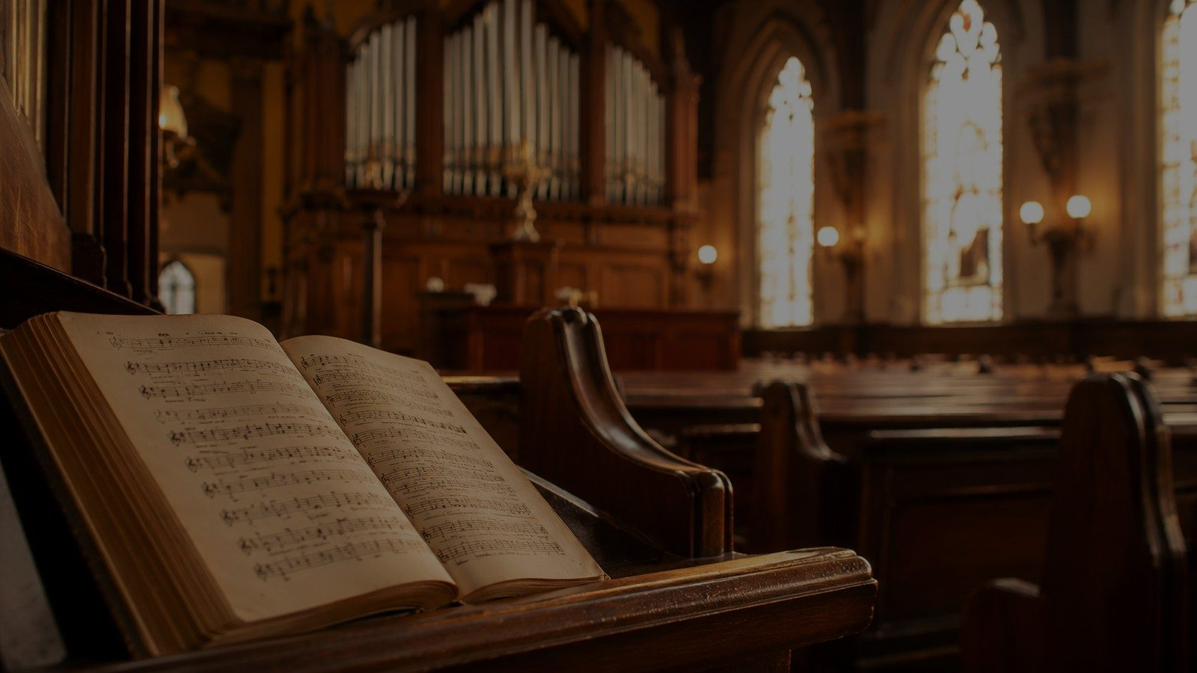
Hymn Identity
A Christian paraphrase of Psalm 118
Title
First line
This Is the Day the Lord Hath Made
This is the day the Lord hath made
Text
Tune often paired
Isaac Watts, 1719
TWENTY-FOURTH — Lucius Chapin
Meter
Scripture center
Common Meter (8.6.8.6)
Psalm 118:22-26; Acts 4:10-11
Prepared for teaching and small group use - hymninfo.com

Slide 4
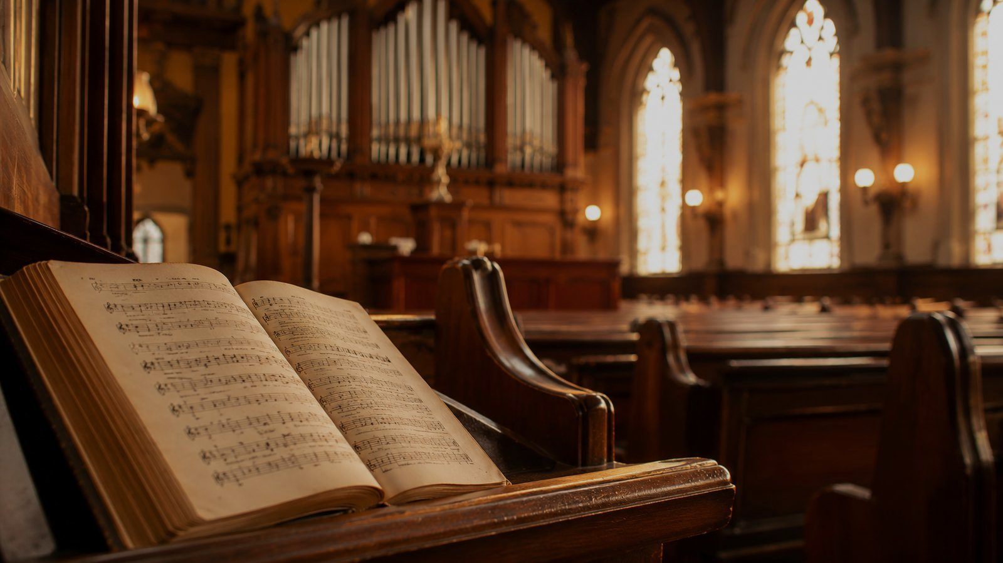
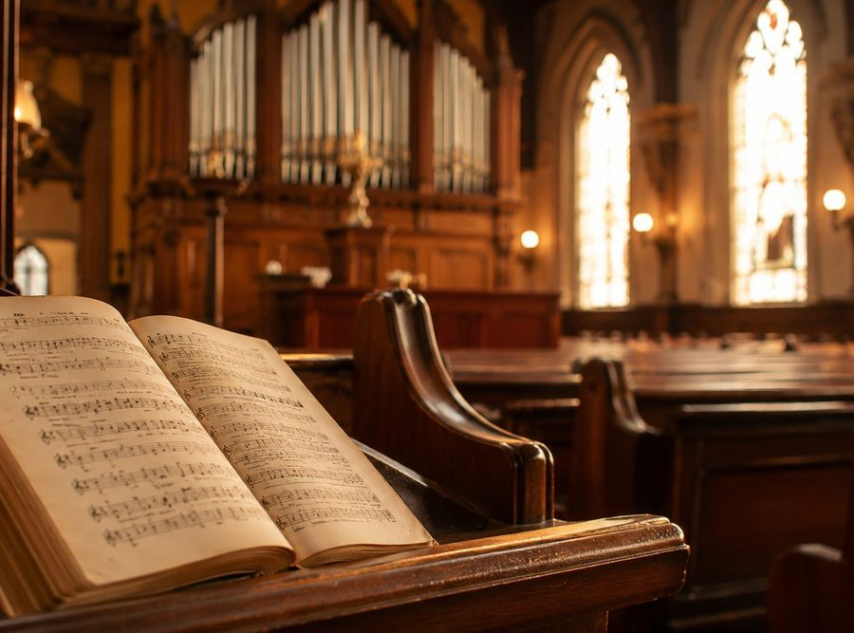
Historical Background
Isaac Watts and Christian psalmody
Published in 1719 in The Psalms of David Imitated in the Language of the New Testament.
Watts sought to sing the Psalms in language shaped by Christ and the gospel.
This hymn comes from his treatment of Psalm 118, especially the cornerstone and day of rejoicing.
The text can be sung to several common-meter tunes; TWENTY-FOURTH is one notable pairing.
Teacher note: present Watts as a careful biblical interpreter, not merely as a writer of cheerful verses.
Prepared for teaching and small group use - hymninfo.com

Slide 5
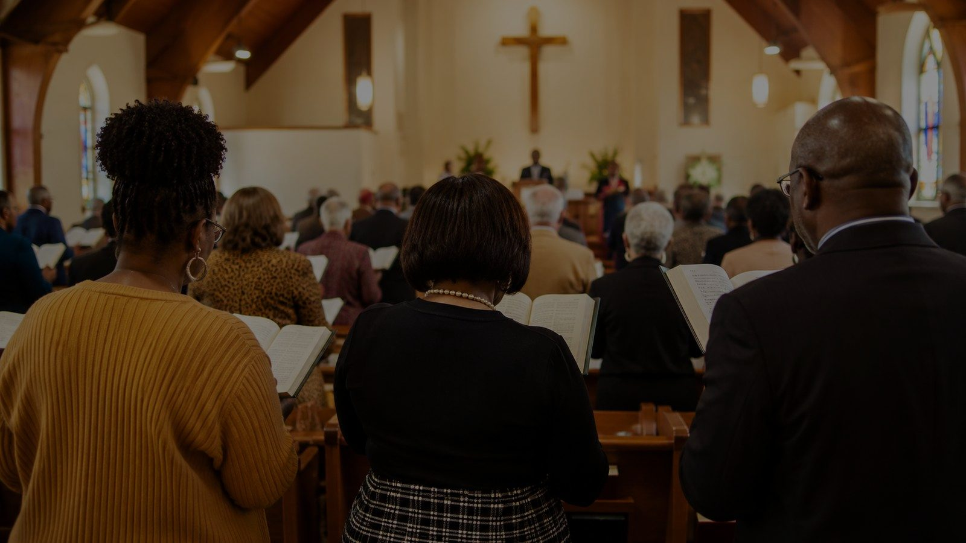
WORSHIP VALUE
Why This Hymn Matters Today
It teaches the church to rejoice because God has acted decisively in the risen Christ.
Prepared for teaching and small group use - hymninfo.com

Slide 6

Biblical Foundation
Psalm 118 read in light of Christ
Psalm 118:22-26
Scripture gives the hymn its shape.
Christ gives the psalm its gospel center.
Worship gives the church its response.
The rejected stone becomes the cornerstone; the Lord makes the day of rejoicing; the people cry for salvation.
Matthew 21:9, 42
Jesus receives the Hosanna cry and applies the cornerstone text to himself.
Acts 4:10-11
The apostles proclaim the crucified and risen Jesus as the cornerstone God has established.
Prepared for teaching and small group use - hymninfo.com

Slide 7

The Movement of Psalm 118
From rejection to rejoicing
Rejected stone
Cornerstone
The day
Hosanna
Human builders dismiss
God establishes
God’s victory revealed
The people cry for saving help
Watts turns this movement into Easter praise: God overturns rejection through the resurrection of Christ.
Prepared for teaching and small group use - hymninfo.com

Slide 8


Stanza 1: The Lord’s Day of Rejoicing
Joy begins with God’s claim on the day
The opening call gathers heaven and earth into praise.
The day is not merely ordinary time; it belongs to the Lord.
Teaching emphasis: Christian gladness is a response to God’s saving work.
Prepared for teaching and small group use - hymninfo.com

Slide 9
Stanza 2: Resurrection Victory
The day is centered on Christ’s rising
Watts makes the Easter reading unmistakable.
The risen Christ triumphs over death and the powers of darkness.
Teaching emphasis: resurrection joy is not shallow cheerfulness; it is gospel confidence.
Key connection
Acts 4:10-11 proclaims the crucified and risen Jesus as the cornerstone God has established.
Prepared for teaching and small group use - hymninfo.com

Slide 10
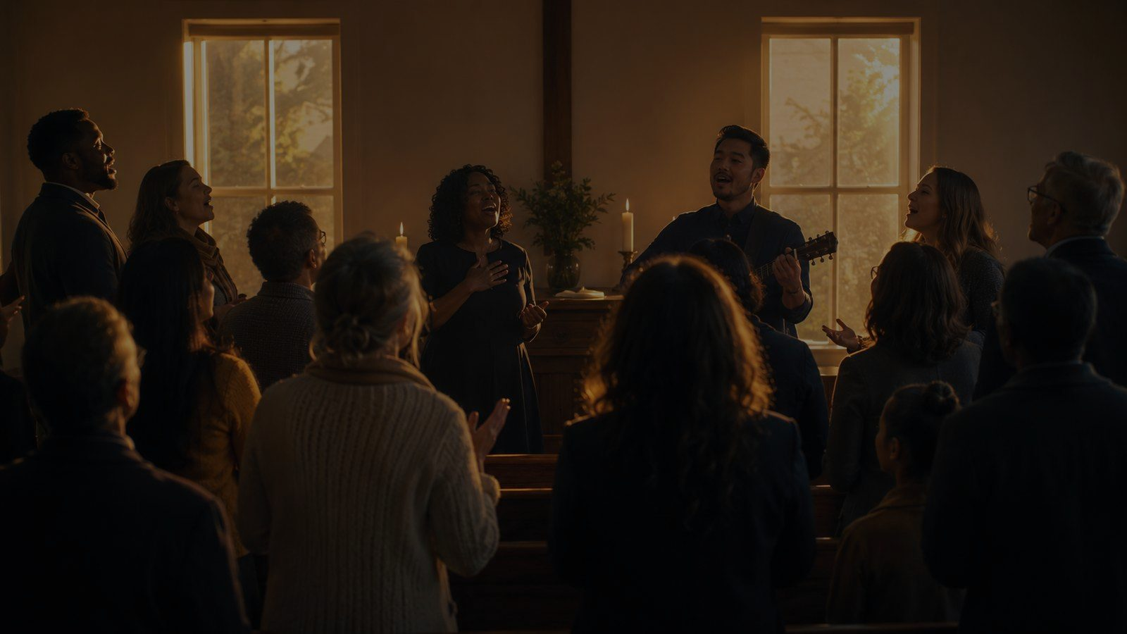
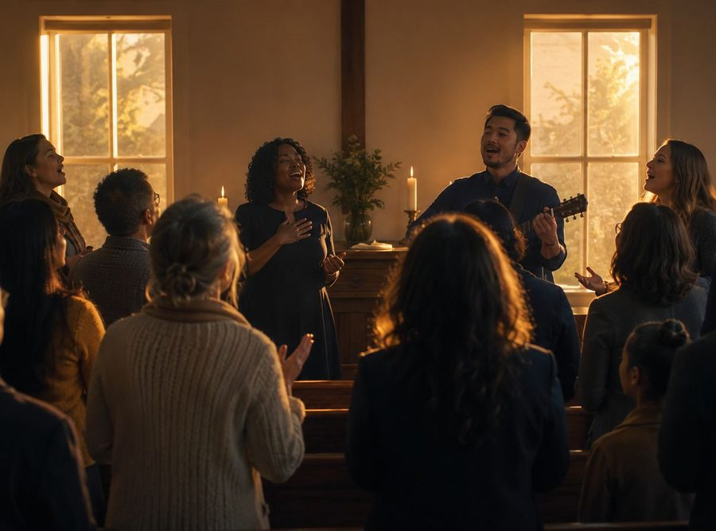
Stanza 3: Hosanna and Saving Help
Praise becomes prayer
Psalm 118 includes the cry for the Lord to save.
The Gospels place that cry around Jesus, David’s Son.
Teaching emphasis: worshipers praise Christ and depend on Christ at the same time.
Prepared for teaching and small group use - hymninfo.com

Slide 11
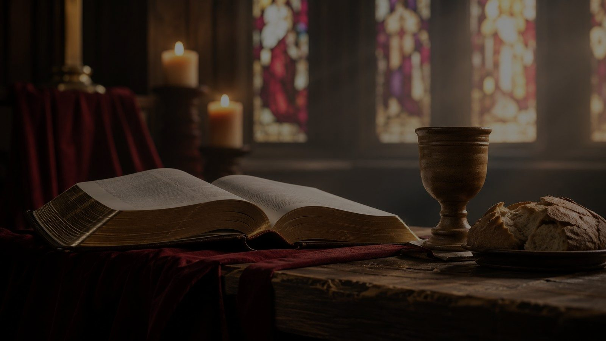
Stanza 4: Grace in the Father’s Name
The coming King brings salvation
The hymn blesses the One who comes in God’s name.
Christ comes with messages of grace and with saving mercy for sinners.
Teaching emphasis: the King’s coming is good news because he comes to save.
Pastoral note
Do not let Easter praise become vague celebration. Keep it tied to Christ’s saving work.
Prepared for teaching and small group use - hymninfo.com

Slide 12


Stanza 5: Earth and Heaven Join Praise
Present worship anticipates fuller praise
The church’s highest praise is real but not yet complete.
Heaven’s worship surpasses what the church can now raise.
Teaching emphasis: every Lord’s Day points beyond itself to eternal worship.
Prepared for teaching and small group use - hymninfo.com

Slide 13

Theological Themes
What the hymn teaches
Resurrection
Cornerstone
Joy
Christ rises and reigns.
God establishes the rejected One.
Praise is grounded in saving action.
Hosanna
Grace
Worship
The church praises and petitions.
The King comes to save sinners.
Earthly praise joins heaven’s praise.
Prepared for teaching and small group use - hymninfo.com

Slide 14
Literary and Musical Observations
Psalm paraphrase, common meter, congregational clarity
Watts moves from biblical thanksgiving into explicit Easter proclamation.
The hymn uses common meter, making it singable with several familiar tunes.
TWENTY-FOURTH is one common pairing; other common-meter tunes may also serve well.
The tone should be bright, confident, and reverent, not rushed.
Choir and leader note
Let the text lead. Clear diction on “cornerstone,” “Hosanna,” and resurrection language helps the congregation hear the gospel shape of the hymn.
Prepared for teaching and small group use - hymninfo.com

Slide 15
Pastoral and Worship Use
Where the hymn serves the church
Easter Sunday and the Sundays of Eastertide
Lord’s Day opening hymn or call to worship
Services of thanksgiving and congregational praise
Teaching moments on Psalm 118 and the cornerstone imagery
Intergenerational worship where a strong Scripture-shaped hymn is needed
Worship planner
Pair the hymn with a reading of Psalm 118:22-26 or Acts 4:10-11 before the congregation sings.
Prepared for teaching and small group use - hymninfo.com

Slide 16


Teaching Questions
For class or rehearsal conversation
How does Psalm 118 shape the hymn’s meaning?
Why does Watts connect the day of rejoicing with Christ’s resurrection?
What does the rejected stone becoming the cornerstone teach about Jesus?
How does the hymn move from thanksgiving to Easter proclamation?
How can we sing this hymn as more than a general song about a new day?
Prepared for teaching and small group use - hymninfo.com

Slide 17
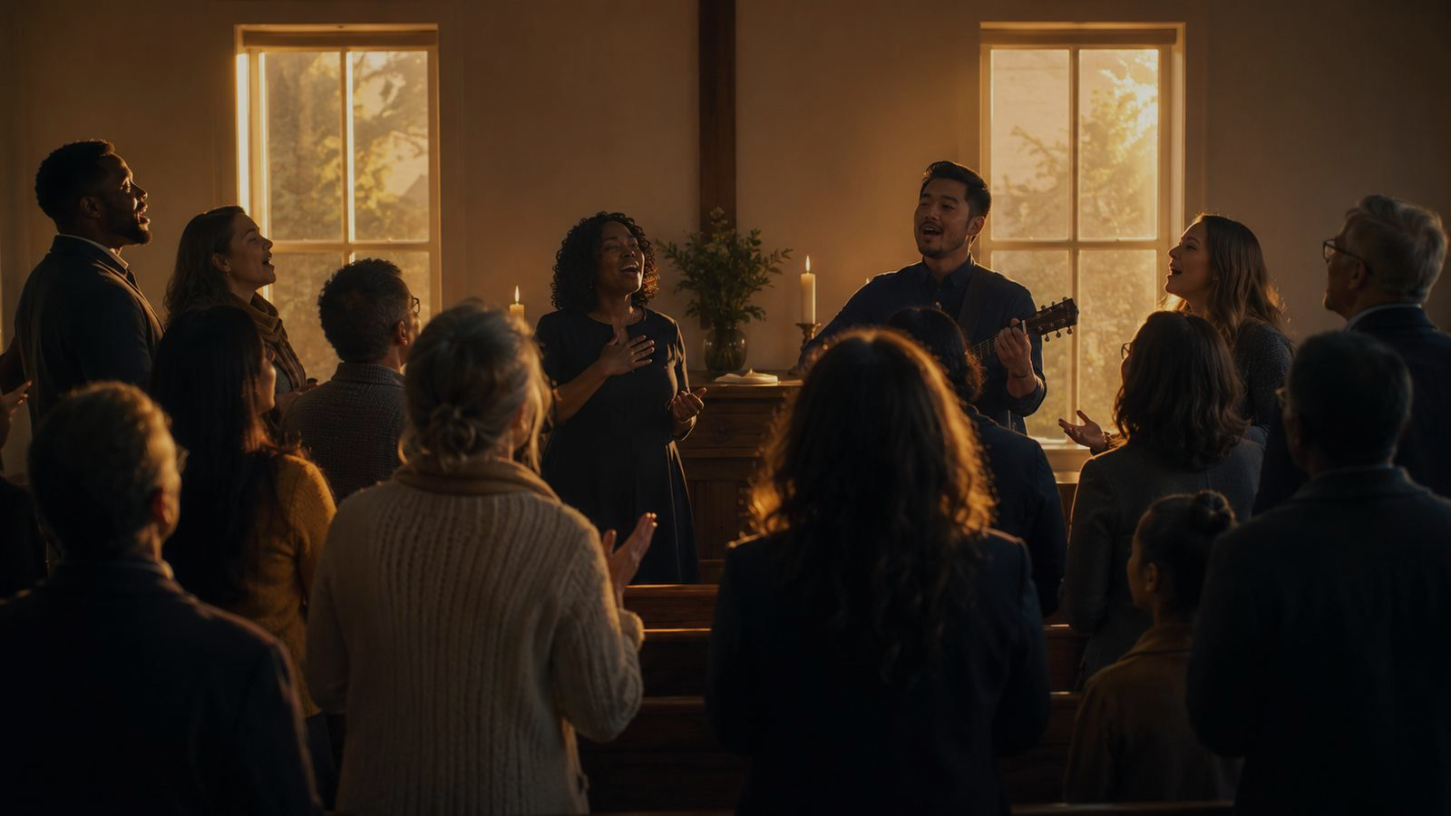
Suggested Lesson Flow
A ready structure for church teaching
30-minute lesson
60-minute lesson
1. Read Psalm 118:22-26
2. Identify the cornerstone and day themes
3. Teach the hymn’s background
4. Discuss stanzas in brief
5. Pray with thanksgiving for Christ’s resurrection
1. Begin with Psalm 118 and Acts 4
2. Trace Watts’s Christian reading of the psalm
3. Study each stanza movement
4. Discuss worship use and tune choices
5. Close with shared applications and prayer
Prepared for teaching and small group use - hymninfo.com

Slide 18
Closing Summary and Prayer
The day the Lord has made is the day of Christ’s victory. The rejected stone stands as cornerstone. The church rejoices, prays, and sings because God has acted.
Risen Lord Jesus, make our worship grateful, our joy steady, and our praise faithful until earth’s song is gathered into heaven’s praise. Amen.
© HymnInfo.com. Free for personal, church, classroom, and small-group teaching use. Please do not sell, repost, or redistribute as downloadable files without permission.
Prepared for teaching and small group use - hymninfo.com

