Slide 1
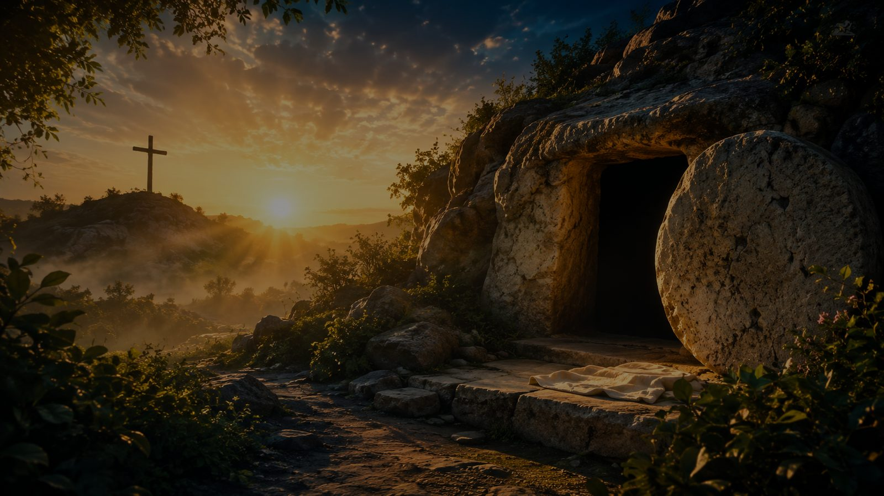
Hymn Study Teaching Guide
We Know That Christ Is Raised
We know that Christ is raised and dies no more • John Brownlow Geyer, 1967
Romans 6 • Resurrection, baptism, and new life in Christ
Prepared for teaching and small group use - hymninfo.com

Slide 2
Teaching Aim
Lead learners from Easter confession to baptismal identity and daily new life.
1
2
3
Understand
Feel
Practice
Romans 6 joins Christ’s resurrection with the believer’s new life.
Joy that death no longer has the final word over Christ or his people.
Live as those buried and raised with Christ.
Prepared for teaching and small group use - hymninfo.com

Slide 3
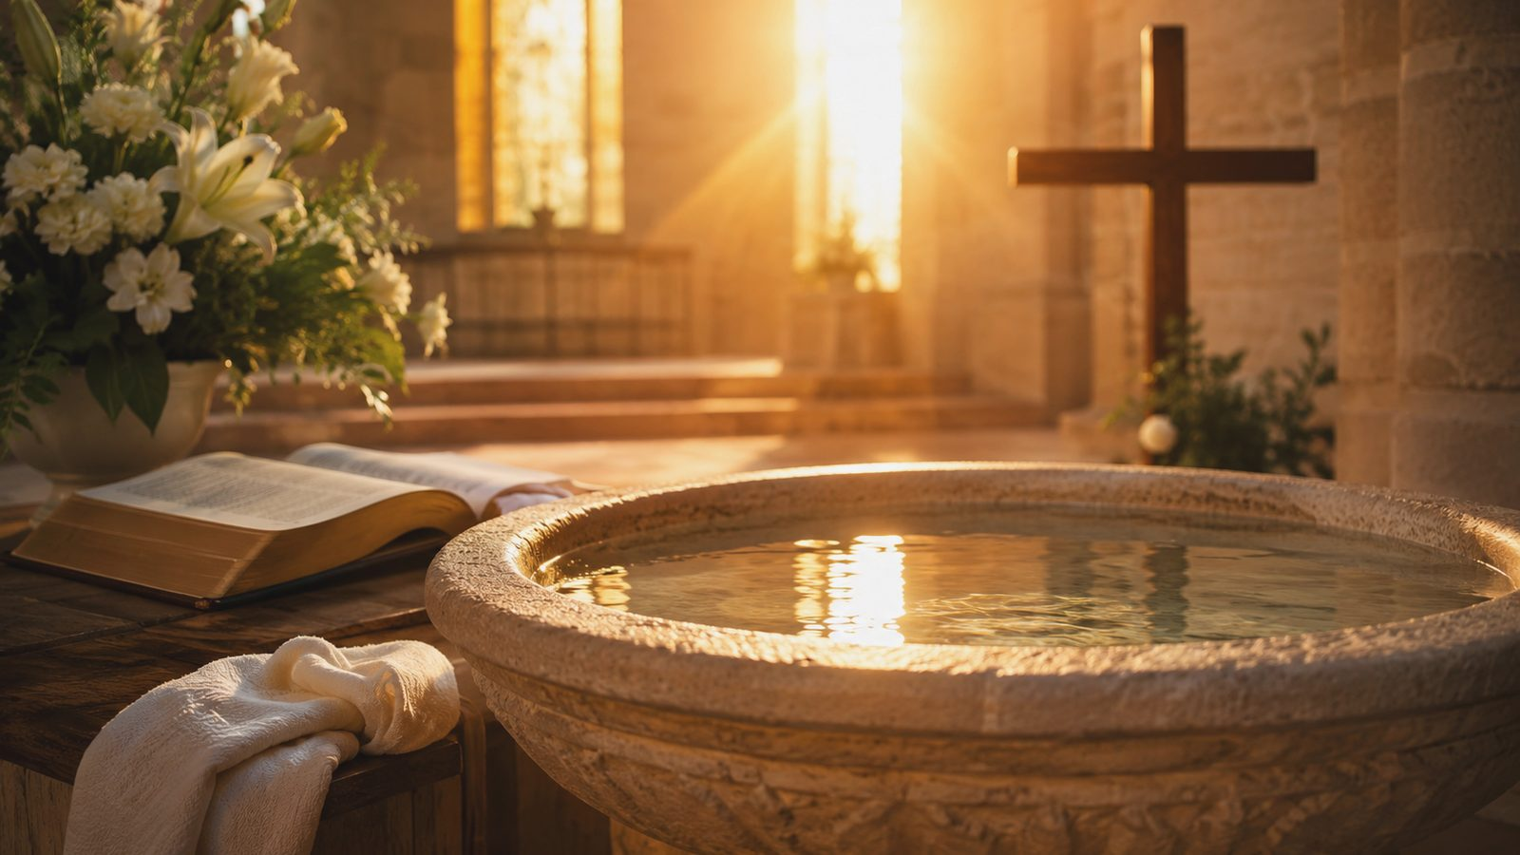
Hymn Identity
A modern hymn where Easter faith and baptismal theology meet.
First line
We know that Christ is raised and dies no more
Text
John Brownlow Geyer, 1967
Tune
ENGELBERG by Charles Villiers Stanford
Meter
10.10.10.4 (with Alleluia)
Primary text
Romans 6:3-11, especially Romans 6:9
Prepared for teaching and small group use - hymninfo.com

Slide 4
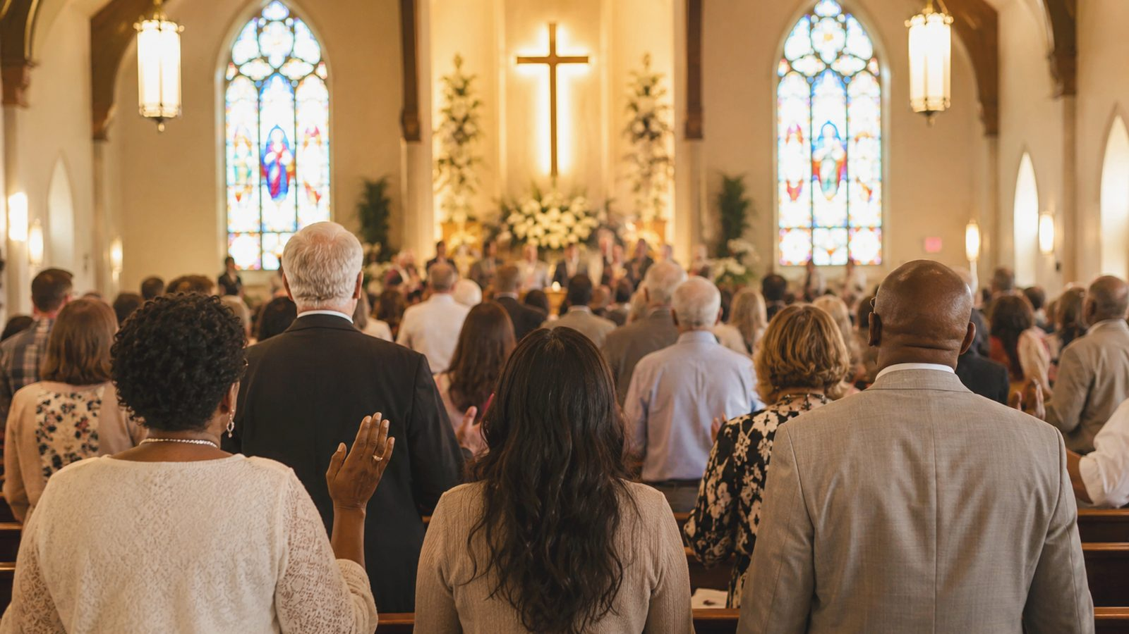
Historical Background
Written for the church to sing resurrection life at the baptismal font.
• John Brownlow Geyer wrote the text in 1967 while serving as a tutor at Cheshunt College, Cambridge.
• The hymn grew from reflection on Romans 6 and the meaning of Christian baptism.
• It entered wider use through hymnals and worship books where Easter, baptism, and new creation are brought together.
• Stanford’s ENGELBERG gives the text a broad, festival character suitable for baptism and Easter worship.
Prepared for teaching and small group use - hymninfo.com

Slide 5

Why This Hymn Matters Today
It gives the church strong language for identity, hope, and renewal.
Pastoral value
It comforts believers with the news that death no longer rules over Christ.
Worship value
It makes baptism visible as a sign of death, resurrection, and new life.
Teaching value
It helps a congregation hear Romans 6 as a living word, not an abstract doctrine.
Devotional value
It calls disciples to walk today in the life of the risen Lord.
Prepared for teaching and small group use - hymninfo.com

Slide 6
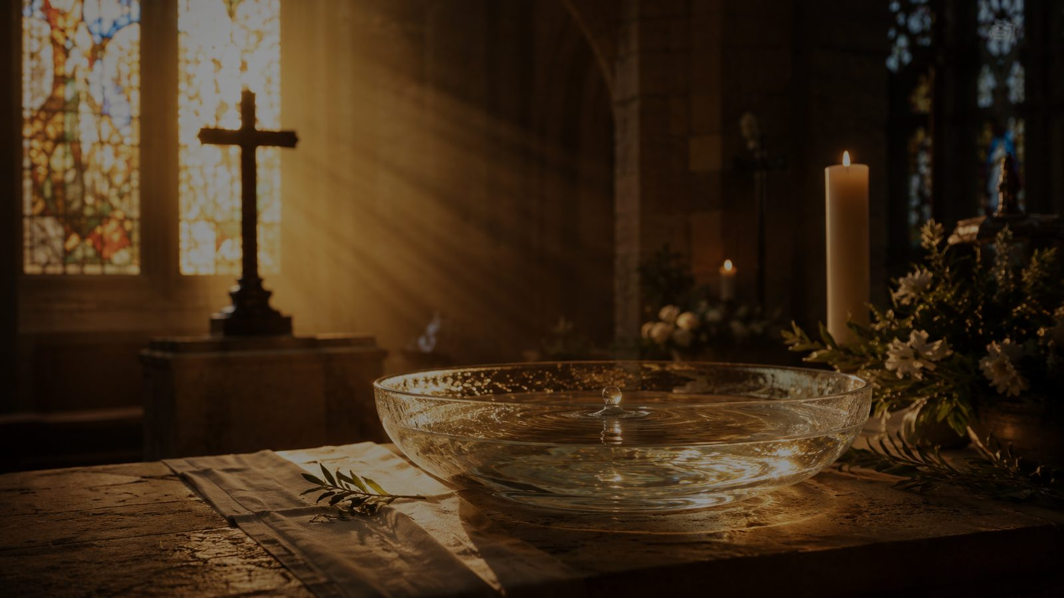
Biblical Foundation
Buried with Christ, raised to walk in newness of life
Prepared for teaching and small group use - hymninfo.com

Slide 7
Romans 6 at the Center
The hymn is built on Paul’s baptismal language of dying and rising with Christ.
Romans 6:9
Christ is raised and death no longer has dominion over him.
Romans 6:3-5
Baptism joins believers to Christ’s death and resurrection life.
Colossians 2:12
God raises believers with Christ through faith in his work.
2 Corinthians 5:17
In Christ, new creation has begun.
1 Corinthians 15:20-22
The resurrection of Christ is the firstfruits of life for all who belong to him.
Prepared for teaching and small group use - hymninfo.com

Slide 8
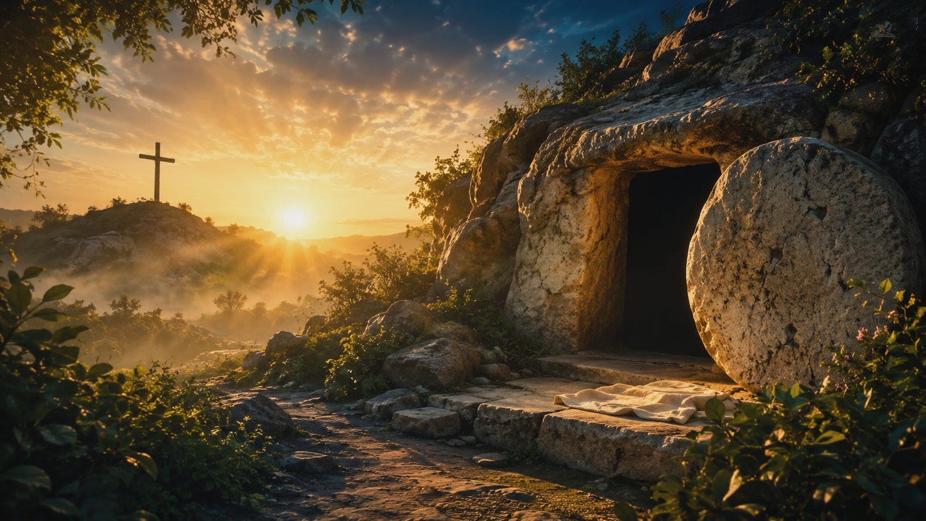
The Hymn’s Movement
Easter confession becomes baptismal identity and creation-wide hope.
1
Christ raised
Death loses its mastery over the risen Lord.
2
Baptismal union
Believers are joined to Christ’s death and risen life.
3
Spirit-given life
The Spirit renews the church as a sign of new creation.
4
Alleluia response
Praise answers what God has done in Christ.
Prepared for teaching and small group use - hymninfo.com

Slide 9
Christ Raised: Death No More
The hymn begins with the finished victory of the risen Christ.
• The first movement is proclamation: the resurrection is not a wish, but a confession of Christian faith.
• Christ has passed through death and broken its hold.
• Easter joy is not optimism; it is grounded in the risen Lord.
Prepared for teaching and small group use - hymninfo.com

Slide 10
Baptismal Union
Baptism announces that the believer belongs to the story of Jesus.
• Paul does not treat baptism as detached from the gospel.
• Believers are named by Christ’s death and resurrection.
• The church is called to walk in newness of life, not merely admire it from a distance.
• The font points to a new identity received by grace.
Prepared for teaching and small group use - hymninfo.com

Slide 11

New Creation Has Begun
The risen life of Christ is the beginning of God’s renewal of all things.
• The hymn moves beyond individual renewal to the life of the church and creation.
• The Spirit forms a people who bear witness to resurrection life.
• Every baptism points toward God’s promised future.
Prepared for teaching and small group use - hymninfo.com

Slide 12
The Alleluia Response
The repeated praise is not decoration. It is the church’s answer to resurrection.
• The refrain-like ending lets doctrine become worship.
• The congregation does not merely learn about Easter; it sings the new life of Christ.
• A choir can help the congregation sing with strength, clarity, and joy.
Prepared for teaching and small group use - hymninfo.com

Slide 13
Theological Themes
These themes should shape how the hymn is taught, sung, and prayed.
Resurrection
Christ’s victory over death.
Baptism
Participation in Christ’s death and life.
Union with Christ
Believers share in the risen Lord.
New Creation
God’s renewal has begun.
Trinity
Father, Son, and Spirit at work.
Hope
The church lives toward God’s future.
Prepared for teaching and small group use - hymninfo.com

Slide 14
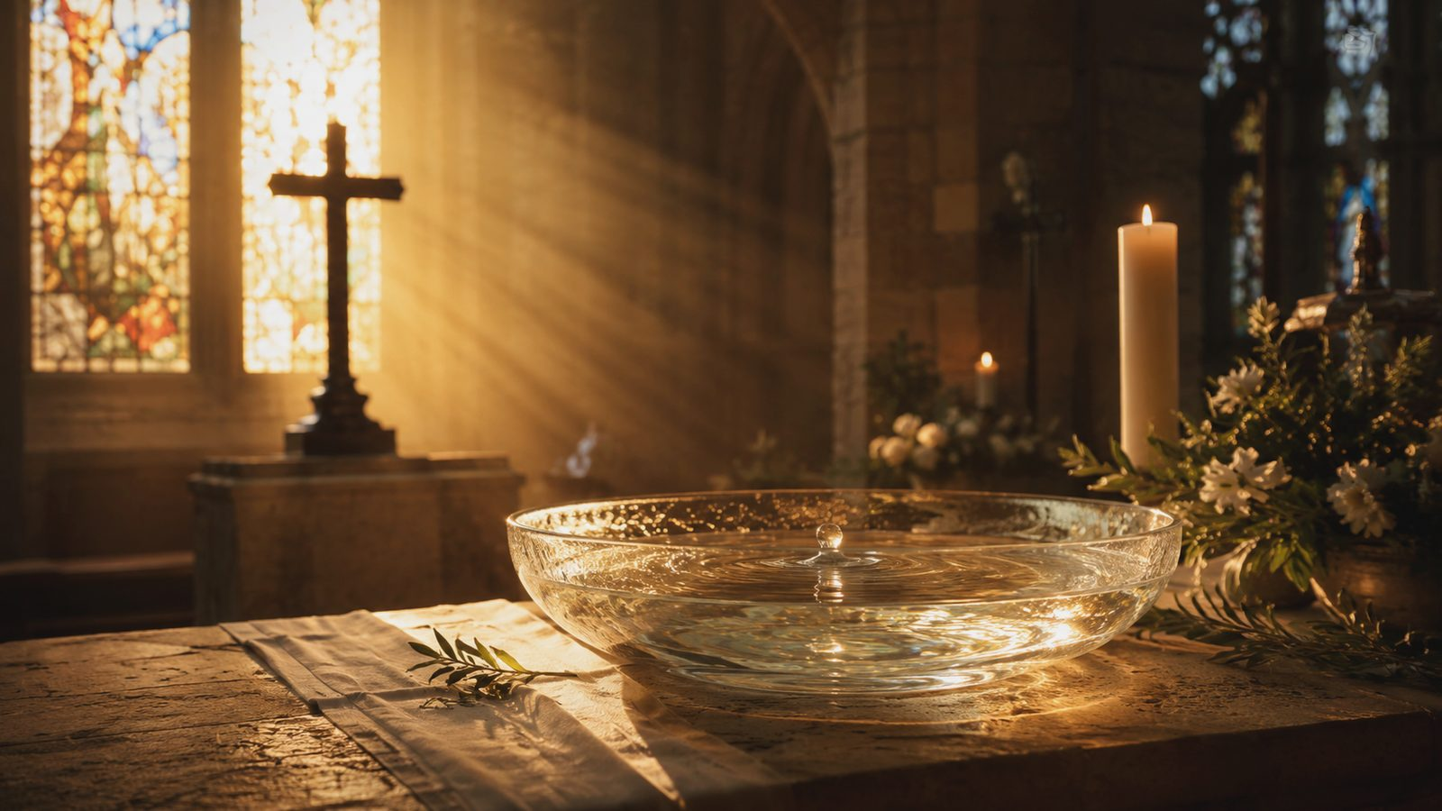
Literary and Musical Observations
Strong doctrine needs clear, confident singing.
• Meter: 10.10.10.4 (with Alleluia).
• ENGELBERG uses broad phrases that can carry the text’s doctrinal weight.
• The tune works well with organ, brass, or strong unison singing on festival days.
• Choose a tempo that allows the congregation to proclaim the words rather than rush through them.
Prepared for teaching and small group use - hymninfo.com

Slide 15
Pastoral and Worship Use
Best suited for moments when the church needs to remember its risen identity.
• Easter Vigil, Easter season, or Baptism of the Lord.
• Services of Holy Baptism, confirmation, or reaffirmation of baptismal faith.
• Sermons on Romans 6, Colossians 2, or new creation in Christ.
• Choir-led congregational singing when the text needs strong musical support.
Prepared for teaching and small group use - hymninfo.com

Slide 16
Teaching Questions
Use these to move from observation to faith and practice.
• What does Romans 6 say has happened to Christ, and what does that mean for believers?
• Why does baptism belong naturally with Easter proclamation?
• What does “newness of life” look like in an ordinary week?
• How can the church show the world that new creation has already begun?
• What difference does resurrection make for grief, fear, and hope?
Prepared for teaching and small group use - hymninfo.com

Slide 17
Suggested Lesson Flow
A flexible plan for Sunday school, choir rehearsal, or baptism preparation.
30-minute lesson
1. Read Romans 6:3-11.
2. Introduce Geyer and ENGELBERG.
3. Trace the hymn’s movement.
4. Discuss baptism and new life.
5. Close with a prayer of Easter hope.
60-minute lesson
1. Open with Easter and baptism stories.
2. Study Romans 6 and Colossians 2.
3. Teach history and tune.
4. Discuss themes in small groups.
5. Plan worship or personal practice.
6. Close in prayer.
Prepared for teaching and small group use - hymninfo.com

Slide 18
Closing Summary and Prayer
• Christ is raised, and death no longer rules him.
• In baptism, believers are joined to his death and life.
• The church lives now as a sign of God’s new creation.
• Risen Lord Jesus, make your church a living witness to your victory. Teach us to remember our baptism, walk in newness of life, and hope in the renewal of all things. Amen.
© HymnInfo.com. Free for personal, church, classroom, and small-group teaching use. Please do not sell, repost, or redistribute as downloadable files without permission.
Prepared for teaching and small group use - hymninfo.com

