Slide 1
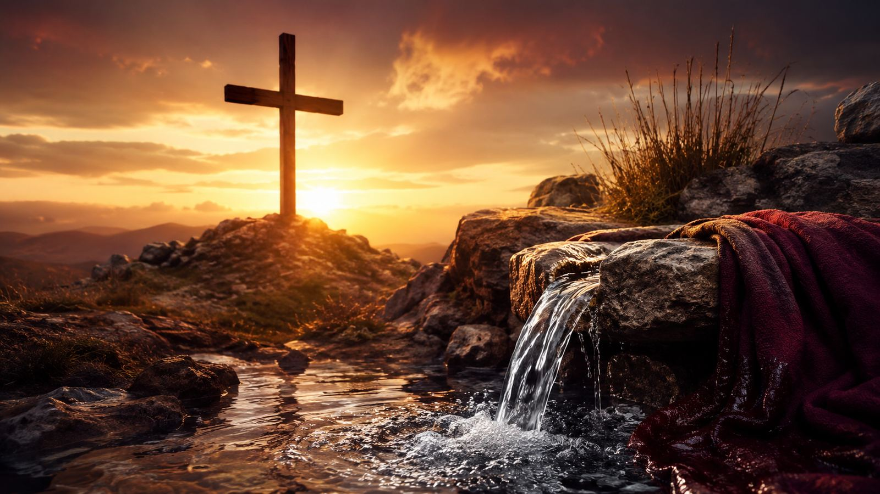
There Is a Fountain Filled with Blood
William Cowper • CLEANSING FOUNTAIN • Zechariah 13:1
A church-ready teaching guide on cleansing grace, atonement, and grateful praise.
Prepared for teaching and small group use - hymninfo.com

Slide 2
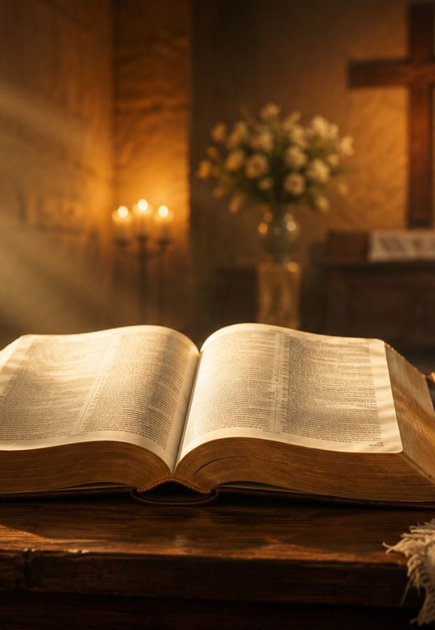
HYMN STUDY
Teaching Aim
Lead learners from biblical image to gospel assurance and grateful response.
✦
♥
✓
Understand
Feel
Practice
• Understand the fountain image from Zechariah and the cross of Christ.
• Feel the weight of sin answered by the mercy of God.
• Practice repentance, assurance, and praise shaped by redeeming love.
Prepared for teaching and small group use - hymninfo.com

Slide 3
HYMN STUDY
Hymn Identity
Key details for teachers and worship planners.
Text
Tune
Primary Scripture
William Cowper
Written in 1772
Included in Olney Hymns, 1779
CLEANSING FOUNTAIN
Often associated with Lowell Mason; some references describe Mason as arranger or harmonizer.
Zechariah 13:1
A spring opened for sin and uncleanness.
Prepared for teaching and small group use - hymninfo.com

Slide 4
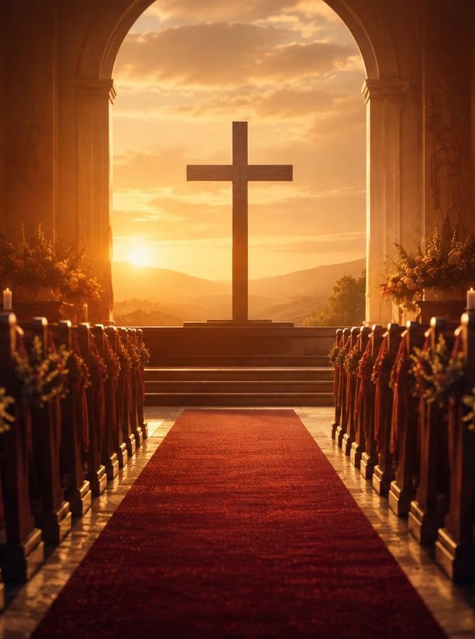
HYMN STUDY
Historical Background
A hymn from the Cowper-Newton circle at Olney.
• Cowper was an English poet and hymn writer whose work joined literary grace with evangelical conviction.
• John Newton encouraged Cowper's writing, and Olney Hymns became a landmark collection.
• The hymn was headed Praise for the Fountain Opened and connected with Zechariah 13:1.
• Its wide use carried the hymn into many English-language worship traditions.
Prepared for teaching and small group use - hymninfo.com

Slide 5
HYMN STUDY
Why This Hymn Matters Today
It gives the church words for sin, mercy, and assurance.
Pastoral
Worship
For burdened consciences
For communion and the cross
Teaching
Devotion
For atonement and assurance
For grateful repentance
Prepared for teaching and small group use - hymninfo.com

Slide 6
HYMN STUDY
Biblical Foundation
The hymn reads Zechariah through the cross of Christ.
Zechariah 13:1
1 John 1:7
God opens cleansing for sin and uncleanness.
The blood of Jesus cleanses from all sin.
1 Peter 1:18-19
Romans 5:9
Believers are redeemed by the precious blood of Christ.
God justifies through Christ's blood.
Prepared for teaching and small group use - hymninfo.com

Slide 7
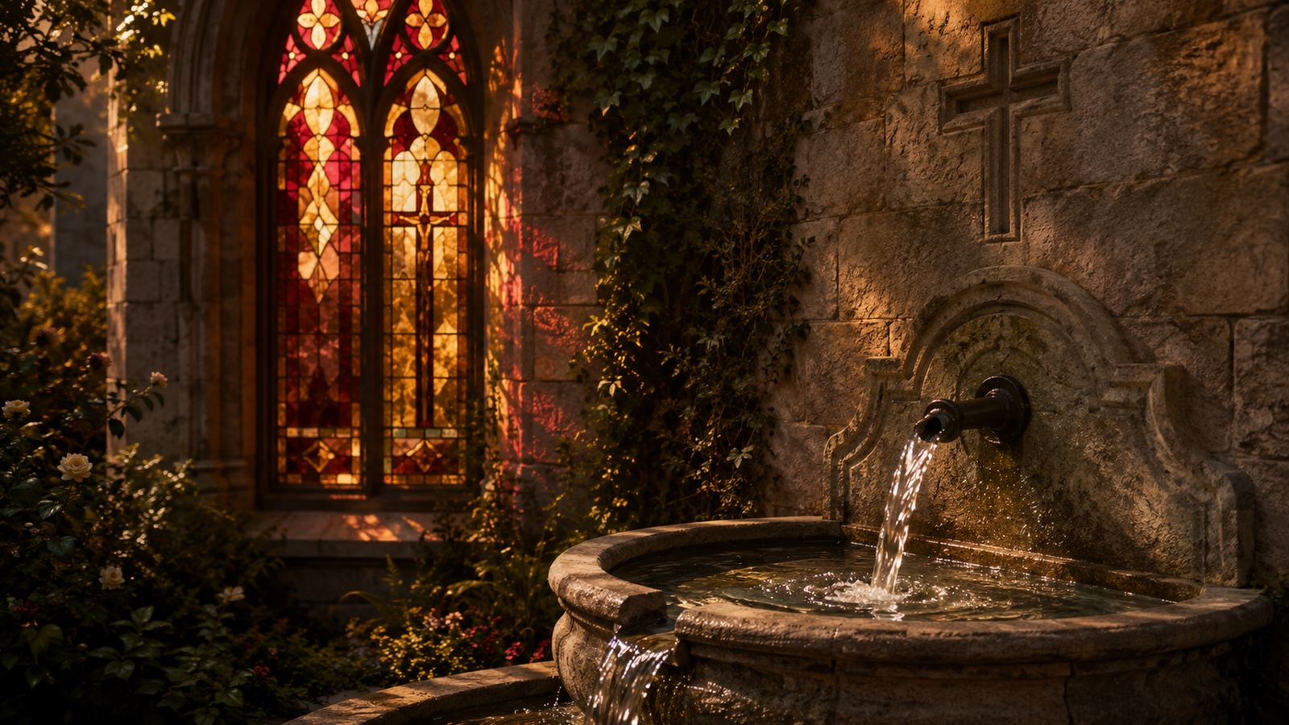
The Fountain Opened
Stanza studies for cleansing grace and redeeming love
Prepared for teaching and small group use - hymninfo.com

Slide 8
HYMN STUDY
Stanza 1: Cleansing for the Guilty
The hymn begins with the opened fountain.
• The central image is a God-given fountain for sin and uncleanness.
• The hymn applies Zechariah's promise to the blood of Christ.
• Teaching emphasis: salvation begins with God's provision, not human self-cleansing.
Prepared for teaching and small group use - hymninfo.com

Slide 9
HYMN STUDY
Stanza 2: Mercy for the Dying Thief
Grace reaches even the person with nothing to offer.
• The dying thief becomes a witness to last-hour mercy.
• The hymn joins biblical memory with personal confession.
• Teaching emphasis: repentance is not a transaction; it is faith turning to the crucified King.
Prepared for teaching and small group use - hymninfo.com

Slide 10
HYMN STUDY
Stanza 3: The Lamb and the Church
Christ's saving power reaches the whole redeemed people of God.
• The hymn names Christ as the dying Lamb whose blood does not lose saving power.
• The horizon widens from one sinner to the ransomed church.
• Teaching emphasis: personal salvation belongs to God's larger work of redemption.
Prepared for teaching and small group use - hymninfo.com

Slide 11
HYMN STUDY
Stanza 4: Redeeming Love Becomes the Theme
Doctrine turns into testimony.
• Faith sees the cross and begins a lifelong song.
• The believer does not merely know about atonement; the heart learns to praise.
• Teaching emphasis: assurance produces gratitude, not spiritual laziness.
Prepared for teaching and small group use - hymninfo.com

Slide 12
HYMN STUDY
Stanza 5: Praise Beyond Death
The hymn ends where Christian worship is headed: fuller praise.
• The singer expects earthly weakness to give way to a nobler song.
• Death does not silence redemption; it ushers the redeemed into fuller praise.
• Teaching emphasis: the cross gives hope that reaches beyond the grave.
Prepared for teaching and small group use - hymninfo.com

Slide 13
HYMN STUDY
Repeated Lines: Dwelling in Grace
The musical repetition slows the heart before the cross.
• The repeated phrases are not filler; they let the congregation linger over cleansing and pardon.
• Repetition turns a doctrine into a confession sung by the whole church.
• A reverent tempo helps the hymn keep both gravity and gospel confidence.
Prepared for teaching and small group use - hymninfo.com

Slide 14
HYMN STUDY
Theological Themes
Six truths carried by the hymn.
Atonement
Cleansing
Redemption
Christ dies for sinners
God answers guilt
The ransomed are free
Assurance
Testimony
Hope
Grace is sufficient
Faith becomes song
Praise continues
Prepared for teaching and small group use - hymninfo.com

Slide 15
HYMN STUDY
Literary and Musical Observations
A vivid image carried by steady congregational song.
• The movement is from opened fountain to personal faith to eternal praise.
• The tune CLEANSING FOUNTAIN gives space for reflection through repeated phrases.
• Common-meter patterns make the text adaptable to several hymn tunes.
• The best singing is reverent, steady, and thankful.
Prepared for teaching and small group use - hymninfo.com

Slide 16
HYMN STUDY
Pastoral and Worship Use
Where the hymn serves the church well.
Communion
before or after the table
Good Friday
Christ's atoning death
Lent
confession and return
Assurance
comfort for the repentant
Teaching
atonement and redemption
Devotion
thanksgiving at the cross
Prepared for teaching and small group use - hymninfo.com

Slide 17
HYMN STUDY
Application and Lesson Flow
Move from Scripture to response.
30 minutes: Scripture, hymn story, two stanza studies, prayer.
60 minutes: Add full stanza study, table discussion, and worship planning application.
1
2
3
4
5
Read
Teach
Trace
Discuss
Pray
Zech. 13:1
the fountain
the cross
assurance
gratitude
Prepared for teaching and small group use - hymninfo.com

Slide 18
Closing Summary and Prayer
Christ has opened cleansing grace for sinners. The hymn leads the church from guilt to mercy, from testimony to worship, and from earthly weakness to eternal praise.
Lord Jesus Christ, Lamb of God, cleanse us from sin, teach us humble repentance, and make redeeming love our song until we join the fuller praise of your redeemed people. Amen.
© HymnInfo.com. Free for personal, church, classroom, and small-group teaching use. Please do not sell, repost, or redistribute as downloadable files without permission.
Prepared for teaching and small group use - hymninfo.com

