Slide 1
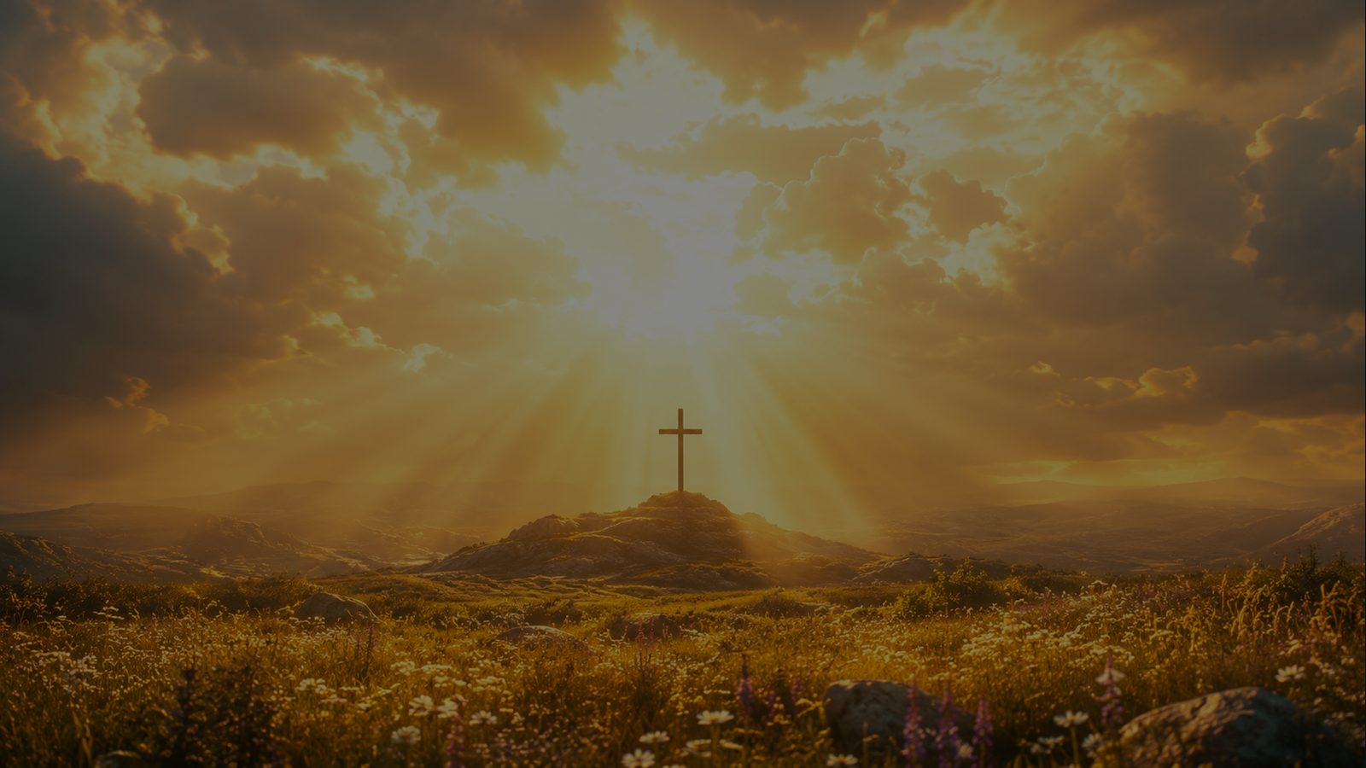
Fairest Lord Jesus
Ruler of all nature · ST. ELIZABETH · Colossians 1:15-17
Prepared for teaching and small group use - hymninfo.com

Slide 2
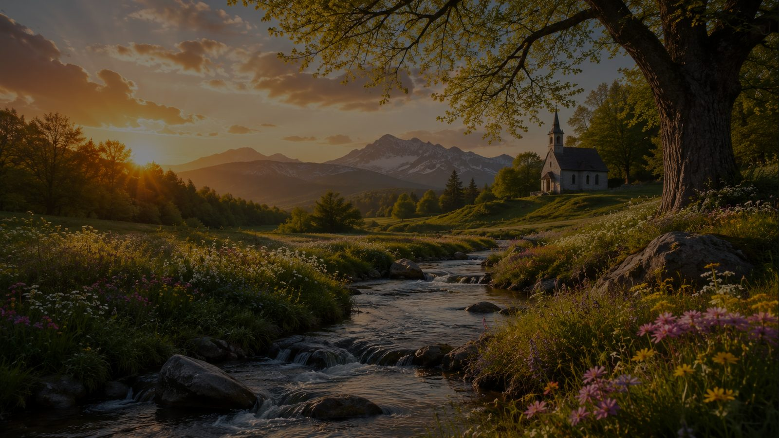
Teaching Aim
Understand Christ’s glory, delight in his beauty, practice doxology
UNDERSTAND
FEEL
PRACTICE
Creation’s beauty points beyond itself to Christ.
Wonder, reverence, and renewed love for the Savior.
Turn beauty into worship and daily praise.
Prepared for teaching and small group use - hymninfo.com

Slide 3

Hymn Identity
A hymn of Christ-centered beauty and adoration
• Title: Fairest Lord Jesus
• First line: Fairest Lord Jesus, Ruler of all nature
• Text: anonymous German, 1677
• English tradition: Joseph A. Seiss
• Tune: ST. ELIZABETH, Silesian folk melody
• Meter: 11.8.11.8
“Thou, my soul’s glory, joy, and crown.”
Prepared for teaching and small group use - hymninfo.com

Slide 4
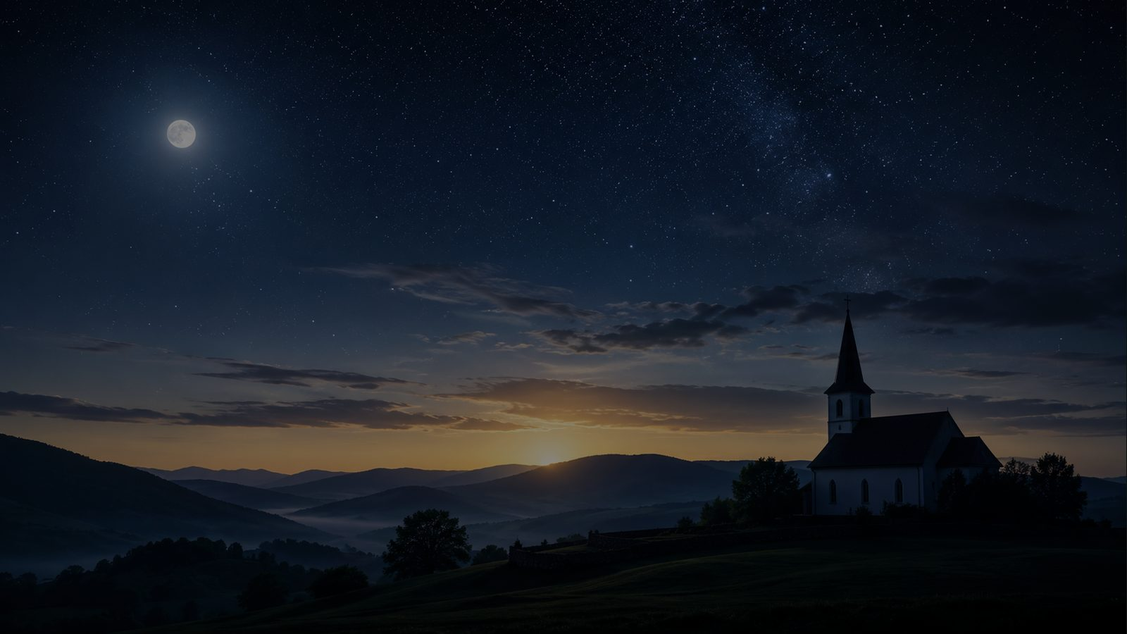
Historical Background
A German devotional hymn carried by a Silesian melody
• The German text “Schönster Herr Jesu” appeared anonymously in 1677.
• The tune ST. ELIZABETH was collected from the Silesian folk tradition in the nineteenth century.
• The familiar “Crusaders’ Hymn” label is legendary rather than reliable history.
• Joseph A. Seiss is associated with the English tradition and the doxological fourth stanza.
Prepared for teaching and small group use - hymninfo.com

Slide 5
Why This Hymn Matters Today
It trains the church to move from admiration to adoration
• It receives creation’s beauty as a gift without making creation ultimate.
• It is simple enough for children and deep enough for mature believers.
• It gives worshipers language for cherishing Christ above every lesser glory.
• It suits Epiphany, Transfiguration, Christ the King, and general praise.
• It connects beauty with redemption: Christ makes the woeful heart sing.
• It helps worship become both visual and doctrinal.
Prepared for teaching and small group use - hymninfo.com

Slide 6
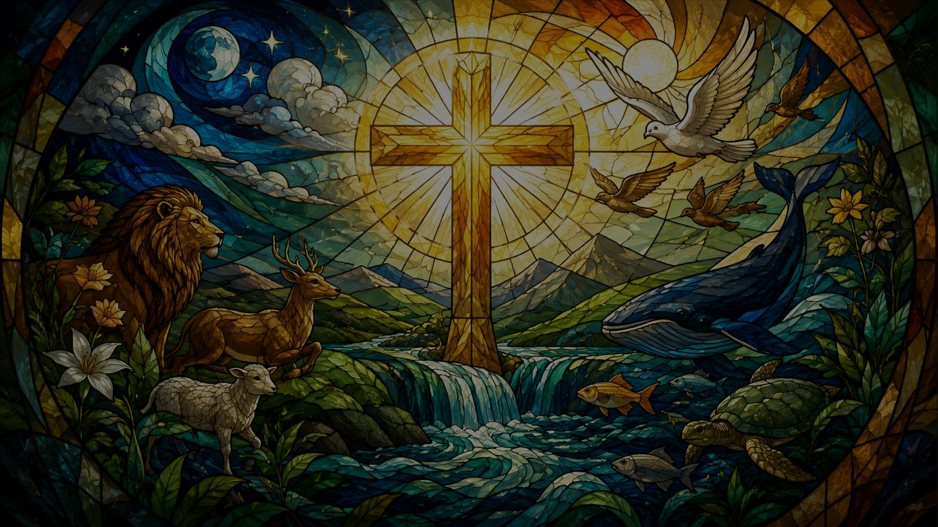
Biblical Foundation
All things were created through Christ and for Christ
Colossians 1:15-17
Christ is the image of the invisible God; all things visible and invisible have been created through him and for him.
• Hebrews 1: the Son is the radiance of God’s glory.
• John 1: the Word became flesh and revealed glory.
• Revelation 5: all creation joins the Lamb’s praise.
Prepared for teaching and small group use - hymninfo.com

Slide 7
Creation as Signpost
The hymn begins with the goodness of the created world
Creation is beautiful, but Christ is the fairest.
Prepared for teaching and small group use - hymninfo.com

Slide 8
Section Study 1
Ruler of all nature, cherished by the soul
• The opening section joins cosmic lordship with personal devotion.
• Jesus is confessed as Son of God and Son of Man.
• Teaching emphasis: the Lord over all nature is also the joy and crown of the worshiping heart.
Prepared for teaching and small group use - hymninfo.com

Slide 9
Section Study 2
Fair are the meadows; Jesus is fairer
• Earthly beauty is honored but not idolized.
• The hymn’s comparison leads from springtime imagery to Christ’s purifying grace.
• Teaching emphasis: Christ’s beauty is saving beauty; he makes the woeful heart sing.
Prepared for teaching and small group use - hymninfo.com

Slide 10
Section Study 3
Sun, moon, stars, and the brighter glory of Christ
• The hymn climbs from earth to the heavens.
• Even celestial beauty and angelic glory are lesser than the glory of Jesus.
• Teaching emphasis: every created light is borrowed; Christ is the radiance of God’s glory.
Prepared for teaching and small group use - hymninfo.com

Slide 11
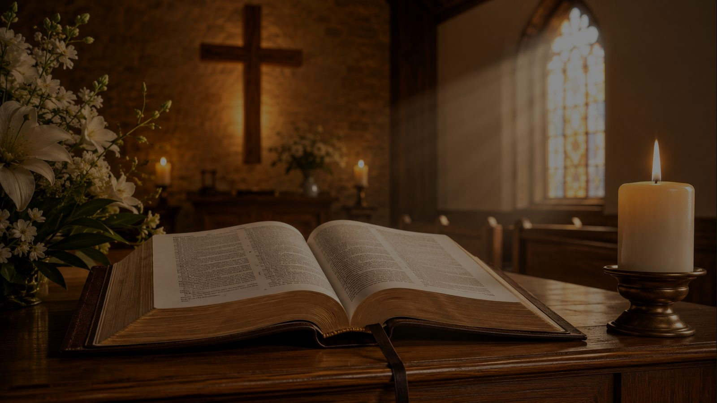
Section Study 4
Beautiful Savior, Lord of the nations
• The hymn ends in direct doxology.
• The final praise belongs to Christ now and forever.
• Teaching emphasis: Christian beauty does not end in mood; it ends in worship.
Glory, honor, praise, and adoration belong to Christ.
Prepared for teaching and small group use - hymninfo.com

Slide 12
Theological Themes
The truths beneath the poetry
• Christology: Jesus is Son of God and Son of Man.
• Redemption: Christ brings joy to the woeful heart.
• Creation: all beauty exists through and for Christ.
• Doxology: worship is the right answer to glory.
• Incarnation: the Word made flesh reveals divine glory.
• Eschatology: present praise anticipates eternal adoration.
Prepared for teaching and small group use - hymninfo.com

Slide 13
Literary and Musical Observations
A graceful hymn that teaches through comparison
• The hymn moves from nature to heaven to doxology.
• Repeated comparisons make the theology memorable.
• ST. ELIZABETH has a gentle contour suited to reverent praise.
• A moderate tempo preserves dignity and avoids sentimentality.
Prepared for teaching and small group use - hymninfo.com

Slide 14
Pastoral and Worship Use
Where the hymn serves well
• Epiphany or Transfiguration: Christ’s glory revealed.
• Creation-focused services, when centered clearly on Christ.
• Christ the King and general praise.
• Children’s teaching on worship, nature, and Jesus’ glory.
• Choir or congregational singing that emphasizes clear, warm phrasing.
Prepared for teaching and small group use - hymninfo.com

Slide 15
Teaching Questions
Lead learners toward worship
• What makes Jesus “fairer” than creation’s beauty?
• How does Colossians 1 reshape the way we see nature?
• Why does the hymn move from meadows to stars to doxology?
• How does Christ make the woeful heart sing?
• What created beauty can become a prompt for prayer this week?
Prepared for teaching and small group use - hymninfo.com

Slide 16
Application
Practice seeing through creation to Christ
• Receive beauty gratefully, but do not worship the gift.
• Let ordinary splendor become a call to praise.
• Bring sorrow to the Savior who makes the heart sing.
• Sing doxology as preparation for eternal worship.
Prepared for teaching and small group use - hymninfo.com

Slide 17
Suggested Lesson Flow
Two practical ways to teach the hymn
30 MINUTES
60 MINUTES
• Read Colossians 1:15-17.
• Add historical background and tune notes.
• Teach the hymn’s movement: nature, heaven, doxology.
• Study each hymn section with Scripture.
• Discuss one image and one Scripture.
• Name the theological themes.
• Close with worshipful prayer.
• Invite personal application and sung response.
Prepared for teaching and small group use - hymninfo.com

Slide 18
Closing Prayer
Beautiful Savior, receive our praise
Lord Jesus Christ, Beautiful Savior, open our eyes to your glory. Teach us to cherish you above every created beauty, and receive our glory, honor, praise, and adoration now and forever. Amen.
© HymnInfo.com. Free for personal, church, classroom, and small-group teaching use. Please do not sell, repost, or redistribute as downloadable files without permission.
Prepared for teaching and small group use - hymninfo.com

