Slide 1
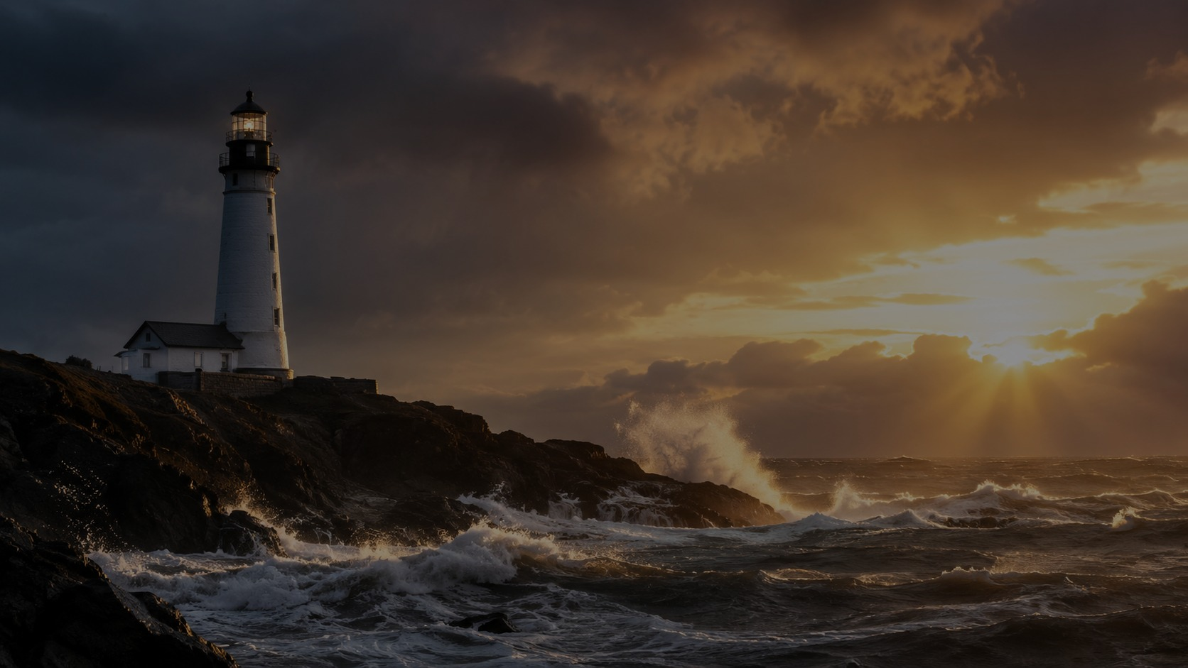
Eternal Father, Strong to Save
A powerful teaching guide on trusting the Triune God in every storm
Psalm 107:23-30 | Tune: MELITA | William Whiting & John Bacchus Dykes
“O hear us when we cry to Thee, for those in peril on the sea.”
Eternal Father, Strong to Save
01

Slide 2
Teaching Roadmap
A session designed for Bible study, Sunday school, worship training, and sermon preparation
1
Hymn story
2
Biblical anchors
Whiting, Dykes, MELITA, and the “Navy Hymn” tradition
Psalm 107, Job 38, Genesis 1, Mark 4, Isaiah 43
3
Stanza study
4
Pastoral response
Father, Son, Spirit, Trinity: a prayerful theology
Intercession, trust, courage, and honest vulnerability
Outcome: learners will see the hymn not as sentimental tradition, but as a sturdy prayer of faith for real danger.
Eternal Father, Strong to Save
02

Slide 3
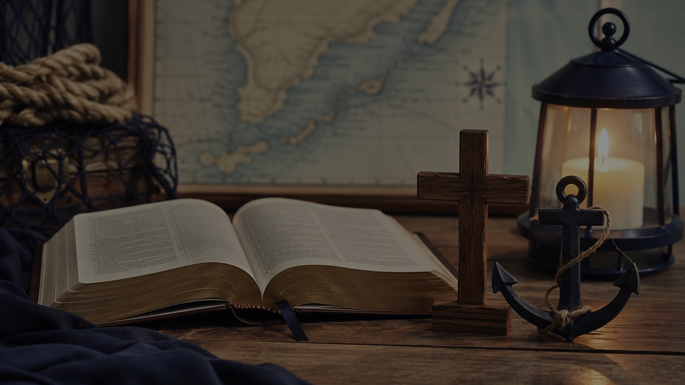
Historical Background
From an educator’s poem to a maritime hymn of intercession
Key historical points
Teaching emphasis
William Whiting wrote the original hymn in 1860.
Hymns Ancient and Modern revised it for 1861 publication.
John Bacchus Dykes composed MELITA specifically for this text.
MELITA recalls Malta, connected with Paul’s shipwreck in Acts 27-28.
The hymn became known as the “Navy Hymn.”
The familiar opening line was created through editorial rearrangement. This reminds us that hymn history often includes revision, reception, and liturgical use—not just a single moment of inspiration.
Powerful teaching move: show how God uses both authors and communities to shape worship language.
Eternal Father, Strong to Save
03

Slide 4
Hymn Identity at a Glance
The facts that frame faithful interpretation
1860
Whiting writes original maritime hymn
1
1861
Text and tune published in Hymns Ancient and Modern
2
MELITA
Tune by John Bacchus Dykes, named for Malta
3
8.8.8.8.8.8
Meter: six lines of eight syllables
4
Navy Hymn
Broadly adopted for maritime and memorial use
5
Eternal Father, Strong to Save
04

Slide 5
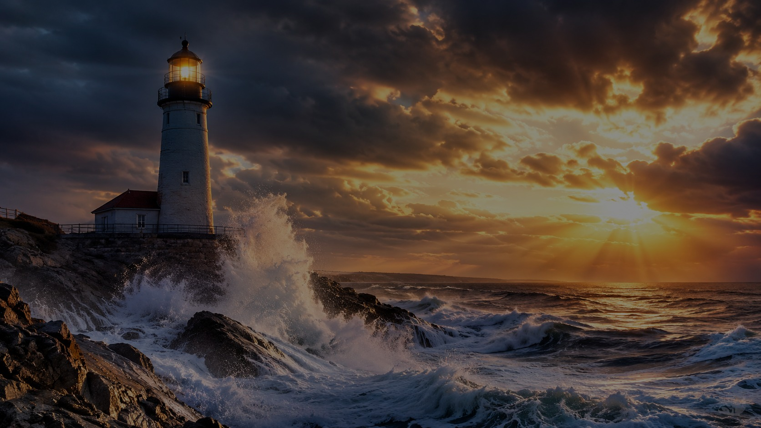
Biblical Foundations
The hymn is carried by Scripture’s storm, sea, and creation imagery
Psalm 107:23-30
Job 38:8-11
Mark 4:39-41
Those who go down to the sea cry to the Lord; He makes the storm a calm, so that its waves are still.
God sets doors and limits for the sea: “Here your proud waves shall be stayed.”
Jesus rebukes the wind and says to the sea, “Peace! Be still!”
Genesis 1:2
Isaiah 43:2
The Spirit of God hovers over the surface of the waters and brings order from chaos.
“When you pass through the waters, I will be with you.”
Eternal Father, Strong to Save
05

Slide 6
Stanza 1: The Father
Sovereign over creation, strong to save
“Eternal Father, strong to save,
Whose arm hath bound the restless wave...”
Teaching Point
God is eternal: He existed before the sea and every storm.
God is sovereign: He sets limits on what feels limitless.
God is approachable: the hymn teaches us to cry to Him.
The Father’s power is not abstract control; it becomes pastoral comfort when people face dangers they cannot command.
Eternal Father, Strong to Save
06

Slide 7
Stanza 2: The Son
Christ commands the storm and comes to His people
“O Savior, whose almighty word
The winds and waves submissive heard...”
Christ does not merely explain fear; He enters it and reveals His authority inside it.
Mark 4: He calms the storm.
Matthew 14: He walks on the waves.
The disciples ask the right question: “Who then is this?”
Pastoral application: trust His presence before you understand His timing.
Eternal Father, Strong to Save
07

Slide 8
Stanza 3: The Spirit
The Spirit brings peace out of chaos
“O Holy Spirit, who didst brood
Upon the chaos dark and rude...”
Discussion Starter
Where do you need the Spirit to bring holy order, peace, courage, or clarity this week?
Creation: the Spirit moves over the deep.
The hymn asks for peace where confusion rages.
The Spirit’s work is both cosmic and personal.
Eternal Father, Strong to Save
08

Slide 9

Stanza 4: The Trinity
The final stanza becomes intercession
“O Trinity of love and power,
Our brethren shield in danger’s hour...”
Who is “in peril” today?
Sailors and fishermen
Rescue and medical workers
Travelers and military personnel
Refugees and families in crisis
Anyone in storms beyond control
Prayer moves outward: “for those in peril.”
The church carries vulnerable people before God.
The Trinity is named as love and power, not power without mercy.
Eternal Father, Strong to Save
09

Slide 10
Core Theological Themes
A rich hymn of providence, Trinity, intercession, and sober trust
Providence
Trinity
God governs creation and human vulnerability.
Father, Son, and Spirit are addressed distinctly and worshiped as one.
Intercession
Sober trust
The church prays for others, not just for itself.
Prayer is not a guarantee of safety, but faithful entrusting.
Powerful insight: the hymn confesses that God is strong to save while refusing to pretend that danger is not real.
Eternal Father, Strong to Save
10

Slide 11
Pastoral Balance
How to teach or preach the hymn with wisdom
Do not use the hymn as a promise that believers will never suffer loss.
Do teach that God’s presence and providence are deeper than every storm.
In memorial settings, honor grief before offering hope.
Keep the focus on Trinitarian intercession rather than military or national triumphalism.
Invite the congregation to pray for real people facing real danger.
Pastoral phrase to remember: “We do not pray because life is safe; we pray because God is faithful.”
Eternal Father, Strong to Save
11

Slide 12
Musical Notes: MELITA
How the tune supports the theology
Musical character
Performance guidance
Composed by John Bacchus Dykes in 1861 specifically for this hymn.
Meter: 8.8.8.8.8.8.
Wave-like melodic contour mirrors storm and sea.
Final phrase settles into calm, matching the prayer for protection.
Use a dignified, steady tempo. Let the tune retain movement and tension without becoming ponderous or militaristic.
Eternal Father, Strong to Save
12

Slide 13
Church Impact
Why this hymn continues to serve the church
Known widely as the “Navy Hymn.”
Used at naval academies, shipboard services, funerals, memorials, Remembrance observances, and services for travelers.
Adapted for land, air, naval, military, submarine, aviation, and space contexts.
Enduring value
It gives the church language for danger without panic, courage without denial, and trust without presumption.
Eternal Father, Strong to Save
13

Slide 14
Teaching Activity
A 15-minute group exercise
Read
Mark
Map
Pray
Read Psalm 107:23-30 aloud.
Underline every word in the hymn connected to danger, power, or protection.
Assign each stanza to Father, Son, Spirit, or Trinity.
Name people “in peril” and pray stanza by stanza.
Leader tip: end by asking, “How does this hymn teach us to pray differently?”
Eternal Father, Strong to Save
14

Slide 15
Sermon Bridge
From hymn study to proclamation
Sermon Big Idea
Because the triune God rules creation, enters our storms, and brings peace from chaos, the church can trust Him deeply and intercede faithfully for those in peril.
I. The Father rules the restless sea.
II. The Son is present and powerful in the storm.
III. The Spirit brings order, peace, and courage.
IV. The church intercedes for those in peril.
Eternal Father, Strong to Save
15

Slide 16
Closing Prayer
A response of trust and intercession
O Trinity of love and power,
shield those in danger’s hour.
Rule our fears, guide our steps,
and receive our praise from land and sea.
Amen.
“For those in peril on the sea.”
Eternal Father, Strong to Save
16

