Slide 1
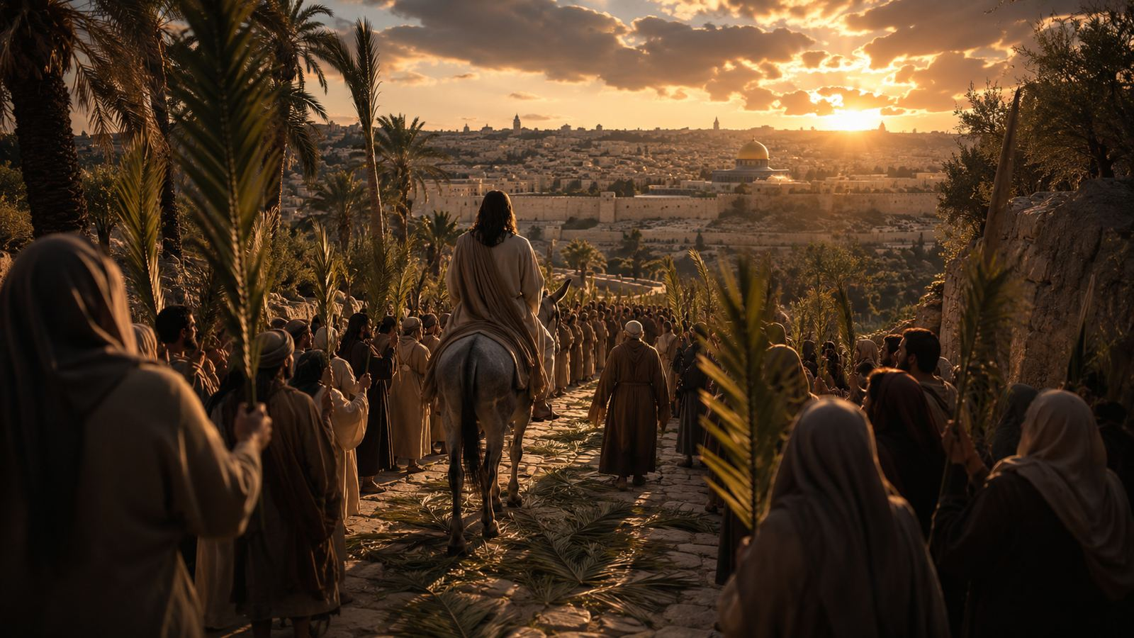
PALM SUNDAY TEACHING GUIDE
Lift High The Triumph Song Today
Following Christ from Olivet to Calvary
Ernest F. McGregor • 1932 • Tune: SUOMI • Matthew 21:9
Prepared for teaching and small group use - hymninfo.com

Slide 2

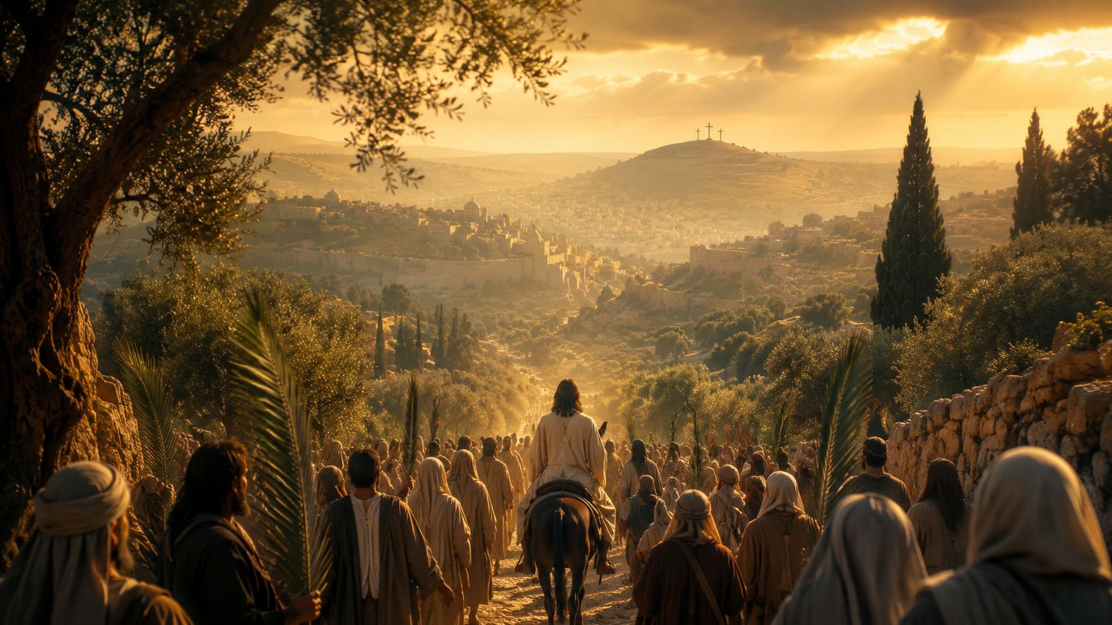
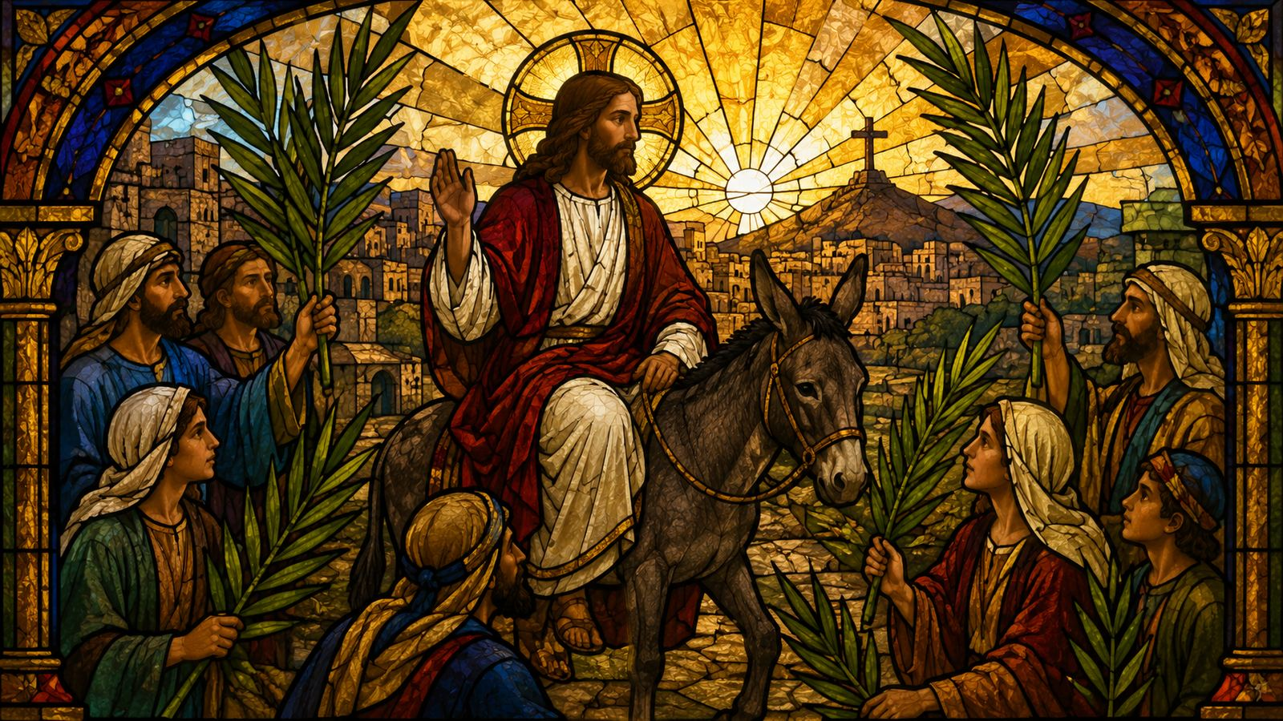
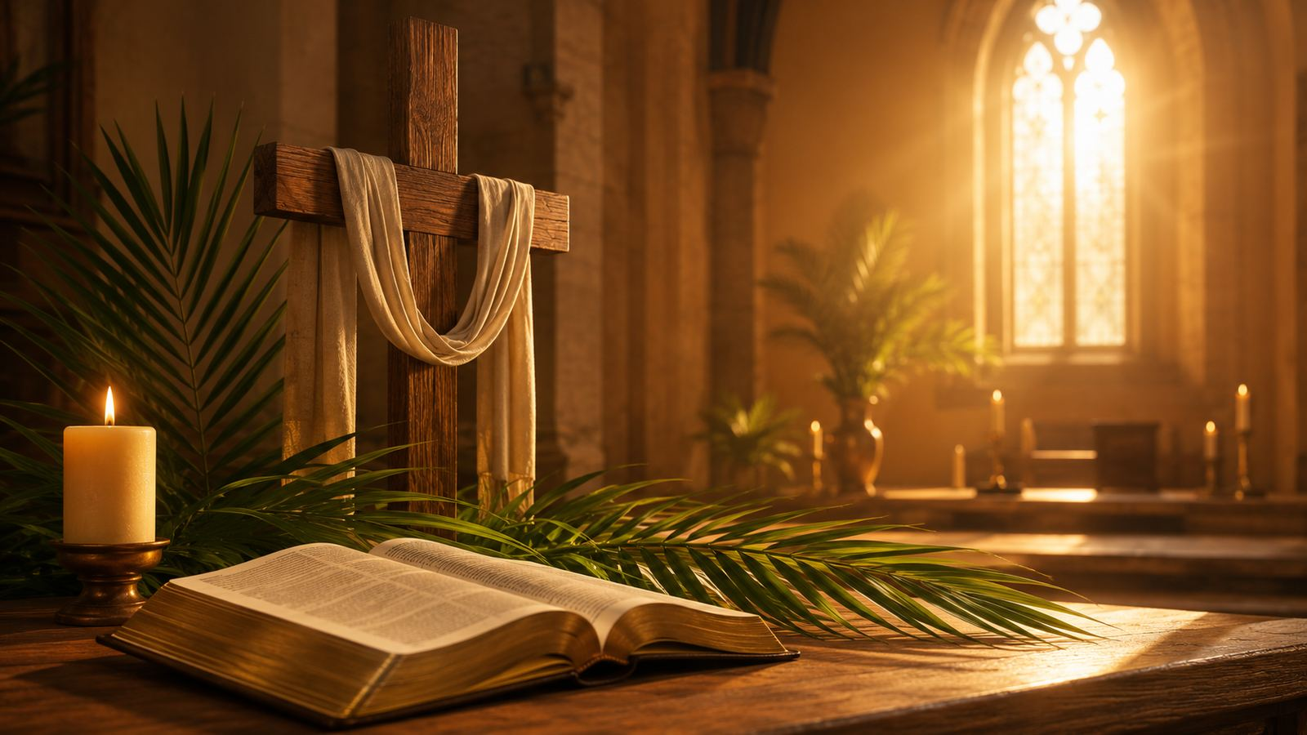
Teaching Aim
What learners should understand, feel, and practice
UNDERSTAND
FEEL
PRACTICE
Palm Sunday praise points toward the cross, not away from it.
The solemn joy of following a humble King who brings peace by sacrifice.
Welcome Christ not only with song, but with surrendered hearts and faithful obedience.
Prepared for teaching and small group use - hymninfo.com

Slide 3
Hymn Identity
Key facts for teaching and worship planning
TITLE
Lift High The Triumph Song Today
OPENING
a Palm Sunday call to lift the triumph song
TEXT
Ernest F. McGregor, 1932
TUNE
SUOMI, a Finnish cavalry march
THEME
Christ’s sacrificial kingship
PRIMARY SCRIPTURE
Matthew 21:9
The hymn belongs to the Palm Sunday tradition of processional praise, but it refuses to separate the hosannas of the crowd from the road to Calvary.
Prepared for teaching and small group use - hymninfo.com

Slide 4
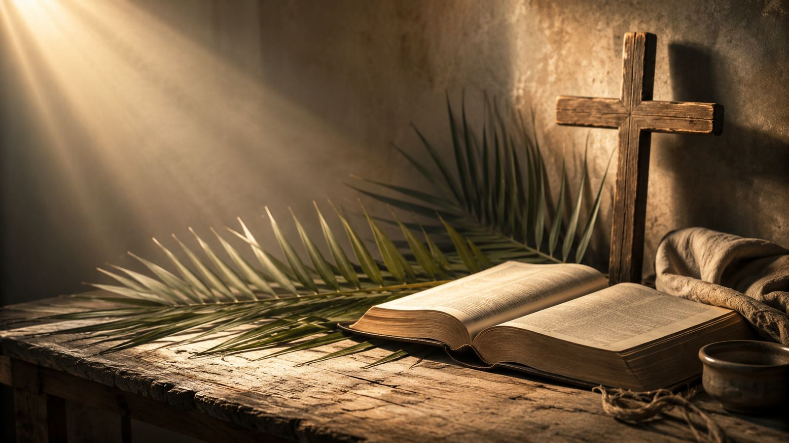
Historical Background
A Palm Sunday hymn from the early twentieth century
Ernest F. McGregor served as a Congregational minister in Connecticut.
The text first appeared in 1932 and became associated with Palm Sunday processions.
Its route from Olivet to Calvary gives the hymn both movement and theological weight.
The tune SUOMI brings sturdy, processional energy; some hymnals use a quieter LMD setting.
Prepared for teaching and small group use - hymninfo.com

Slide 5
Why This Hymn Matters Today
Palm branches, praise, and the road of obedience
AGAINST SHALLOW PRAISE
AGAINST FALSE POWER
It teaches that acclamation without surrender is incomplete.
It shows Christ’s majesty in humility rather than display.
FOR HOLY WEEK
FOR DISCIPLESHIP
It prepares the church to hold Palm Sunday and Good Friday together.
It asks whether Christ’s peace will rule the heart.
Prepared for teaching and small group use - hymninfo.com

Slide 6
Biblical Foundation
Praise, prophecy, peace, and the cross
MATTHEW 21:9
Hosanna to the Son of David
ZECHARIAH 9:9
The lowly King comes with salvation
ISAIAH 9:6
The promised Prince of Peace
PHILIPPIANS 2:8
Obedient even to death on a cross
Palm Sunday praise is true only when it follows the King all the way to the cross.
Prepared for teaching and small group use - hymninfo.com

Slide 7
The Road of the Hymn
From outward procession to inward surrender
Prepared for teaching and small group use - hymninfo.com

Slide 8
Hymn Section 1
The triumph song begins on a road
The congregation joins the Palm Sunday movement toward Jerusalem.
The hymn names the geography of Holy Week: Olivet, Calvary, and the path between them.
The teacher’s emphasis: celebration must learn where Christ is going.
Teaching focus: Christian praise follows the King, even when the path leads through sacrifice.
Prepared for teaching and small group use - hymninfo.com

Slide 9
Hymn Section 2
A King without worldly pomp
The hymn contrasts Christ’s kingship with worldly pride and display.
His nearness and self-giving presence define his reign.
Teaching emphasis: true majesty appears in humble service.
Prepared for teaching and small group use - hymninfo.com

Slide 10

Hymn Section 3
The King’s throne in the heart
The hymn turns from the public road to the interior life.
Palm Sunday praise becomes a prayer for Christ to reign within.
The final movement asks for life itself to become praise.
Prepared for teaching and small group use - hymninfo.com

Slide 11
Central Response
A procession that becomes discipleship
1
Sing
2
Follow
3
Yield
Praise the King who comes in God’s name.
Walk the road from triumph to cross.
Let the Prince of Peace reign within.
Prepared for teaching and small group use - hymninfo.com

Slide 12
Theological Themes
Christ’s humble victory forms the church’s praise and practice
Prepared for teaching and small group use - hymninfo.com

Slide 13
Theological Themes
Doctrines and practices carried by the hymn
SACRIFICIAL KINGSHIP
PEACE
DISCIPLESHIP
Christ reigns by giving himself.
His peace comes through costly obedience.
The church follows the road of its Lord.
WORSHIP
HUMILITY
HOLY WEEK
Praise is joined to surrender.
Majesty is revealed without pride.
Palm Sunday opens into the Passion.
Prepared for teaching and small group use - hymninfo.com

Slide 14
Literary and Musical Observations
Movement, tension, and congregational energy
The text moves geographically: Olivet, Calvary, and the heart.
The language of triumph is held in tension with suffering and death.
SUOMI gives a strong processional pulse; LMD offers a quieter congregational character.
A steady tempo keeps the hymn solemn without losing forward motion.
Prepared for teaching and small group use - hymninfo.com

Slide 15
Pastoral and Worship Use
Where this hymn can serve the church
PALM SUNDAY PROCESSION
Use near the opening to gather the congregation into the Holy Week road.
CHOIR OR CONGREGATION
Teach the tune ahead if unfamiliar; let the words be clear.
HOLY WEEK TEACHING
Pair with Matthew 21 and Philippians 2 for cross-centered discipleship.
PASTORAL PRAYER
Use the closing petition as a prayer for Christ’s reign in the heart.
Prepared for teaching and small group use - hymninfo.com

Slide 16
Application and Lesson Flow
Turning Palm Sunday praise into faithful practice
PRACTICE THIS WEEK
SUGGESTED LESSON FLOW
Name one rival throne in your heart.
Practice one hidden act of humble service.
Pray daily: “Prince of Peace, reign in me.”
30 minutes: Scripture, hymn movement, discussion, prayer.
60 minutes: add history, tune comparison, application planning, and group prayer.
CLOSING QUESTION
Will we only welcome Christ in song, or will we follow him in the way of peace?
Prepared for teaching and small group use - hymninfo.com

Slide 17
Closing Summary and Prayer
Lift the song. Follow the road. Yield the throne.
Prepared for teaching and small group use - hymninfo.com

Slide 18
Prayer
A pastoral close for teaching or worship
Lord Jesus Christ, Prince of Peace, receive our praise and rule our hearts. Lead us beyond easy acclamation into faithful discipleship. Teach us to follow your humble road and to find true triumph in your cross. Amen.
© HymnInfo.com. Free for personal, church, classroom, and small-group teaching use. Please do not sell, repost, or redistribute as downloadable files without permission.
Prepared for teaching and small group use - hymninfo.com

