Slide 1

I Am Trusting Thee, Lord Jesus
Teaching Guide
A hymn of steady confidence, grace, and lifelong dependence on Christ
I am trusting thee, Lord Jesus
Frances Ridley Havergal, 1874 • Tune: BULLINGER • Primary Scripture: 2 Timothy 1:12
Prepared for teaching and small group use - hymninfo.com

Slide 2

Teaching Aim
What learners should understand, feel, and practice
1
2
3
UNDERSTAND
FEEL
PRACTICE
Christ is sufficient for pardon, cleansing, guidance, and strength.
The settled peace that comes from entrusting the whole self to Jesus.
A daily pattern of committing each decision, need, and weakness to Christ.
Lesson direction: trust is not vague optimism; it is personal reliance on the Lord Jesus in every part of salvation and discipleship.
Prepared for teaching and small group use - hymninfo.com

Slide 3

Hymn Identity
Key facts for teaching and worship planning
Title
I Am Trusting Thee, Lord Jesus
First line
I am trusting thee, Lord Jesus
Writer
Frances Ridley Havergal (1836-1879)
Date
1874; later published in Loyal Responses
Tune commonly used
BULLINGER
Composer
Ethelbert William Bullinger (1837-1913)
Central theme
complete reliance on Christ
Prepared for teaching and small group use - hymninfo.com

Slide 4
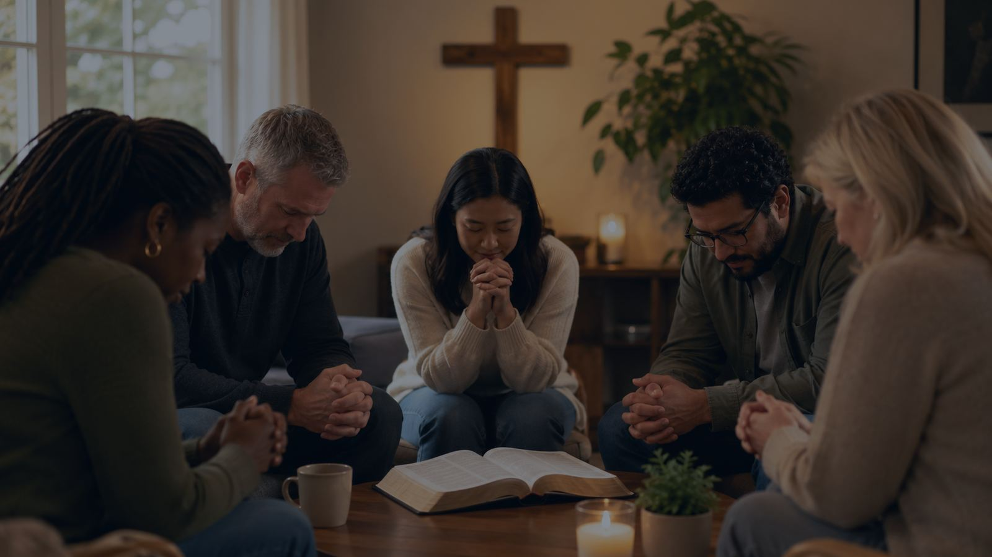
Historical Background
Frances Ridley Havergal and a hymn of consecrated trust
• Frances Ridley Havergal was an English Anglican hymn writer known for direct, devotional texts of consecration and assurance.
• This hymn was written in 1874 during a period of earnest spiritual reflection and commitment.
• The text speaks in the first person, making trust in Christ a present-tense prayer rather than a general idea.
• The tune BULLINGER, associated with Ethelbert W. Bullinger, supports the hymn with a simple, prayerful musical frame.
Teaching caution: focus on well-attested biographical and hymnal facts; do not turn the hymn into an unsupported origin story.
Prepared for teaching and small group use - hymninfo.com

Slide 5
Why This Hymn Matters Today
A prayer for anxious, weary, and growing disciples
For the anxious
Trust shifts the heart from self-protection to Christ’s keeping power.
For the guilty
The hymn places pardon and cleansing in Christ, not in personal repair work.
For the serving
It asks Christ for words, power, and daily supply for faithful witness.
For worship
The whole congregation can sing a shared confession of dependence.
Prepared for teaching and small group use - hymninfo.com

Slide 6

Biblical Foundation
Trusting Christ with what we cannot keep ourselves
2 Timothy 1:12
The believer entrusts life to Christ, who is able to guard it.
Proverbs 3:5-6
Trust rejects self-reliance and acknowledges the Lord in all ways.
Hebrews 12:2
Faith looks to Jesus, the author and perfecter of faith.
Psalm 37:5
The faithful commit their way to the Lord.
Isaiah 26:3-4
Steadfast trust rests in the everlasting Rock.
Trust is biblical when it is directed toward the Lord who saves, guides, sustains, and keeps his people.
Prepared for teaching and small group use - hymninfo.com

Slide 7

Section Study 1
Trusting Christ for Full Salvation
Teaching Emphasis
The hymn opens by placing the whole work of salvation in the hands of Jesus. It is not half-trust or partial surrender; it is complete reliance on grace.
Scripture Connections
• Ephesians 2:8-10
• 2 Timothy 1:12
• Ask: What would it look like to entrust this area to Christ this week?
Prepared for teaching and small group use - hymninfo.com

Slide 8
Section Study 2
Trusting Christ for Pardon
Teaching Emphasis
The singer bows as one who needs mercy. Trust becomes repentance, humility, and confidence that Christ receives sinners.
Scripture Connections
• Psalm 37:5
• Romans 5:1
• Ask: What would it look like to entrust this area to Christ this week?
Prepared for teaching and small group use - hymninfo.com

Slide 9
Section Study 3
Trusting Christ for Cleansing
Teaching Emphasis
The hymn moves from pardon to holiness. Christ not only forgives guilt; he makes his people clean and forms them for obedient life.
Scripture Connections
• 1 John 1:7
• Hebrews 12:2
• Ask: What would it look like to entrust this area to Christ this week?
Prepared for teaching and small group use - hymninfo.com

Slide 10
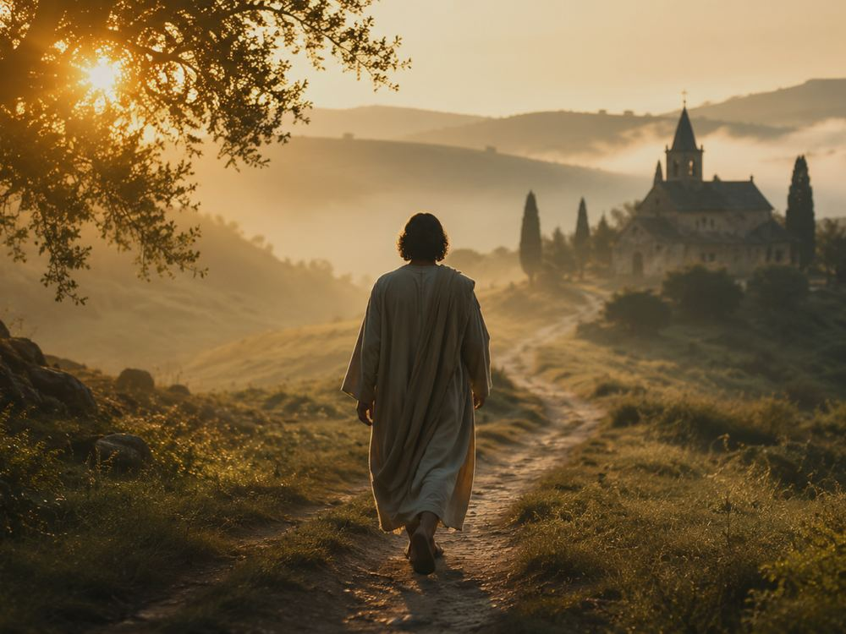
Section Study 4
Trusting Christ to Guide
Teaching Emphasis
The Christian life is lived one day and one hour at a time. The hymn teaches dependence for direction, wisdom, and daily supply.
Scripture Connections
• Proverbs 3:5-6
• Isaiah 26:3-4
• Ask: What would it look like to entrust this area to Christ this week?
Prepared for teaching and small group use - hymninfo.com

Slide 11
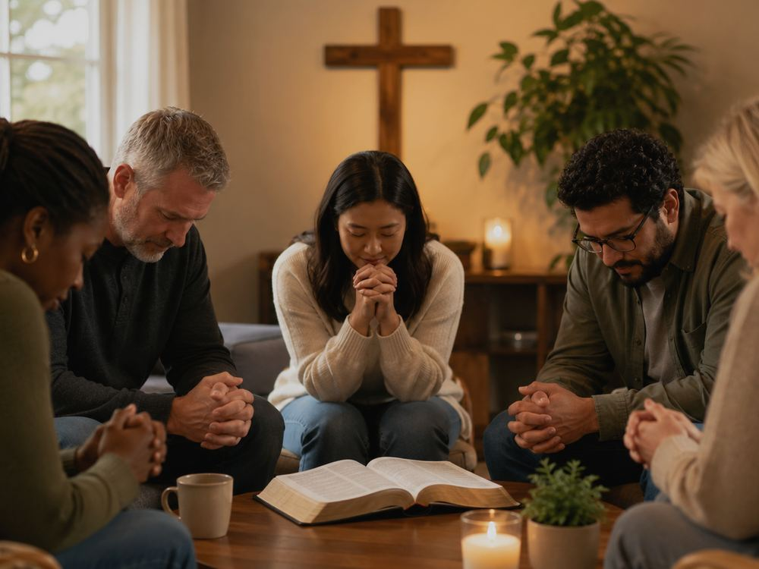
Section Study 5
Trusting Christ for Power
Teaching Emphasis
Weak servants need words, courage, and perseverance. The hymn places Christian usefulness in the Lord’s unfailing strength.
Scripture Connections
• 2 Corinthians 12:9
• Psalm 37:5
• Ask: What would it look like to entrust this area to Christ this week?
Prepared for teaching and small group use - hymninfo.com

Slide 12
Section Study 6
Trusting Christ Forever and for All
Teaching Emphasis
The closing movement gathers the whole life into Christ’s keeping. The prayer is simple: do not let me fall; keep me to the end.
Scripture Connections
• 2 Timothy 1:12
• Jude 24-25
• Ask: What would it look like to entrust this area to Christ this week?
Prepared for teaching and small group use - hymninfo.com

Slide 13
Theological Themes
What the hymn teaches clearly
Grace
Assurance
Sanctification
1
2
3
salvation as gift, not achievement
Christ can keep what we commit to him
pardon leads to cleansing and holiness
Guidance
Dependence
Perseverance
4
5
6
daily direction comes from the Lord
weakness drives believers toward Christ
trust stretches from today into forever
Prepared for teaching and small group use - hymninfo.com

Slide 14
Literary and Musical Observations
Why the hymn sings so directly
• The repeated first-person pattern makes the hymn a sustained prayer of reliance.
• Each section names one concrete need: salvation, pardon, cleansing, guidance, power, and keeping grace.
• The compact tune BULLINGER supports a meditative rather than theatrical style.
• The best congregational tempo is steady and unhurried, with clear phrasing and gentle confidence.
Prepared for teaching and small group use - hymninfo.com

Slide 15
Pastoral and Worship Use
Where this hymn can serve the church
Assurance
after a sermon on faith or Christ’s keeping power
Consecration
at the close of a service calling for renewed surrender
Prayer meeting
as a sung prayer before intercession
Pastoral care
with those who feel weak, guilty, or afraid
Choir rehearsal
to teach text clarity and gentle confidence
Discipleship
as a weekly confession of dependence
Prepared for teaching and small group use - hymninfo.com

Slide 16
Teaching Questions
Move from observation to obedience
1
What specific needs does the hymn place before Christ?
2
How is biblical trust different from mere optimism?
3
Why does the hymn move from salvation to daily guidance and power?
4
Which section names the area where you most need Christ’s help now?
5
How can a congregation sing this hymn without making trust sound easy or painless?
6
What practice could help you commit your way to the Lord this week?
Prepared for teaching and small group use - hymninfo.com

Slide 17
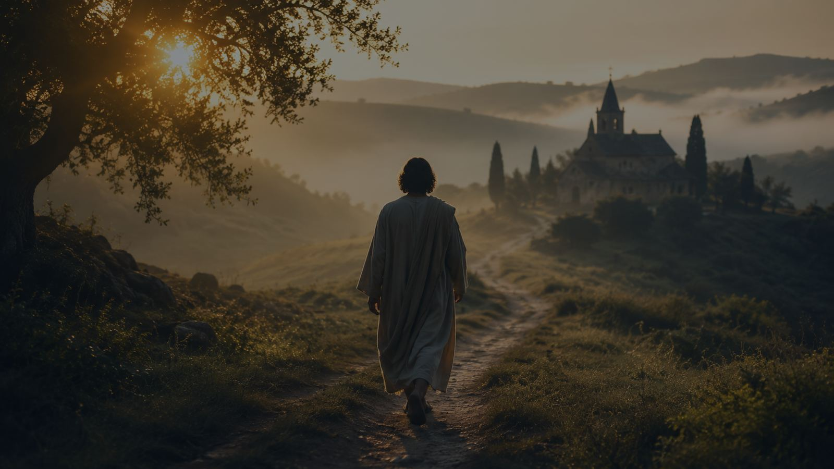
Suggested Lesson Flow
Two ready-to-use teaching paths
30-Minute Plan
60-Minute Plan
5 min
Read 2 Timothy 1:12 and introduce the hymn.
10 min
Opening reflection: where is trust hardest right now?
10 min
Teach Havergal’s context and the meaning of trust.
15 min
Historical background and biblical foundation.
10 min
Walk through salvation, pardon, guidance, and keeping grace.
20 min
Section-by-section teaching with Scripture connections.
5 min
Close with prayer and one weekly practice.
10 min
Small-group discussion and testimony.
5 min
Prayer of commitment and singing.
Prepared for teaching and small group use - hymninfo.com

Slide 18
Closing Summary and Prayer
This hymn teaches the church to entrust the whole life to Jesus: the beginning of salvation, the growth of holiness, the work of service, and the final keeping of the soul.
Lord Jesus, teach us to trust you with what we cannot save, cleanse, guide, strengthen, or keep by ourselves. Make our faith honest, our obedience willing, and our confidence settled in your mercy. Amen.
© HymnInfo.com. Free for personal, church, classroom, and small-group teaching use. Please do not sell, repost, or redistribute as downloadable files without permission.
Prepared for teaching and small group use - hymninfo.com

