Slide 1
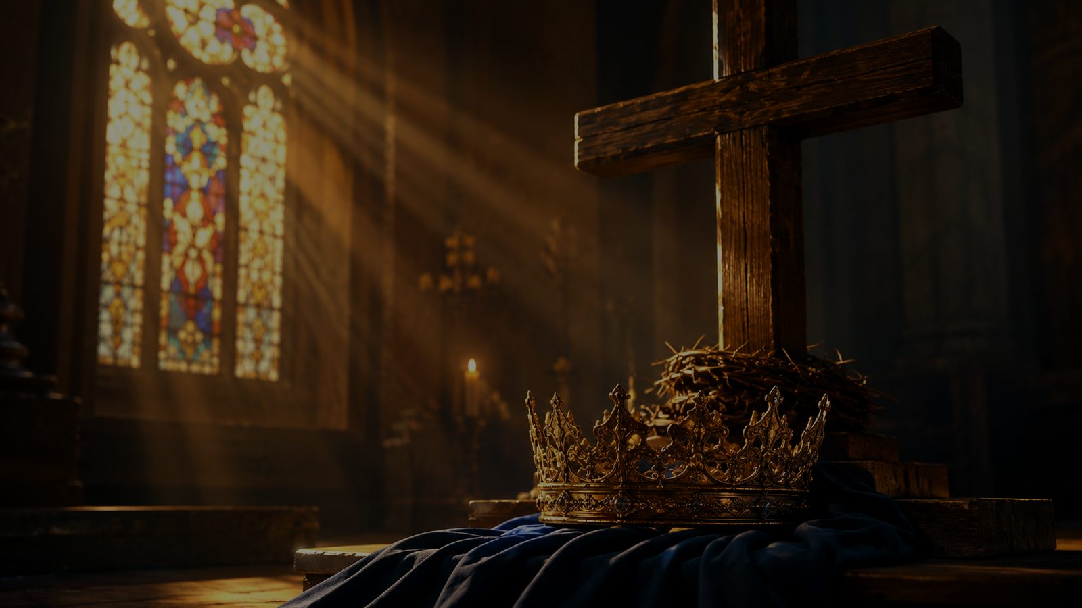
At Calvary
A hymn study on grace, pardon, and liberty at the cross
First line: Years I spent in vanity and pride
Words: William Reed Newell • Music: Daniel Brink Towner
1895 • Primary Scripture: Romans 5:20-21
Prepared for teaching and small group use - hymninfo.com

Slide 2

Teaching Aim
What this study should form in learners
Understand
Grace is not earned by moral repair; it is received at Calvary through Christ.
Feel
The cross exposes sin without crushing hope, because mercy is greater than guilt.
Practice
Move from self-reliance to confession, surrender, gratitude, and public witness.
Prepared for teaching and small group use - hymninfo.com

Slide 3

Hymn Identity
A gospel song shaped for testimony and congregational singing
Title
First line
At Calvary
Years I spent in vanity and pride
Text
Tune
William Reed Newell (1868-1956)
CALVARY
Music
Date
Daniel Brink Towner (1850-1919)
1895
Central movement
Primary theme
Conviction → pardon → surrender → wonder
Grace and liberty at the cross
Prepared for teaching and small group use - hymninfo.com

Slide 4

The Road to Calvary
The hymn’s story moves from pride to pardon, then from pardon to praise.
Prepared for teaching and small group use - hymninfo.com

Slide 5

Historical Background
Moody-era gospel song, written for clear evangelical teaching
William R. Newell served as a Bible teacher and leader at Moody Bible Institute in Chicago.
Daniel B. Towner, a gospel music director and educator, supplied the tune that became inseparable from the text.
The hymn belongs to the American gospel song tradition: memorable refrain, direct testimony, and a clear appeal to the cross.
Its lasting use comes from the way it joins personal conversion language with sturdy doctrines of grace, pardon, and assurance.
history
song
cross
Prepared for teaching and small group use - hymninfo.com

Slide 6
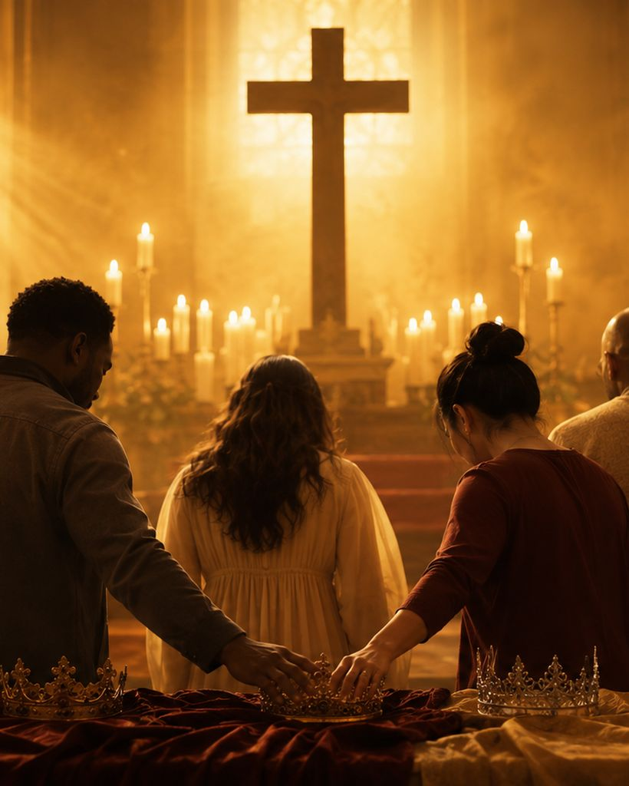
Why This Hymn Matters Today
It gives the church honest words for sin and strong words for grace.
It names self-reliance and pride without pretending they are harmless.
It shows the Word of God as both a mirror that exposes sin and a guide that leads to mercy.
It teaches that pardon is not vague optimism; it is grounded in Christ crucified.
It helps congregations sing testimony with clarity: mercy was great, grace was free, and the soul found liberty.
mercy
grace
liberty
Prepared for teaching and small group use - hymninfo.com

Slide 7
Biblical Foundation
The hymn rests on the gospel of the cross
Luke 23:33
Romans 5:20-21
Christ is crucified at the place called The Skull.
Where sin increased, grace abounded more exceedingly.
Galatians 6:14
Ephesians 2:8-9
The believer’s only boast is the cross of Jesus Christ.
Salvation is God’s gift, not human achievement.
Prepared for teaching and small group use - hymninfo.com

Slide 8
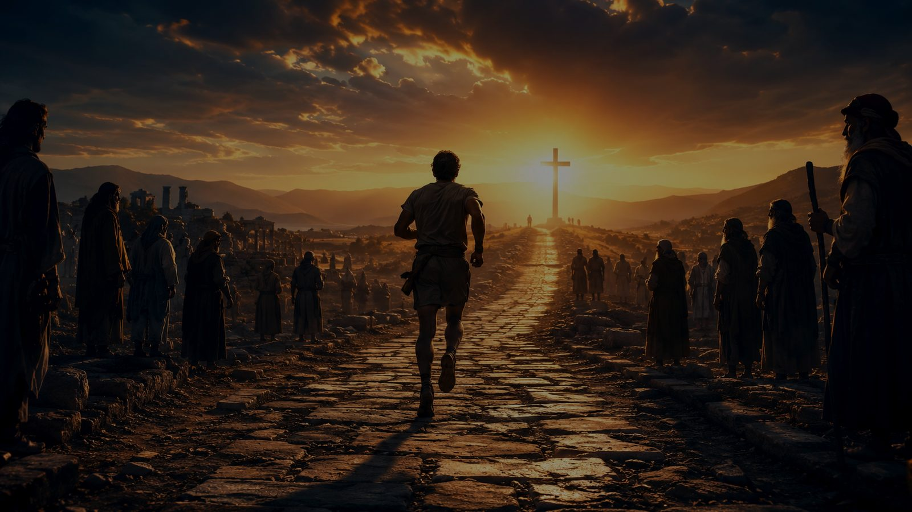
From Pride to Grace
The hymn walks the singer through conversion, confession, and wonder.
Prepared for teaching and small group use - hymninfo.com

Slide 9

Hymn Section 1
Self-reliance before the cross
The hymn begins with the honesty of a life centered on self and unaware of Christ’s personal mercy.
The first movement is not sentimental; it remembers ignorance, pride, and the failure to see the meaning of the cross.
Teaching emphasis: the gospel begins by telling the truth about sin so that grace can be received as grace.
blindness
Calvary
mercy
Prepared for teaching and small group use - hymninfo.com

Slide 10

Hymn Section 2
Conviction by the Word
The second movement brings Scripture into view: God’s Word awakens the conscience and reveals sin.
The law is not treated as an enemy; it exposes the need that only Christ can answer.
Teaching emphasis: conviction should lead the guilty soul toward the Savior, not toward despair.
Word
law
turn
Prepared for teaching and small group use - hymninfo.com

Slide 11
Hymn Section 3
Surrender and joyful confession
The hymn then moves from pardon to allegiance: the forgiven believer gladly owns Christ as King.
The song of the soul is no longer self-defense but grateful praise.
Teaching emphasis: grace does not leave the heart unchanged; mercy produces surrender, worship, and obedience.
King
joy
praise
Prepared for teaching and small group use - hymninfo.com

Slide 12
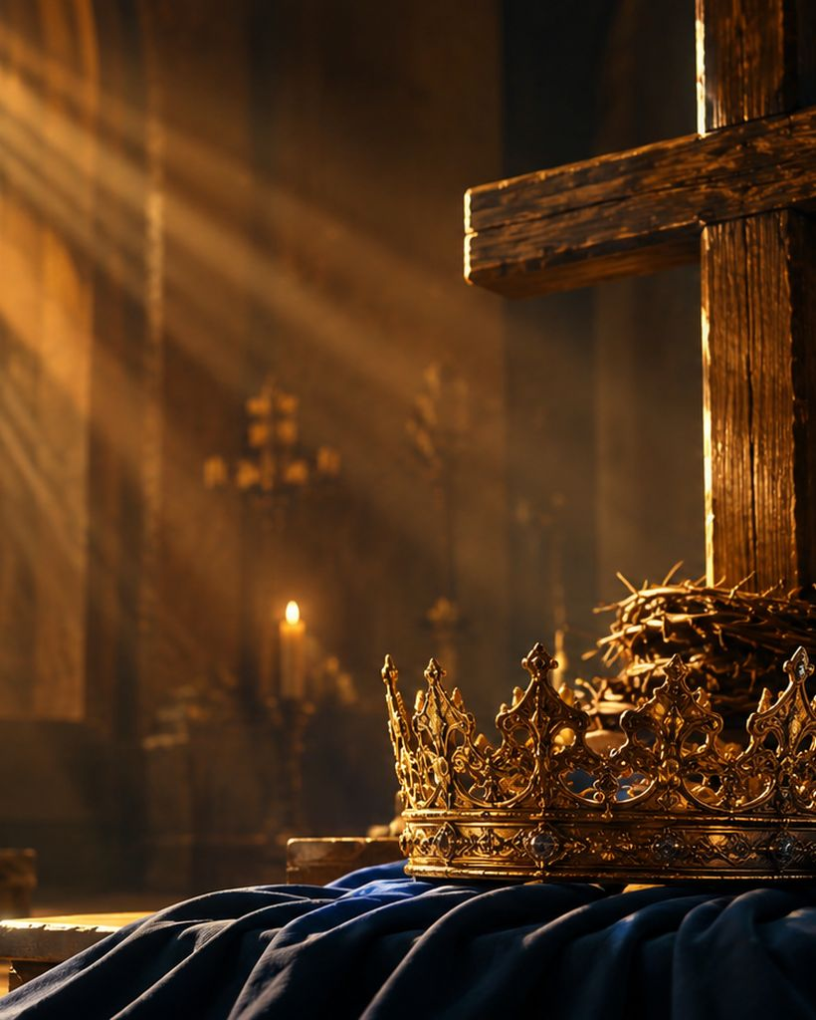
Hymn Section 4
Wonder at the love of God
The final movement widens from personal testimony to adoration of God’s saving plan.
The cross is presented as the bridge over the gulf between holy God and sinful humanity.
Teaching emphasis: mature faith does not move past Calvary; it grows deeper in wonder there.
bridge
cross
wonder
Prepared for teaching and small group use - hymninfo.com

Slide 13
The Refrain’s Gospel Center
Mercy, grace, pardon, and liberty belong together.
Mercy
Grace
Pardon
Liberty
God meets the guilty with compassion instead of abandonment.
The gift is free because Christ bears the cost.
Forgiveness is personal, abundant, and received by faith.
The burdened soul is released from condemnation to serve Christ gladly.
Prepared for teaching and small group use - hymninfo.com

Slide 14
Theological Themes
Four doctrines sung in plain gospel language
Sin and Pride
Conviction
Grace and Pardon
The hymn refuses shallow comfort by naming the sinner’s condition honestly.
God’s Word reveals sin and moves the heart toward the cross.
Salvation is received as gift, not achieved by religious performance.
Assurance and Liberty
Surrender
Wonder
The forgiven soul rests in Christ and sings with confidence.
Christ’s kingship calls for the whole life, not only a private feeling.
The final note is adoration of the love that planned salvation.
Prepared for teaching and small group use - hymninfo.com

Slide 15
Literary Movement
The hymn preaches through testimony
Memory: it looks back on a life lived apart from the meaning of the cross.
Conviction: the Word of God interrupts self-deception.
Conversion: the guilty soul turns toward Calvary for pardon.
Consecration: the forgiven singer gladly belongs to Christ.
Doxology: the hymn ends in wonder at the love and grace of God.
Prepared for teaching and small group use - hymninfo.com

Slide 16
Musical Observations
A gospel-song tune built for congregational testimony
The tune CALVARY supports the text with direct, memorable melodic motion.
The refrain is the emotional and theological center; let it sound confident but not rushed.
Choirs can shape the stanzas as a testimony and invite the congregation to sing the refrain strongly.
The hymn works best when the tempo carries the joy of liberty without losing reverence for the cross.
melody
phrase
message
Prepared for teaching and small group use - hymninfo.com

Slide 17
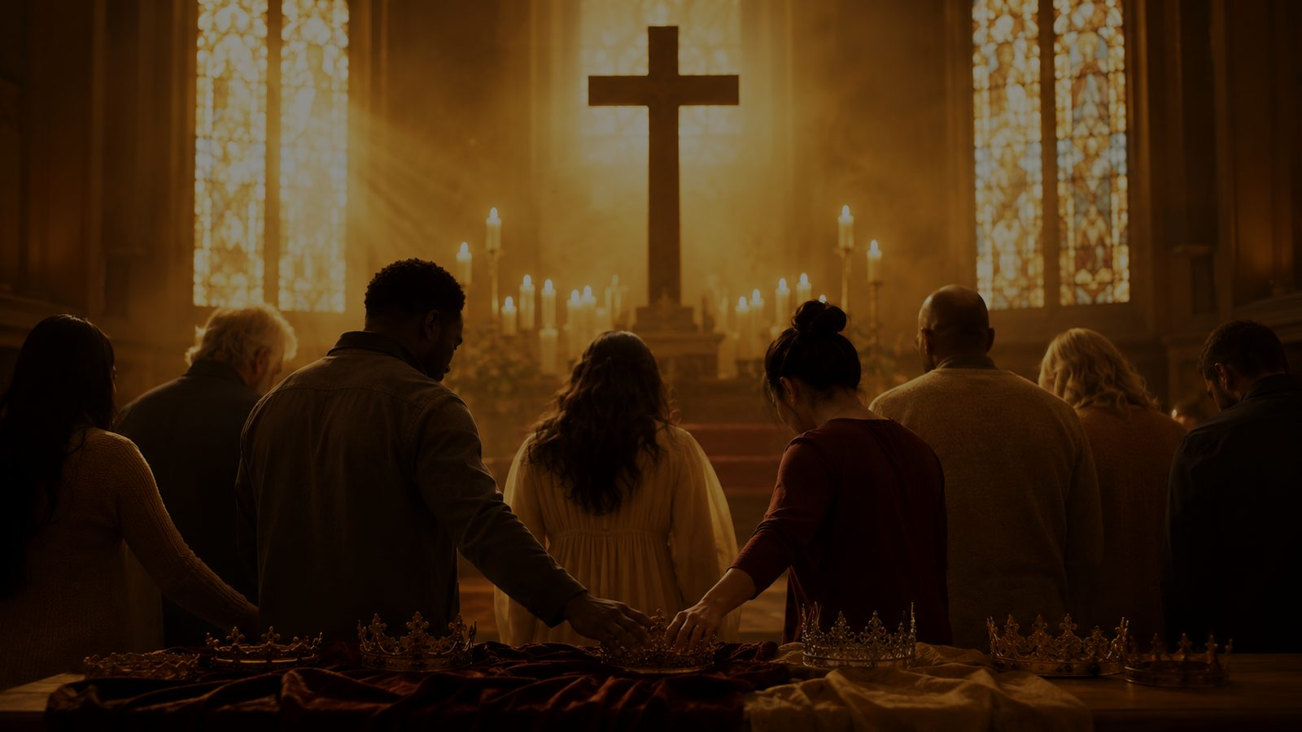
Pastoral and Worship Use
Where the hymn serves the church well
Evangelistic teaching
Lent or Good Friday
Communion preparation
Clear movement from guilt to pardon.
Focused attention on the cross.
Grateful remembrance of Christ’s saving work.
Testimony services
Assurance after confession
Discipleship classes
Personal language without losing doctrine.
Pardon and liberty are sung with confidence.
Grace leads to surrender and worship.
Prepared for teaching and small group use - hymninfo.com

Slide 18
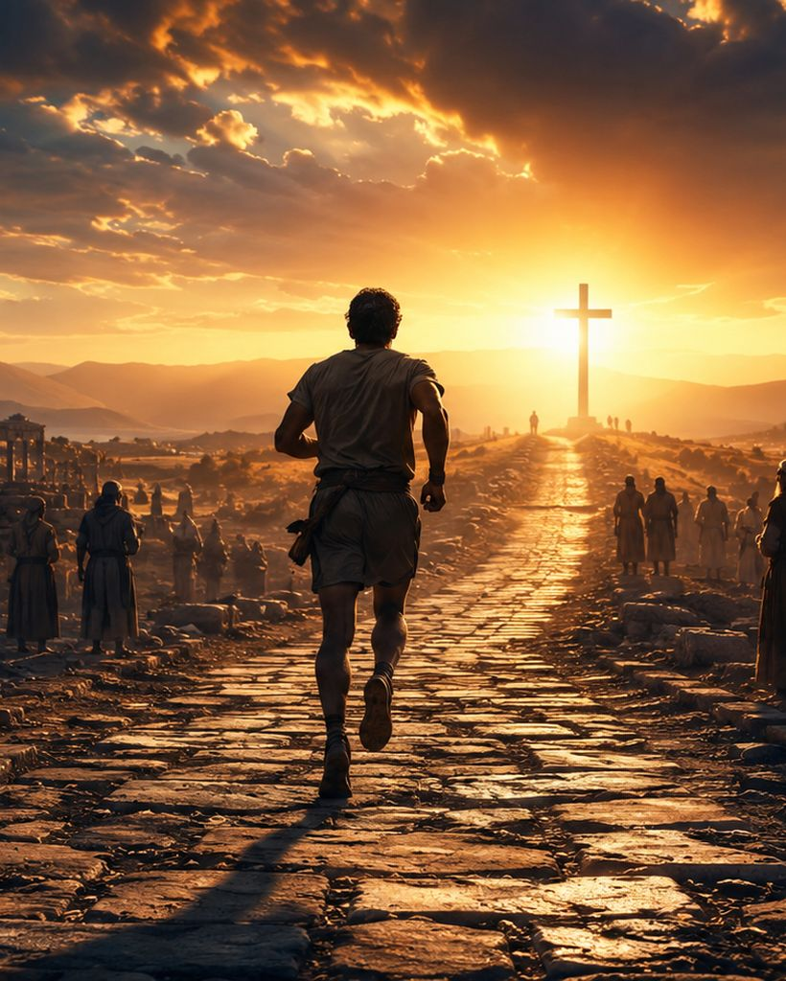
Teaching Questions
Use these to open discussion after singing
What difference is there between regret and true conviction before God?
How does Romans 5:20-21 deepen the refrain’s confidence in grace?
Why is liberty at the cross different from simply feeling better about ourselves?
What part of the hymn best names your own testimony?
How can a congregation sing this hymn without turning it into mere nostalgia?
Prepared for teaching and small group use - hymninfo.com

Slide 19
Application
Four ways to respond this week
Confess honestly
Receive freely
Surrender gladly
Witness humbly
Name pride, self-defense, and hidden sin before God.
Rest in grace rather than bargaining with God.
Ask where Christ’s kingship should reshape daily habits.
Tell the story of mercy without boasting in yourself.
Prepared for teaching and small group use - hymninfo.com

Slide 20
Suggested 30-Minute Lesson Flow
A compact plan for Sunday school or choir rehearsal
0-5 min — Sing or read the refrain and identify its four gospel words.
1
5-10 min — Read Romans 5:20-21 and Ephesians 2:8-9.
2
10-18 min — Walk through the hymn’s movement: pride, conviction, pardon, surrender, wonder.
3
18-25 min — Discuss one question: What burden does Calvary remove?
4
25-30 min — Pray in thanksgiving for mercy and grace.
5
Prepared for teaching and small group use - hymninfo.com

Slide 21
Suggested 60-Minute Lesson Flow
A fuller plan for hymn study and discussion
0-8
8-15
Opening reflection and prayer
Hymn identity and Moody-era context
15-25
25-40
Scripture study: Luke 23, Romans 5, Galatians 6, Ephesians 2
Hymn-section study: from pride to wonder
40-50
50-60
Pastoral application: assurance, surrender, witness
Sing, summarize, and close in prayer
Prepared for teaching and small group use - hymninfo.com

Slide 22
Closing Summary
Calvary is where the burdened soul finds liberty.
The hymn begins with human pride and ends with divine love.
It teaches that conviction is a mercy when it leads us to Christ.
It gives congregations words for grace that is free, pardon that is abundant, and liberty that is real.
It sends worshipers away not boasting in themselves, but praising the Savior who meets sinners at the cross.
Prepared for teaching and small group use - hymninfo.com

Slide 23
Closing Prayer
Lord Jesus Christ, bring us again to Calvary. Strip away pride, awaken honest confession, and teach us to receive the mercy we cannot earn. Let your grace free burdened souls, make our worship grateful, and send us to live as forgiven people. Amen.
© HymnInfo.com. Free for personal, church, classroom, and small-group teaching use. Please do not sell, repost, or redistribute as downloadable files without permission.
Prepared for teaching and small group use - hymninfo.com

