Slide 1

Some Glorious Morning Sorrow Will Cease
Also known as "Some Golden Daybreak"
A hymn study on Christian hope, comfort, and the promised return of Christ
Charles A. Blackmore · Carl A. Blackmore · 1934
1 Thessalonians 4:16–17
Prepared for teaching and small group use - hymninfo.com

Slide 2
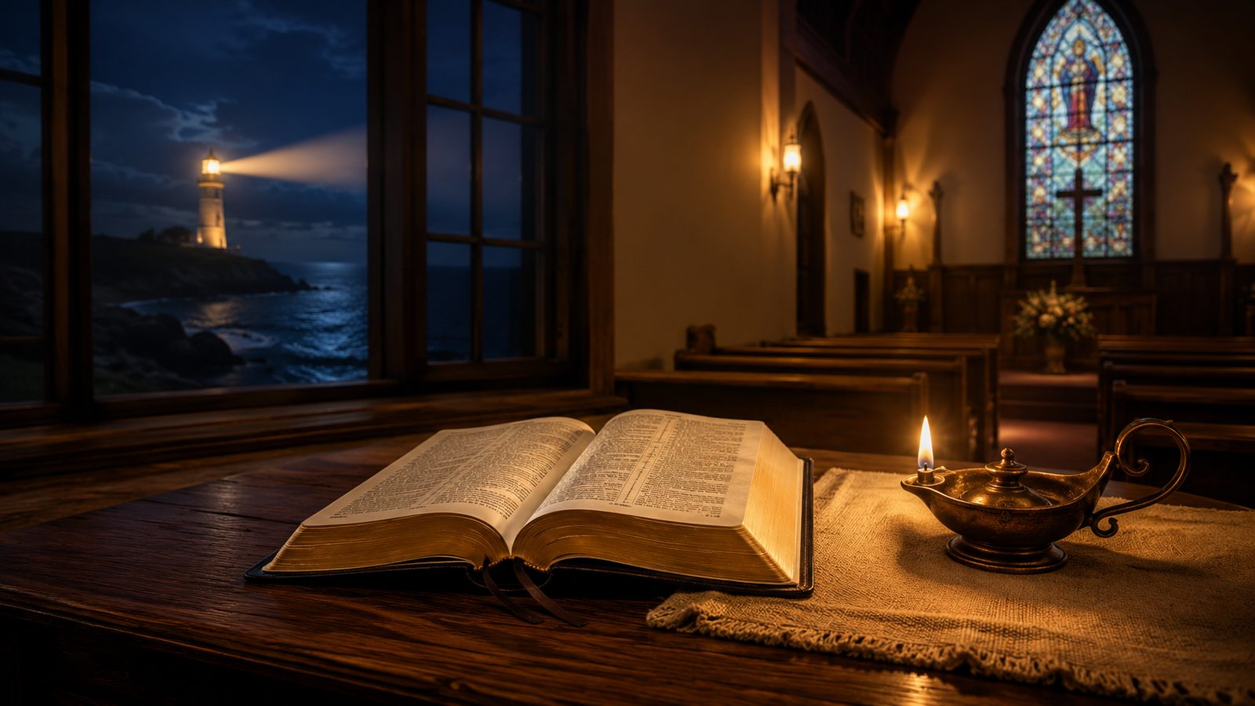
Teaching Aim
What this lesson should form in the church
☀
Understand
❤
Feel
✦
Practice
Christ’s return is the believer’s blessed hope, not a vague religious comfort.
Let grief be honest while anchoring sorrow in resurrection promise.
Comfort one another with Scripture, readiness, and steady hope.
Teach the hymn as pastoral hope: not escape from pain, but confidence in the Lord who will come.
Prepared for teaching and small group use - hymninfo.com

Slide 3

Hymn Identity
A gospel song of daybreak after darkness
Title
Some Glorious Morning Sorrow Will Cease
• A song for grief, assurance, funerals, Advent hope, and teaching on the return of Christ.
• Its imagery moves from earthly sorrow to the dawn of eternal joy.
• The repeated daybreak image keeps the focus on Jesus rather than on speculation.
Refrain title
Some Golden Daybreak
First line
Some glorious morning sorrow will cease
Text
Charles A. Blackmore
Music
Carl A. Blackmore
Date
1934
Primary theme
Christ’s return and final comfort
Prepared for teaching and small group use - hymninfo.com

Slide 4
Historical Setting
Father and son, mission work, and gospel hope
• Charles A. Blackmore served in rescue-mission work in Erie, Pennsylvania.
• Carl A. Blackmore composed the music and refrain; Charles wrote the verses.
• The song entered gospel use in 1934 and traveled through radio ministry and songbooks.
• Its enduring appeal comes from pastoral comfort: Christ will come, sorrow will cease, and God’s people will be gathered to him.
Use the background story as a pastoral window, then let Scripture govern the hope being taught.
Prepared for teaching and small group use - hymninfo.com

Slide 5

Biblical Foundation
Christ will come · the dead will rise · the church will be with the Lord
Prepared for teaching and small group use - hymninfo.com

Slide 6
1 Thessalonians 4:16–17
The Lord himself will descend
This passage gives the hymn its strongest doctrinal center: the return of Christ, resurrection, gathering, and everlasting fellowship with the Lord.
Teaching emphasis
Let the class hear Paul’s purpose: “comfort one another.” This doctrine is not meant to feed fear, but to strengthen the weary and console the grieving.
• Comfort is rooted in an event God promises.
• The subject is not timing speculation; it is the Lord who comes.
• The church’s hope ends in being “with the Lord forever.”
Primary Text
Prepared for teaching and small group use - hymninfo.com

Slide 7
Revelation 21:4
The end of tears is God’s own promise
✧
Death will be no more
☂
Mourning will end
☀
The first things pass away
The hymn’s hope is not simply better circumstances; it is the removal of death itself.
Christian comfort honors sorrow because God promises to answer it fully.
The daybreak image points toward God’s new creation, where pain no longer rules.
Pastoral caution: do not use future hope to silence present grief. Let the promise strengthen love, patience, and prayer.
Prepared for teaching and small group use - hymninfo.com

Slide 8
1 Corinthians 15 and Titus 2
Changed in hope, waiting in faith
Bodily hope
Watchful hope
The resurrection promise reaches the whole person. Aging, sickness, and death do not get the final word over those who belong to Christ.
Titus calls the appearing of Christ the “blessed hope.” The church waits with worship, mission, holiness, and compassion.
1 Corinthians 15:51–52
Titus 2:13
Prepared for teaching and small group use - hymninfo.com

Slide 9
The Hymn’s Movement
Sorrow · Daybreak · Victory · Reunion
Prepared for teaching and small group use - hymninfo.com

Slide 10
Section 1: Present Sorrow
The hymn begins where many people live
• The song does not deny grief, heartache, weakness, or struggle.
• It names a world where sorrow is felt deeply.
• This gives pastors a doorway into honest care rather than shallow cheerfulness.
Teaching emphasis
Before asking learners to sing about final victory, give them permission to tell the truth about present pain. Christian hope is not denial; it is confidence in a Savior stronger than sorrow.
Prepared for teaching and small group use - hymninfo.com

Slide 11
Section 2: The Daybreak
Hope becomes visible in Christ
☀
Morning after night
⚑
Victory in Jesus
✦
Personal comfort
The image of daybreak says that present darkness is temporary under God’s promise.
The return of Christ is sung as triumph over sin, death, and every enemy of God.
The hope is not abstract. It is for the weary believer, the grieving family, and the waiting church.
Avoid turning the hymn into timeline speculation. Keep the lesson centered on Christ’s promised appearing.
Prepared for teaching and small group use - hymninfo.com

Slide 12
Section 3: Changed and Satisfied
The gospel includes the redemption of the body
For the sick and aging
• Preach this hope at bedsides.
• Teach it carefully at funerals.
• Let the church learn to bless weak bodies with future promise.
The hymn’s hope speaks tenderly to bodies marked by weakness. Scripture promises not escape from embodiment, but resurrection life in Christ.
1 Corinthians 15
Prepared for teaching and small group use - hymninfo.com

Slide 13
Section 4: Reunion in Christ
Comfort one another with these words
The hope of reunion is precious, but it must remain centered in the Lord. Scripture says believers will be “with the Lord forever.”
Pastoral use
• Speak with tenderness.
• Avoid vague sentimentality.
• Let Christ’s resurrection carry the weight of the comfort.
1 Thessalonians 4:17–18
Prepared for teaching and small group use - hymninfo.com

Slide 14
Theological Themes
What the hymn teaches when sung carefully
Blessed hope
Final comfort
Bodily resurrection
The appearing of Jesus is the church’s promised morning.
God himself will answer sorrow, tears, and death.
Believers await transformation, not mere survival.
Watchful readiness
Christ-centered reunion
Pastoral courage
Hope should produce faithful living today.
Christian comfort ends with being with the Lord.
The church can speak hope where grief is deepest.
Prepared for teaching and small group use - hymninfo.com

Slide 15
Literary and Musical Observations
Why the song stays in the memory
• The contrast is simple: sorrowful night and golden morning.
• The refrain carries the strongest emotional lift.
• The gospel-ballad style supports testimony, comfort, and congregational memory.
Choir and worship note
Sing steadily and warmly. The song should sound confident without becoming hurried. Let the refrain feel like a shared confession, not a performance.
Prepared for teaching and small group use - hymninfo.com

Slide 16
Pastoral and Worship Use
Where this hymn serves the church well
✚
Funerals and memorials
☀
Advent and Second Coming
❤
Pastoral care
Use when the congregation needs to grieve with biblical hope.
Pair with preaching on watchfulness, promise, and blessed hope.
Use with the sick, aging, weary, and bereaved when spoken gently.
⚑
Testimony and assurance
♬
Choir or congregation
Help believers speak of victory without denying present struggle.
Let the refrain be clear, steady, and full of hope.
Prepared for teaching and small group use - hymninfo.com

Slide 17
Teaching Questions
Move from observation to application
• What kinds of sorrow does the hymn name or imply?
• How does the daybreak image help the church speak about the return of Christ?
• Why is bodily resurrection essential for Christian comfort?
• How can a believer be watchful without being fearful or speculative?
• What would it mean for our congregation to comfort one another with these words?
Prepared for teaching and small group use - hymninfo.com

Slide 18
Suggested Lesson Flow
Two ready-to-use teaching options
30 minutes
60 minutes
• 5 min — Read 1 Thessalonians 4:13–18
• 8 min — Hymn background and main images
• 10 min — Discuss grief, daybreak, and comfort
• 7 min — Pray for those who are grieving
• 10 min — Opening reflection and Scripture
• 12 min — History and gospel-song setting
• 18 min — Scripture foundations in four passages
• 12 min — Pastoral uses and applications
• 8 min — Closing prayer and response
Prepared for teaching and small group use - hymninfo.com

Slide 19
Closing Summary and Prayer
The morning is promised by the risen Christ
The hymn gives the church a language of hope for the night: sorrow is real, death is an enemy, but Christ will come in victory. The believer’s future is not darkness, but the dawning of life with the Lord.
Prayer
Lord Jesus, comfort those who grieve, steady those who are afraid, and teach your church to wait with faith until the day when sorrow, death, and tears are no more. Amen.
Prepared for teaching and small group use - hymninfo.com

Slide 20
For Church Teaching Use
© HymnInfo.com. Free for personal, church, classroom, and small-group teaching use. Please do not sell, repost, or redistribute as downloadable files without permission.
Prepared for teaching and small group use - hymninfo.com

