Slide 1
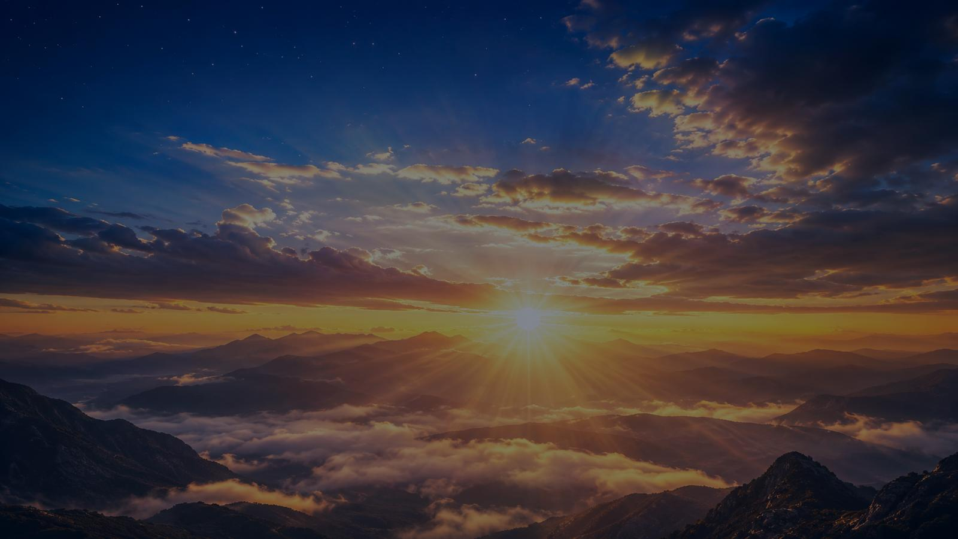
THE SPACIOUS FIRMAMENT ON HIGH
Teaching Guide
Creation, Wonder, and the Glory of God
TEXT
TUNE
SCRIPTURE
FIRST LINE
Joseph Addison
1712
CREATION
Haydn adaptation
Psalm 19:1-6
The spacious firmament on high
Prepared for teaching and small group use - hymninfo.com

Slide 2

Teaching Aim
What this session should form in learners
1
2
3
Understand
Feel
Practice
Creation gives true witness to God’s glory, power, and providence.
Reverent wonder before the Creator who speaks through his works.
Turn daily rhythms of sky, sun, moon, and stars into prayer and praise.
Prepared for teaching and small group use - hymninfo.com

Slide 3

Hymn Identity
A creation hymn rooted in Psalm 19
Title
The Spacious Firmament on High
“The heavens declare the glory of God.”
Psalm 19:1
First line
The spacious firmament on high
Text
Joseph Addison, 1712
Tune
CREATION, adapted from Haydn’s The Creation
Meter
L.M.D. (8.8.8.8.8.8.8.8)
The hymn trains worshipers to read the visible heavens as a daily call to praise: day speaks, night answers, and faith hears the Creator’s glory.
Primary text
Psalm 19:1-6
Prepared for teaching and small group use - hymninfo.com

Slide 4

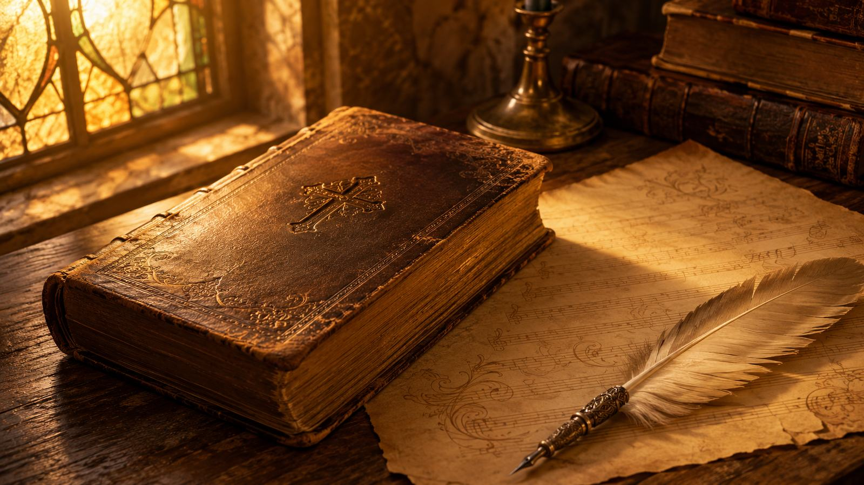
Historical Background
Joseph Addison, The Spectator, and devotional meditation
• Published in The Spectator on August 23, 1712.
• Reflects Addison’s concern for ordered reflection, moral seriousness, and worshipful attention.
• Closely follows Psalm 19: the heavens proclaim God’s glory without ordinary speech.
• Haydn’s CREATION tune gives the hymn a noble musical frame for congregational praise.
Teaching emphasis: this is not nature sentimentality. It is reverent attention to the Creator’s witness in the work of his hands.
Prepared for teaching and small group use - hymninfo.com

Slide 5
Why This Hymn Matters Today
Reverence
It slows the heart enough to notice glory.
Humility
The vast heavens put human pride in its place.
Thanksgiving
Daily light becomes a daily reason for praise.
Witness
Creation points beyond itself to the living God.
Prepared for teaching and small group use - hymninfo.com

Slide 6
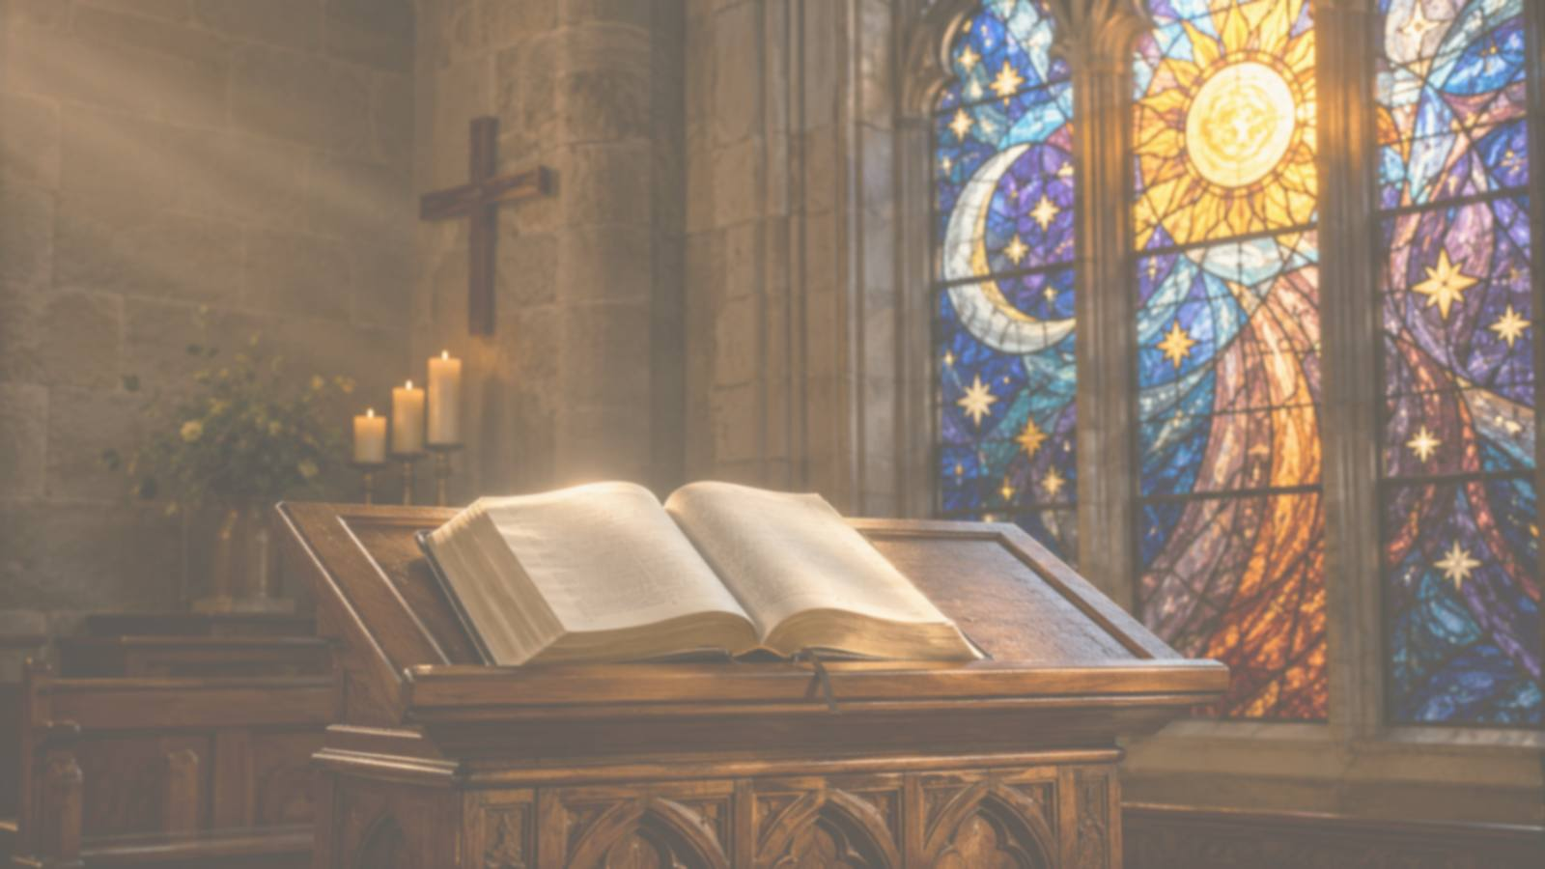
Biblical Foundation
Psalm 19 and the witness of creation
• Psalm 19:1-6 — creation declares God’s glory across the earth.
• Genesis 1:14-19 — the lights in the sky are made and appointed by God.
• Romans 1:19-20 — created things truly witness to God’s power and divinity.
• Psalm 8:3-4 — the heavens humble human pride.
• Isaiah 40:26 — the Lord calls the stars by name.
Creation awakens awe; Scripture gives clearer speech; Christ brings saving grace.
Teaching caution: creation is not divine. Its beauty points beyond itself to the Creator.
Prepared for teaching and small group use - hymninfo.com

Slide 7
Stanza 1: Daylight Witness
The sun’s daily course becomes a sermon without words.
• The created order is public witness.
• Every day declares God’s power and craftsmanship.
• The hymn turns sunrise into a call to worship.
“Day after day they pour forth speech.”
Prepared for teaching and small group use - hymninfo.com

Slide 8
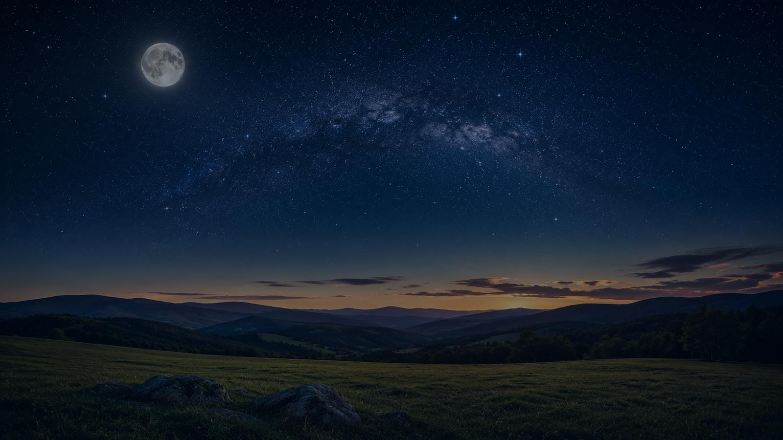
Stanza 2: Night Takes Up the Tale
When daylight fades, witness continues.
• The moon and stars continue the proclamation.
• Silence does not mean absence.
• Night can become a place of wonder, trust, and prayer.
Pastoral use: speak this stanza to the weary, anxious, or sleepless. God’s witness is still present when the day is done.
Prepared for teaching and small group use - hymninfo.com

Slide 9
Stanza 3: Hearing the Silent Voice
Creation speaks clearly, though not audibly
• The heavens make no ordinary sound.
• Faithful reason hears order, wisdom, and praise.
• The final confession sends all glory to the divine Maker.
SEE
RECEIVE
WORSHIP
Prepared for teaching and small group use - hymninfo.com

Slide 10
Natural Revelation and Scripture
What creation does and does not say
Creation truly speaks
Scripture speaks more clearly
Christ is the fullest light
God’s power, wisdom, order, and divine glory are perceived through what he has made.
The Bible names the Creator, tells the truth about sin, and reveals God’s saving work.
The glory hinted in creation is made personal and saving in Jesus Christ.
Prepared for teaching and small group use - hymninfo.com

Slide 11
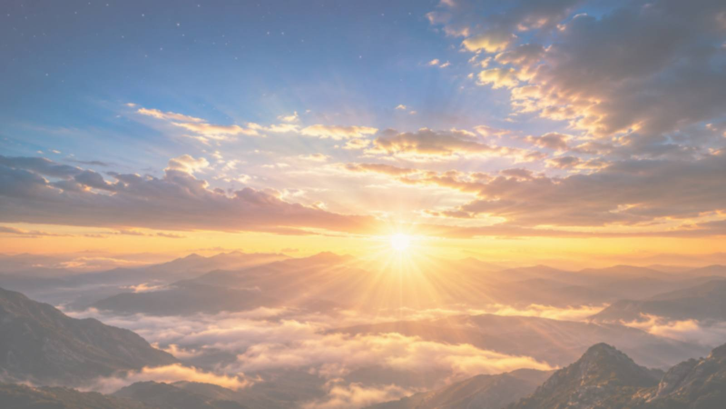
The Creator, Not Creation
A needed distinction for church teaching
• Creation is magnificent, but it is not ultimate.
• The sun, moon, and stars are not divine powers.
• Their beauty points beyond itself to the One who made them.
SIGNPOST
Worship
the Maker
Prepared for teaching and small group use - hymninfo.com

Slide 12
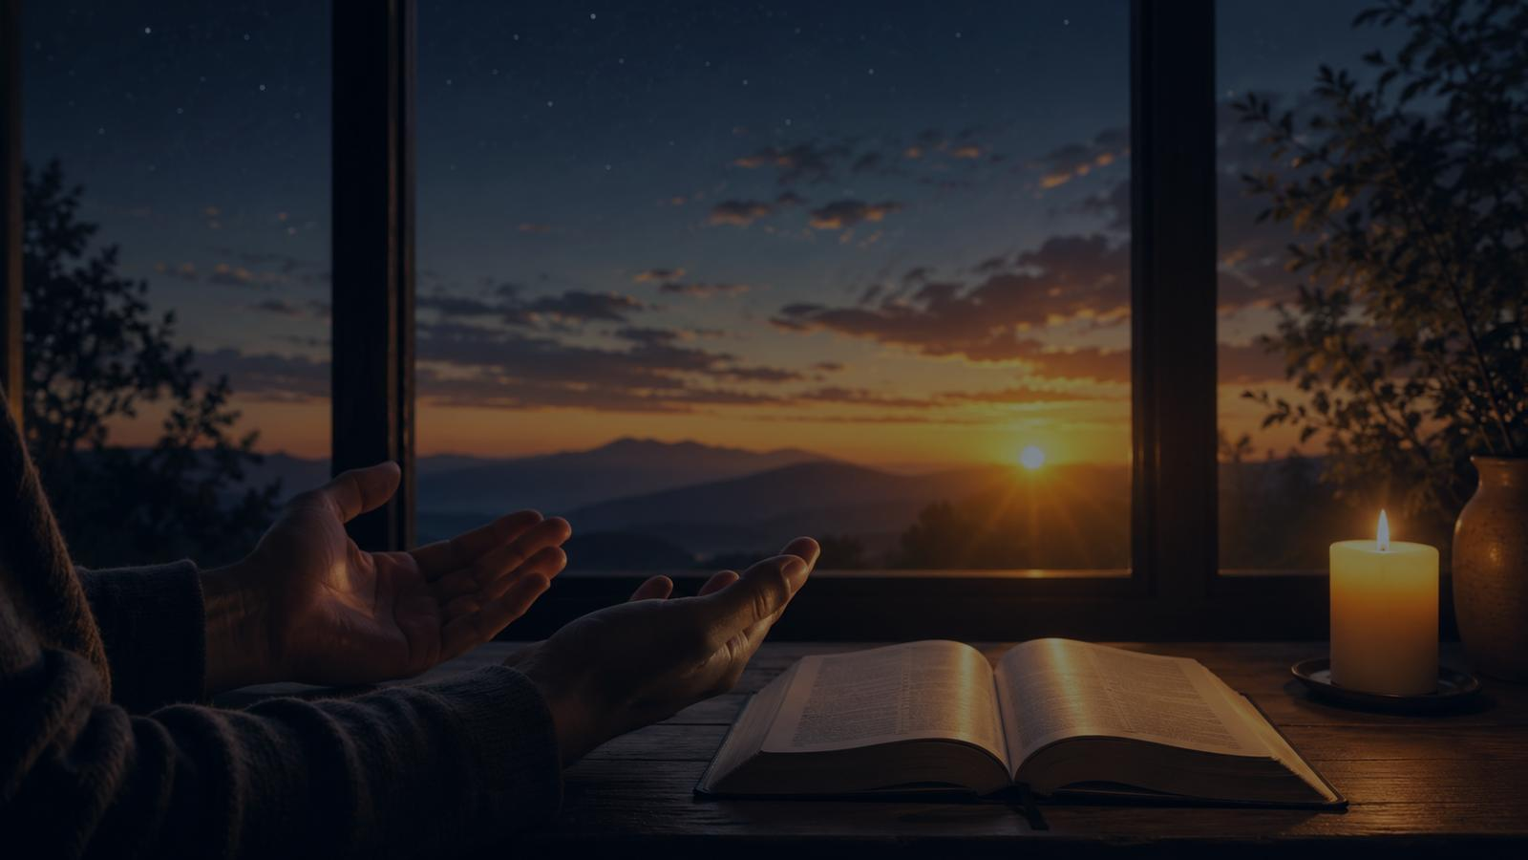
Providence in Daily Rhythms
Morning, evening, and night teach trust.
☀
☾
✦
Morning
Evening
Night
Receive the day as a gift.
Return the day with thanks.
Rest under the God who keeps watch.
Prepared for teaching and small group use - hymninfo.com

Slide 13
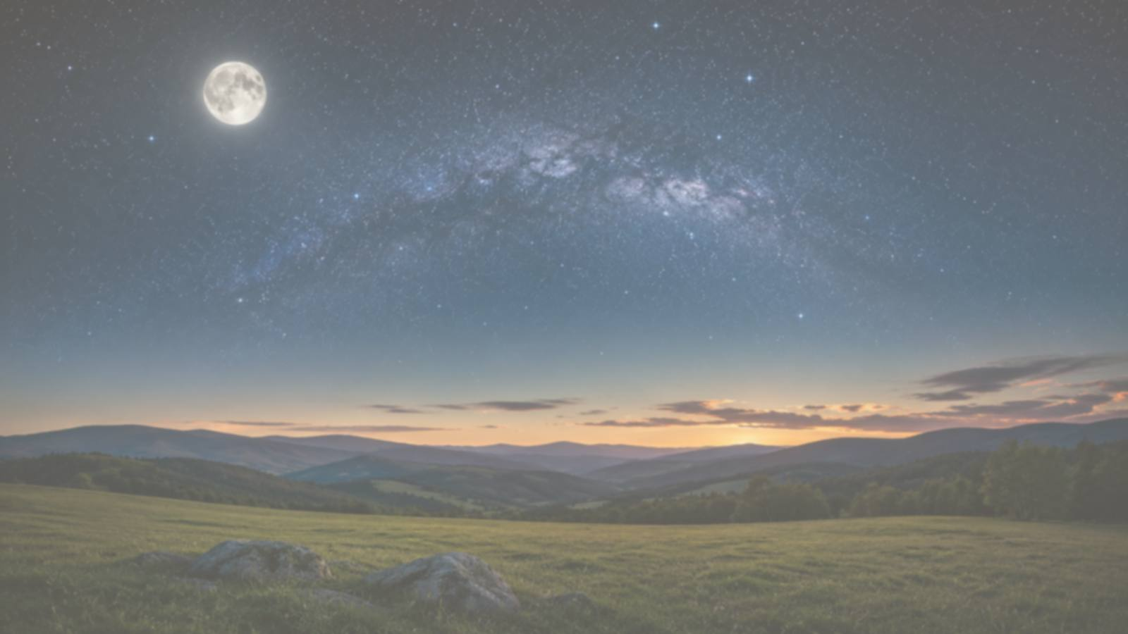
Theological Themes
Doctrine sung through the heavens
1
Creation
2
Natural Revelation
3
Providence
4
Worship
5
Humility
6
Thanksgiving
The hymn’s theology is simple but sturdy: the Maker’s glory is written across the visible world, and the church must learn to answer with praise.
Prepared for teaching and small group use - hymninfo.com

Slide 14
Literary and Musical Observations
Dignified language for wonder
• The poem moves from day to night to contemplative hearing.
• The language is polished, ordered, and meditative.
• The repeated sense of witness gives the hymn its unity.
• The tune CREATION supplies breadth, nobility, and lift.
Choir note: the long phrases need breath support and a steady tempo. Let the grandeur remain prayerful, not rushed.
Prepared for teaching and small group use - hymninfo.com

Slide 15
The Tune: CREATION
Adapted from Haydn’s oratorio The Creation.
• Broad melodic sweep suits a text about the heavens.
• Classical dignity supports reverent praise.
• Best sung with confidence and a moderate tempo.
• A choir or strong song leader can help introduce it.
Let the tune carry wonder without losing clarity of the words.
Prepared for teaching and small group use - hymninfo.com

Slide 16
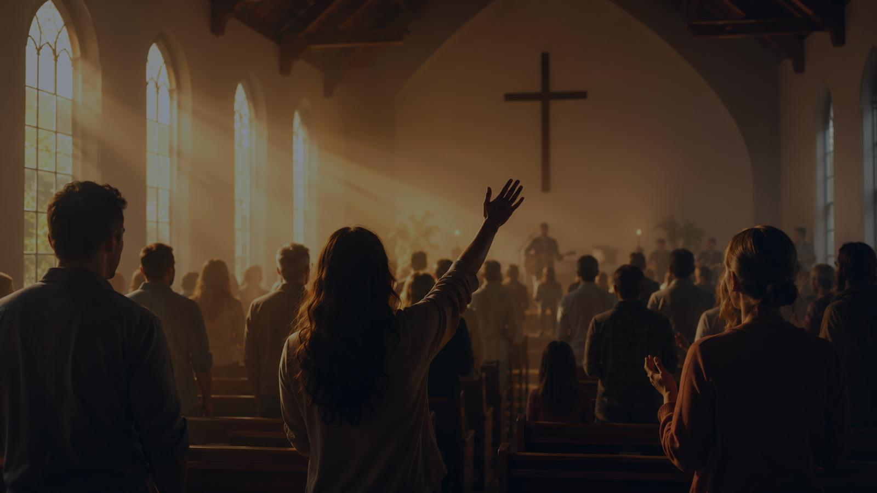
Pastoral and Worship Use
Call to worship
Begin a service by lifting the congregation’s eyes.
Creation and thanksgiving
Name God as Maker and Sustainer.
Choir or festival setting
Use the tune’s grandeur with steady confidence.
Teaching devotion
Pair with Psalm 19 and a practice of holy attention.
Prepared for teaching and small group use - hymninfo.com

Slide 17
Teaching Questions
Move from observation to worship
• What does Psalm 19 say the heavens are doing every day?
• How can creation “speak” without an audible voice?
• Why must Christians worship the Creator rather than creation?
• What daily rhythm could become a reminder to pray?
• How does creation’s witness prepare us for Scripture and Christ?
Prepared for teaching and small group use - hymninfo.com

Slide 18
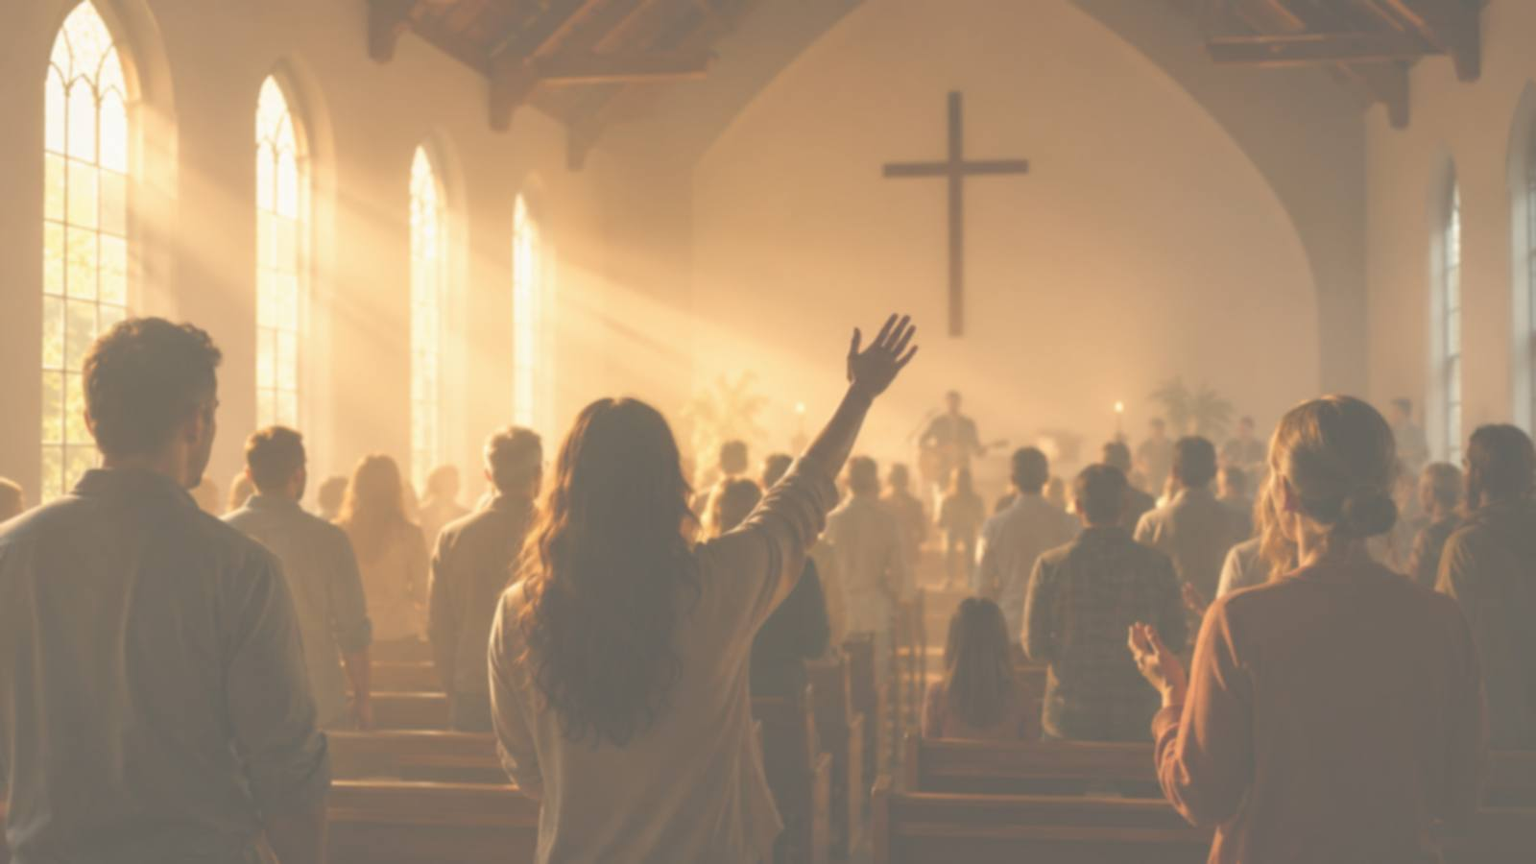
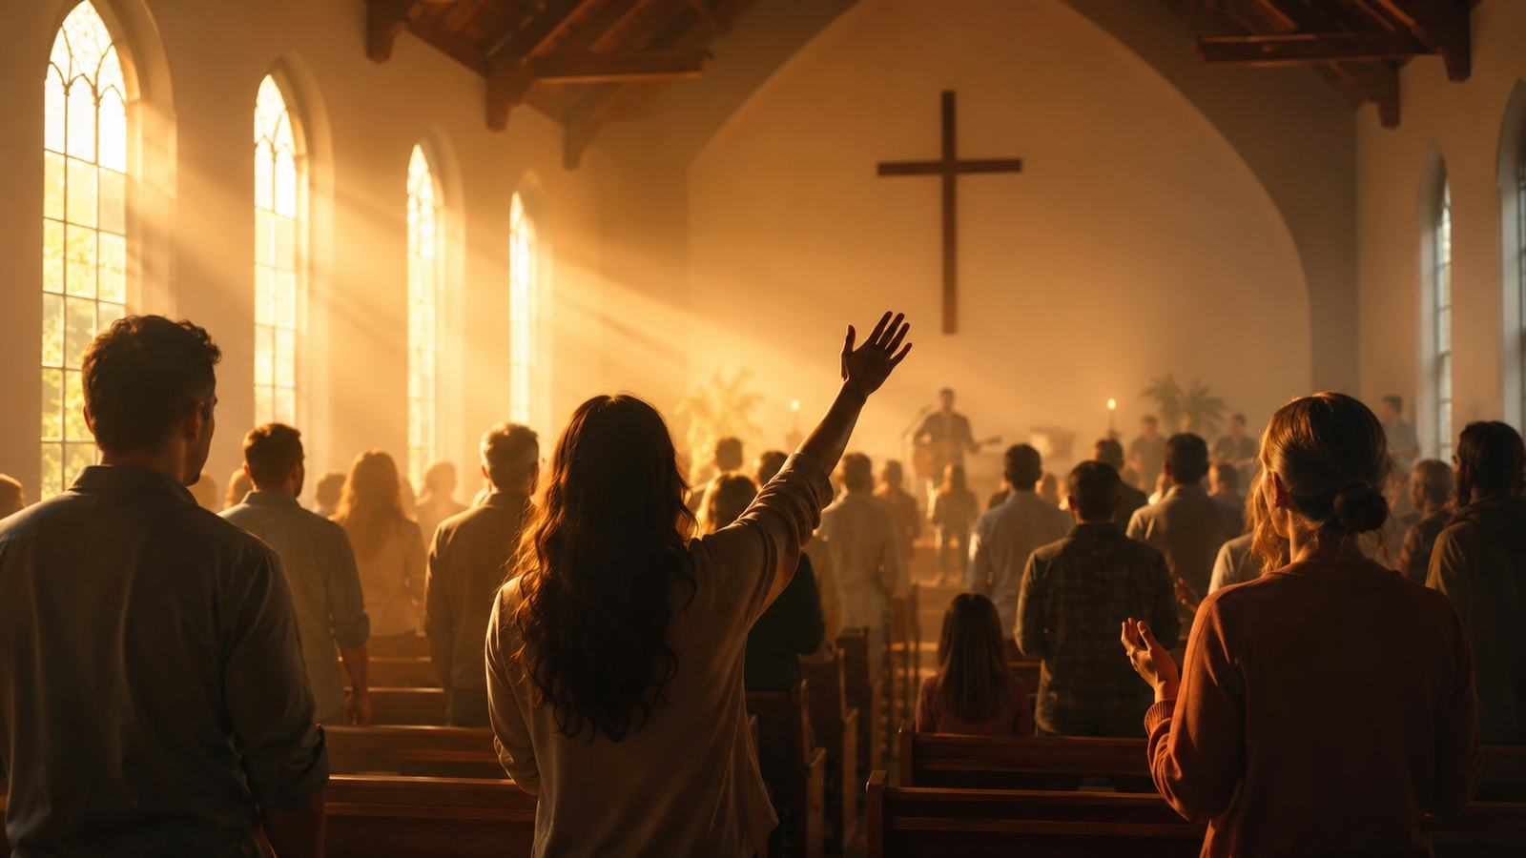
Choir and Worship Planner Notes
Helping the congregation sing with understanding
• Introduce Psalm 19 before singing.
• Let a choir sing stanza 1 if the tune is unfamiliar.
• Avoid rushing the long lines.
• Use a fuller accompaniment on the final stanza.
• Place the hymn near a Scripture reading or creation prayer.
Strong singing should sound like reverence, not performance.
Prepared for teaching and small group use - hymninfo.com

Slide 19
Practice Holy Attention
Small acts that turn wonder into worship
• Read Psalm 19 at sunrise.
• Pause at sunset to give thanks.
• Pray Psalm 8 under the night sky.
• Name one created gift without treating it as ultimate.
• Let wonder lead to obedience.
Prepared for teaching and small group use - hymninfo.com

Slide 20
Suggested Lesson Flow
Two ready-to-use options
30-Minute Plan
60-Minute Plan
• Opening question — 4 min
• Read Psalm 19:1-6 — 5 min
• Teach hymn background — 7 min
• Stanza walk-through — 10 min
• Closing prayer — 4 min
• Opening reflection — 7 min
• Scripture foundation — 10 min
• Historical and musical notes — 10 min
• Stanza study — 18 min
• Discussion and application — 10 min
• Prayer and song — 5 min
Prepared for teaching and small group use - hymninfo.com

Slide 21
Closing Summary
1
The heavens bear witness to God’s glory.
2
Creation is magnificent, but the Creator alone is worthy of worship.
3
Scripture teaches us how to hear creation rightly.
4
Wonder should become praise, humility, and trust.
Prepared for teaching and small group use - hymninfo.com

Slide 22
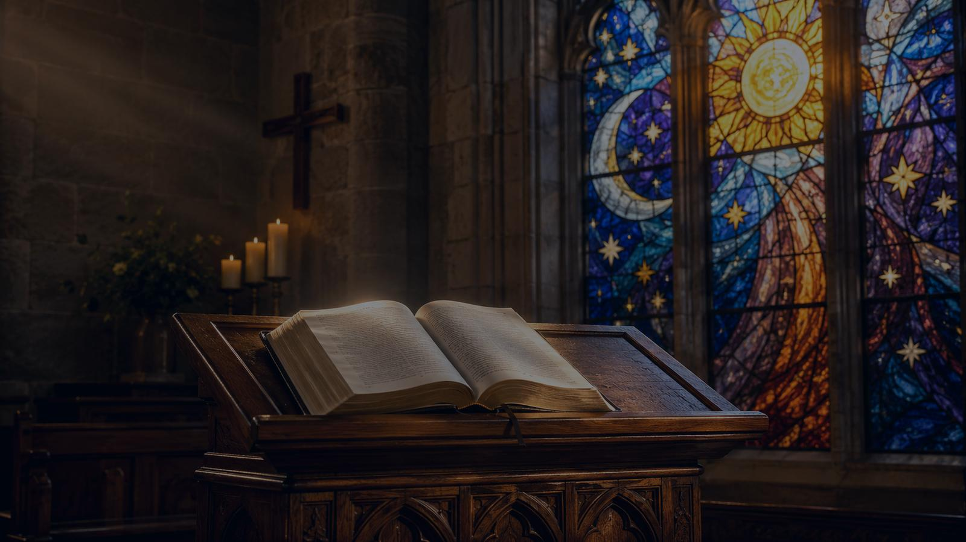
Closing Prayer
Creator and Lord, teach us to hear what the heavens declare. Open our eyes to your glory, and lead our wonder into thankful worship through Jesus Christ our Lord. Amen.
© HymnInfo.com. Free for personal, church, classroom, and small-group teaching use. Please do not sell, repost, or redistribute as downloadable files without permission.
Prepared for teaching and small group use - hymninfo.com

