Slide 1
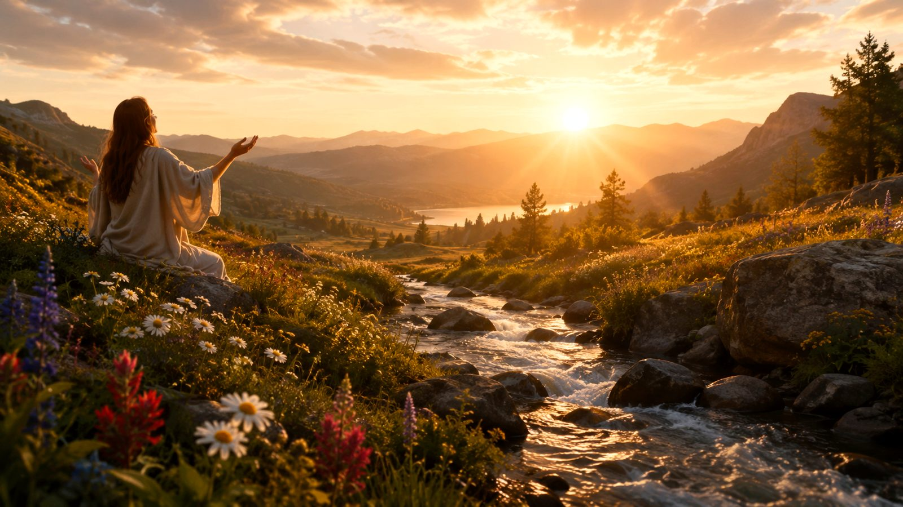
God, Who Touchest Earth with Beauty
A hymn study on creation, renewal, and Spirit-formed character
First line: God, who touchest earth with beauty
Text: Mary Susannah Edgar, 1925
Common tune: BULLINGER; other tune pairings also appear
Primary Scripture: Psalm 51:10-12
Prepared for teaching and small group use - hymninfo.com

Slide 2
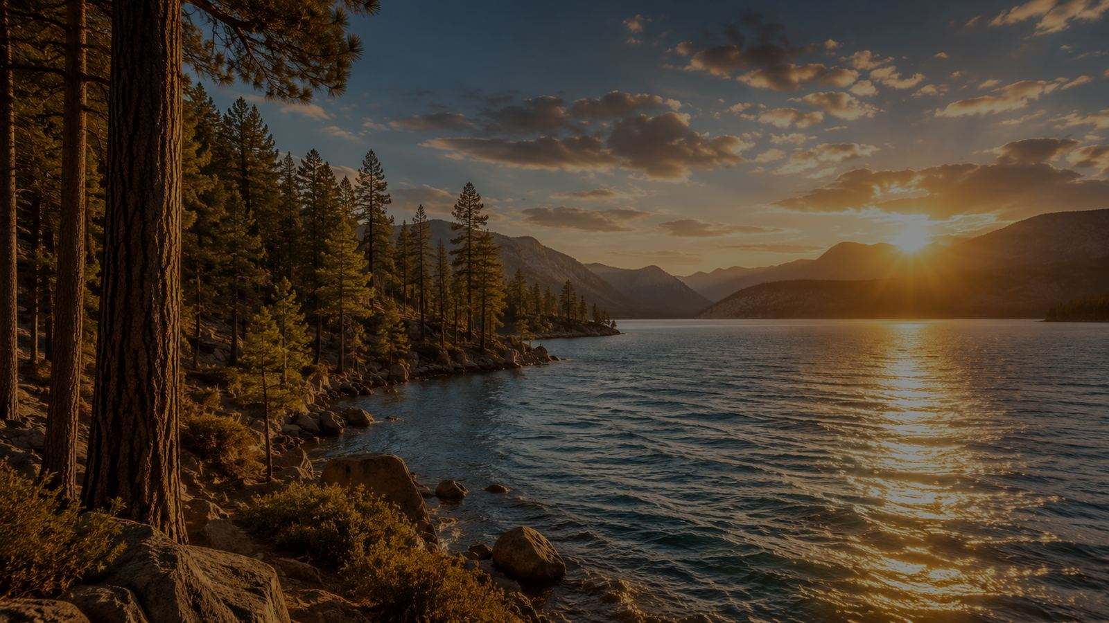
Teaching Aim
1
Understand
2
Feel
3
Practice
Creation can become a doorway to prayer, but the Creator remains the focus.
Gratitude, humility, and holy desire before the God who renews the heart.
Ask God for purity, strength, joy, uprightness, lifted thought, and loving service.
Prepared for teaching and small group use - hymninfo.com

Slide 3
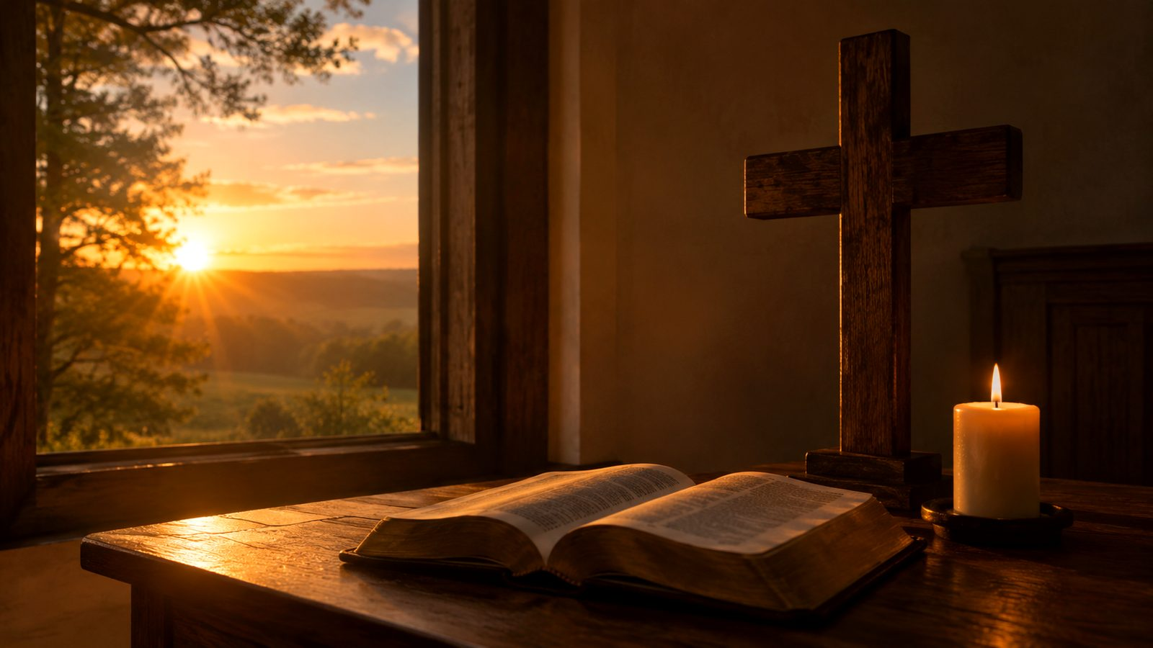
Hymn Identity
Title
God, Who Touchest Earth with Beauty
First line
God, who touchest earth with beauty
Author
Mary Susannah Edgar (1889-1973)
Year
1925
Themes
Creation, renewal, purity, Christian character, Holy Spirit, service
Tune notes
BULLINGER is one common setting; several hymnals use alternate tunes.
Prepared for teaching and small group use - hymninfo.com

Slide 4
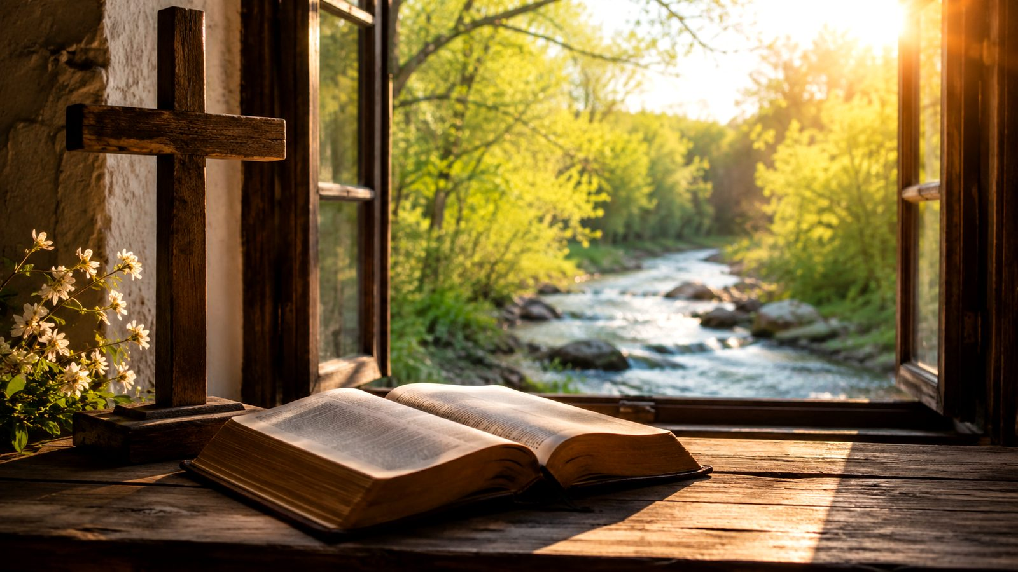
A Prayer Shaped by Creation
The hymn looks outward at God's world and inward toward the renewed heart.
Prepared for teaching and small group use - hymninfo.com

Slide 5

Historical Background
Mary Susannah Edgar was a Canadian author, poet, hymn writer, and camp director. Her work joined Christian formation with a love for the natural world.
She founded Glen Bernard Camp for Girls in Ontario in 1922. This setting helps explain the hymn's outdoor images: springs, rocks, waves, pine trees, and heavens become a school of prayer.
The hymn was written in 1925 and has appeared in several hymnals, sometimes with modernized wording and different tune pairings.
Prepared for teaching and small group use - hymninfo.com

Slide 6

Why This Hymn Matters Today
Beauty without sentimentality
The hymn does not stop at admiration. Beauty becomes a summons to holiness.
Formation for all ages
Children, youth, and adults can connect visible creation with practical Christian character.
Prayer before service
The renewed heart is not kept private; it becomes ministries of love.
Prepared for teaching and small group use - hymninfo.com

Slide 7
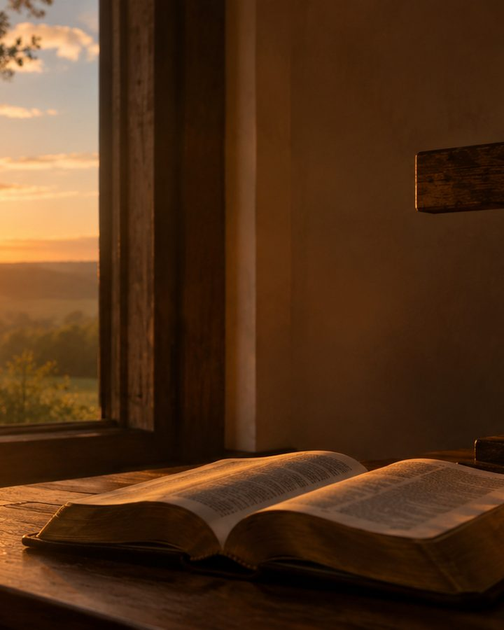
Biblical Foundation
Psalm 51:10-12
The central prayer is for a clean heart and a renewed spirit.
Romans 12:1-2
Renewal is not only emotional; it reshapes the mind and the whole life offered to God.
Ephesians 4:22-24
The new life is created after God's likeness in righteousness and holiness.
Psalm 33 and Psalm 90
Creation's beauty and God's favor lead worshipers to awe, trust, and fruitful work.
Prepared for teaching and small group use - hymninfo.com

Slide 8
Stanza 1: Beauty Becomes Prayer
The hymn begins with God touching the earth with beauty, then immediately asks for inner renewal.
Teaching emphasis:
Creation points beyond itself to the Creator.
The heart needs recreating, not merely improving.
Beauty before God includes purity, strength, and truth.
Prepared for teaching and small group use - hymninfo.com

Slide 9
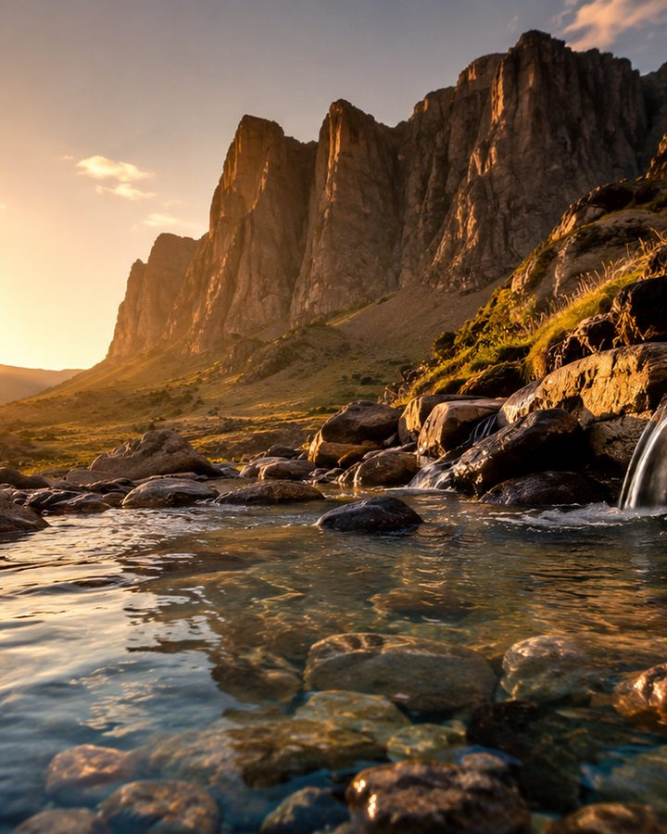
Stanza 2: Purity and Strength
Springs and running waters teach the prayer for a clean life. Rocks and towering grandeur teach the prayer for steadiness.
A mature Christian life needs both. Purity without firmness becomes fragile. Strength without purity becomes hardness.
Scripture connection: Psalm 51:10 and Ephesians 4:24.
Prepared for teaching and small group use - hymninfo.com

Slide 10
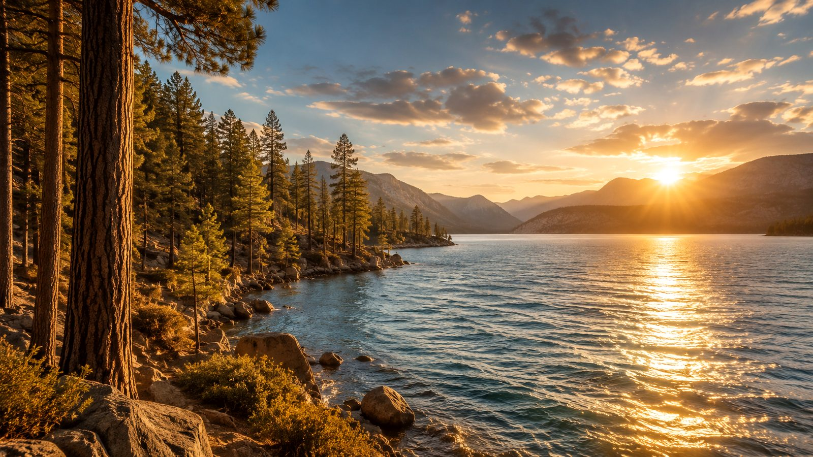
Stanza 3: Glad and Upright
The hymn joins joy and integrity. Waves in sunlight suggest glad freedom; pine trees suggest uprightness.
Teaching emphasis:
Christian holiness is not gloomy.
True freedom is not crookedness but life made straight before God.
The Spirit forms joy and moral clarity together.
Prepared for teaching and small group use - hymninfo.com

Slide 11
Stanza 4: Dreams Become Ministries
The hymn lifts the mind above shallow concerns and asks God to turn inner longing into loving action.
Lifted thoughts
Noble action
Ministries of love
The heavens become an image of a mind raised toward God.
A beautiful dream must become faithful obedience.
Renewal moves outward toward people who need care.
Prepared for teaching and small group use - hymninfo.com

Slide 12
Stanza 5: Kept by the Spirit
The final stanza returns to the opening prayer and asks God to keep the worshiper pure, strong, and true.
The hymn ends in dependence, not self-confidence. The life God recreates is a life God must also sustain.
Prepared for teaching and small group use - hymninfo.com

Slide 13
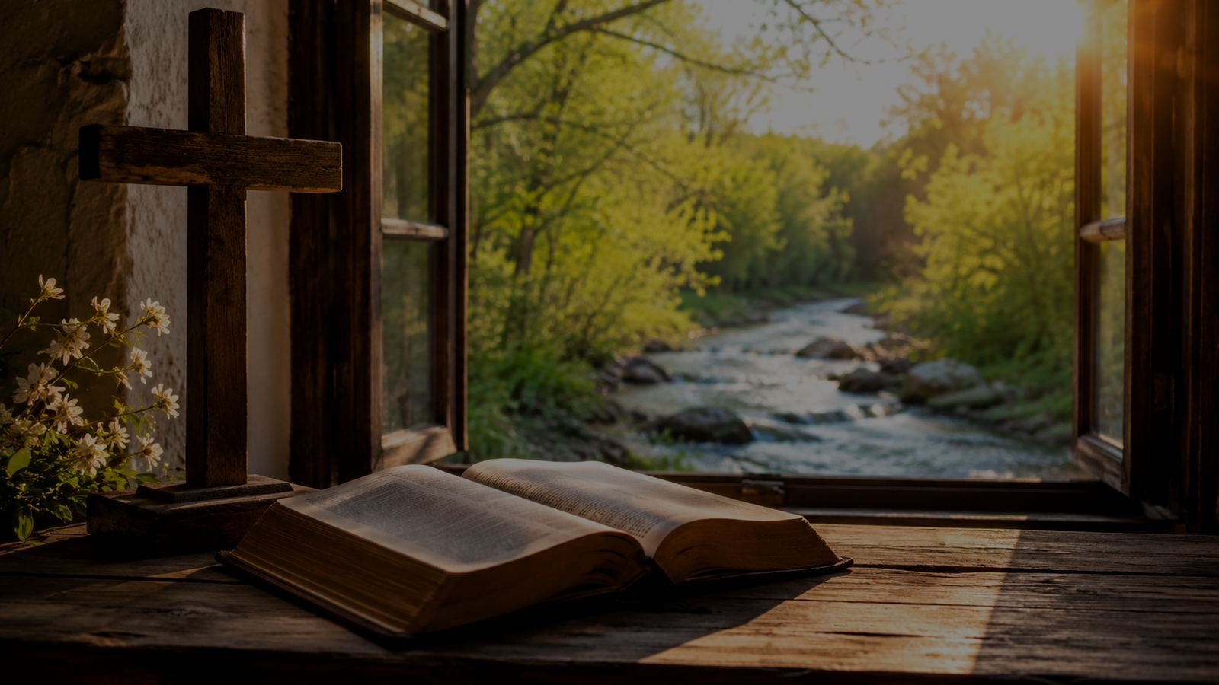
The Central Prayer
Make my heart anew
This repeated plea gathers the hymn's movement: the Creator who gives beauty to the earth can also form beauty in the human heart.
Use this line as a short prayer before worship, outdoor retreats, service projects, or personal renewal.
Prepared for teaching and small group use - hymninfo.com

Slide 14
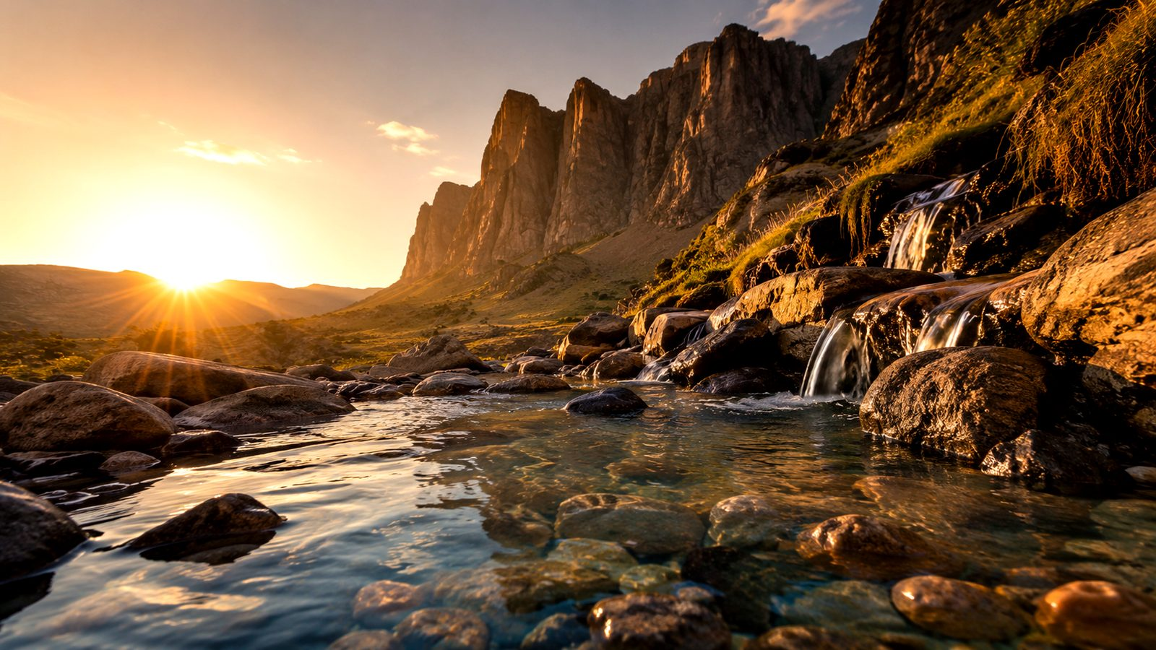
Christian Character in Creation's Language
Springs, rocks, waves, trees, and heavens help worshipers pray for a holy life.
Prepared for teaching and small group use - hymninfo.com

Slide 15
Theological Themes
Creation
Renewal
Sanctification
God's world bears witness to divine artistry.
The heart must be recreated by God's Spirit.
Purity, strength, joy, and uprightness are works of grace.
Service
Thanksgiving
Dependence
Holy beauty becomes ministries of love.
Wonder becomes worship and obedience.
The Spirit who renews also keeps.
Prepared for teaching and small group use - hymninfo.com

Slide 16
Literary and Musical Observations
Literary movement
Each stanza turns a created image into a prayer for character. The images are simple, concrete, and memorable.
Musical setting
BULLINGER is one common tune pairing. The text is also found with other tunes, so leaders should check the hymnal used by their congregation.
Singing approach
Warm, prayerful, steady, and unhurried. The hymn is best treated as a petition, not a nature song only.
Prepared for teaching and small group use - hymninfo.com

Slide 17
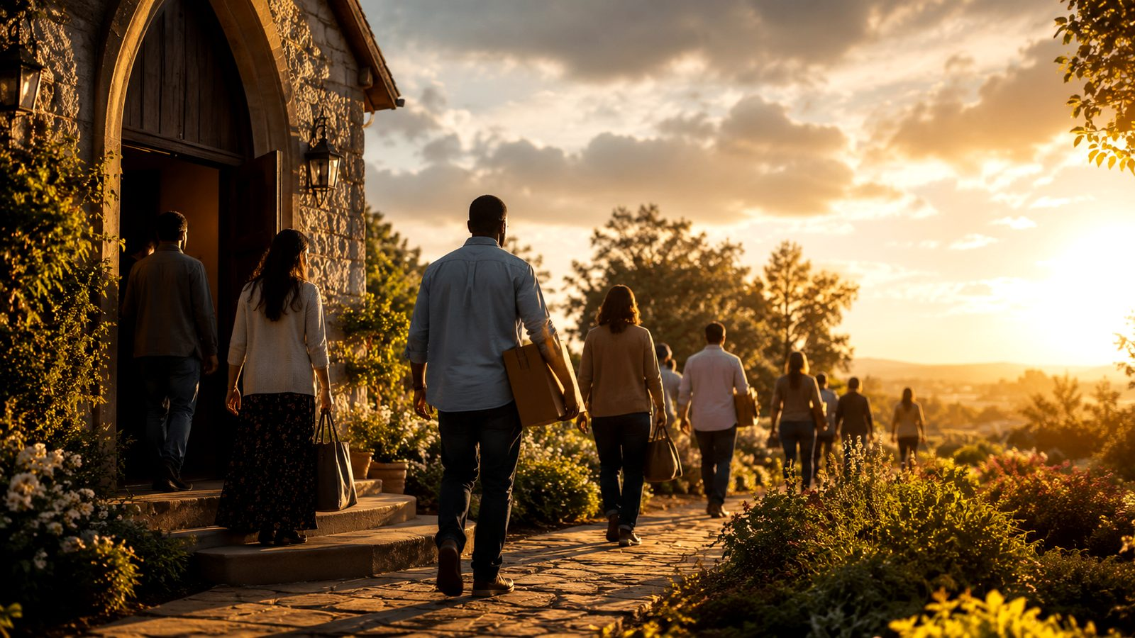
Pastoral and Worship Use
Well suited for:
creation-themed worship
retreats, camps, and outdoor services
Christian education and youth formation
prayers for renewal and holiness
teaching on service and love of neighbor
Pastoral note: keep the focus on the God who renews, not on creation as an end in itself.
Prepared for teaching and small group use - hymninfo.com

Slide 18
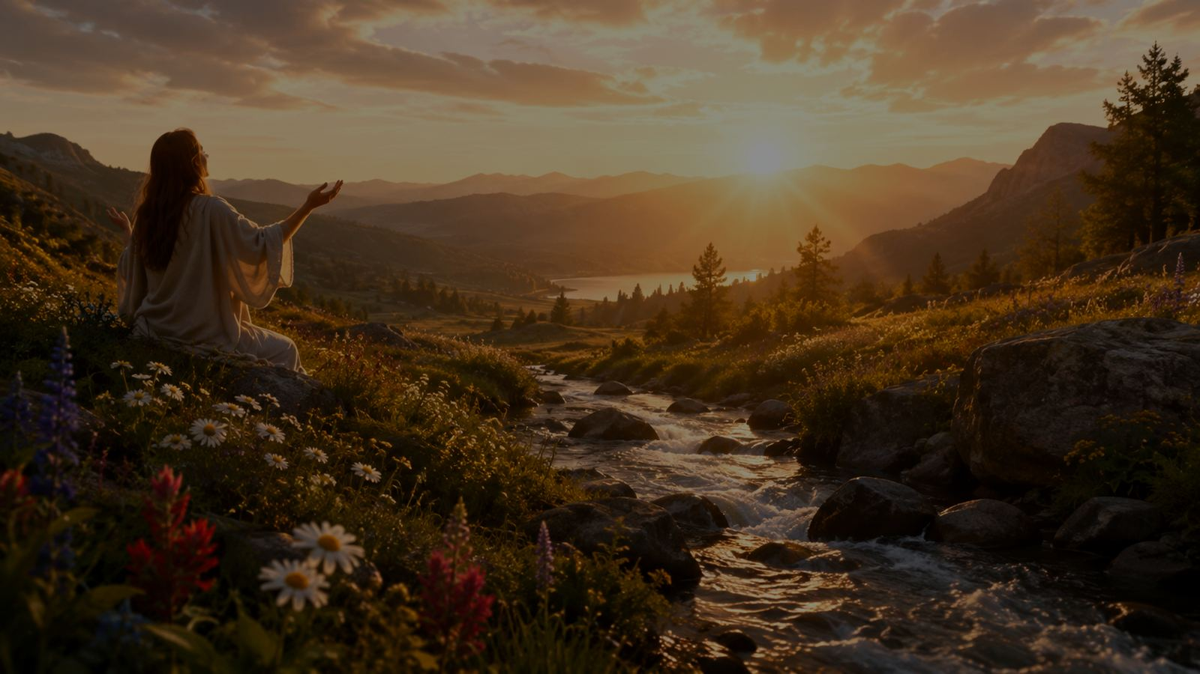
Teaching Questions
1. What created image in the hymn most clearly names something you need God to form in you?
2. Why does the hymn ask for both purity and strength?
3. How does Psalm 51 help us understand the prayer, 'Make my heart anew'?
4. What is the difference between admiring beauty and being changed by the God of beauty?
5. Where might God be turning a dream into a ministry of love?
Prepared for teaching and small group use - hymninfo.com

Slide 19

Practicing the Hymn This Week
Morning prayer
Ask God to make your heart clean, strong, glad, upright, and loving.
Creation walk
Notice one image from the hymn: water, rock, trees, sky, or light. Turn it into prayer.
One ministry of love
Choose one concrete act of service that turns a noble intention into action.
Prepared for teaching and small group use - hymninfo.com

Slide 20
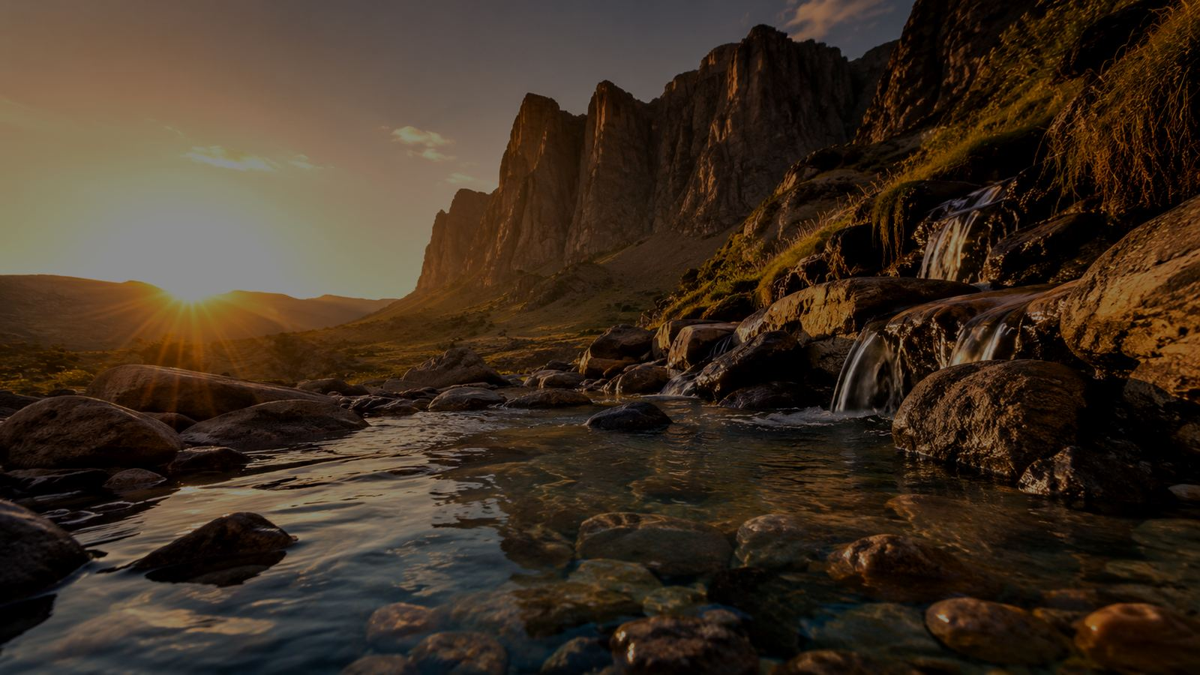
Suggested Lesson Flow
30-minute lesson
60-minute lesson
5 min - Opening prayer and Psalm 51
8 min - Hymn background and central prayer
10 min - Stanza images and virtues
5 min - Discussion
2 min - Closing prayer
10 min - Scripture reading and response
10 min - Mary Edgar and hymn setting
20 min - Stanza study
10 min - Table discussion
7 min - Practice plan
3 min - Prayer
Prepared for teaching and small group use - hymninfo.com

Slide 21
From Wonder to Renewal
The hymn teaches worshipers to pray: let the beauty God gives the earth become holiness in us.
Prepared for teaching and small group use - hymninfo.com

Slide 22
Closing Summary and Prayer
Summary
God's beauty in creation is not merely something to see. It becomes a prayer for the heart to be recreated by the Spirit and turned toward loving service.
Prayer
Creator God, make our hearts new. Cleanse us like pure water, steady us like strong rock, gladden us like sunlight on waves, make us upright before you, and turn our best hopes into ministries of love. Through Christ our Lord. Amen.
Prepared for teaching and small group use - hymninfo.com

Slide 23
For Teaching Use
Prepared for teaching and small group use - hymninfo.com
© HymnInfo.com. Free for personal, church, classroom, and small-group teaching use. Please do not sell, repost, or redistribute as downloadable files without permission.
Prepared for teaching and small group use - hymninfo.com

