Slide 1

And Now, O Father, Mindful of the Love
A Communion hymn on Christ’s sacrifice, intercession, and sustaining grace
First line: And now, O Father, mindful of the love
Text: William Bright • Tune: UNDE ET MEMORES • 1873
Primary Scripture: Hebrews 7:25-27; 10:10-12
Prepared for teaching and small group use - hymninfo.com
1

Slide 2
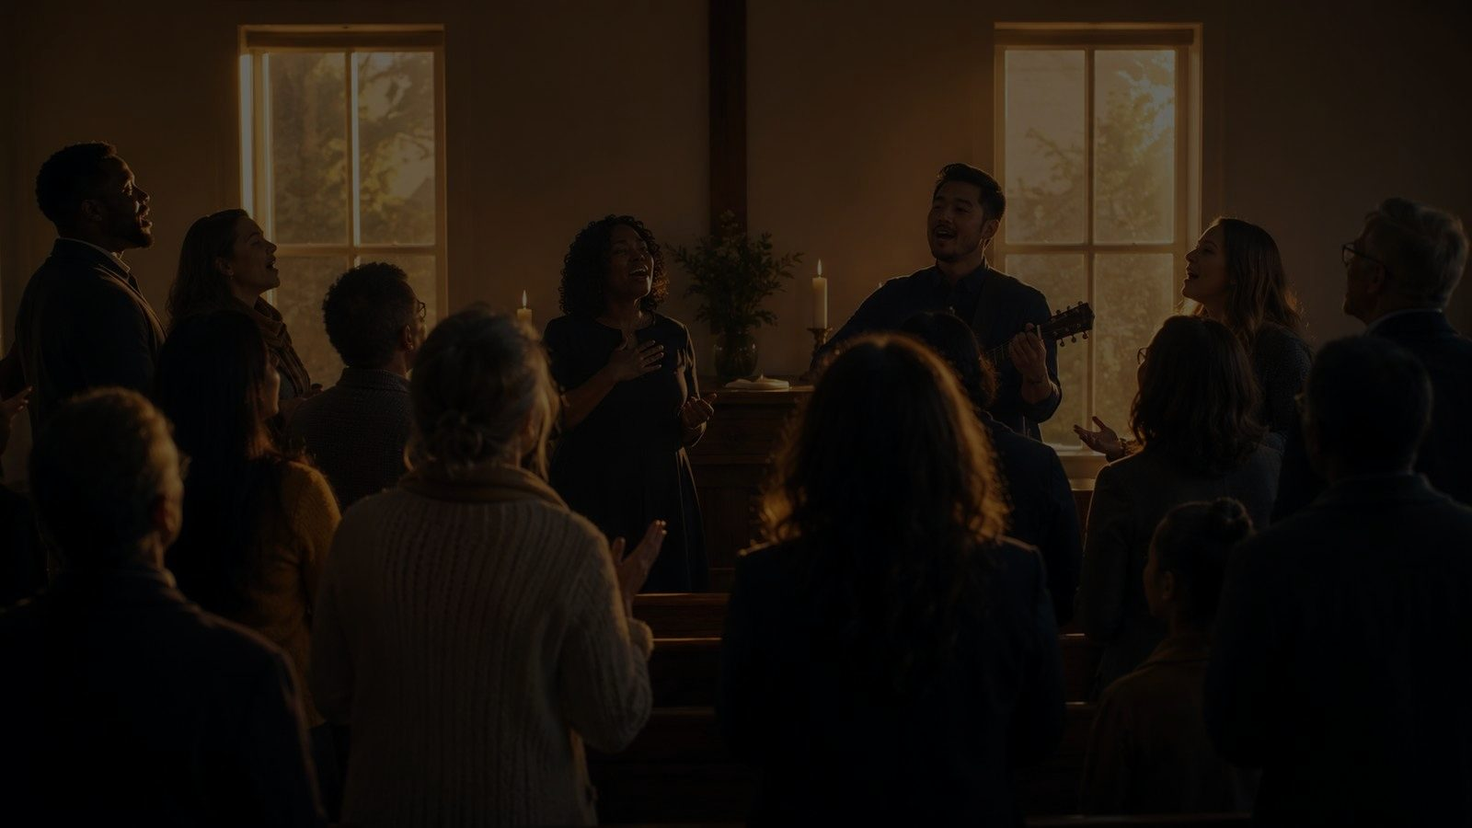
Teaching Aim
Understand
Feel
Practice
Christ’s offering is once for all, and his priestly intercession continues.
Assurance that the Father receives believers in the Son.
Come to Communion with confession, gratitude, and joyful service.
Prepared for teaching and small group use - hymninfo.com
2

Slide 3
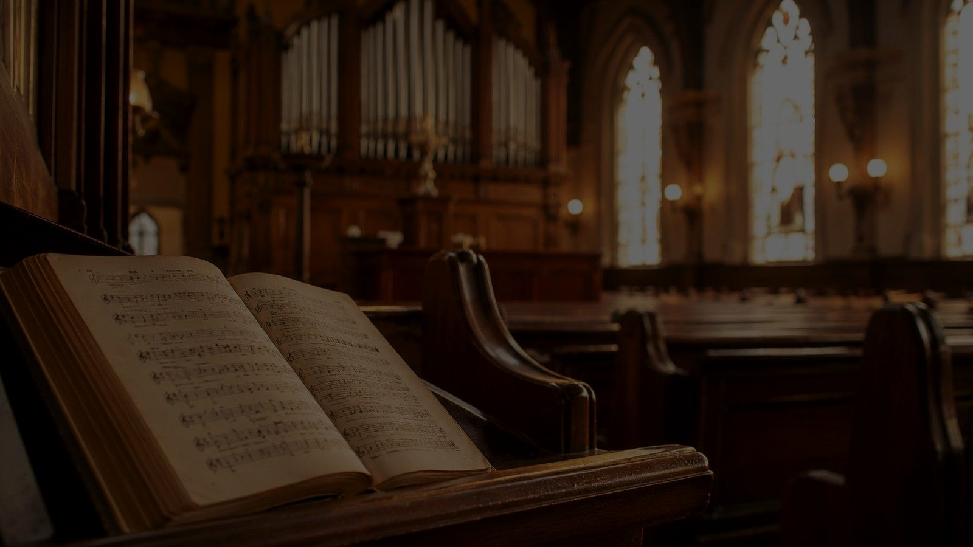
Hymn Identity
At a Glance
Ministry Setting
Title: And Now, O Father, Mindful of the Love
First line: And now, O Father, mindful of the love
Author: William Bright
Composer: William Henry Monk
Tune: UNDE ET MEMORES
Meter: 10.10.10.10.10.10
Holy Communion and sacramental devotion
Maundy Thursday and Passiontide
Confession, assurance, intercession, consecration
Worship shaped by remembrance of Christ’s sacrifice
Prepared for teaching and small group use - hymninfo.com
3

Slide 4

Historical Background
William Bright and the Hymn
Monk and UNDE ET MEMORES
Bright was an English Anglican priest, theologian, church historian, and Oxford scholar.
The hymn was first published in 1873 under the title The Eucharistic Presentation.
Its familiar form became widely known through Victorian hymnody.
William Henry Monk composed the tune for Hymns Ancient and Modern.
The tune title reflects language associated with Eucharistic remembrance.
Its dignified six-line shape supports long prayerful sentences.
Prepared for teaching and small group use - hymninfo.com
4

Slide 5

Christ at the Center of the Table
Once-for-all sacrifice • living intercession • grace for holy service
Prepared for teaching and small group use - hymninfo.com
5

Slide 6

Biblical Foundation
Hebrews: The Priesthood of Christ
Table and Assurance
Christ saves completely those who draw near through him.
He offered himself once for all.
The Supper remembers and rests on this sufficient sacrifice.
Romans 8: Christ intercedes and no charge can stand.
1 Corinthians 11: the church proclaims the Lord’s death until he comes.
Philippians 3: believers are found in Christ by faith.
Prepared for teaching and small group use - hymninfo.com
6

Slide 7

Stanza 1: Remembering the Love
Teaching Emphasis
The church approaches the Father mindful of Christ’s redeeming love.
Calvary is named as the one true sacrifice, perfect before God.
Christ’s intercession above gives worshipers confidence below.
Communion begins with Christ’s completed work, not with the worshiper’s spiritual performance.
Prepared for teaching and small group use - hymninfo.com
7

Slide 8

Stanza 2: Found in Him
Teaching Emphasis
Pastoral Word
The hymn is honest about weak prayer, dim faith, and misused grace.
Assurance does not come from denying sin.
The Father receives his people as they are found in Christ.
Confession and confidence are not enemies.
In Christ, repentance does not end in despair.
The Passion of the Son stands between sin and judgment.
Prepared for teaching and small group use - hymninfo.com
8

Slide 9
Stanza 3: Nourished for Service
Teaching Emphasis
The prayer asks the patient Savior to draw worshipers near.
The meal is described as both holy and sweet: reverence and comfort together.
Grace received at the table becomes glad, free service.
Communion is not only remembrance; it is grace that strengthens holiness, fellowship, and obedience.
Prepared for teaching and small group use - hymninfo.com
9

Slide 10
The Prayer’s Movement
Remember
Confess
Rest
Receive
Christ’s love and sacrifice
weak faith and misused grace
in the believer’s union with Christ
nourishment for holy service
Prepared for teaching and small group use - hymninfo.com
10

Slide 11
Theological Themes
Atonement
Intercession
Assurance
Christ’s one sufficient offering
The risen Lord pleads for his people
Believers are received in the Son
Confession
Union with Christ
Consecration
Sin is faced honestly before God
Grace rests on being found in him
The table sends us into glad service
Prepared for teaching and small group use - hymninfo.com
11

Slide 12
Literary and Musical Observations
Text
Tune: UNDE ET MEMORES
Long, prayerful sentences create a worshiping posture.
The address moves between Father and Savior, keeping Trinitarian devotion in view.
The contrast between divine grace and human weakness deepens pastoral power.
A dignified 10.10.10.10.10.10 meter.
Measured melody supports thoughtful singing.
Best sung with clear phrasing so the theology remains intelligible.
Prepared for teaching and small group use - hymninfo.com
12

Slide 13
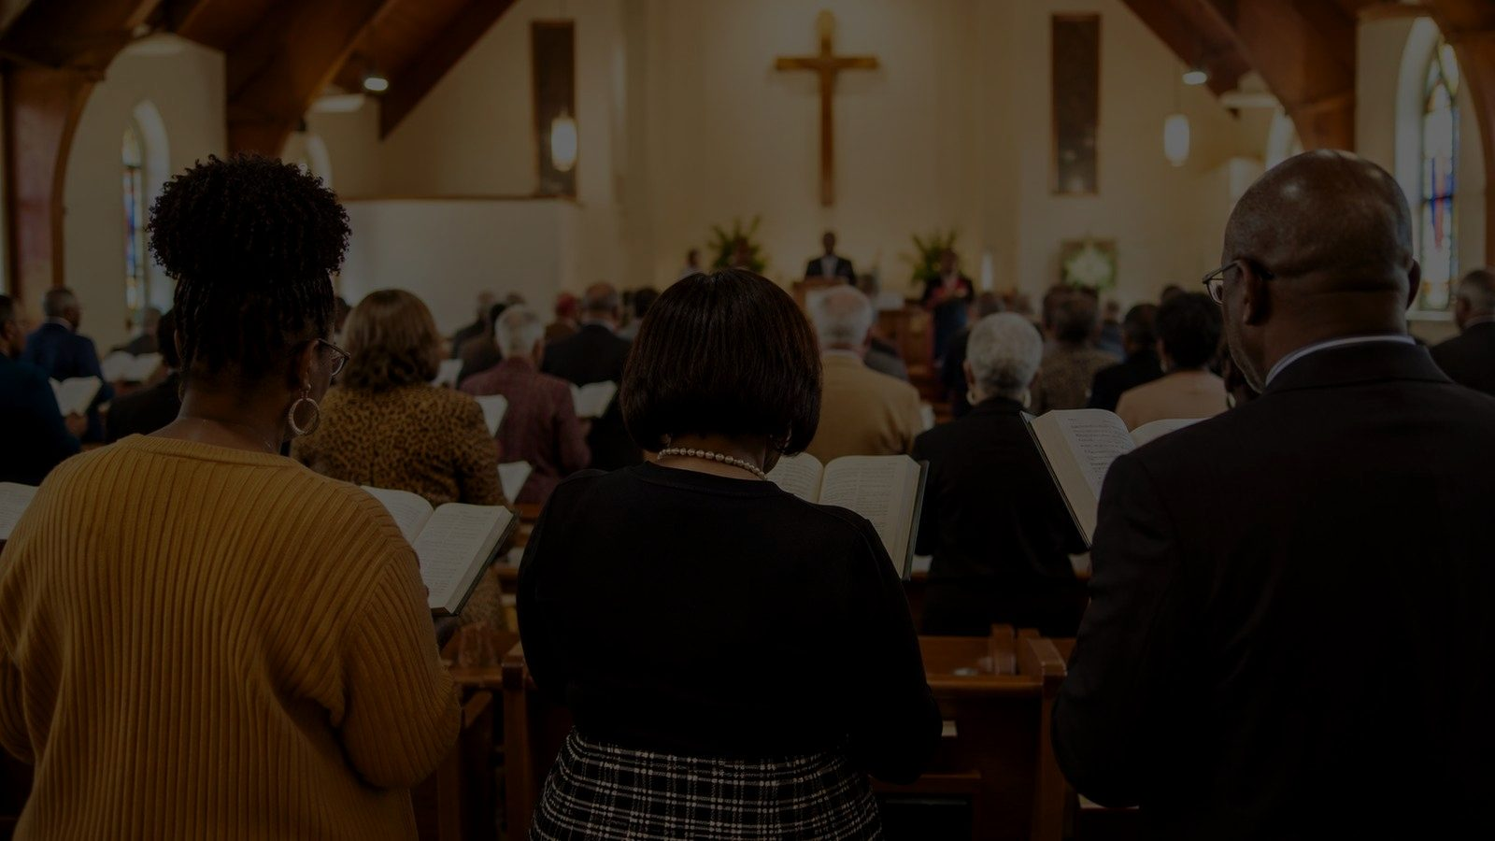
Pastoral and Worship Use
Best Settings
Holy Communion or Eucharistic worship
Maundy Thursday and Passiontide
Confession and assurance of pardon
Teaching on Christ’s priesthood and intercession
Choir or congregation with a reverent tempo
Pastoral cue: let the hymn help the congregation come humbly, not fearfully; reverently, not despairingly.
Prepared for teaching and small group use - hymninfo.com
13

Slide 14
Teaching Questions
Discuss
Listen For
What does Hebrews mean by a once-for-all sacrifice?
How does Christ’s intercession strengthen weak prayer?
Why is being found in Christ the heart of assurance?
How can Communion deepen glad service?
What does this hymn teach about reverence without fear?
Learners may equate Communion with personal worthiness.
Gently redirect toward Christ’s sufficiency.
Emphasize that repentance and assurance meet at the table.
Prepared for teaching and small group use - hymninfo.com
14

Slide 15
Application for Believers
Respond This Week
Prepare for Communion with confession and thanksgiving.
When conscience accuses you, answer with Christ’s finished work.
Pray for grace to serve with gladness rather than mere duty.
Encourage someone who feels unworthy to come to Christ.
Come near. Receive grace. Go forth in glad and free service.
Prepared for teaching and small group use - hymninfo.com
15

Slide 16

Suggested Lesson Flow
30-Minute Plan
60-Minute Plan
5 min - Read Hebrews 7:25-27
6 min - Introduce Bright, Monk, and Communion setting
10 min - Teach the three stanza movements
6 min - Discuss assurance in Christ
3 min - Closing prayer
10 min - Scripture and hymn identity
15 min - Historical and theological background
15 min - Stanza study with Scripture
12 min - Group discussion
8 min - Application and prayer
Prepared for teaching and small group use - hymninfo.com
16

Slide 17
Closing Summary and Prayer
Christ has offered himself once for all.
Christ lives to intercede.
Christ feeds his people for glad service.
Father, receive us in your beloved Son. Teach us to come to the table with honest confession, settled assurance, and grateful obedience. Feed us by the life of Christ and keep us near him. Amen.
Prepared for teaching and small group use - hymninfo.com
17

Slide 18
For Teaching and Ministry Use
May this resource help congregations approach the Lord’s table with reverence, gospel assurance, and glad service.
© HymnInfo.com. Free for personal, church, classroom, and small-group teaching use. Please do not sell, repost, or redistribute as downloadable files without permission.
Prepared for teaching and small group use - hymninfo.com
18

