Slide 1

A Parting Blessing
A hymn study on blessing, sending, and God's keeping
First line: May the road rise to meet you
Words: Traditional blessing, anonymous
Music: J. Jerome Williams
Form: SATB a cappella choral benediction
Primary Scripture: Numbers 6:24-26
Prepared for teaching and small group use - hymninfo.com

Slide 2

Teaching Aim
1
2
3
Understand
Feel
Practice
- A benediction sends God's people under his care.
- Parting is not abandonment; the Lord keeps the road ahead.
- The church blesses, prays, encourages, and continues fellowship.
Prepared for teaching and small group use - hymninfo.com

Slide 3

Hymn Identity
Title: A Parting Blessing
First line: May the road rise to meet you
Text: traditional anonymous blessing
Composer: J. Jerome Williams
Publication setting: Shawnee Press choral octavo, 1970s
Form: SATB a cappella choral benediction
Best understood as a sung benediction
It is not a regular congregational hymn with a standard tune meter.
Its function is prayerful sending: the community entrusts one another to God's care.
Prepared for teaching and small group use - hymninfo.com

Slide 4
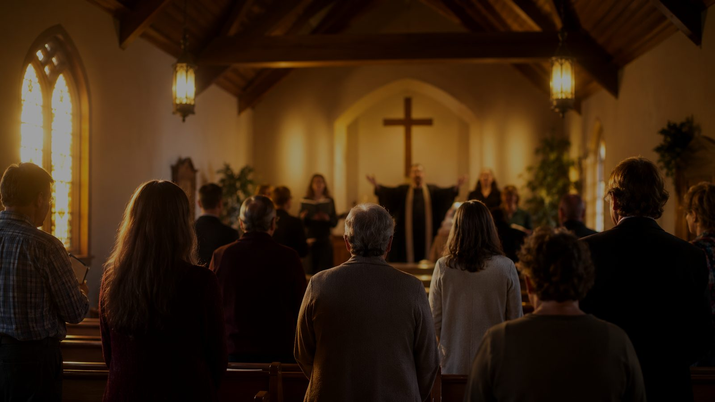
Historical Background
- J. Jerome Williams is an American choral composer, conductor, and music educator from North Carolina.
- The SATB a cappella setting became associated with worship closings, concerts, graduations, and farewells.
- The blessing text is commonly identified with Irish tradition, but it should be treated carefully as anonymous traditional wording.
- Its lasting strength is its usefulness: it lets a choir pray a final word of peace over the gathered people.
Choral benediction
Traditional blessing
Prayer of sending
God's keeping
Prepared for teaching and small group use - hymninfo.com

Slide 5

Why This Blessing Matters Today
The end of worship is still worship.
Pastoral value
- A benediction reminds the church that people leave with a promise, not merely with a schedule.
- It gives pastoral language for transitions, farewells, travel, graduation, grief, and mission.
- It trains the congregation to bless one another rather than simply say goodbye.
- It speaks peace when the road ahead is uncertain.
- It makes farewell a moment of prayer.
- It centers confidence in God's presence.
Prepared for teaching and small group use - hymninfo.com

Slide 6
Biblical Foundation
Numbers 6:24-26
Psalm 121:7-8
- God blesses and keeps.
- God's face shines with grace.
- God gives peace.
- The Lord keeps the soul.
- The Lord guards going out and coming in.
- The Lord's care is not limited to the church building.
Teaching emphasis: the blessing rests on God's character, not on an easy road.
Prepared for teaching and small group use - hymninfo.com

Slide 7
The Language of Blessing
- The piece uses the familiar language of road, wind, sun, rain, reunion, and God's hand.
- These images do not promise a trouble-free journey; they pray for divine care in ordinary life.
- The final assurance is personal and tender: God's people are held, guarded, and remembered.
Natural images become pastoral prayer.
Road = journey
Wind = help
Sun and rain = providence
Hand = God's keeping
Prepared for teaching and small group use - hymninfo.com

Slide 8
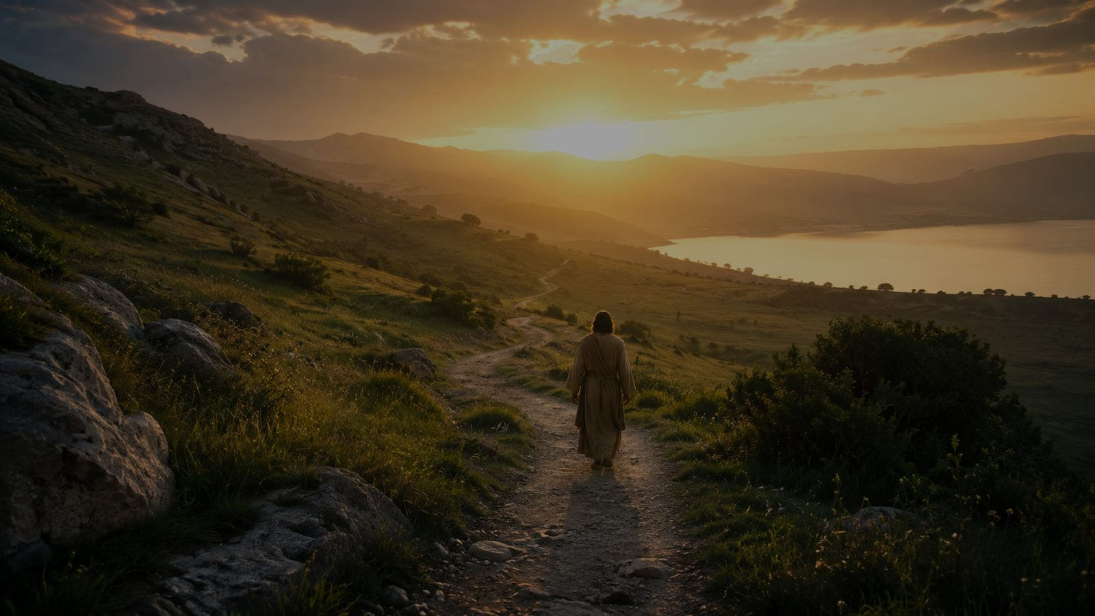
Journey and Sending
A road is more than scenery.
Class question
- In Scripture, God's people are often a people on the way.
- Parting moments expose our limits: we cannot control the next season.
- Christian sending names that uncertainty and places it before God.
When have you needed a blessing more than advice?
Prepared for teaching and small group use - hymninfo.com

Slide 9
Going Out and Coming In
Psalm 121 gives this piece its pastoral backbone.
- The Lord's care covers departure and arrival.
- The Lord's keeping reaches beyond public worship into kitchens, roads, schools, workplaces, hospitals, and homes.
- The closing song should send people outward with confidence in God's presence.
Worship ends; God's care does not.
Prepared for teaching and small group use - hymninfo.com

Slide 10
The Hand That Leads and Holds
- Psalm 139:10 speaks of God's hand leading and holding.
- Isaiah 41:10 speaks of God upholding the fearful.
- The final image of the blessing is not vague comfort; it is the biblical promise of God's sustaining presence.
Pastoral caution
A blessing should not deny danger; it entrusts people to God within danger.
Prepared for teaching and small group use - hymninfo.com

Slide 11
Literary and Musical Observations
- Brief form: one compact blessing rather than a multi-stanza hymn.
- A cappella writing: the choir's blend must carry the prayer without instrumental weight.
- Text clarity: every consonant matters because the piece functions as spoken prayer set to music.
- Emotional restraint: warmth and peace serve the text better than dramatic excess.
Choir aim: sing as though giving a blessing, not performing a farewell.
Prepared for teaching and small group use - hymninfo.com

Slide 12
Theological Themes
Providence
Peace
Guidance
God governs the road ahead.
Blessing places fear under grace.
God leads when paths change.
Protection
Fellowship
Hope
God keeps the soul.
The church sends people with prayer.
Parting is held within God's care.
Prepared for teaching and small group use - hymninfo.com

Slide 13
Pastoral and Worship Use
Suitable moments
Placement matters
- Worship dismissal
- Commissioning or sending
- Graduation recognition
- Farewell for a pastor or member
- Choir concert closing
- Travel or mission prayer
The piece works best when it functions as the actual sending word of the service, not as background music after the service is over.
Prepared for teaching and small group use - hymninfo.com

Slide 14
Choir Director Notes
- Rehearse the text as spoken prayer before singing.
- Keep vowels unified and consonants clear; the congregation receives the blessing through the words.
- Shape phrases gently; avoid rushing the final assurance.
- Balance inner voices carefully so the a cappella harmony feels secure.
- Use stillness after the final chord. Let the blessing land.
Conduct the piece with pastoral warmth more than concert brilliance.
Prepared for teaching and small group use - hymninfo.com

Slide 15
Teaching Questions
- What makes a sung benediction different from an ordinary closing song?
- How do Numbers 6 and Psalm 121 shape the meaning of this piece?
- Why should farewell in Christian worship be more than sentiment?
- What does the image of God's hand teach about human uncertainty?
- How can a congregation embody this blessing after the service ends?
Prepared for teaching and small group use - hymninfo.com

Slide 16
Application: Blessing the Road Ahead
- Pray by name for people entering a new season.
- Send departing members with Scripture, not only good wishes.
- Follow a blessing with practical care: notes, meals, calls, and continued prayer.
- Remember that the church's dismissal is mission: people leave to serve under God's keeping.
A Christian farewell says: God goes with you, and we continue to love you.
Prepared for teaching and small group use - hymninfo.com

Slide 17
Suggested Lesson Flow
30-minute plan
60-minute plan
- 5 min - opening question about farewell
- 7 min - hymn identity and choral function
- 8 min - Numbers 6 and Psalm 121
- 7 min - pastoral uses
- 3 min - closing prayer
- 10 min - listen or read the blessing devotionally
- 10 min - background and careful attribution
- 15 min - biblical study
- 10 min - choral and worship observations
- 10 min - group application
- 5 min - benediction prayer
Prepared for teaching and small group use - hymninfo.com

Slide 18
Closing Summary and Prayer
The church does not merely end a service; it sends God's people under the blessing and keeping of the Lord.
Lord, bless and keep your people as they go. Let your face shine upon them with grace. Guard their going out and coming in, lead them by your hand, and give them peace through Jesus Christ our Lord. Amen.
© HymnInfo.com. Free for personal, church, classroom, and small-group teaching use. Please do not sell, repost, or redistribute as downloadable files without permission.
Prepared for teaching and small group use - hymninfo.com

