Slide 1
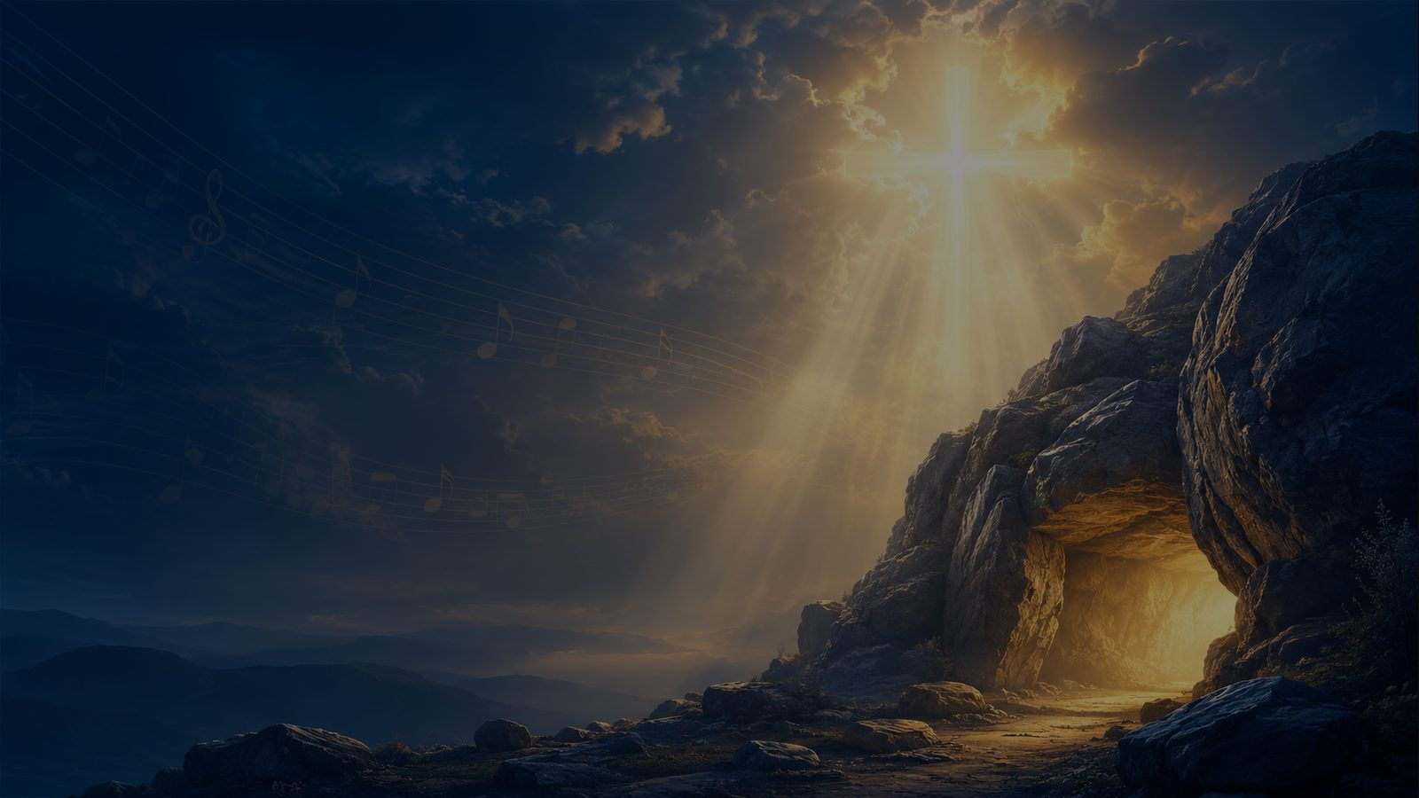
A Wonderful Savior Is Jesus My Lord
A hymn study on Christ as refuge, burden bearer, daily strength, and eternal hope
Common title: He Hideth My Soul
First line: A wonderful Savior is Jesus my Lord
Text: Frances Jane Crosby (1820-1915)
Music: William James Kirkpatrick (1838-1921)
Written: 1890
Primary Scripture: Exodus 33:22
Prepared for teaching and small group use - hymninfo.com

Slide 2

Teaching Aim
FORMATION GOALS
Understand Christ as Savior, refuge, burden bearer, source of daily strength, and hope of eternal fellowship.
Feel confidence that Christian assurance rests in the Savior’s care, not in changing circumstances.
Practice bringing anxiety, weakness, and burdens to Christ in prayer, worship, and mutual encouragement.
Prepared for teaching and small group use - hymninfo.com

Slide 3
Hymn Identity
BASIC HYMN FACTS
Text and Setting
Central Themes
Title: A Wonderful Savior Is Jesus My Lord
Common title: He Hideth My Soul
First line: A wonderful Savior is Jesus my Lord
Text: Frances Jane Crosby, 1890
Music: William James Kirkpatrick
Tune: KIRKPATRICK / HE HIDETH MY SOUL
Assurance and comfort
Christ as refuge and Savior
Burden bearing and daily strength
Divine protection and peace
Eternal hope and final praise
Prepared for teaching and small group use - hymninfo.com

Slide 4

Historical Background
1890 GOSPEL HYMN
Frances Jane Crosby wrote the hymn in 1890.
William James Kirkpatrick composed the gospel tune commonly identified as KIRKPATRICK or HE HIDETH MY SOUL.
The hymn became widely known through gospel songbooks, revival hymnody, and later hymnals.
Its common title comes from the recurring image of the soul hidden in the Savior’s care.
The hymn joins testimony, Scripture imagery, and a memorable refrain in the American gospel song tradition.
Prepared for teaching and small group use - hymninfo.com

Slide 5
Why This Hymn Matters Today
PASTORAL VALUE
It gives language for believers who need shelter, not merely explanation.
It teaches assurance without denying burdens, weakness, or trouble.
It connects present refuge in Christ with the hope of being with the Lord forever.
It is useful for services of comfort, testimony, prayer, funerals, and pastoral care.
It helps congregations confess that Christ sustains his people in every season.
Prepared for teaching and small group use - hymninfo.com

Slide 6
Biblical Foundation
EXODUS 33:22
Exodus 33:22
It will happen, while my glory passes by, that I will put you in a cleft of the rock, and will cover you with my hand until I have passed by;
Prepared for teaching and small group use - hymninfo.com

Slide 7

Supporting Scriptures
BIBLICAL FRAMEWORK
Psalm 27:5 - in trouble, God hides his people and lifts them upon a rock.
Psalm 32:7 - the Lord is a hiding place who preserves and surrounds his people with songs of deliverance.
Isaiah 32:2 - God provides shelter from the wind, refuge from the storm, and shade in a weary land.
Deuteronomy 33:25 - as your days, so shall your strength be.
1 Thessalonians 4:17 - believers will be with the Lord forever.
Prepared for teaching and small group use - hymninfo.com

Slide 8

Stanza 1: A Wonderful Savior
STANZA STUDY
Theme Summary
Scripture Connection
The hymn opens in praise. Jesus is not presented only as a helper in crisis but as the Savior who gives the believer a secure place of refuge.
Psalm 32:7 and Psalm 27:5 describe God as a hiding place and shelter in trouble. These texts deepen the hymn’s image of safety in Christ.
Teaching Emphasis
Teach assurance as personal trust in the Savior who shelters the soul.
Prepared for teaching and small group use - hymninfo.com

Slide 9
Stanza 2: Hidden in the Rock
STANZA STUDY
Theme Summary
Scripture Connection
The cleft of the rock image gives the hymn its most vivid picture: the believer is covered, protected, and held by divine mercy.
Exodus 33:22 gives the image of God placing Moses in the rock and covering him with his hand as his glory passes by.
Teaching Emphasis
Help learners see refuge as God’s active mercy, not passive escape.
Prepared for teaching and small group use - hymninfo.com

Slide 10
Stanza 3: Burdens and Daily Strength
STANZA STUDY
Theme Summary
Scripture Connection
The hymn recognizes the ordinary weight of life: burdens, weakness, and the need for strength. It teaches that Christ sustains his people day by day.
Deuteronomy 33:25 points to strength measured for the day, while Isaiah 32:2 pictures shelter and refreshment in a weary land.
Teaching Emphasis
Ask believers to name present burdens and entrust them to Christ in prayer.
Prepared for teaching and small group use - hymninfo.com

Slide 11
Stanza 4: Future Glory
STANZA STUDY
Theme Summary
Scripture Connection
The final movement looks beyond present shelter toward the day when believers will be with the Lord forever. Present refuge becomes everlasting praise.
1 Thessalonians 4:17 gives the final hope: the Lord’s people will be with him forever.
Teaching Emphasis
Teach Christian hope as more than survival; it is communion with Christ.
Prepared for teaching and small group use - hymninfo.com

Slide 12
“You are my hiding place. You will preserve me from trouble. You will surround me with songs of deliverance.”
Psalm 32:7
Prepared for teaching and small group use - hymninfo.com

Slide 13
Theological Theme: Christ the Refuge
DOCTRINE IN SONG
The hymn presents Christ as more than a distant rescuer; he is the hiding place of his people.
Refuge does not mean trouble disappears; it means the believer is held by the Savior within trouble.
The image of the rock speaks of stability, shelter, and divine nearness.
Assurance rests in Christ’s faithfulness, not in the believer’s strength.
This theme is especially suited for pastoral care and prayer.
Prepared for teaching and small group use - hymninfo.com

Slide 14
Theological Theme: Sustaining Grace
GRACE FOR EACH DAY
The hymn teaches that Christ meets weakness with sustaining care.
Daily strength is a form of grace: God gives what is needed for obedience and endurance today.
Burdens are not denied; they are brought to the Savior who bears and strengthens.
The church can use this hymn to comfort the weary without minimizing sorrow.
Grace is both sheltering and strengthening.
Prepared for teaching and small group use - hymninfo.com

Slide 15
Theological Theme: Eternal Hope
WITH THE LORD FOREVER
The hymn’s final hope is not only relief from present distress but fellowship with the Lord.
Christian assurance looks forward as well as upward.
The Savior who hides and strengthens now will bring his people safely into glory.
1 Thessalonians 4:17 gives the future shape of the hymn’s hope.
Present worship anticipates everlasting praise.
Prepared for teaching and small group use - hymninfo.com

Slide 16
Literary and Musical Observations
HOW THE HYMN WORKS
Textual Movement
Tune Character
Begins with praise for the Savior
Develops the rock and hiding place image
Names burdens and daily strength
Moves toward final glory
Uses testimony to invite congregational trust
Gospel-song melody with a memorable refrain
Gentle but confident emotional tone
Meter commonly listed as 11.8.11.8 with refrain
Works well at a moderate tempo
Supports worship, testimony, and pastoral comfort
Prepared for teaching and small group use - hymninfo.com

Slide 17
Pastoral and Worship Use
CHURCH SETTINGS
Services focused on assurance, comfort, testimony, or Christ as refuge
Pastoral care gatherings, prayer meetings, and services of healing
Funerals and memorial services when paired with resurrection hope
Sermons on Exodus 33, Psalm 32, Isaiah 32, or daily strength
Choir or congregational singing when the church needs a gentle confession of trust
Prepared for teaching and small group use - hymninfo.com

Slide 18
Choir and Congregational Notes
MUSICAL LEADERSHIP
Let the refrain carry the testimony without rushing it.
A moderate tempo preserves both comfort and confidence.
Use clear diction on words that describe refuge, covering, strength, and glory.
Piano, organ, choir, or simple gospel-style accompaniment can support the text well.
Keep the musical mood warm and steady rather than overly dramatic.
Prepared for teaching and small group use - hymninfo.com

Slide 19
Teaching Questions
FOR DISCUSSION
Observation
Application
What picture of Jesus stands at the center of this hymn?
How does Exodus 33:22 shape the image of refuge?
Which Scripture best supports the theme of daily strength?
Where do you seek shelter apart from Christ?
What burden do you need to bring honestly to the Savior?
How does future hope change present fear?
Prepared for teaching and small group use - hymninfo.com

Slide 20
Application: Enter the Refuge
RESPONSE
Name one burden before the Lord without trying to soften it.
Pray Psalm 32:7 as a confession of trust.
Ask God for strength for this day, not control over every tomorrow.
Encourage someone who needs Christ’s sheltering care.
Let the promise of being with the Lord forever reshape fear and grief.
Prepared for teaching and small group use - hymninfo.com

Slide 21
Suggested Lesson Flow
TEACHING PLAN
30 Minutes
60 Minutes
5 min - introduce the hymn and read Exodus 33:22
8 min - discuss refuge and the cleft of the rock image
10 min - study daily strength and eternal hope
5 min - group application questions
2 min - closing prayer
10 min - hymn identity and historical setting
15 min - Scripture study
15 min - stanza-by-stanza discussion
10 min - pastoral and worship use
10 min - application and prayer
Prepared for teaching and small group use - hymninfo.com

Slide 22
Closing Summary
FINAL TAKEAWAYS
The hymn praises Jesus as a wonderful Savior who hides, holds, and sustains his people.
Exodus 33:22 gives the central image of shelter in the cleft of the rock.
Psalm 32:7 teaches believers to confess God as their hiding place.
Deuteronomy 33:25 directs the weary to daily strength.
1 Thessalonians 4:17 lifts present comfort toward eternal fellowship with Christ.
Prepared for teaching and small group use - hymninfo.com

Slide 23
Closing Prayer
PASTORAL PRAYER
Wonderful Savior, hide us in your mercy and hold us in your care.
Teach the anxious to rest and the weary to receive strength for today.
Make your church a sheltering people who point one another to Christ.
Keep our hope fixed on the day when we will be with you forever.
Receive our trust, our worship, and our praise. Amen.
Prepared for teaching and small group use - hymninfo.com

Slide 24
Usage Notice
HYMNINFO RESOURCES
© HymnInfo.com. Free for personal, church, classroom, and small-group teaching use. Please do not sell, repost, or redistribute as downloadable files without permission.
Prepared for teaching and small group use - hymninfo.com
Prepared for teaching and small group use - hymninfo.com

