Slide 1
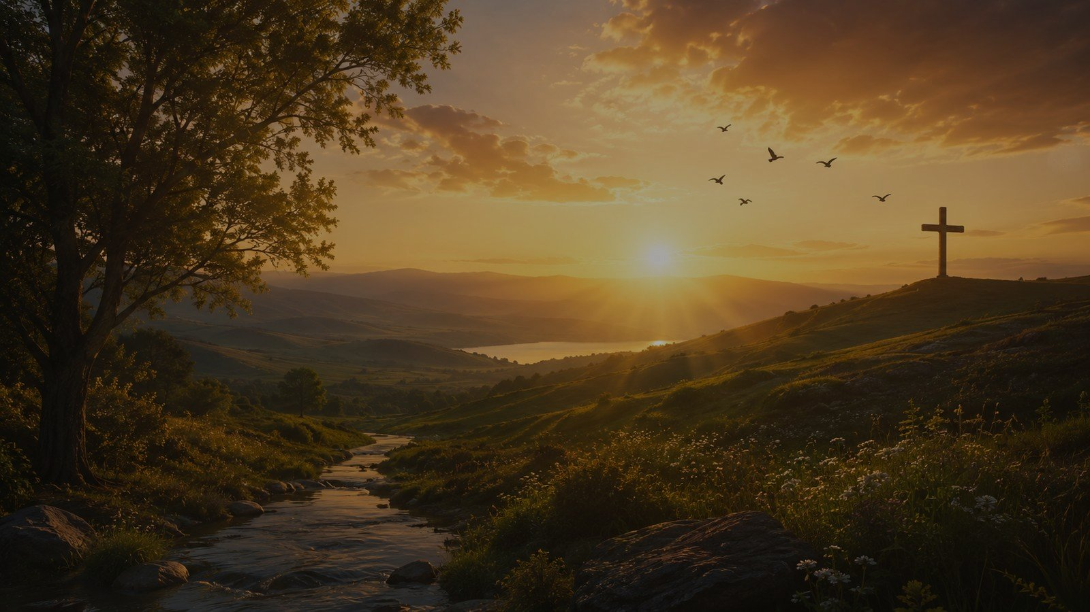
All Creatures of Our God and King
First line: “All creatures of our God and King”
Francis of Assisi • William Henry Draper • LASST UNS ERFREUEN • 1919
Primary Scripture: Psalm 148
A hymn study for worship, creation, providence, and doxology
Prepared for teaching and small group use - hymninfo.com

Slide 2
Teaching Aim
Understand
Feel
Practice
• Understand how the hymn joins biblical creation praise with Christian worship.
• Feel renewed wonder, humility, and gratitude before the Creator.
• Practice praise that includes creation, human sorrow, mercy, and trinitarian doxology.
Prepared for teaching and small group use - hymninfo.com

Slide 3
Hymn at a Glance
• Title: All Creatures of Our God and King
• First line: “All creatures of our God and King”
• Text: based on the Canticle of the Sun associated with Francis of Assisi
• English paraphrase: William Henry Draper
• Tune: LASST UNS ERFREUEN
• Common date in English hymn references: 1919
• Meter: often indexed as 8.8.4.4.8.8 with alleluias, or L.M. with additions
Prepared for teaching and small group use - hymninfo.com

Slide 4
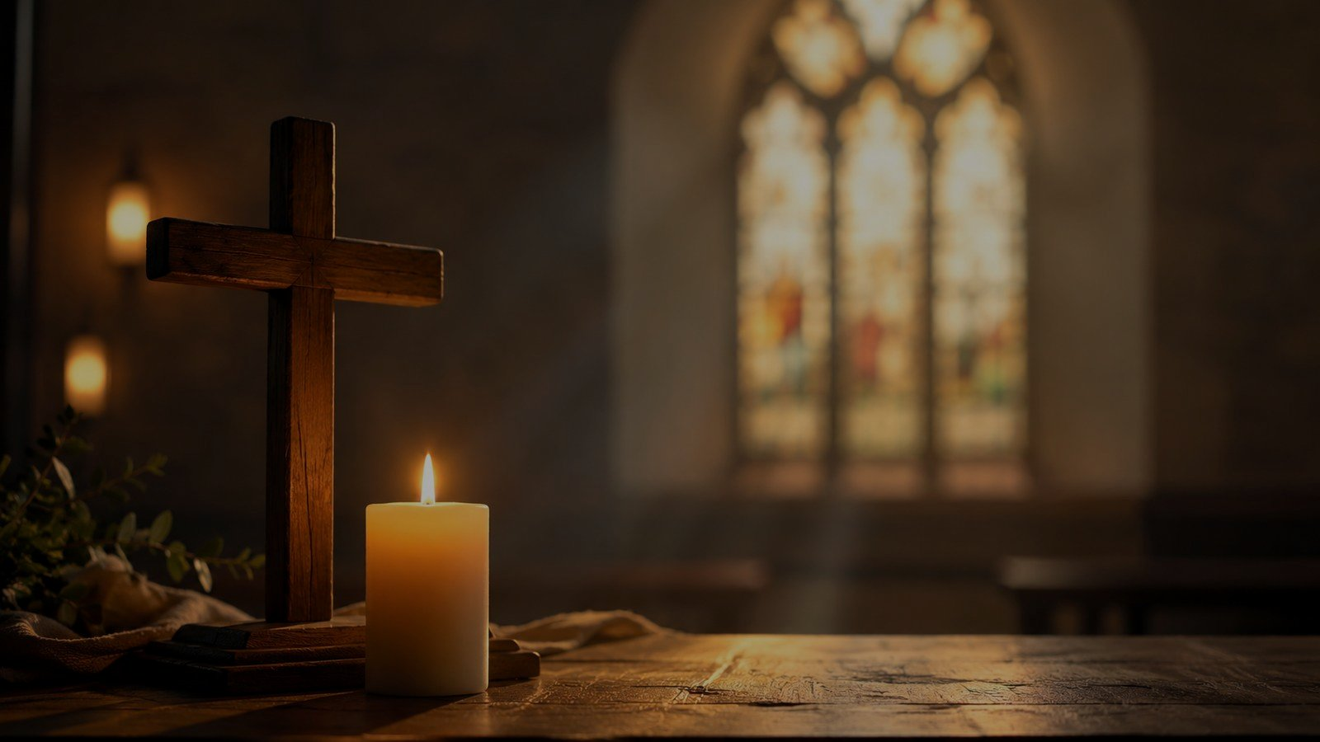
Historical Background
A medieval song of praise reshaped for English congregational worship.
Prepared for teaching and small group use - hymninfo.com

Slide 5
Francis of Assisi and the Canticle
Historical Setting
Teaching Value
• Francis of Assisi lived from 1182 to 1226.
• The Canticle of the Sun is associated with the end of his life.
• Its imagery honors God through created things.
• The hymn carries humility, gratitude, and reverence into congregational song.
• Creation is treated as God’s good work, not as an object of worship.
• The tone is joyful without becoming sentimental.
Prepared for teaching and small group use - hymninfo.com

Slide 6
William Henry Draper’s Paraphrase
Draper’s Contribution
Why It Matters
• William Henry Draper was an Anglican priest and scholar.
• His English text is a free paraphrase rather than a literal translation.
• The hymn became durable because it sings naturally in a congregation.
• A medieval devotional text became accessible for modern English worship.
• The text is memorable, vivid, and expansive.
• It invites worshipers to see creation as a witness to God’s goodness.
Prepared for teaching and small group use - hymninfo.com

Slide 7
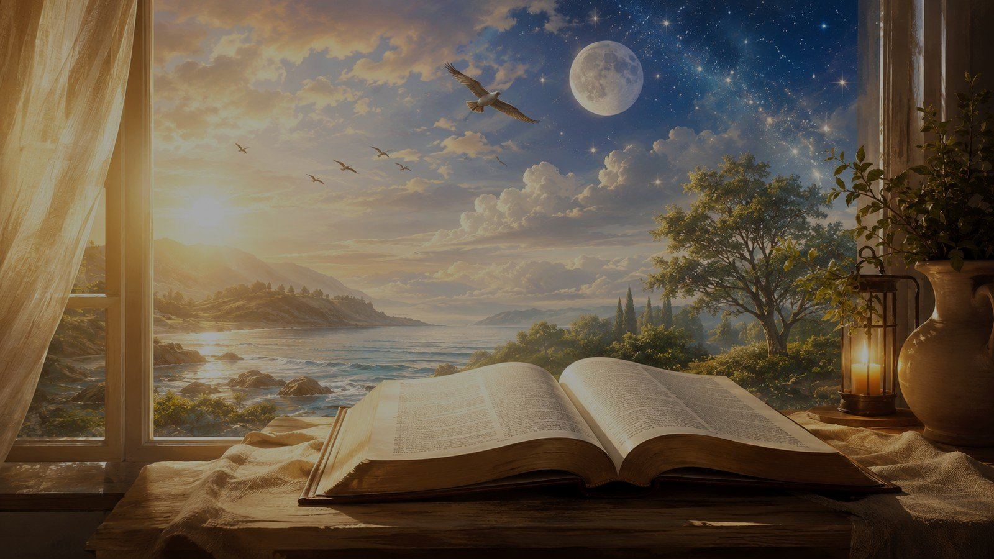
Biblical Foundation: Psalm 148
“Praise the LORD from the heavens! Praise him in the heights!... Let them praise the LORD’s name, for his name alone is exalted.”
• The psalm summons heaven and earth into praise.
• Sun, moon, stars, weather, mountains, animals, rulers, and children all join the call.
• The hymn sings this biblical vision in congregational form.
Prepared for teaching and small group use - hymninfo.com

Slide 8
Why This Hymn Matters Today
Wonder
Gratitude
Doxology
• It teaches worshipers to move from wonder to worship.
• It forms gratitude for God’s created world and sustaining care.
• It brings human tenderness, forgiveness, and sorrow into praise.
• It keeps creation praise directed toward the triune God.
• It gives churches a strong hymn for thanksgiving, creation, Trinity, and festival worship.
Prepared for teaching and small group use - hymninfo.com

Slide 9
Stanza Study 1
The Whole Creation Invited to Praise
Theme
Scripture Link
Teaching Emphasis
The hymn opens with a broad summons: every creature is invited to lift its voice. The sun and moon become signs of the glory of God.
Psalm 148 names heavenly bodies and earthly creatures as participants in praise.
Worship is larger than private feeling. The church joins the praise of all God has made.
Prepared for teaching and small group use - hymninfo.com

Slide 10
Stanza Study 2
Wind, Clouds, Morning, and Evening
Theme
Scripture Link
Teaching Emphasis
The daily patterns of sky, weather, and time become reminders of God’s faithfulness.
Psalm 104 celebrates God’s wisdom in the rhythms and gifts of creation.
Teach believers to receive ordinary days as repeated calls to praise.
Prepared for teaching and small group use - hymninfo.com

Slide 11
Stanza Study 3
Water and Fire as Servants of God
Theme
Scripture Link
Teaching Emphasis
Water and fire are pictured as useful, life-giving parts of God’s world: refreshing, warming, lighting, and sustaining.
Psalm 104 sees creation as ordered by divine wisdom and sustained by God’s open hand.
Creation’s usefulness points to the Creator’s generosity.
Prepared for teaching and small group use - hymninfo.com

Slide 12
Stanza Study 4
Human Tenderness, Sorrow, and Mercy
Theme
Scripture Link
Teaching Emphasis
The hymn turns from nature imagery to human life: forgiving others, bearing sorrow, and casting care on God.
1 Peter 5:7 and the psalms teach believers to bring anxiety, grief, and trust before the Lord.
Praise is not denial. It carries pain, mercy, and dependence into worship.
Prepared for teaching and small group use - hymninfo.com

Slide 13
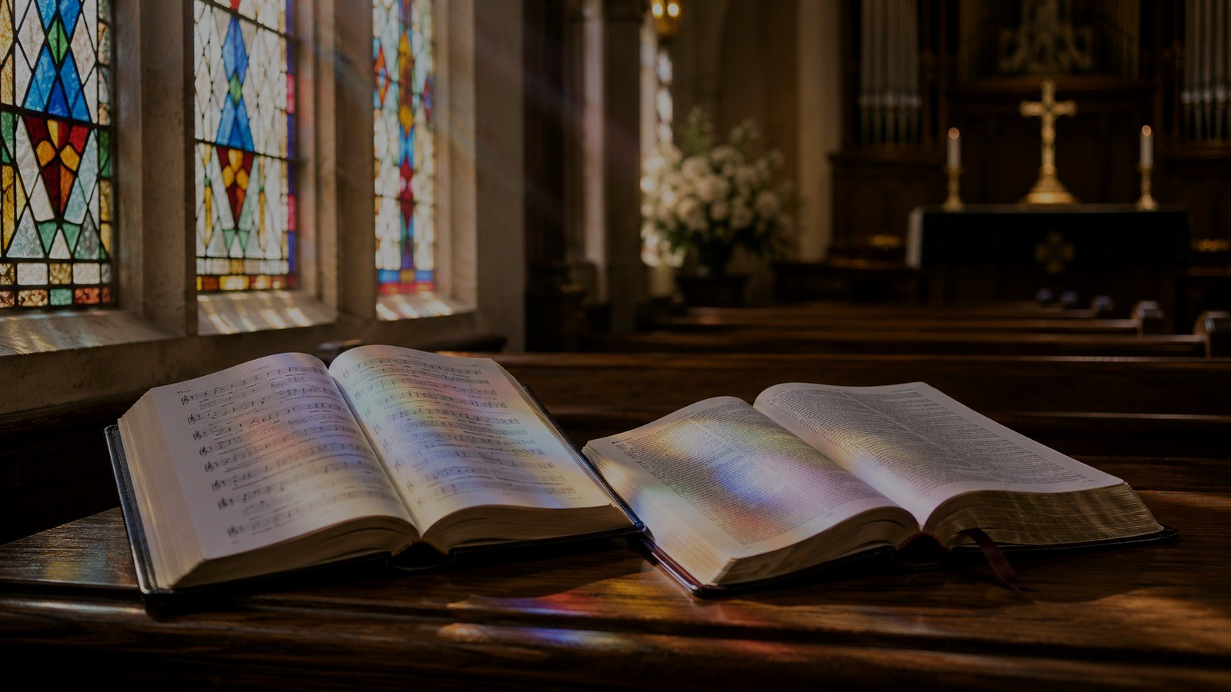
Stanza Study 5
Doxology to the Triune God
Theme
Scripture Link
Teaching Emphasis
The closing movement gathers all things into humble worship of Father, Son, and Spirit.
Revelation 5:13 pictures every created thing giving glory to God and the Lamb.
Creation praise reaches its proper goal in worship of the triune God.
Prepared for teaching and small group use - hymninfo.com

Slide 14
Theological Themes
• Creation: the world is God’s good work and witness.
• Providence: God sustains what he has made.
• Praise: worship is the fitting response to God’s glory.
• Humility: creatures worship the Creator, not themselves.
• Trinity: the final praise is directed to Father, Son, and Spirit.
• Hope: all creation is moving toward the worship pictured in Scripture.
Prepared for teaching and small group use - hymninfo.com

Slide 15
Christ and Creation
“All things have been created through him and for him... and in him all things are held together.”
• Colossians 1 deepens the hymn’s creation theology.
• Christ is not merely added to creation praise; all things exist through him and for him.
• The cross shows that the Creator is also Redeemer.
Prepared for teaching and small group use - hymninfo.com

Slide 16
Literary and Musical Observations
Text and Imagery
Tune Character
• The hymn moves outward: creatures, elements, human hearts, and final doxology.
• The repeated alleluias create a festival response.
• Nature imagery serves worship rather than replacing it.
• LASST UNS ERFREUEN has strong lift, repetition, and congregational energy.
• The long phrases need a confident but not rushed tempo.
• Organ, piano, choir, brass, or mixed accompaniment can support its festival character.
Prepared for teaching and small group use - hymninfo.com

Slide 17
Pastoral and Worship Use
Church
Class
Choir
Prayer
• Call to worship or opening hymn for a praise service.
• Creation, thanksgiving, Trinity, or festival worship.
• Small group study on Psalm 148 or Colossians 1.
• Choir rehearsal focus on joyful tone and clear alleluias.
• Pastoral teaching on gratitude, humility, and responsible care for creation.
Prepared for teaching and small group use - hymninfo.com

Slide 18
Teaching Questions
• How does Psalm 148 shape the hymn’s call to praise?
• What is the difference between praising God for creation and treating creation as divine?
• Which image in the hymn best helps you worship?
• How does Colossians 1 connect this hymn to Christ?
• Why does the hymn include mercy, suffering, and care?
• How can a congregation sing this hymn as prayer rather than mere celebration?
Prepared for teaching and small group use - hymninfo.com

Slide 19
Suggested Lesson Flow
Two ways to teach the hymn
30-Minute Plan
60-Minute Plan
1. Read Psalm 148 aloud (5 min)
2. Introduce hymn background (5 min)
3. Study stanza movement (10 min)
4. Discuss Christ and creation (5 min)
5. Close in prayer (5 min)
1. Opening reflection (10 min)
2. Historical setting (10 min)
3. Scripture study: Psalm 148 and Colossians 1 (15 min)
4. Stanza-by-stanza teaching (15 min)
5. Worship and application discussion (5 min)
6. Closing prayer (5 min)
Prepared for teaching and small group use - hymninfo.com

Slide 20
Application This Week
Praise
Thank
Encourage
Serve
• Read Psalm 148 as a personal prayer of praise.
• Name three ordinary gifts of creation and thank God for each one.
• Encourage someone carrying sorrow by praying with them.
• Practice one act of stewardship as gratitude to the Creator.
• Let worship lead you from admiration to obedience.
Prepared for teaching and small group use - hymninfo.com

Slide 21
Closing Summary and Prayer
This hymn begins with the world God made and ends in worship of Father, Son, and Spirit. It teaches the church to receive creation with gratitude, carry sorrow with trust, and join all things in praise.
Lord God, Maker of heaven and earth, awaken praise in us. Teach us to see your gifts, trust your providence, and worship you through Jesus Christ our Lord. Amen.
© HymnInfo.com. Free for personal, church, classroom, and small-group teaching use. Please do not sell, repost, or redistribute as downloadable files without permission.
Prepared for teaching and small group use - hymninfo.com

