Slide 1

Make Me a Blessing
Out in the Highways and Byways of Life — Teaching Guide
“Out of my life may Jesus shine.”
Refrain
01
Notes:
Opening frame: Introduce the hymn as a prayer of daily consecration. Its setting is not merely a sanctuary but the highways and byways where people are weary, sad, and in need of light.

Slide 2

Core Message
What the hymn teaches the church
Christian mission begins by noticing real human need.
Blessing is received from God so it may flow outward to others.
Witness requires both truthful words and a truthful life.
The refrain turns service into prayer: “Make me a blessing.”
02
Notes:
Emphasize that the hymn does not encourage self-importance. It asks Christ to make the believer a channel.

Slide 3
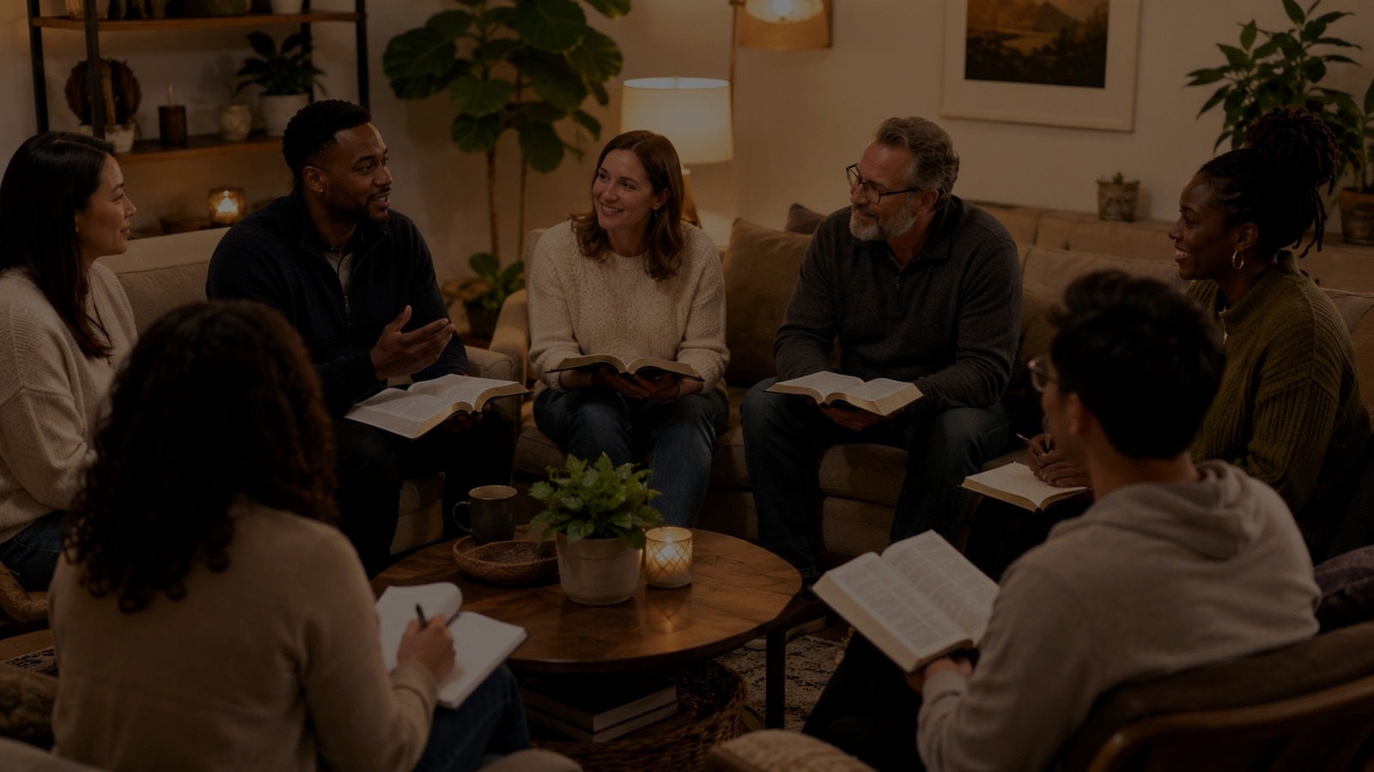
Hymn Identity
A mission hymn with a memorable refrain
Full title: “Out in the Highways and Byways of Life.”
Common title: “Make Me a Blessing.”
First line: “Out in the highways and byways of life.”
Text: Ira Bishop Wilson, 1909; tune SCHULER: George Stark Schuler, 1924.
Meter: 10.7.10.7 with refrain.
03
Notes:
Use this slide to establish the hymn clearly. Note the distinction between the first-line title and the title by which most congregations know the hymn.

Slide 4
Historical Background
Moody, Lorenz, and gospel-song mission
Wilson studied at Moody Bible Institute and worked with Lorenz Publishing Company.
Schuler was associated with Moody Bible Institute and Moody Memorial Church.
The completed text-tune pairing was issued in 1924 and dedicated to the Moody Memorial Church choir.
The hymn belongs to the early twentieth-century evangelical gospel-song tradition.
04
Notes:
Connect the hymn with Sunday schools, choirs, revival services, and mission-minded congregational song.

Slide 5
Scripture Foundation
Matthew 5:14–16
Jesus calls disciples “the light of the world.”
Visible good works should lead others to glorify the Father.
The hymn transforms this command into prayer: may Jesus shine through my life.
The goal is not attention to self, but glory to God.
“Let your light shine before men…”
Matthew 5:16
05
Notes:
Read Matthew 5:14-16 before singing. Ask listeners to identify every image of light, darkness, and good works in the hymn.

Slide 6
Blessed to Bless
Genesis 12, Luke 14, John 15, James 2
Genesis 12:2 — God blesses Abram so he will be a blessing.
Luke 14:23 — God’s servants go into the highways and hedges.
John 15:12 — disciples love as the Master loved them.
James 2:15–17 — faith becomes credible through practical mercy.
06
Notes:
This slide helps teachers avoid reducing the hymn to “be nice.” It is a biblically grounded vision of mission, witness, and mercy.

Slide 7
Verse 1: See the Need
“Many are weary and sad”
The hymn begins with human need, not institutional programming.
“Highways and byways” implies people outside familiar circles.
The Christian response is light-bearing: carry sunshine where darkness is rife.
Gladness is not shallow cheerfulness; it is hope carried into sorrow.
07
Notes:
Invite the group to name modern “highways and byways”: workplaces, hospitals, schools, neighborhoods, online spaces, and overlooked communities.

Slide 8
Verse 2: Tell the Story
Words joined to a trustworthy life
The hymn calls believers to tell of Christ’s love and forgiving power.
Evangelism is not pressure; it is faithful testimony to Christ.
The line “if only you prove true” links witness with integrity.
Our lives should confirm, not contradict, the message we speak.
08
Notes:
This is an important teaching point: verbal witness and sanctified character are not competing ministries. They belong together.

Slide 9
Verse 3: Give and Help
Grace received becomes mercy shared
“Give as ’twas given to you” roots generosity in grace.
“Love as the Master loved you” makes Jesus the pattern of service.
“Be to the helpless a helper indeed” demands practical action.
Mission is faithfulness to a God-given assignment, not occasional sentiment.
09
Notes:
Use James 2:15-17 here. Genuine faith refuses to bless people only with words when practical help is needed.

Slide 10
The Refrain as Prayer
A daily vocation, not a slogan
“Make me a blessing” is dependence on the Savior’s work in us.
“Out of my life may Jesus shine” centers Christ, not the servant.
“To someone today” keeps mission concrete, personal, and urgent.
The refrain can be prayed before work, ministry, visitation, or service.
“Make me a blessing to someone today.”
Refrain
10
Notes:
Consider having the class read the refrain as a spoken prayer before singing it.

Slide 11
Theological Themes
What the hymn forms in us
Consecration: the whole life becomes available to Christ.
Holistic witness: proclamation, character, generosity, and mercy belong together.
Grace-shaped generosity: Christians give because they have received.
Vocation: blessing is not abstract; it is directed toward real neighbors.
11
Notes:
Frame the hymn as practical theology. It teaches a way of being Christian in public, everyday life.

Slide 12
Musical Teaching Notes
SCHULER — warm, pastoral, and prayerful
Tune: SCHULER by George Stark Schuler, composed for Wilson’s text in 1924.
Meter: 10.7.10.7 with refrain; uploaded setting is in C major and 6/4 time.
The stanzas move with calm pastoral flow; the refrain broadens into prayer.
Sing warmly with steady pace; avoid dragging the refrain into sentimentality.
12
Notes:
Remind musicians that the refrain is long enough to require planned breathing. Keep a flowing compound-meter pulse.

Slide 13
Church Ministry Uses
Where the hymn serves well
Mission emphasis, commissioning, volunteer dedication, and service Sundays.
Evangelism training that values both words and integrity.
Community care, benevolence, visitation, and outreach ministries.
Choir ministry and congregational prayer before service projects.
13
Notes:
Pair the hymn with a concrete ministry opportunity so that the prayer becomes action.

Slide 14
Discussion + Practice
Move from study to action
Which stanza challenges our church most right now?
Who are the weary, sad, sorrowing, or helpless near us?
How can we tell Christ’s story with both words and a truthful life?
Choose one person or group to bless this week; name the action before closing.
14
Notes:
This slide can become the small group closing activity. Ask people to name one action that can happen within seven days.

Slide 15
Closing Commission
A prayer for everyday witness
Lord Jesus, make us a blessing.
Let your light shine through our words, our integrity, and our care.
Send us into the highways and byways with compassion and courage.
Make us a blessing to someone today. Amen.
15
Notes:
Close by praying the refrain. If appropriate, sing only the refrain softly after the prayer.

