Slide 1

MORE LIKE
THE MASTER
A powerful hymn teaching guide on Christlikeness, sanctification, surrender, and mission
Charles H. Gabriel • 1906 • Tune: HANFORD
“Take Thou my heart, I would be Thine alone.”
More Like the Master
01

Slide 2

Teaching Aim
Move learners from admiring Jesus to actively praying and practicing Christlikeness.
Christlikeness is God’s saving purpose, not a vague aspiration.
Sanctification includes humility, courage, love, cross-bearing, and mission.
The chorus teaches surrender: God must take, cleanse, wash, and keep the heart.
God saves us to make us like His Son.
Session outcome: a concrete area of growth, a surrendered prayer, and one act of Christlike service.
More Like the Master
02

Slide 3

Historical Setting
A gospel song shaped for confession, discipleship, and service.
Text and music are credited to Charles Hutchinson Gabriel, one of the most prolific American gospel hymn writers.
The text is dated 1906 and was first published in Praise and Service in 1907.
Later hymnals identify the tune as HANFORD and commonly preserve the three-stanza form with chorus.
The hymn belongs to the gospel-song tradition: memorable refrains carrying teaching about holiness and commitment.
Historical note: some sources differ on the tune copyright date, but the hymn’s identity is stable: Gabriel + HANFORD.
More Like the Master
03

Slide 4
BIBLICAL CENTER
Teaching movement
Romans 8:29: Conformed to the image of His Son
God’s purpose: make us like Christ.
Christ’s pattern: humility and self-giving service.
Spirit’s work: love, gentleness, self-control.
Disciple’s path: take up the cross and follow.
Heart’s prayer: cleanse, renew, restore, uphold.
More Like the Master
04

Slide 5

The Hymn’s Internal Logic
Each stanza answers the question: What does “more like the Master” look like?
1
Character
Meekness • humility • zeal • courage
2
Discipleship
Cross-bearing • kingdom labor • Spirit-filled witness
3
Love
Growth • service • self-denial like Jesus
Chorus
Surrender
Take my heart • purge me • wash me • keep me
More Like the Master
05

Slide 6

Verse 1: Character Before Activity
The Master’s virtues shape the worker’s service.
Meekness: strength submitted to God.
Humility: self removed from the center.
Zeal: love made diligent in service.
Courage: truthfulness when faithfulness costs.
“More of His meekness, more humility.”
Teaching question: Where does my service need Christ’s character, not just more effort?
More Like the Master
06

Slide 7
Verse 2: Cross-Bearing
Christlikeness matures under costly obedience.
“More strength to carry crosses I must bear” echoes Luke 9:23-24.
The cross is not ordinary inconvenience; it is costly loyalty to Jesus.
“Bring His kingdom in” turns holiness outward toward God’s rule and mission.
“More of His Spirit, the wanderer to win” refuses mission without Spirit-formed love.
More Like the Master
07

Slide 8

Verse 3: Love That Looks Like Jesus
Growth is visible in love and self-denial.
“Live and grow” emphasizes ongoing sanctification.
Christlike love must become visible to others.
Self-denial is not self-hatred; it is freedom from self-rule.
“Like His in Galilee” points to Jesus’ earthly ministry of humble service.
More Like the Master
08

Slide 9
THE HEART OF THE HYMN
Four verbs of surrender
Take Thou my heart
Take — exclusive ownership
Make — wholehearted belonging
Purge / Wash — honest cleansing from sin
Keep — preserving grace
Psalm 51:10-12 gives language for the chorus: clean heart, renewed spirit, restored joy, willing obedience.
More Like the Master
09

Slide 10

Core Theology
Sanctification is active obedience sustained by divine grace.
Sanctification
Conformity to Christ in character and conduct.
Discipleship
The path includes self-denial and cross-bearing.
Grace
God takes, cleanses, and keeps the heart.
Mission
The transformed life seeks the wanderer and serves the kingdom.
Spirit
The fruit of Christlike character is Spirit-produced.
More Like the Master
10

Slide 11

Musical Notes
How the tune HANFORD supports the hymn’s prayer.
Tune: HANFORD, linked with Charles H. Gabriel.
Meter: 10.10.11.11 with chorus.
Commonly printed in D-flat major and 6/8 time.
The compound meter gives gentle forward motion, suited to prayerful aspiration.
Moderate tempo helps singers articulate the petitions clearly.
More Like the Master
11

Slide 12
60-Minute Teaching Plan
Designed for Sunday school, discipleship class, or midweek group.
0-8
Sing + open prayer
8-18
Historical identity: Gabriel, HANFORD, gospel-song context
18-32
Romans 8:29 and the doctrine of Christlikeness
32-45
Verse-by-verse discussion
45-55
Application: one quality, one surrender, one act of service
55-60
Pray the chorus together
Leader emphasis: make each doctrine become prayer, and each prayer become practice.
More Like the Master
12

Slide 13

Application Workshop
Ask the hymn’s prayer honestly and specifically.
Quality
Loyalty
What Christlike virtue do I most need now?
What rival master must be dethroned?
Cross
Mission
Where is obedience currently costly?
Who is a wanderer I can pursue with humility?
Take-away commitment: “This week, I will practice Christlike ______ by ______.”
More Like the Master
13

Slide 14
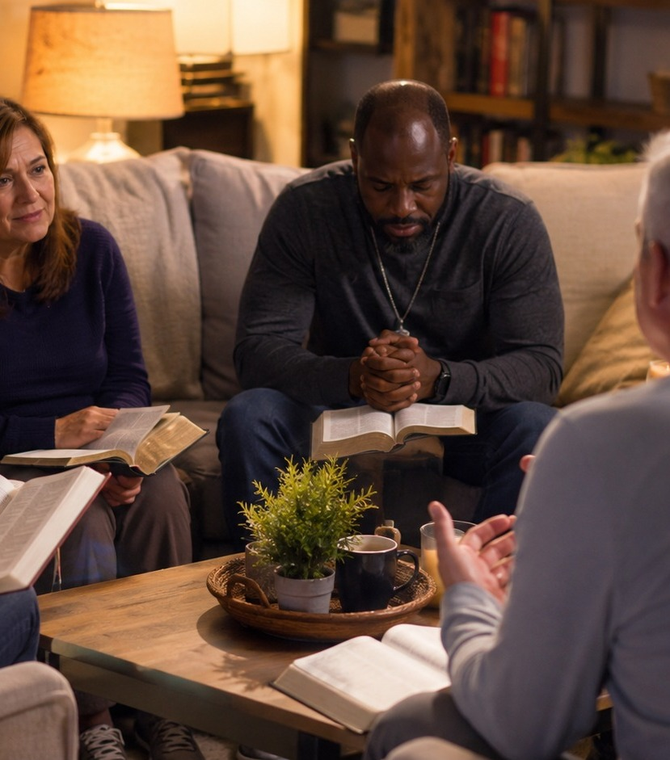
Facilitator Notes
Keep the session pastoral, concrete, and prayerful.
Read Romans 8:29 first: Christlikeness is God’s purpose, not self-improvement branding.
Name the virtues in the stanzas and ask for real-life examples.
Treat the chorus as confession before treating the hymn as motivation.
Connect holiness to mission: Spirit-filled character makes witness credible.
End by praying the chorus slowly, phrase by phrase.
More Like the Master
14

Slide 15
Closing Response
Take Thou my heart,
I would be Thine alone.
Purge me from sin, O Lord, I now implore;
Wash me and keep me Thine forevermore.
Prayer: Lord, make us more like the Master in humility, love, courage, self-denial, service, and mission. Amen.
More Like the Master
15

