Slide 1
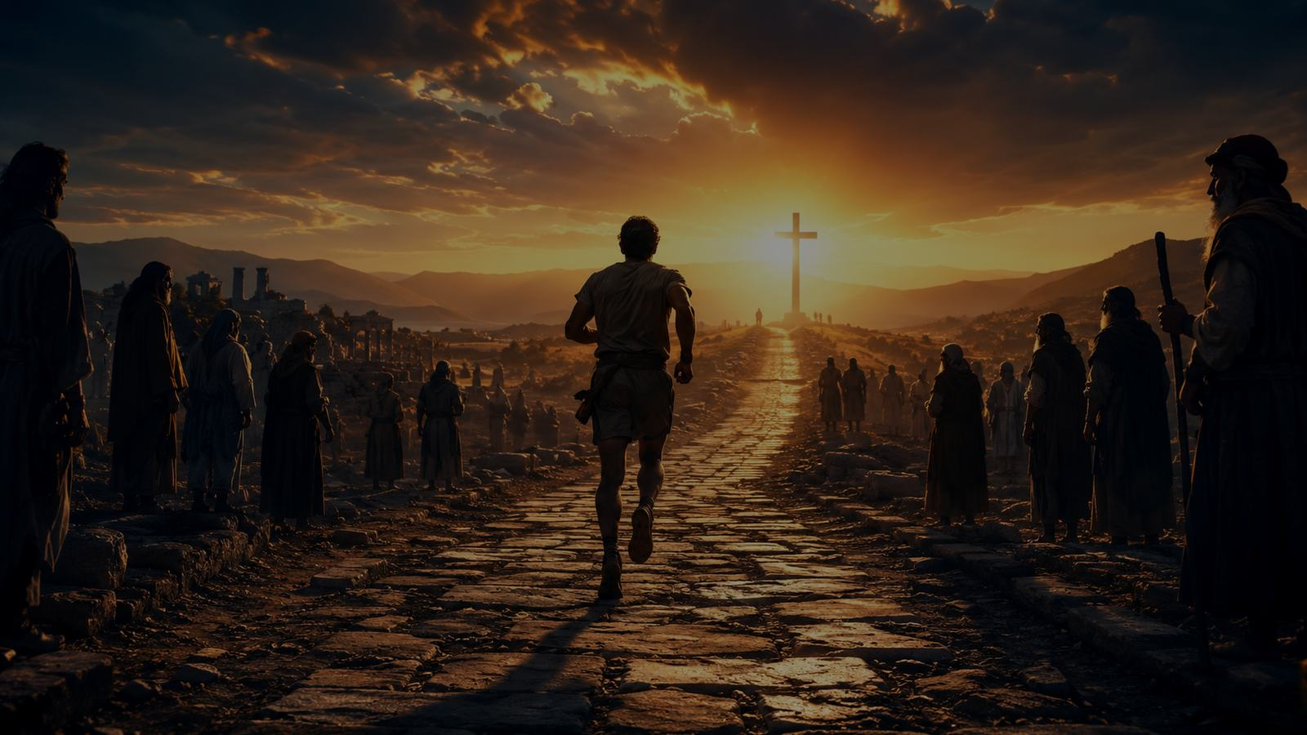
Awake, My Soul, Stretch Every Nerve
A hymn study on perseverance, holy zeal, and the crown laid at Christ's feet
Philip Doddridge • commonly sung to CHRISTMAS • Hebrews 12:1-2
Prepared for teaching and small group use - hymninfo.com
1

Slide 2
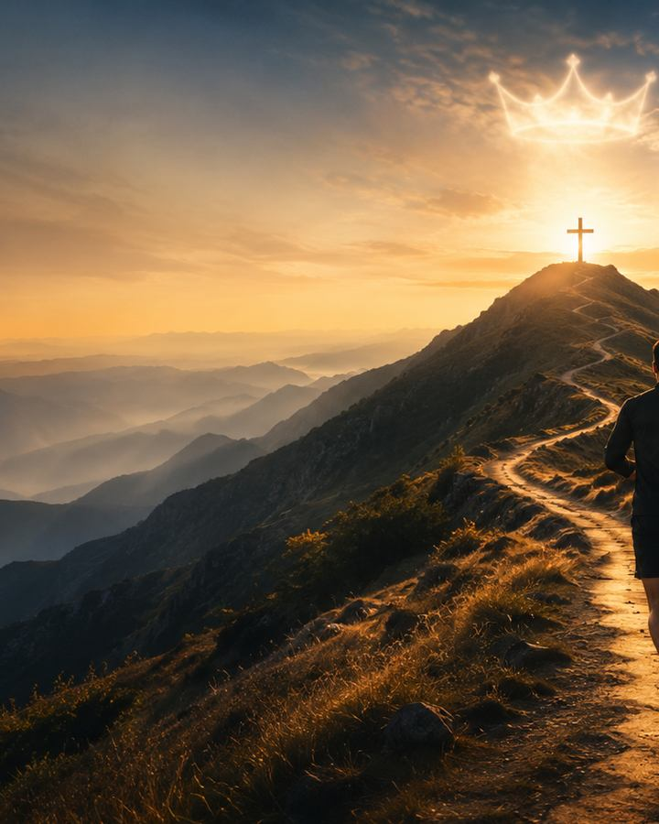
Teaching Aim
What this session should form in learners
1
2
3
Understand
Feel
Practice
Christian perseverance is a grace-shaped race, not self-saving effort.
A sober hope that awakens sluggish faith and strengthens weary disciples.
Lay aside hindrances, keep moving toward Christ, and give every honor back to him.
Prepared for teaching and small group use - hymninfo.com
2

Slide 3
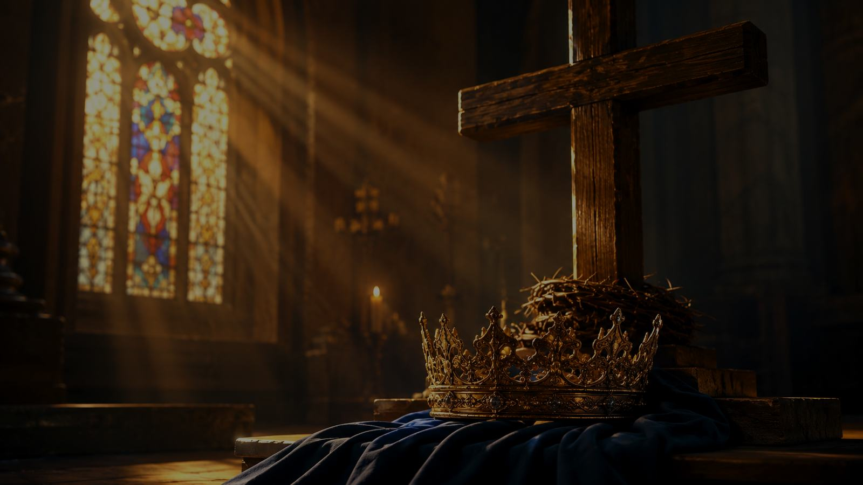
Hymn Identity
A vigorous eighteenth-century hymn of discipleship
First line
Awake, my soul, stretch every nerve
A call to awaken from spiritual dullness
A summons to run the race with holy perseverance
A final movement from victory to worship
Lyricist
Philip Doddridge (1702-1751)
First publication
Published posthumously in 1755
Common tune
CHRISTMAS, adapted from Handel material
Meter
Common Meter, often with repeated final line
Primary Scripture
Hebrews 12:1-2
Prepared for teaching and small group use - hymninfo.com
3

Slide 4
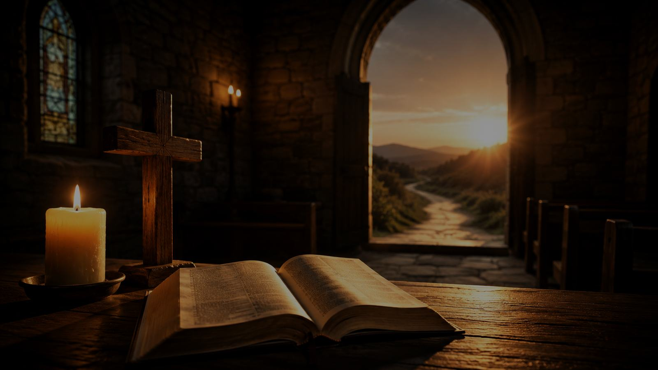
Historical Background
Doddridge’s sermon-shaped hymnody turned Scripture into congregational exhortation.
Prepared for teaching and small group use - hymninfo.com
4

Slide 5
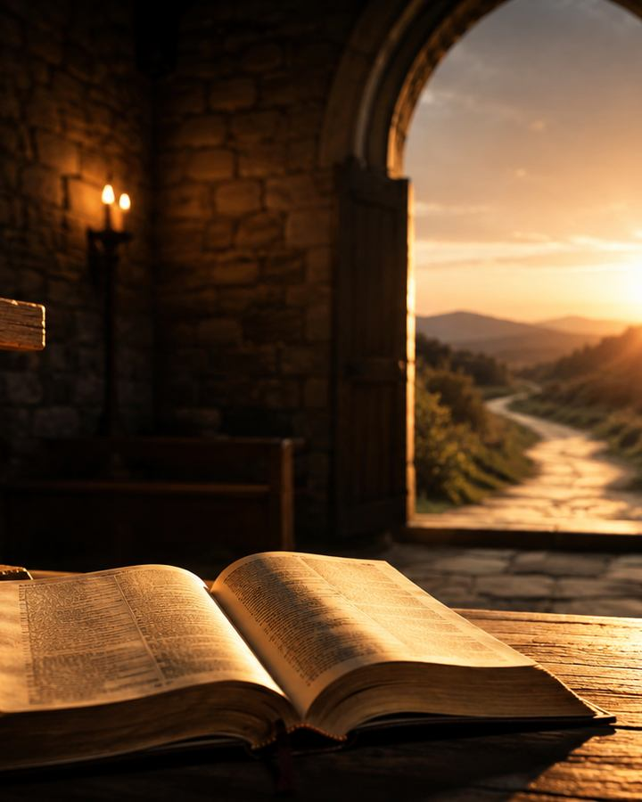
From Sermon to Song
What can be stated responsibly
Philip Doddridge was an English Nonconformist minister, educator, and hymn writer.
The hymn appeared after his death in Hymns Founded on Various Texts in the Holy Scriptures (1755), edited by Job Orton.
Doddridge often wrote hymns in connection with biblical texts and preaching.
Later hymnals commonly connect this text with the race imagery of Hebrews 12, 1 Corinthians 9, and Philippians 3.
Prepared for teaching and small group use - hymninfo.com
5

Slide 6
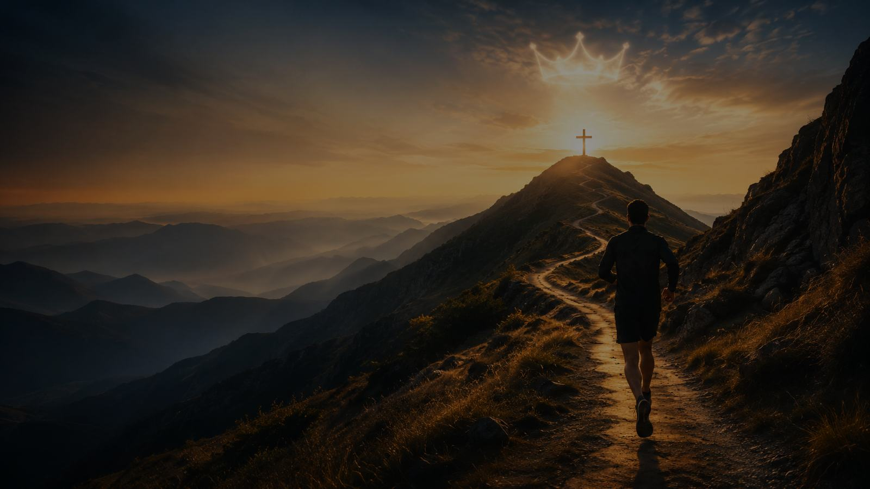
Why This Hymn Matters Today
For weary disciples and sleeping souls
It speaks directly to spiritual drift without shaming the weak.
It joins exertion with grace: the call is God’s, the race is Christ’s, the prize is received by faith.
It gives the church language for perseverance, discipline, courage, and humility.
Pastoral Key
The hymn does not say, “try harder so God will accept you.” It says, “Because Christ has brought you into the race, run toward him with hope.”
Prepared for teaching and small group use - hymninfo.com
6

Slide 7
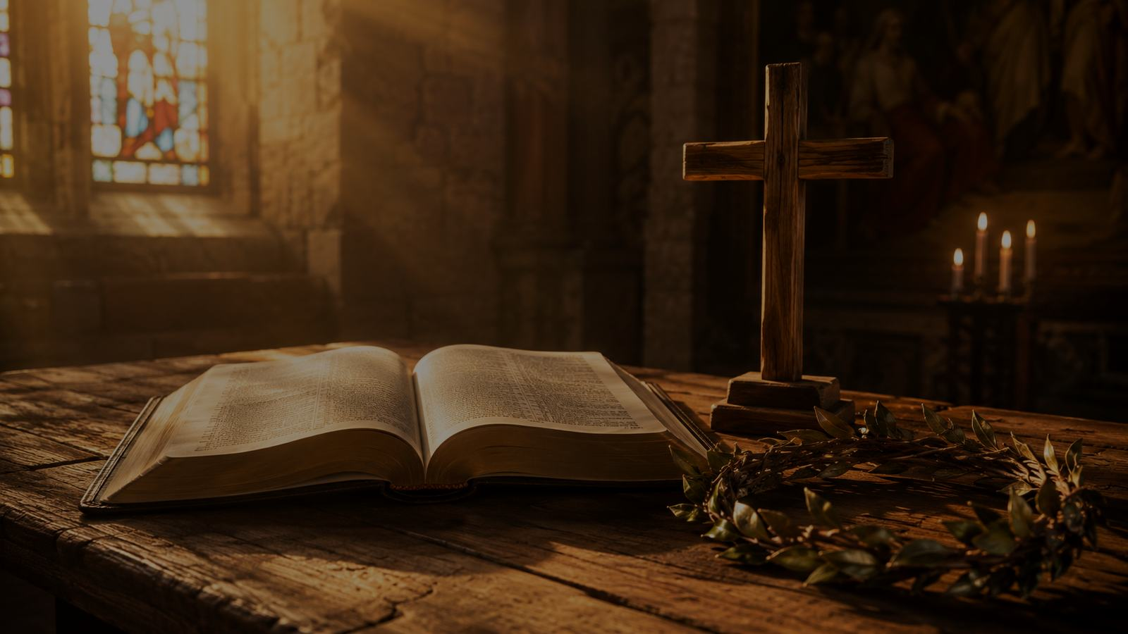
Biblical Foundation
Run with perseverance, looking to Jesus.
Prepared for teaching and small group use - hymninfo.com
7

Slide 8
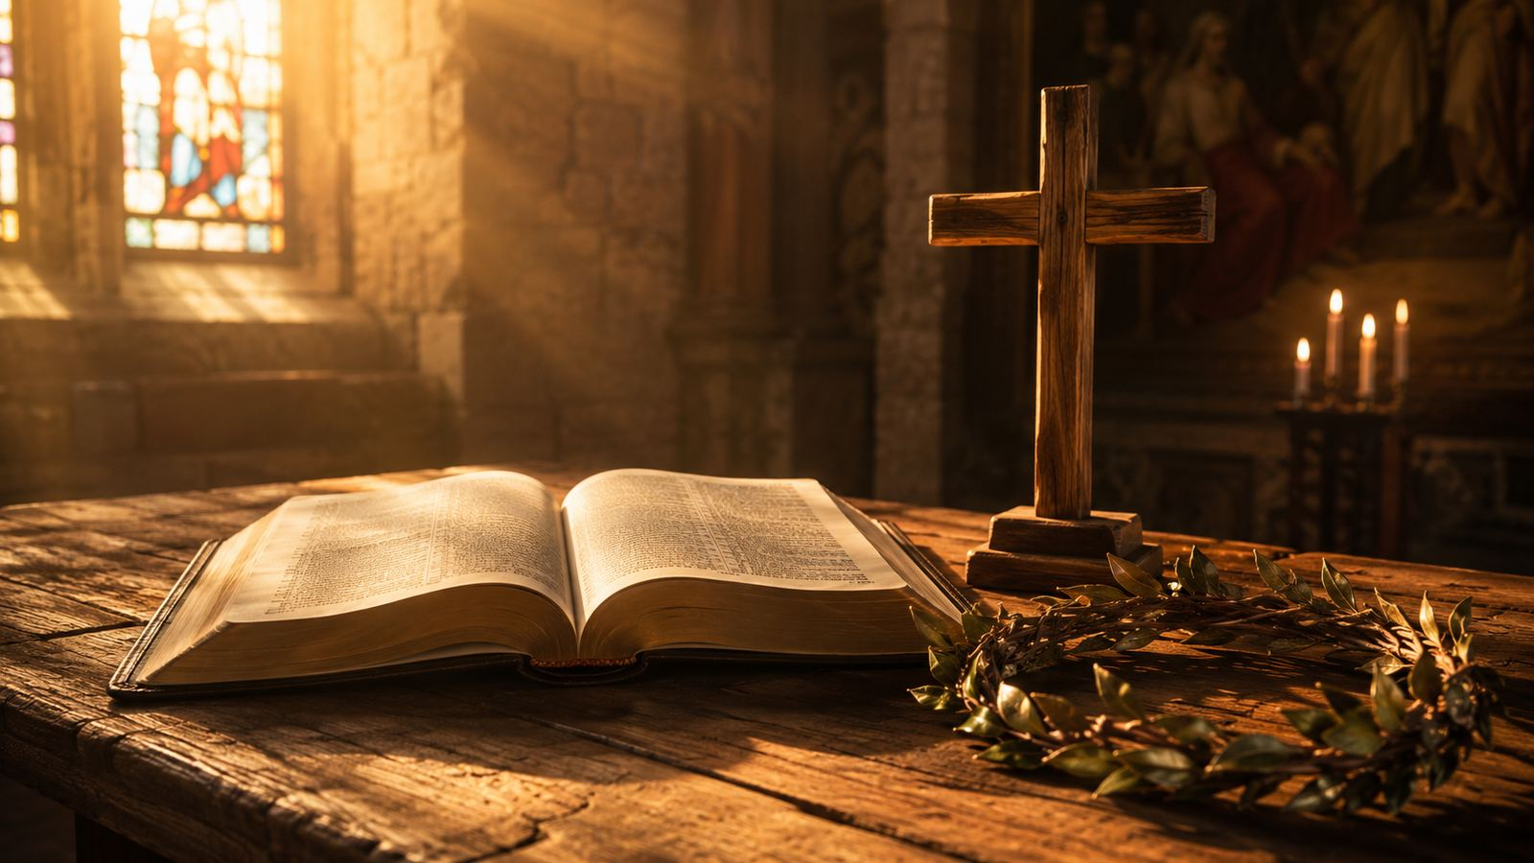
Hebrews 12:1-2
The race set before us
“Let us run with perseverance the race that is set before us, looking to Jesus...”
Strip away what entangles.
Run the actual race God has set before us.
Look to Jesus, not to self-confidence.
Remember that Christ endured before us and reigns above us.
Teaching emphasis
Christian endurance is not grim self-reliance. It is sustained attention to Jesus.
Prepared for teaching and small group use - hymninfo.com
8

Slide 9
Supporting Scriptures
The hymn gathers several biblical images
1 Corinthians 9:24-25
Run to receive an incorruptible crown.
Philippians 3:13-14
Forget what lies behind; press toward the goal.
2 Timothy 4:7-8
Finish the course and keep the faith.
James 1:12
The one who endures receives the crown of life.
Revelation 4:10-11
Crowns are finally cast before the throne.
Prepared for teaching and small group use - hymninfo.com
9

Slide 10
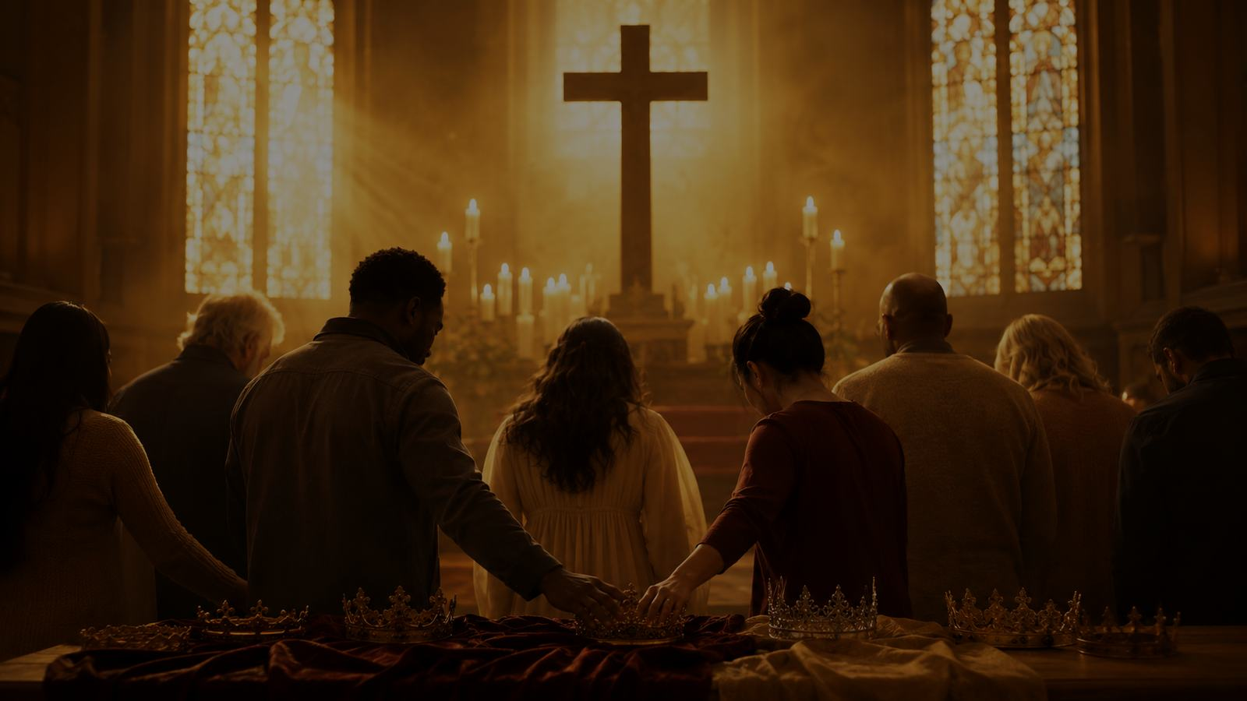
Stanza-by-Stanza Study
The hymn moves from awakening, to witnesses, to God’s call, to worship at Christ’s feet.
Prepared for teaching and small group use - hymninfo.com
10

Slide 11
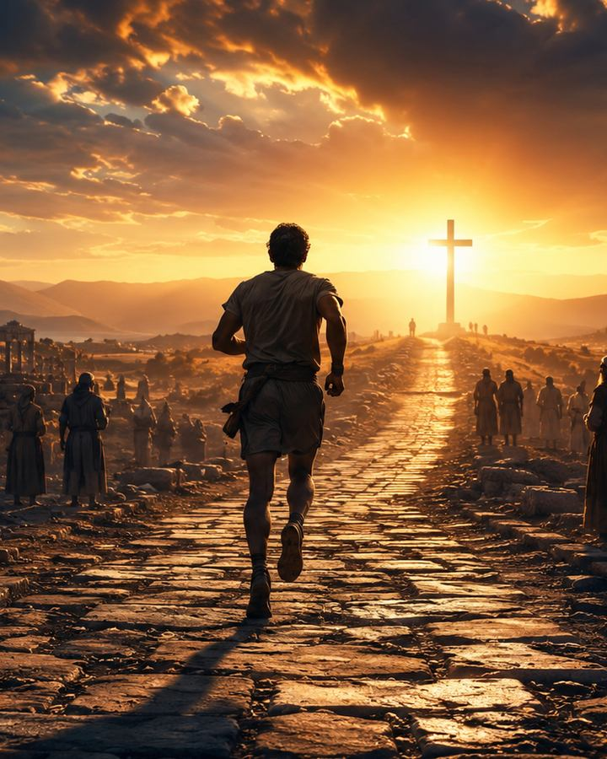
Stanza 1: Awakened Zeal
The race requires the whole person
The opening is a direct address to the soul, not a casual invitation.
“Stretch every nerve” names focused effort, discipline, and spiritual urgency.
The crown is “immortal,” so the prize is not applause, status, or earthly success.
Teaching point: grace does not make believers passive; it awakens them.
Prepared for teaching and small group use - hymninfo.com
11

Slide 12
Stanza 2: Surrounded by Witnesses
The church is never running alone
The hymn echoes the “cloud of witnesses” in Hebrews 12.
The faithful who have gone before encourage the church to continue.
“Forget the steps already trod” warns against living on yesterday’s obedience.
Teaching point: memory should encourage perseverance, not replace it.
Prepared for teaching and small group use - hymninfo.com
12

Slide 13
Stanza 3: God’s Enlivening Call
The prize is given by divine grace
The deepest summons comes from God, not from human ambition.
The believer’s energy is awakened by God’s “all-animating voice.”
The prize is presented by God’s own hand, so perseverance remains grace-shaped.
Teaching point: Christian striving is faith responding to God’s call.
Prepared for teaching and small group use - hymninfo.com
13

Slide 14
Stanza 4: Honors at Christ’s Feet
Victory ends in worship
The race begins through the blessed Savior.
Victory is real, but it is not self-glory.
The crown is placed at Christ’s feet in humility and adoration.
Teaching point: the finish line of discipleship is worship.
Prepared for teaching and small group use - hymninfo.com
14

Slide 15
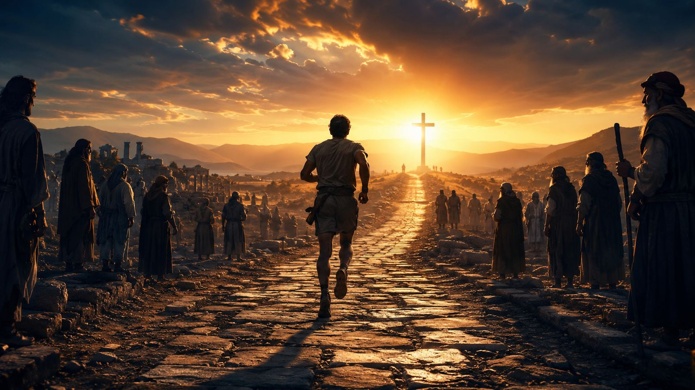
The Repeated Final Line
Repetition as devotional emphasis
Many hymnals repeat the final line of each stanza.
This is more than a musical device. It allows the congregation to linger over the stanza’s final image: the crown, the onward way, the prize, and the honors laid down before Christ.
Teaching cue: sing the repeats with intent, not as automatic echoes.
Prepared for teaching and small group use - hymninfo.com
15

Slide 16
Theological Themes
Six anchors for teaching
Perseverance
Sanctification
Witness
Faith continues under pressure.
Grace forms disciplined obedience.
The faithful encourage the living church.
Calling
Hope
Worship
God’s voice awakens spiritual life.
The prize is incorruptible and promised.
Every crown returns to Christ.
Prepared for teaching and small group use - hymninfo.com
16

Slide 17
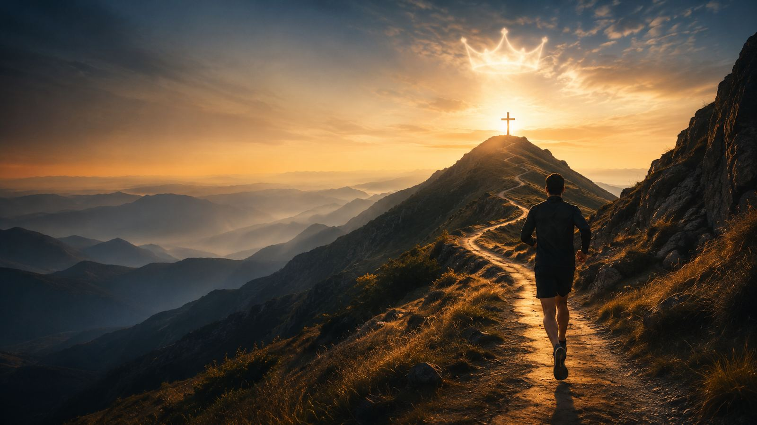
Literary and Musical Observations
How the hymn carries its message
Common Meter makes the text easy to sing and remember.
The frequent pairing with CHRISTMAS gives the hymn forward motion and brightness.
The tone is urgent but not frantic; the music should be firm, hopeful, and unhurried.
The text moves from command, to encouragement, to God’s call, to Christ-centered worship.
Prepared for teaching and small group use - hymninfo.com
17

Slide 18
Pastoral and Worship Use
Where this hymn can serve the church
Commitment or renewal services
Sermons on Hebrews 12, Philippians 3, or 1 Corinthians 9
Lessons on sanctification and disciplined discipleship
Pastoral encouragement for weary Christians
Closing hymn after a call to perseverance
Prepared for teaching and small group use - hymninfo.com
18

Slide 19
Teaching Questions
Questions that move from text to life
1
Where do you see the race imagery most clearly in the hymn?
2
What spiritual “weights” might need to be laid aside?
3
How do witnesses from the past encourage present obedience?
4
What difference does it make that God’s own voice calls the believer onward?
5
Why does the hymn end with honors laid at Christ’s feet?
Prepared for teaching and small group use - hymninfo.com
19

Slide 20
Application: Run the Race This Week
Practical response
Name one weight that slows obedience.
Read Hebrews 12:1-2 each morning for one week.
Ask God to awaken holy desire, not mere busyness.
Encourage one weary believer to continue in faith.
Practice returning praise to Christ when you are commended.
Prepared for teaching and small group use - hymninfo.com
20

Slide 21
Suggested Lesson Flow
Two ready-to-use options
30 minutes
60 minutes
Opening Scripture and prayer - 5
Hymn identity and background - 5
Stanza study highlights - 12
One application question - 5
Closing prayer - 3
Opening worship and Hebrews 12 - 8
Historical and musical setting - 10
Stanza-by-stanza study - 22
Group discussion - 12
Application and prayer - 8
Prepared for teaching and small group use - hymninfo.com
21

Slide 22
Closing Summary
Awakened by grace, running toward Christ
The Christian life is a race set before us by God.
Perseverance is not self-saving effort; it is faith animated by divine grace.
The witnesses encourage us, but Jesus is the one we look to.
The prize ends in worship: every crown belongs at Christ’s feet.
Prepared for teaching and small group use - hymninfo.com
22

Slide 23
Closing Prayer
Lord Jesus, awaken our souls by your grace. Help us lay aside every weight, run with perseverance, and keep our eyes fixed on you. Strengthen the weary, humble the confident, and teach us to return every honor to your feet. Amen.
© HymnInfo.com. Free for personal, church, classroom, and small-group teaching use. Please do not sell, repost, or redistribute as downloadable files without permission.
Prepared for teaching and small group use - hymninfo.com
23

