Slide 1
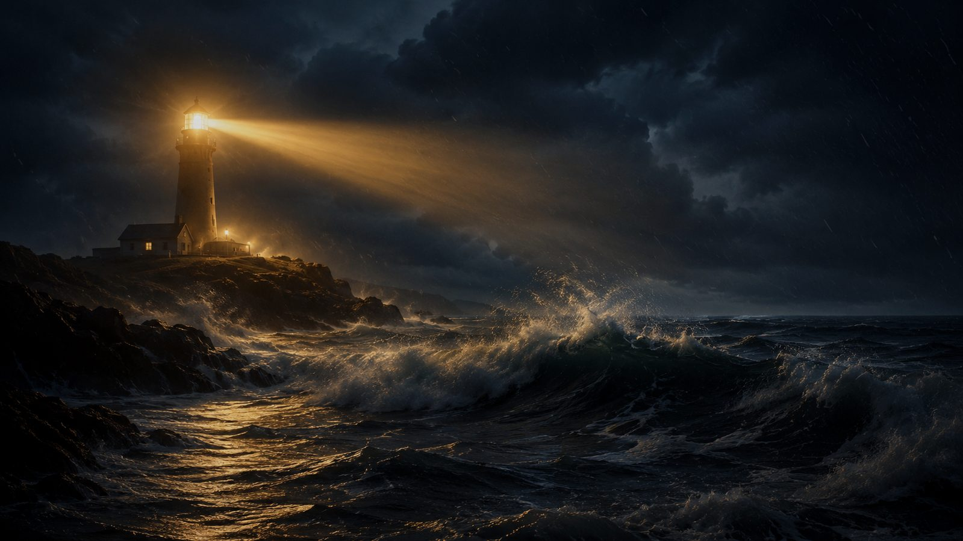
Brightly Beams Our Father's Mercy
Brightly beams our Father's mercy
Philip P. Bliss, 1871
Mission, witness, and the light of Christ
Primary Scripture: Matthew 5:14-16
Prepared for teaching and small group use - hymninfo.com

Slide 2
Teaching Aim
A lesson on mercy received and witness entrusted
LIGHT
CARE
SHINE
Understand
Feel
Practice
God is the source of saving mercy.
Compassion for those in danger.
Clear, humble witness where God places us.
By the end, learners should see the hymn as a call to faithful witness, not spiritual pride.
Prepared for teaching and small group use - hymninfo.com

Slide 3
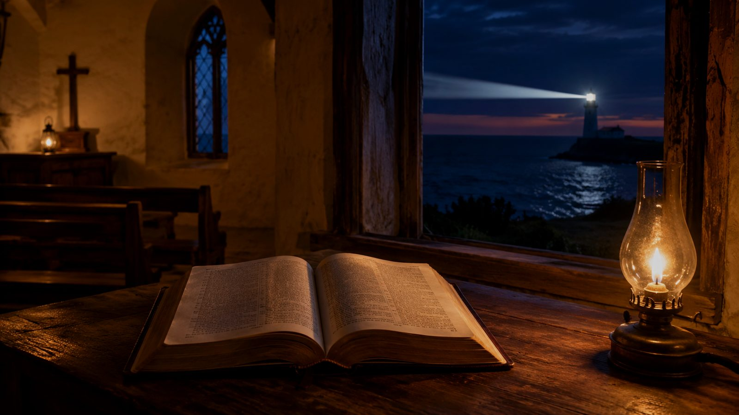
Hymn Identity
A gospel song of mission and compassionate responsibility
TITLE
Brightly Beams Our Father's Mercy
FIRST LINE
Brightly beams our Father's mercy
AUTHOR AND COMPOSER
Philip P. Bliss
YEAR
1871
COMMON EMPHASIS
Mission, evangelism, compassion, Christian witness
TUNE CHARACTER
Accessible gospel-song style with a memorable refrain
Prepared for teaching and small group use - hymninfo.com

Slide 4
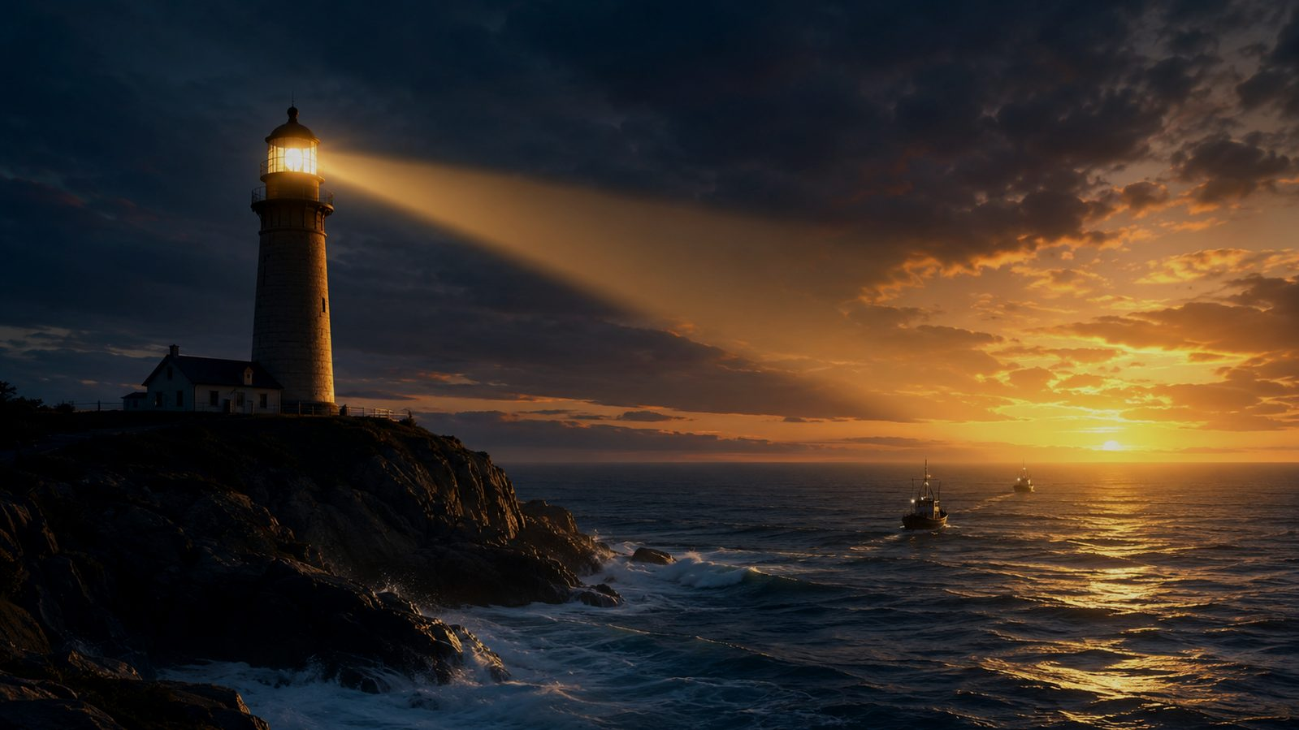
Historical Background
Bliss, revival song, and practical gospel witness
Philip P. Bliss wrote both words and music in 1871.
The hymn belongs to the American gospel-song tradition shaped by revival preaching and evangelistic singing.
A traditional harbor-light story is often associated with the hymn; it can serve as an illustration, while the hymn itself stands on its biblical call to witness.
Its vivid maritime imagery helped make the call to mission easy to remember and sing.
Prepared for teaching and small group use - hymninfo.com

Slide 5

Why This Hymn Matters Today
A church can receive mercy and still neglect the shore
It teaches that Christian witness is entrusted to ordinary believers.
It joins evangelism with compassion rather than pressure or self-focus.
It reminds the church that unclear witness can leave the vulnerable without help.
It points beyond our little lights to the saving light of Christ.
Pastoral emphasis
Not every believer preaches publicly, but every believer can shine faithfully, speak truthfully, and serve compassionately.
Prepared for teaching and small group use - hymninfo.com

Slide 6
Biblical Foundation
Christ is the light. The church bears witness to him.
Prepared for teaching and small group use - hymninfo.com

Slide 7
Biblical Foundation
Scriptures that frame the hymn
Matthew 5:14-16
Believers are called to visible discipleship that glorifies the Father.
John 8:12
Christ himself is the true light of the world.
Philippians 2:15-16
The church shines by holding forth the word of life.
Jude 22-23
Gospel witness includes urgent compassion.
Matthew 28:19-20
The risen Christ sends his people to make disciples.
Prepared for teaching and small group use - hymninfo.com

Slide 8
Hymn Section 1
Mercy beams from God; responsibility is entrusted to us
The opening image begins with the Father’s mercy, not human effort.
Believers are pictured as keepers of nearer lights along the shore.
The teaching emphasis is stewardship: grace received becomes witness given.
Teaching connection
Matthew 5 does not ask disciples to become the sun. It tells them not to hide the lamp.
Prepared for teaching and small group use - hymninfo.com

Slide 9
Hymn Section 2
The night is real, and watching eyes need guidance
The storm imagery names spiritual danger without turning witness into fear-mongering.
The hymn assumes that people in darkness are not enemies but persons in need of compassion.
The church’s witness must be steady enough to be seen in difficult weather.
Discussion prompt
Where do people around us need a clearer sign of hope, mercy, and truth?
Prepared for teaching and small group use - hymninfo.com

Slide 10
Hymn Section 3
Trim the lamp: ordinary faithfulness matters
The final movement is practical: tend the light you have been given.
A “feeble” lamp still matters when it is placed where it can be seen.
Faithful witness includes words, deeds, prayer, hospitality, and perseverance.
WORD
HAND
Truth
Service
PRAY
HEART
Prayer
Mercy
Prepared for teaching and small group use - hymninfo.com

Slide 11
Refrain Study
A repeated call to keep the guiding lights burning
The refrain turns the hymn from reflection into direct exhortation.
Its repeated image of light across the water makes witness concrete and urgent.
It does not claim that human effort saves; it teaches that God often uses faithful witness as an instrument of mercy.
The congregation sings not only about mission but as a congregation being summoned to mission.
Prepared for teaching and small group use - hymninfo.com

Slide 12
Theological Themes
What the hymn teaches the church to confess and practice
Mercy
Christ the Light
Mission
Salvation begins with the Father’s compassion.
Witness reflects him; it does not replace him.
Disciples are sent into real places and needs.
Compassion
Responsibility
Perseverance
Those in danger need care, not contempt.
God entrusts the church with visible witness.
The light must keep burning through the storm.
Prepared for teaching and small group use - hymninfo.com

Slide 13
Literary and Musical Observations
A gospel song designed for memory, urgency, and response
The maritime metaphor moves from divine light to shoreline witness.
The repeated refrain makes the congregation participants in the call.
The simple gospel-song structure supports quick learning and strong communal singing.
A steady tempo preserves earnestness without heaviness.
Musical use
Suitable for congregational singing, mission emphasis, evangelistic gatherings, and services of commissioning or outreach.
Prepared for teaching and small group use - hymninfo.com

Slide 14
Pastoral and Worship Use
Where the hymn serves the church well
Mission Sundays and outreach commissioning
Sermons on Matthew 5, John 8, Philippians 2, or the Great Commission
Small-group studies on witness and discipleship
Choir or congregation emphasis on clear, compassionate testimony
Prayer meetings asking God to revive local witness
Pastoral caution
Use the hymn to awaken compassion, not guilt. The goal is faithful witness shaped by mercy.
Prepared for teaching and small group use - hymninfo.com

Slide 15
Teaching Questions
Move from observation to action
1.
What does the lighthouse image teach about the difference between God’s mercy and our witness?
2.
How does Matthew 5 shape the hymn’s call to shine?
3.
Where can a church’s witness become unclear or hidden?
4.
How can evangelism be marked by compassion rather than pressure?
5.
What practical “lower light” can you tend this week?
Prepared for teaching and small group use - hymninfo.com

Slide 16
Application
Keep the light where it can be seen
Pray
Speak
Serve
Invite
Persevere
Ask God for compassion for people drifting in darkness.
Name Christ clearly when the door opens.
Let visible love make the gospel credible.
Welcome others into worship, study, and fellowship.
Keep the light steady even when results are slow.
Prepared for teaching and small group use - hymninfo.com

Slide 17
Suggested Lesson Flow
Two ready-to-use teaching paths
30-minute plan
60-minute plan
5 min - Sing or read the hymn summary
8 min - Matthew 5:14-16 and John 8:12
10 min - Three hymn movements
7 min - Personal application and prayer
10 min - Story, setting, and Scripture
15 min - Biblical study of light and witness
15 min - Hymn section study
10 min - Group discussion
10 min - Commitments and intercession
Prepared for teaching and small group use - hymninfo.com

Slide 18
Closing Summary and Prayer
The Father’s mercy shines steadily. Christ is the true light. The church is called to keep faithful witness visible along the shore.
Lord, keep our lamps burning with truth, mercy, courage, and love. Use our witness to point others safely toward Christ. Amen.
© HymnInfo.com. Free for personal, church, classroom, and small-group teaching use. Please do not sell, repost, or redistribute as downloadable files without permission.
Prepared for teaching and small group use - hymninfo.com

