Slide 1

The Lord Bless You and Keep You
A choral benediction on Numbers 6:24–26
First line: The Lord bless you and keep you
Composer: Peter Christian Lutkin
Date: around 1900
Primary Scripture: Numbers 6:24–26
Prepared for teaching and small group use - hymninfo.com

Slide 2

Teaching Aim
Understand
Receive
Practice
Benediction is God's Word of blessing, not a polite closing.
Hear the Lord's care, grace, favor, and peace spoken over his people.
Leave worship as people kept by God and sent into daily life.
Prepared for teaching and small group use - hymninfo.com

Slide 3


Hymn Identity
Title: The Lord Bless You and Keep You
Composer: Peter Christian Lutkin (1858–1931)
Text: Numbers 6:24–26
Form: compact SATB choral benediction rather than a stanza hymn
Distinctive feature: the extended sevenfold Amen
Prepared for teaching and small group use - hymninfo.com

Slide 4

Historical Setting
A biblical blessing given new life in American choral worship.
Prepared for teaching and small group use - hymninfo.com

Slide 5

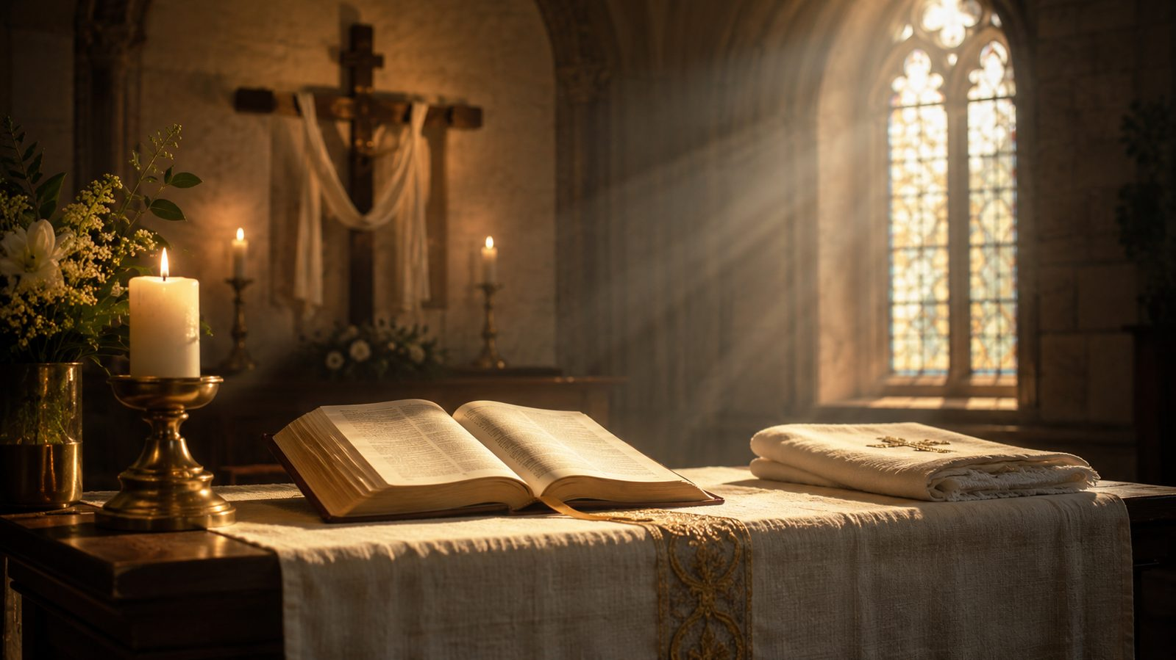
Peter Christian Lutkin
American organist, conductor, composer, and music educator.
Served churches in Chicago and shaped music education at Northwestern University.
This benediction became his best-known sacred composition.
The setting gained wide use in church, school, college, and community choirs.
Prepared for teaching and small group use - hymninfo.com

Slide 6

Biblical Foundation
The Lord places his name on his people through blessing, keeping, grace, favor, and peace.
Prepared for teaching and small group use - hymninfo.com

Slide 7

Numbers 6:24–26
The blessing begins with God’s initiative: the Lord blesses and keeps.
The shining face of the Lord communicates favorable presence and gracious attention.
Peace is the culminating gift: wholeness, security, reconciliation, and life under God’s rule.
A benediction sends worshipers out under God’s promise, not merely human goodwill.
Prepared for teaching and small group use - hymninfo.com

Slide 8


Supporting Scriptures
Psalm 67 connects God’s shining face with witness among the nations.
2 Corinthians 13:14 shows the continuing Christian use of blessing language.
Philippians 4:7 speaks of God’s peace guarding hearts and minds in Christ.
Jude 24–25 praises the One who is able to keep his people from stumbling.
Prepared for teaching and small group use - hymninfo.com

Slide 9

The Blessing in Four Movements
Bless. Keep. Shine. Give peace.
Prepared for teaching and small group use - hymninfo.com

Slide 10
Movement 1: Bless and Keep
Blessing is not a reward earned by worshipers; it is God’s generous favor.
Keeping emphasizes protection, preservation, and sustaining care.
Teachers can ask: What do people carry when they leave worship that needs God’s keeping?
Prepared for teaching and small group use - hymninfo.com

Slide 11


Movement 2: The Shining Face
Biblical language of God’s face points to personal presence and covenant favor.
The blessing assures the congregation that God’s attention is gracious, not distant.
The choir’s task is to sing this with warmth, dignity, and clear diction.
Prepared for teaching and small group use - hymninfo.com

Slide 12
Movement 3: Grace and Peace
Grace names God’s merciful dealing with undeserving people.
Peace is more than calm; it is life held together under the Lord’s faithful care.
The words prepare worshipers to enter the week as people blessed and sent.
Prepared for teaching and small group use - hymninfo.com

Slide 13
The Sevenfold Amen
The Amen is the choir’s prayerful agreement with Scripture.
Its repeated unfolding gives the congregation time to receive the blessing.
The musical effect should be reverent rather than dramatic for its own sake.
Prepared for teaching and small group use - hymninfo.com

Slide 14

Theology and Worship
A sung benediction teaches the church how to leave worship.
Prepared for teaching and small group use - hymninfo.com

Slide 15
Theological Themes
Divine initiative: blessing begins with the Lord.
Protection: God keeps his people in weakness and uncertainty.
Presence: the shining face means gracious nearness.
Grace: God’s mercy rests on his people.
Peace: worship ends with God’s wholeness and sending.
Prepared for teaching and small group use - hymninfo.com

Slide 16
Musical and Choral Notes
SATB choral anthem, often unaccompanied or lightly accompanied.
Smooth voice leading and sustained phrases require blend and breath control.
The Scripture text must remain intelligible; diction matters more than volume.
The Amen should feel like communal assent, not a performance flourish.
Prepared for teaching and small group use - hymninfo.com

Slide 17
Pastoral and Worship Use
Close Sunday worship with a clear sense of sending.
Use in weddings, funerals, graduations, ordinations, confirmations, and farewells.
Teach the congregation to receive a benediction as Scripture spoken over them.
Choirs can frame the piece as service, prayer, and pastoral care.
Prepared for teaching and small group use - hymninfo.com

Slide 18
Teaching Questions
What does it mean for the Lord to keep his people?
How does the image of God’s shining face comfort worshipers?
Why does the biblical blessing end with peace?
How is a benediction different from a general closing song?
What changes when people leave worship under God’s promise?
Prepared for teaching and small group use - hymninfo.com

Slide 19
Suggested Lesson Flow
30 minutes: read Numbers 6; explain each phrase; listen or sing; discuss one application.
60 minutes: add Psalm 67, 2 Corinthians 13, Philippians 4, and Jude; discuss choral practice and worship use.
Close by speaking the biblical blessing slowly over the group.
Prepared for teaching and small group use - hymninfo.com

Slide 20
Closing Prayer
Lord, bless your people and keep them. Make your face shine upon us and be gracious to us. Lift up your countenance upon your church, and give us peace through Jesus Christ our Lord. Amen.
© HymnInfo.com. Free for personal, church, classroom, and small-group teaching use. Please do not sell, repost, or redistribute as downloadable files without permission.
Prepared for teaching and small group use - hymninfo.com

Slide 21
Usage Notice
© HymnInfo.com. Free for personal, church, classroom, and small-group teaching use. Please do not sell, repost, or redistribute as downloadable files without permission.
Prepared for teaching and small group use - hymninfo.com

