Slide 1
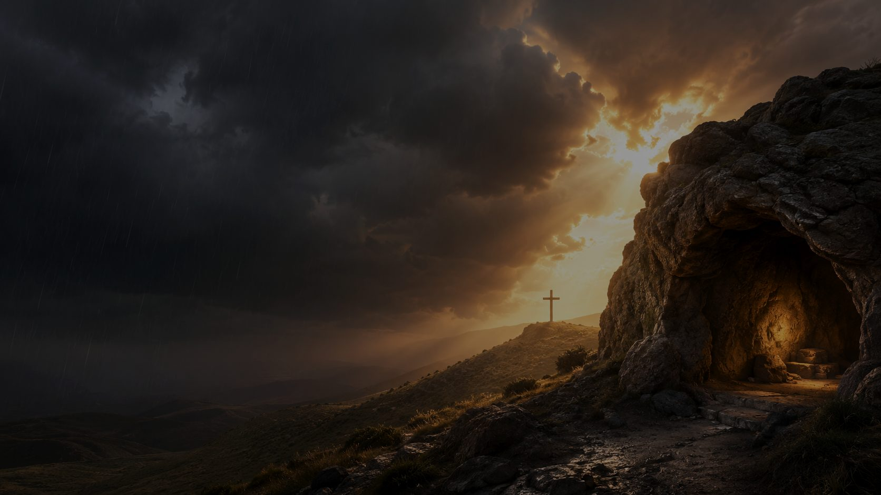
A Shelter in the Time of Storm
First line: The Lord's our Rock, in Him we hide
Text: Vernon John Charlesworth
Music: Ira David Sankey
Tune: SHELTER • around 1880
Primary Scripture: Isaiah 25:4
A hymn study resource for teaching, worship, and pastoral care
Prepared for teaching and small group use - hymninfo.com

Slide 2
Teaching Aim
By the end of the session, learners should...
Understand the hymn’s biblical images: rock, refuge, shade, shelter, and help in trouble.
Feel invited to bring real fear and weariness to Christ rather than hiding them.
Practice answering present storms with prayer, Scripture, and congregational encouragement.
Prepared for teaching and small group use - hymninfo.com

Slide 3
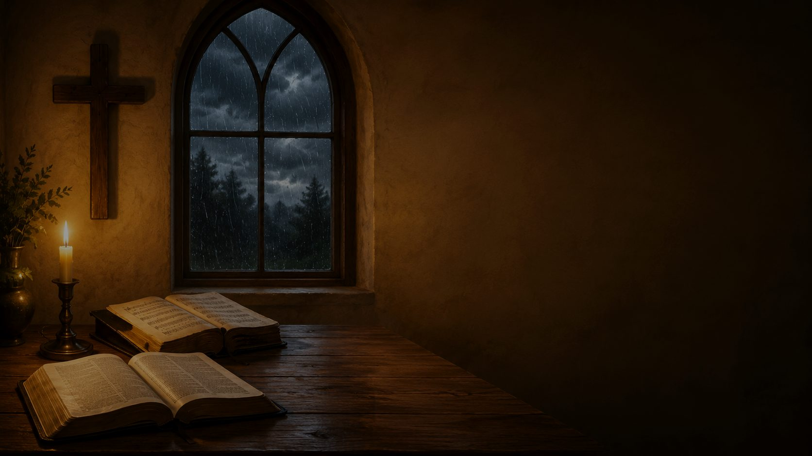
Hymn Identity
A teaching resource for hymn study, worship planning, and discipleship
Hymn facts
Teaching focus
Title: A Shelter in the Time of Storm
First line: The Lord's our Rock, in Him we hide
Text: Vernon John Charlesworth
Music: Ira David Sankey
Tune: SHELTER
Meter: 8.8.8.8 with refrain (often L.M. with refrain)
Christ as refuge in distress
Faith that does not deny storms
Assurance rooted in Scripture
Comfort for pastoral care
Prepared for teaching and small group use - hymninfo.com

Slide 4
Historical Background
A late nineteenth-century gospel hymn of refuge
The text is credited to Vernon John Charlesworth and is commonly dated around 1880.
Charlesworth served as an English Baptist minister, educator, author, and hymn writer.
Ira D. Sankey composed the tune SHELTER in 1885 and helped spread the hymn through gospel songbooks.
Its simple refrain made it useful for worshipers needing a clear confession of trust.
Prepared for teaching and small group use - hymninfo.com

Slide 5

Why This Hymn Matters Today
It gives the church a faithful vocabulary for trouble.
It is honest about storms without becoming despairing.
It names Christ as refuge, not merely as an idea of comfort.
It can serve anxious, grieving, weary, opposed, and suffering believers.
It helps a congregation sing together when individual words are hard to find.
Prepared for teaching and small group use - hymninfo.com

Slide 6
Primary Scripture
“For you have been a stronghold to the poor, a stronghold to the needy in his distress, a refuge from the storm, a shade from the heat, when the blast of the dreaded ones is like a storm against the wall.”
Isaiah 25:4
This passage gives the hymn its main grammar of refuge: God is shelter not only after trouble, but in trouble.
Prepared for teaching and small group use - hymninfo.com

Slide 7
Supporting Scriptures
The hymn gathers a biblical chorus of refuge.
Psalm 46:1: God is refuge, strength, and present help.
Psalm 61:2-3: The overwhelmed heart asks to be led to the higher Rock.
Psalm 18:2: The Lord is rock, fortress, deliverer, shield, and tower.
Isaiah 32:2: God provides shelter from wind and shade in a weary land.
Matthew 7:24-25: A life built on Christ’s words stands when storms beat against it.
Prepared for teaching and small group use - hymninfo.com

Slide 8
Study Map
How the hymn moves from confession to prayer
Movement
Hymn Emphasis
Scripture Lens
Confession
The Lord is rock and hiding place
Psalm 18:2
Protection
Shade, defense, refuge, and safe retreat
Isaiah 32:2
Perseverance
Storms may rage, but Christ remains shelter
Psalm 46:1
Prayer
Lord, remain near as helper and protector
Psalm 61:2-3
Prepared for teaching and small group use - hymninfo.com

Slide 9

Stanza 1: The Lord Our Rock
The hymn begins with confession.
The first movement names the Lord as the one in whom believers hide.
The image of rock suggests stability, strength, and protection beyond human ability.
Teaching emphasis: Christian refuge begins with who God is, not with how strong we feel.
Prepared for teaching and small group use - hymninfo.com

Slide 10
Stanza 2: Shade and Defense
The hymn moves from danger to protection.
The imagery of shade speaks to exhaustion as well as fear.
The Lord’s care covers both the heat of pressure and the darkness of uncertainty.
Teaching emphasis: God’s refuge is steady, not occasional.
Prepared for teaching and small group use - hymninfo.com

Slide 11
Stanza 3: When Storms Rage
The hymn does not deny hardship.
Storms remain real: grief, illness, anxiety, opposition, and spiritual weariness.
The refrain answers trouble with repeated confession: Christ is shelter in the storm.
Teaching emphasis: faith is not a storm-free life, but safety in Christ through every storm.
Prepared for teaching and small group use - hymninfo.com

Slide 12
Stanza 4: A Prayer for Nearness
The final movement becomes prayer.
The singer asks the Lord to remain near as helper and protector.
The hymn ends with dependence rather than self-confidence.
Teaching emphasis: the church sings not only about shelter, but to the Shelter himself.
Prepared for teaching and small group use - hymninfo.com

Slide 13
Refrain Study
The refrain is the hymn’s congregational center.
It gives simple words for trust when trouble feels complex.
It repeats the central truth until it can be remembered under pressure.
It names Jesus as both Rock and shelter, joining strength and tenderness.
It functions well as a sung testimony after Scripture, prayer, or pastoral exhortation.
Prepared for teaching and small group use - hymninfo.com

Slide 14
Theological Themes
Only themes genuinely present in the hymn
Refuge: God is the safe place for distressed people.
Assurance: confidence rests in Christ’s character and nearness.
Providence: the Lord remains faithful through changing circumstances.
Perseverance: believers endure because they are sheltered by the Rock.
Hope: storms are real, but they are not ultimate.
Prepared for teaching and small group use - hymninfo.com

Slide 15
Literary Observations
How the text teaches through imagery and repetition
Concrete images carry the doctrine: rock, storm, shade, refuge, shelter.
The movement is pastoral: confession, protection, perseverance, prayer.
The repeated refrain helps the heart answer fear with truth.
The hymn’s language is direct enough for children and deep enough for suffering adults.
Prepared for teaching and small group use - hymninfo.com

Slide 16
Musical Observations
The tune SHELTER supports the message.
Ira D. Sankey’s tune has a clear gospel-song shape and strong refrain.
The melody is accessible for congregational singing and pastoral services.
A moderate, steady tempo communicates assurance without heaviness.
The refrain should sound confident and prayerful, not rushed.
Prepared for teaching and small group use - hymninfo.com

Slide 17
Pastoral and Worship Use
Places where this hymn can serve the church
Services of comfort, lament, assurance, or pastoral care.
Prayer meetings, hospital or grief ministry, and testimony services.
Sermons on refuge, providence, suffering, or building on Christ the Rock.
A congregational response after reading Psalm 46, Psalm 61, or Isaiah 25.
Prepared for teaching and small group use - hymninfo.com

Slide 18
Choir and Congregational Use
Simple ways to lead the hymn well
Teach the refrain first if the congregation is unfamiliar with the hymn.
Use the opening stanza reflectively, then let the refrain gather confidence.
Consider a softer accompaniment for stanzas and fuller support on refrains.
Invite the choir to sing a stanza as prayer before the congregation joins.
Prepared for teaching and small group use - hymninfo.com

Slide 19
Teaching Questions
For Sunday school, choir rehearsal, or small group study
What biblical image of safety speaks most strongly to you?
How does the hymn help us be honest about trouble?
What is the difference between avoiding storms and being sheltered by Christ?
How does repeated singing shape memory and faith?
How can the church become a community that points others to the Shelter?
Prepared for teaching and small group use - hymninfo.com

Slide 20
Application
Practical responses for believers this week
Pray Psalm 46:1 each morning and name one present burden.
Memorize Isaiah 25:4 or Psalm 61:2-3 as a refuge prayer.
Encourage one person who is facing a storm with Scripture-shaped comfort.
Let the refrain become a quiet prayer when fear rises.
Prepared for teaching and small group use - hymninfo.com

Slide 21
Suggested 30-Minute Lesson Flow
A compact teaching plan
5 min: Introduce hymn identity and historical background.
7 min: Read Isaiah 25:4 and Psalm 46:1; discuss refuge imagery.
8 min: Walk through stanza movements and refrain.
5 min: Discuss one pastoral application.
5 min: Sing or read the refrain and close in prayer.
Prepared for teaching and small group use - hymninfo.com

Slide 22
Suggested 60-Minute Lesson Flow
A fuller study plan
10 min: Opening reflection and hymn identity.
15 min: Biblical foundations: Isaiah 25, Psalms 46/61/18, Matthew 7.
15 min: Stanza-by-stanza study and musical observations.
10 min: Small-group discussion questions.
10 min: Application, pastoral prayer, and singing.
Prepared for teaching and small group use - hymninfo.com

Slide 23
Closing Summary
The hymn’s central witness
Storms are real, but Christ is more real still.
The Lord is Rock, refuge, shade, and present help.
The congregation learns to answer trouble with repeated confession and prayer.
Those sheltered by Christ are called to become instruments of comfort for others.
Prepared for teaching and small group use - hymninfo.com

Slide 24
Closing Prayer
Lord Jesus Christ, our Rock and shelter, teach us to hide in you when storms rise around us. Strengthen the weary, comfort the fearful, and make our congregation a place where troubled hearts are gently pointed to your faithful care. Amen.
© HymnInfo.com. Free for personal, church, classroom, and small-group teaching use. Please do not sell, repost, or redistribute as downloadable files without permission.
Prepared for teaching and small group use - hymninfo.com

