Slide 1

10,000 Reasons (Bless the Lord)
A hymn study on Psalm-shaped praise, gratitude, and eternal hope
First line: The sun comes up, it's a new day dawning
Writers: Matthew James Redman and Jonas Myrin
Year: 2011
Primary Scripture: Psalm 103:1-2
Prepared for teaching and small group use - hymninfo.com

Slide 2

Teaching Aim
• Understand how the song is rooted in Psalm 103 and the biblical call to bless the Lord.
• Feel renewed gratitude for God's mercy, patience, goodness, and enduring worth.
• Practice daily remembrance, Christ-centered praise, and hopeful worship in every season.
Prepared for teaching and small group use - hymninfo.com

Slide 3
Hymn Identity
Basic information
Biblical frame
• Title: 10,000 Reasons (Bless the Lord)
• First line: The sun comes up, it's a new day dawning
• Writers: Matthew James Redman and Jonas Myrin
• Year: 2011
• Meter: irregular contemporary worship song structure
• Primary Scripture: Psalm 103:1-2
• Central action: blessing the Lord with the whole self
• Main themes: gratitude, mercy, daily praise, and eternal worship
• Best read as modern doxology shaped by Scripture
Prepared for teaching and small group use - hymninfo.com

Slide 4
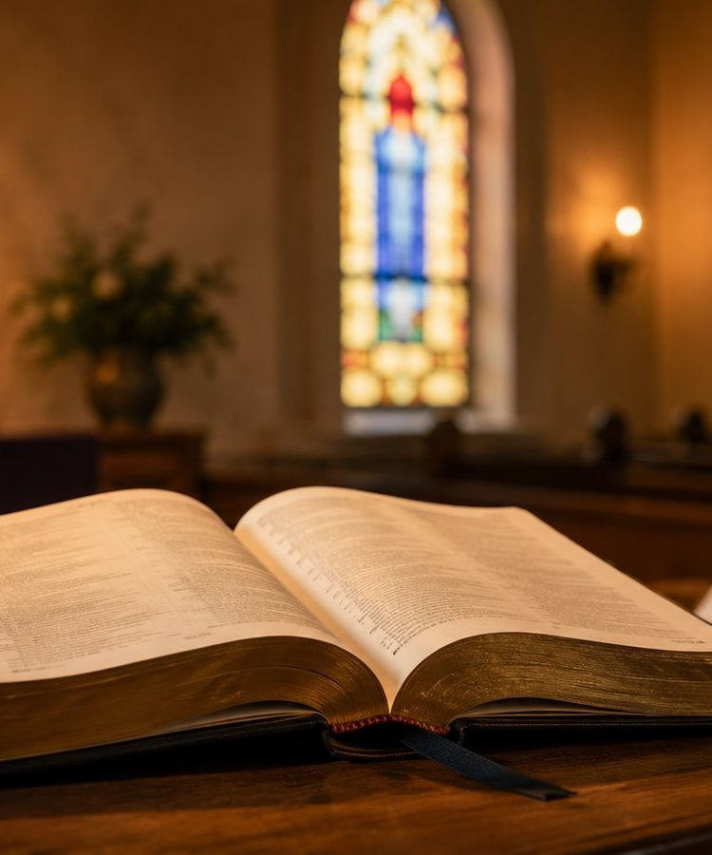
Writers and Setting
• Matt Redman is an English worship leader and songwriter associated with contemporary evangelical worship.
• Jonas Myrin is a Swedish songwriter, pianist, and producer active in Christian worship music.
• The song was released in connection with Redman's 2011 worship album.
• Its worship language closely echoes Psalm 103.
Prepared for teaching and small group use - hymninfo.com

Slide 5
Historical Background
• The song emerged within twenty-first-century contemporary congregational worship.
• It gained broad use through recordings, worship gatherings, digital song libraries, and church services.
• Its strength is not novelty but a memorable return to biblical praise language.
• The song helped many congregations sing Psalm 103 in an accessible modern form.
Prepared for teaching and small group use - hymninfo.com

Slide 6

Why This Song Matters Today
• It helps worshipers praise God with both heart and memory.
• It grounds thanksgiving in God's character rather than changing circumstances.
• It works well in gathered worship, small groups, devotional settings, and pastoral care.
• It connects morning praise, lifelong endurance, and eternal worship.
Prepared for teaching and small group use - hymninfo.com

Slide 7
Biblical Foundation
Psalm 103:1-2
Psalm 103:8
• The psalmist calls the soul to praise the Lord.
• Praise involves all that is within the worshiper.
• Remembering God's benefits guards the heart from forgetfulness.
• The song echoes this inward summons to worship.
• God is merciful and gracious.
• God is slow to anger.
• God is abundant in loving kindness.
• Praise becomes response to revealed character.
Prepared for teaching and small group use - hymninfo.com

Slide 8
Supporting Scriptures
Daily and continual praise
Praise through Christ
• Psalm 34:1: blessing the Lord at all times.
• Psalm 145:2-3: daily praise and unsearchable greatness.
• Praise is a discipline, not only a response to a mood.
• Hebrews 13:15: praise is offered to God through Christ.
• Revelation 5:13: all creation blesses the throne and the Lamb.
• Earthly worship anticipates eternal worship.
Prepared for teaching and small group use - hymninfo.com

Slide 9
Movement of the Song
• Morning: a new day becomes a call to worship.
• Remembrance: the soul blesses God and recalls his benefits.
• Character: God's love, patience, kindness, and goodness sustain praise.
• Eternity: praise continues beyond weakness and death.
Prepared for teaching and small group use - hymninfo.com

Slide 10

Opening Movement: Daily Praise
• The song begins with ordinary time: the beginning of a day.
• This opening invites worship before outcomes are known.
• The worshiper asks to remain singing whatever comes.
• Teaching emphasis: daily praise trains the soul to remember God.
Prepared for teaching and small group use - hymninfo.com

Slide 11
Central Refrain Study
• The refrain gathers the song around a direct call to bless the Lord.
• It is both personal and congregational: each soul is summoned, yet the church sings together.
• Its repetition functions like spiritual formation, returning worshipers to God's name and worth.
• The refrain should be led with clarity rather than mere emotional intensity.
Prepared for teaching and small group use - hymninfo.com

Slide 12
Second Movement: God's Character
• The song reflects the language of God's revealed mercy and patience.
• Praise is rooted in theology: God is loving, kind, and good.
• The countless reasons for praise point to the immeasurable richness of God's grace.
• Teaching emphasis: worship should name who God is.
Prepared for teaching and small group use - hymninfo.com

Slide 13
Final Movement: Eternal Praise
• The song honestly faces human weakness and mortality.
• It refuses despair because the praise of God outlasts earthly strength.
• The final horizon is not private survival but worship without end.
• Teaching emphasis: Christian hope turns fragile life toward everlasting praise.
Prepared for teaching and small group use - hymninfo.com

Slide 14
Theological Themes
Doxology and gratitude
Hope and perseverance
• Blessing God means praising, honoring, and delighting in his holy name.
• Gratitude is formed by remembrance of God's benefits.
• Worship is anchored in God's character, not in self-expression alone.
• Daily praise prepares believers for difficult seasons.
• Praise through Christ becomes an offering even when costly.
• Eternal praise gives perspective to present suffering and aging.
Prepared for teaching and small group use - hymninfo.com

Slide 15
Literary Observations
• The song uses the image of a new day as a doorway into devotion.
• The phrase of abundance expresses God's goodness as more than we can count.
• The movement is simple and pastoral: daybreak, remembrance, divine character, and eternal worship.
• Its language is accessible while carrying strong biblical resonance.
Prepared for teaching and small group use - hymninfo.com

Slide 16
Musical Observations
• The song uses contemporary verse-and-refrain form rather than fixed traditional hymn meter.
• The melody is memorable, repetitive, and accessible for congregational singing.
• Moderate tempo supports reflective praise without losing momentum.
• It can be served by acoustic accompaniment, piano, full worship band, or simplified congregational settings.
Prepared for teaching and small group use - hymninfo.com

Slide 17
Pastoral and Worship Use
Suitable occasions
Leadership guidance
• Opening worship and calls to praise
• Thanksgiving services
• Teaching on Psalm 103
• Services focused on God's mercy and faithfulness
• Funerals or memorial settings when hope is emphasized
• Frame the song with Scripture rather than sentiment alone.
• Encourage worshipers to name specific reasons for gratitude.
• Use authorized songbooks or proper licensing when printing, projecting, streaming, or recording the song.
• Keep accompaniment supportive of congregational participation.
Prepared for teaching and small group use - hymninfo.com

Slide 18
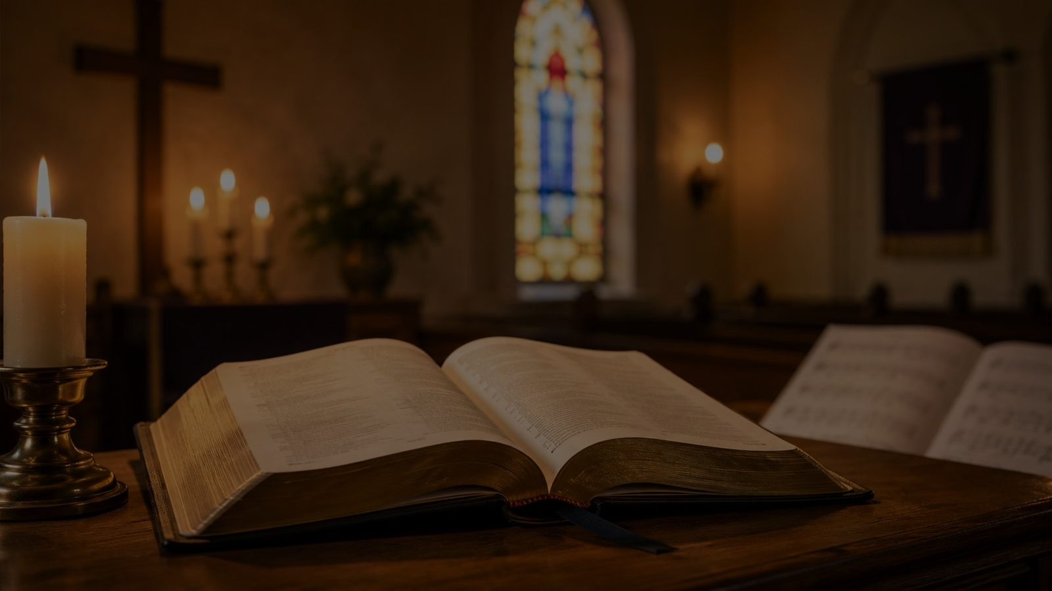
Choir and Congregational Notes
• Choirs can model clear phrasing and attentive worship rather than performance alone.
• A worship leader may read Psalm 103:1-8 before singing.
• Instrumental dynamics should help the congregation hear the theological center.
• Invite the congregation to connect the song with testimony and prayer.
Prepared for teaching and small group use - hymninfo.com

Slide 19
Teaching Questions
• How does Psalm 103 shape the message of the song?
• What does it mean to bless the Lord with the whole self?
• Why is remembering God's benefits essential to worship?
• How can praise be faithful in grief, anxiety, or weakness?
• How does eternal worship change our view of ordinary days?
Prepared for teaching and small group use - hymninfo.com

Slide 20
Application
• Begin each day this week with Psalm 103:1-2.
• Write down one specific reason to thank God each day.
• Encourage a weary believer with a truth about God's mercy.
• Practice congregational singing as attentive participation, not background sound.
• Let future hope reshape present fear.
Prepared for teaching and small group use - hymninfo.com

Slide 21
Suggested Lesson Flow
30-minute plan
60-minute plan
• 5 min: Read Psalm 103:1-8.
• 7 min: Introduce writers, year, and song background.
• 8 min: Discuss the song's movement from daybreak to eternal praise.
• 7 min: Ask two discussion questions.
• 3 min: Closing prayer.
• 10 min: Scripture reading and opening reflection.
• 10 min: Historical and worship setting.
• 15 min: Verse and refrain theme study.
• 15 min: Group discussion and pastoral application.
• 10 min: Practice plan and closing prayer.
Prepared for teaching and small group use - hymninfo.com

Slide 22
Closing Summary and Prayer
• This song calls the church to remember God's mercy and bless his holy name.
• It turns ordinary days into opportunities for gratitude.
• It teaches praise that endures beyond changing circumstances.
• Prayer: Lord, awaken our souls to bless you through Christ, now and forever. Amen.
Prepared for teaching and small group use - hymninfo.com

