Slide 1

In the Garden
A hymn study on resurrection, prayer, and fellowship with Christ
First line: I come to the garden alone
Words and music: Charles Austin Miles, 1912
Tune: GARDEN / IN THE GARDEN
Primary Scripture: John 20:16-18

Slide 2
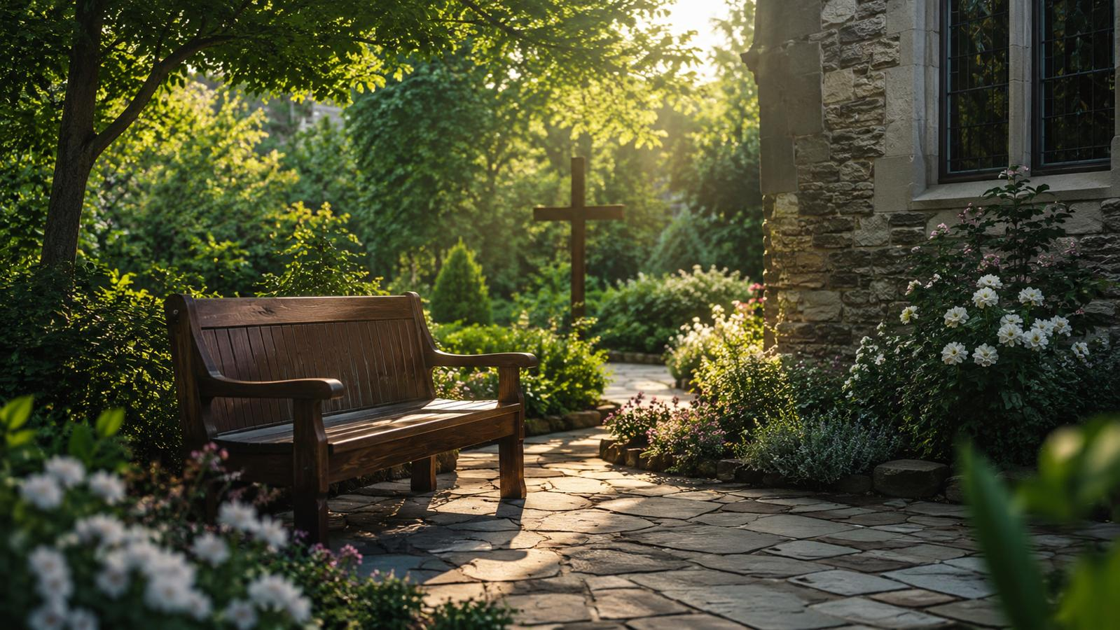
Teaching Aim
What learners should understand, feel, and practice.
Understand the hymn as a devotional meditation shaped by John 20 and the risen Christ’s encounter with Mary Magdalene.
Feel the comfort of Christ’s living presence without reducing the hymn to vague sentiment.
Practice Scripture-rooted prayer, attentive listening, and faithful response to Christ’s voice.

Slide 3

Hymn Identity
Key facts for teachers and worship leaders.
Title
In the Garden
First line
I come to the garden alone
Writer and composer
Charles Austin Miles
Year
1912
Tune
GARDEN / IN THE GARDEN
Meter
Irregular with refrain
Primary text
John 20:16-18

Slide 4
Historical Background
A gospel song from early twentieth-century American hymnody.
Charles Austin Miles trained in pharmacy before devoting his career to gospel music publishing.
He wrote both words and music for this hymn in 1912 while associated with the Hall-Mack Company.
The hymn is closely linked with a devotional meditation on John 20 and the resurrection encounter near the empty tomb.
It became widely loved in American Protestant worship, gospel singing, devotional meetings, and funeral services.

Slide 5

The John 20 Setting
The garden is not merely private scenery; it stands near the resurrection witness.
Mary Magdalene comes to the tomb in sorrow. Her grief is met by the risen Christ, who calls her by name. Recognition leads to witness: she goes and tells the disciples, “I have seen the Lord.”

Slide 6
Why This Hymn Matters Today
A quiet hymn can serve deep pastoral work.
It gives language to believers who long for personal communion with Christ.
It can comfort the grieving with the presence of the risen Lord.
It teaches that Christ’s voice calls for recognition, trust, and response.
It reminds the church to connect private devotion with biblical resurrection hope.

Slide 7
Biblical Foundation
The hymn’s devotional warmth rests on Scripture.
John 20:16-18
John 10:27
The risen Christ calls Mary by name and sends her to witness to the disciples.
Christ’s sheep hear his voice, are known by him, and follow him.
Psalm 16:11
Revelation 3:20
Joy is found in the presence of the Lord.
The Lord graciously offers fellowship to those who hear and respond.

Slide 8
Stanza 1: Solitude and Encounter
The hymn begins with quiet approach and attentive listening.
Image: the believer enters a quiet garden, a place suitable for prayer and reflection.
Theological movement: solitude becomes communion because Christ is present.
Scripture connection: John 20 gives the garden its resurrection setting.
Teaching emphasis: Christian quietness is not empty; it is attentive to the living Lord.

Slide 9
Refrain Study
The repeated center of the hymn is fellowship with Christ.
The refrain gathers the hymn’s main devotional claim: Christ’s presence is personal, communicative, assuring, and joyful. Its simplicity helps the congregation remember that the risen Lord is not distant from his people.
Walks: nearness and companionship
Talks: the Lord addresses his people through his Word and Spirit
Tells: assurance of belonging
Joy: fellowship that renews the heart

Slide 10
Stanza 2: The Voice of Christ
Recognition turns into inward melody.
The hymn pictures Christ’s voice as sweet, compelling, and life-giving.
This is best taught in connection with John 10:27: his sheep hear his voice and follow.
The inward melody points to joy and worship awakened by communion with the Lord.
Teaching emphasis: hearing Christ is not mystical self-invention; it is Scripture-rooted trust and obedience.

Slide 11
The Hymn’s Movement
From quiet devotion to renewed witness.
Solitude → Recognition → Communion → Response
The hymn can be taught as a movement of the soul: the believer comes apart for prayer, recognizes Christ’s gracious presence, receives joy in fellowship, and returns to ordinary life with renewed trust.

Slide 12
Theological Theme: Resurrection Presence
The hymn’s comfort depends on the risen Christ. The garden is meaningful because the tomb is empty. Christ is not only remembered; he is alive. He calls, comforts, and sends his people.
John 20 keeps the hymn from becoming mere nostalgia.
The risen Lord knows his people personally.
Resurrection hope gives devotional experience its solid foundation.

Slide 13
Theological Theme: Prayer and Fellowship
Christian prayer is communion with the living Lord.
Prayer is more than speaking words into silence; it is practiced before the Lord who speaks through Scripture.
Fellowship with Christ includes assurance, correction, guidance, and joy.
The hymn is strongest when used to draw believers into Scripture-shaped communion.

Slide 14
Theological Theme: Comfort With Balance
Personal devotion should lead back to worship, Scripture, and witness.
The hymn is deeply personal. Teachers can preserve its pastoral value while helping believers avoid isolated individualism. Communion with Christ should lead believers back into Scripture, worship, and witness with the church.
Private prayer should nourish public faithfulness.
Devotional joy should be tested and shaped by Scripture.
Comfort received from Christ should become encouragement offered to others.

Slide 15
Literary Observations
Simple imagery serves a focused devotional purpose.
Garden imagery creates quietness, intimacy, and a resurrection echo.
Voice imagery gives the hymn its personal center.
The refrain reinforces assurance through repetition.
The emotional tone is tender, contemplative, and consoling.
The hymn does not try to say everything; it lingers over fellowship with Christ.

Slide 16
Musical Observations
The tune supports a reflective gospel-song character.
Tune: GARDEN / IN THE GARDEN, written by Charles Austin Miles.
Style: early twentieth-century American gospel song.
Meter: irregular with refrain, often described in several related ways by hymn indexes.
Melody: lyrical, memorable, and well suited for solo, congregational, or devotional use.
Best use: gentle tempo, clear phrasing, and accompaniment that does not overpower the text.

Slide 17
Pastoral and Worship Use
Where the hymn can serve the church well.
Eastertide: connect the hymn explicitly to John 20.
Funerals and grief care: emphasize the presence of the risen Christ.
Prayer meetings: invite Scripture-rooted quiet reflection.
Small groups: discuss the difference between devotion and isolation.
Choir or solo use: preserve the gentle character and clear text.

Slide 18
Choir and Leader Notes
Help the congregation sing with understanding.
Before singing, read John 20:16-18 or briefly retell the resurrection encounter.
Avoid making the hymn merely sentimental; keep Christ’s resurrection at the center.
Use warm but restrained accompaniment.
Encourage clear diction in the refrain so assurance and joy are heard.
Consider pairing it with a more corporate resurrection hymn or Scripture response.

Slide 19
Teaching Questions
For class, choir rehearsal, or small group discussion.
How does John 20 shape the meaning of the garden in the hymn?
What does the hymn teach about recognizing Christ’s voice?
How can personal devotion be rooted in Scripture rather than sentiment alone?
Why might this hymn speak deeply to the grieving or lonely?
How can private communion with Christ strengthen public worship and witness?

Slide 20
Application
Practical responses for this week.
Read John 20:16-18 slowly and prayerfully.
Spend ten quiet minutes each day listening to Christ through Scripture.
Write one sentence of thanks for the risen Lord’s nearness.
Encourage someone who feels alone with the promise of Christ’s presence.
Let private prayer lead to one act of obedient witness.

Slide 21
Suggested Lesson Flow
Two options for teaching the hymn.
30-minute plan
60-minute plan
Read John 20:16-18
Introduce Miles and the 1912 hymn
Study the garden image and refrain
Discuss two questions
Close with prayer
Read John 20 and John 10:27
Walk through hymn background
Study stanza themes and musical character
Discuss personal devotion and church witness
Practice weekly applications
Close with prayer or singing

Slide 22
Closing Summary and Prayer
The risen Christ meets, comforts, and sends his people.
Lord Jesus Christ, risen and living Savior, call us again through your Word. Comfort the lonely, strengthen the weary, and turn our private devotion into faithful love, worship, and witness. Amen.
Key reminder: the joy of the garden flows from the reality of the empty tomb.

