Slide 1

COUNT YOUR
BLESSINGS
Teaching Guide
A gospel hymn on gratitude, providence, and trust when life feels storm-tossed
Johnson Oatman Jr. | Edwin O. Excell | 1897 | Psalm 103:2
Prepared for teaching and small group use - hymninfo.com
HymnInfo.com

Slide 2

Teaching Aim
How this study should form the class
U
F
P
Understand
Feel
Practice
God’s people are called to remember his benefits, not because life is painless, but because God remains faithful in trouble.
•
See gratitude as biblical remembrance, not forced cheerfulness.
•
Bring anxiety, envy, and discouragement before God with thanksgiving.
•
Practice naming specific mercies as an act of faith and praise.
Prepared for teaching and small group use - hymninfo.com
HymnInfo.com

Slide 3
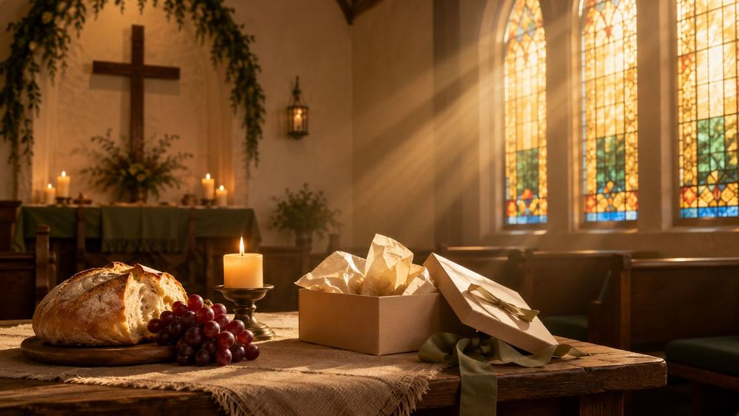
Hymn Identity
The people, tune, and setting
Title
Count Your Blessings
First line
When upon life’s billows you are tempest tossed
Text
Johnson Oatman Jr. (1856-1922)
Music
Edwin Othello Excell (1851-1921)
Tune
BLESSINGS
Publication
First published in Songs for Young People, 1897
Meter
11.11.11.11 with refrain
Prepared for teaching and small group use - hymninfo.com
HymnInfo.com

Slide 4

SECTION 1
Remember the Benefits
Biblical thanksgiving begins with memory: the soul looks back honestly and names the goodness of the Lord.
Prepared for teaching and small group use - hymninfo.com
HymnInfo.com

Slide 5

Historical Background
A gospel song for ordinary believers
•
Johnson Oatman Jr. was a Methodist Episcopal minister, businessman, and prolific gospel hymn writer.
•
Edwin O. Excell was a gospel composer, song leader, publisher, and hymnal editor.
•
The hymn appeared in the American gospel-song world of Sunday schools, revival meetings, and congregational testimony.
•
Its direct language and memorable refrain helped it travel widely in churches and evangelistic songbooks.
Teaching emphasis
The hymn’s strength is not novelty. It gives a simple, durable practice for believers under pressure: remember, name, and praise God for his mercies.
Prepared for teaching and small group use - hymninfo.com
HymnInfo.com

Slide 6

Biblical Foundation
Thanksgiving anchored in Scripture
Primary text: Psalm 103:2
“Praise Yahweh, my soul, and don’t forget all his benefits.”
•
1 Thessalonians 5:18 - giving thanks in every circumstance.
•
James 1:17 - every good gift comes from the Father of lights.
•
Philippians 4:6-7 - prayer with thanksgiving guards the heart.
•
Hebrews 13:5-6 - contentment rests in God’s faithful presence.
Prepared for teaching and small group use - hymninfo.com
HymnInfo.com

Slide 7
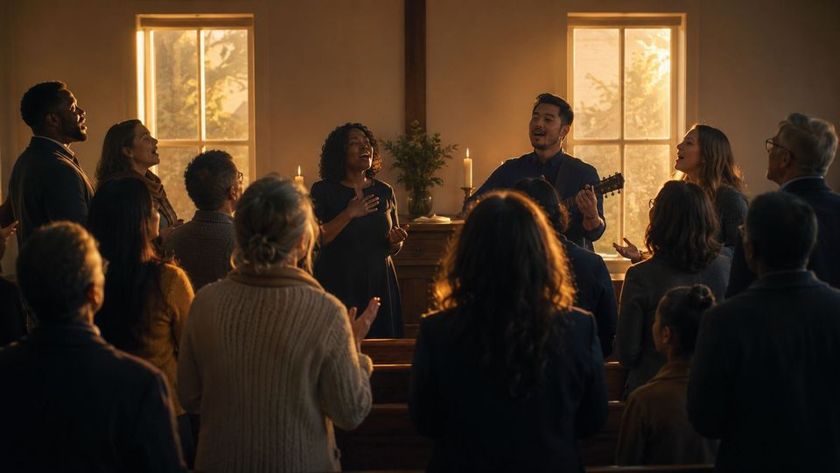
Why This Hymn Matters Today
Gratitude in a restless world
Anxiety
Comparison
Thanksgiving brings fear into prayer.
Gratitude exposes the poverty of envy.
Discouragement
Perseverance
Memory resists the lie that all is lost.
Named mercies strengthen weary saints.
Prepared for teaching and small group use - hymninfo.com
HymnInfo.com

Slide 8
SECTION 2
When Life Is Tempest-Tossed
The hymn begins where many believers live: overwhelmed, discouraged, and tempted to forget God’s care.
Prepared for teaching and small group use - hymninfo.com
HymnInfo.com

Slide 9

Hymn Section Study
Trouble does not have the last word
•
The opening movement names real distress: storm, discouragement, and the feeling that all is lost.
•
The pastoral answer is not denial. The hymn directs believers to deliberate remembrance.
•
Counting blessings is an act of faith: God’s past mercy helps the heart trust him now.
•
Connect with Psalm 103: the soul must be preached to when forgetfulness takes over.
Teaching question
What does your heart forget first when trouble rises?
Prepared for teaching and small group use - hymninfo.com
HymnInfo.com

Slide 10
Hymn Section Study
Burdens carried with thanksgiving
•
The hymn acknowledges “load of care” and the weight of the cross believers bear.
•
Thanksgiving does not erase the cross; it changes how the cross is carried.
•
Philippians 4 joins petition and thanksgiving, promising God’s peace to guard the heart.
•
The song trains believers to pray before discouragement settles into unbelief.
Pastoral note
Use this hymn tenderly. Some saints need help naming grief before they can name gratitude.
Prepared for teaching and small group use - hymninfo.com
HymnInfo.com

Slide 11

Hymn Section Study
Blessings money cannot buy
•
The hymn speaks directly to comparison: looking at others with possessions, status, or ease.
•
It redirects the believer from visible wealth to the riches promised in Christ.
•
Hebrews 13 teaches contentment by grounding the heart in God’s presence: “I will in no way leave you.”
•
Gratitude is a defense against envy because it names what God has already given.
Discussion prompt
Which blessings in Christ cannot be purchased, measured, or lost?
Prepared for teaching and small group use - hymninfo.com
HymnInfo.com

Slide 12

Hymn Section Study
Help to the journey’s end
•
The closing movement places gratitude amid conflict, not after every conflict is resolved.
•
The phrase “God is over all” points to providence: the Lord rules while his people walk.
•
Blessing-counting becomes perseverance-counting: mercies are markers on the road home.
•
The hymn ends with comfort, not triumphalism. God sustains his people to the end.
Leader emphasis
Help learners trace a path from anxiety to prayer, from comparison to contentment, and from discouragement to praise.
Prepared for teaching and small group use - hymninfo.com
HymnInfo.com

Slide 13

SECTION 3
From Memory to Ministry
A remembered mercy should become a shared testimony, a steadied heart, and a generous life.
Prepared for teaching and small group use - hymninfo.com
HymnInfo.com

Slide 14
Theological Themes
What the hymn teaches
Providence
Thanksgiving
Contentment
God rules and cares amid conflict.
Gratitude remembers God’s benefits.
Spiritual riches outweigh comparison.
Perseverance
Prayer
Encouragement
Mercy strengthens the journey.
Requests belong with thanksgiving.
Testimony helps the weary sing.
Prepared for teaching and small group use - hymninfo.com
HymnInfo.com

Slide 15
Musical and Worship Use
How to sing and place the hymn
•
Tune: BLESSINGS, written by Edwin O. Excell for Oatman’s text.
•
Shape: gospel-song verses with a memorable refrain that reinforces the practice of remembering.
•
Tempo: lively enough to encourage, unhurried enough for clear text.
•
Use: Thanksgiving services, testimony gatherings, family worship, stewardship, contentment, or pastoral encouragement.
•
Teaching caution: do not use the song to silence lament; gratitude can stand beside honest grief.
Prepared for teaching and small group use - hymninfo.com
HymnInfo.com

Slide 16
Suggested Lesson Flow
Two ready-to-teach options
30 minutes
60 minutes
•
Read Psalm 103:1-5.
•
Open with testimony.
•
Sing or summarize the hymn.
•
Compare Psalm 103 and Philippians 4.
•
Teach the four movements.
•
Study each section of the hymn.
•
Discuss one anxiety and one blessing.
•
Use small-group reflection.
•
Close with prayer.
•
Create a gratitude practice for the week.
Prepared for teaching and small group use - hymninfo.com
HymnInfo.com

Slide 17

Closing Summary and Prayer
Count Your Blessings teaches the church to remember God’s benefits when trouble rises, comparison tempts, and the road feels long.
Lord, train our hearts to remember your mercies. Teach us to pray with thanksgiving, resist envy, comfort the weary, and trust your faithful care until the journey is complete. Amen.
© HymnInfo.com. Free for personal, church, classroom, and small-group teaching use. Please do not sell, repost, or redistribute as downloadable files without permission.
Prepared for teaching and small group use - hymninfo.com
HymnInfo.com

