Slide 1


The Lily of the Valley
A hymn study on Christ as faithful Friend and sufficient Savior
First line: I have found a friend in Jesus, He's everything to me
Text: Charles W. Fry, 1881
Tune: SALVATIONIST; adapted from Will Hays and arranged by Ira D. Sankey
Primary Scripture: John 15:15
Prepared for teaching and small group use - hymninfo.com

Slide 2
Teaching Aim
Understand, feel, and practice
• Understand how the hymn presents Christ as faithful friend, beautiful Savior, and sufficient keeper.
• Feel gratitude for the personal care and nearness of Christ.
• Practice bringing sorrow, temptation, and testimony into worship and prayer.
Prepared for teaching and small group use - hymninfo.com

Slide 3
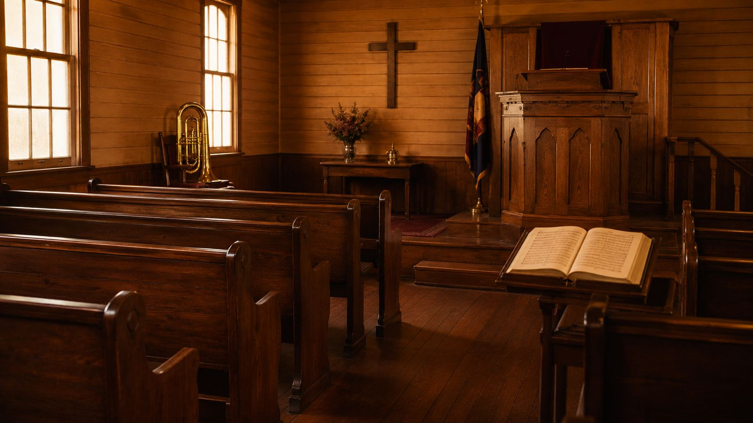
Hymn Identity
Key hymnological facts
• Title: The Lily of the Valley.
• First line: I have found a friend in Jesus, He's everything to me.
• Text: Charles W. Fry, 1881.
• Tune: SALVATIONIST; adapted from a Will Hays melody and arranged for gospel use by Ira D. Sankey.
• Meter: irregular gospel song with refrain.
Prepared for teaching and small group use - hymninfo.com

Slide 4
Historical Background
Salvation Army and gospel song witness
• Charles W. Fry served within the early Salvation Army movement in Britain.
• The hymn joined biblical imagery with testimony language suited to evangelistic meetings.
• Its memorable refrain helped it spread into wider evangelical singing.
• The tune reflects the nineteenth-century gospel practice of adapting familiar melodies for Christian use.
Prepared for teaching and small group use - hymninfo.com

Slide 5
The People Behind the Hymn
Fry, Hays, and Sankey
• Charles W. Fry wrote the devotional testimony text.
• Will Hays composed the melody that was later adapted for this hymn.
• Ira D. Sankey arranged and helped circulate the tune in gospel hymn contexts.
• Together, text and tune made the hymn vivid, singable, and memorable.
Prepared for teaching and small group use - hymninfo.com

Slide 6
Why This Hymn Matters Today
Pastoral and devotional value
• It gives believers warm language for friendship with Christ.
• It teaches that Christ is sufficient in sorrow, temptation, and uncertainty.
• It models testimony as congregational praise.
• It invites worshipers to see the beauty of Christ as a living consolation.
Prepared for teaching and small group use - hymninfo.com

Slide 7

Scripture and Imagery
Friendship, beauty, rest, and faithful presence
Prepared for teaching and small group use - hymninfo.com

Slide 8
Biblical Foundation
Primary and supporting passages
• John 15:15 - Jesus calls his disciples friends.
• Song of Solomon 2:1 - flower imagery associated with beauty and delight.
• Psalm 23:1-3 - the Lord restores and guides his people.
• Matthew 11:28-30 - Christ gives rest to the weary.
• Hebrews 13:5 - God will never leave or forsake his own.
John 15:15
Jesus calls his disciples friends, grounding fellowship in his gracious self-disclosure.
Prepared for teaching and small group use - hymninfo.com

Slide 9
The Lily and the Friend
How the central images work
• The lily image communicates beauty, purity, and delight.
• Friendship language expresses personal fellowship with Christ.
• The hymn joins beauty and friendship: Christ is precious because he is near and saving.
• Teaching emphasis: biblical imagery can warm the heart without weakening doctrine.
Prepared for teaching and small group use - hymninfo.com

Slide 10
Stanza-by-Stanza Study
The hymn moves from testimony to trust to hope
Prepared for teaching and small group use - hymninfo.com

Slide 11
Stanza 1 Study
Christ discovered as everything the soul needs
• The hymn opens as personal testimony: the singer has found a friend in Jesus.
• Christ is described as spiritually beautiful and wholly sufficient.
• Cleansing, wholeness, comfort, and burden-bearing point to saving and sustaining grace.
• Teaching emphasis: Christian testimony begins with who Christ is, not merely with how we feel.
Matthew 11:28
Christ invites the weary and burdened to come to him for rest.
Prepared for teaching and small group use - hymninfo.com

Slide 12
Refrain Study
A repeated confession of Christ’s worth
• The refrain gathers the hymn’s main idea into joyful praise.
• It repeatedly compares Christ’s beauty and worth to every other treasure.
• In congregational singing, the refrain turns personal witness into shared confession.
• Teaching emphasis: repetition can deepen faith when it repeats substantial truth.
Prepared for teaching and small group use - hymninfo.com

Slide 13
Stanza 2 Study
Christ in grief, temptation, and conflict
• The hymn becomes honest about sorrow, temptation, and spiritual struggle.
• Christ is not only admired; he is relied upon as a strong tower.
• The stanza calls believers to forsake idols and trust Christ’s keeping power.
• Teaching emphasis: devotion to Christ includes repentance, endurance, and confidence.
Psalm 23:3
The Lord restores the soul and guides his people in right paths.
Prepared for teaching and small group use - hymninfo.com

Slide 14
Stanza 3 Study
Never forsaken, finally brought home
• The final stanza rests in the promise of Christ’s faithful presence.
• Images of fire, manna, and glory express protection, provision, and final hope.
• The hymn moves from daily faithfulness to the joy of seeing Christ face to face.
• Teaching emphasis: present fellowship with Christ is a foretaste of eternal joy.
Hebrews 13:5
The Lord promises that he will not leave or forsake his people.
Prepared for teaching and small group use - hymninfo.com

Slide 15
Theological Themes
The beauty and sufficiency of Christ
Prepared for teaching and small group use - hymninfo.com

Slide 16
Theological Themes
What the hymn genuinely emphasizes
Friendship with Christ
The believer is received and known by Jesus.
Comfort in Christ
Sorrow is carried into the care of a faithful Savior.
Spiritual devotion
Personal testimony is shaped by biblical images.
Perseverance
Christ keeps his people through temptation and trouble.
Eternal hope
Present fellowship points toward glory with Christ.
Prepared for teaching and small group use - hymninfo.com

Slide 17
Christ as Friend and Savior
Personal fellowship grounded in grace
• Jesus calls disciples friends because he has made known the Father’s will.
• This friendship is not casual familiarity but covenant mercy.
• The hymn’s devotional warmth is strongest when anchored in the gospel.
• Christ is friend because he first came as Redeemer.
Prepared for teaching and small group use - hymninfo.com

Slide 18
Comfort and Burden Bearing
Pastoral use of the hymn
• The hymn helps believers name grief without surrendering hope.
• It speaks to those facing loneliness, temptation, or spiritual weariness.
• It points troubled hearts toward Christ’s care rather than inward self-sufficiency.
• It is suitable for prayer meetings, testimony services, and pastoral encouragement.
Prepared for teaching and small group use - hymninfo.com

Slide 19
Literary Observations
Images that carry meaning
• Flower imagery: beauty, delight, and preciousness.
• Friendship imagery: closeness, welcome, and confidence.
• Tower imagery: refuge and protection in spiritual danger.
• Food and fire imagery: provision and guarding presence.
• Journey imagery: perseverance toward the final goal.
Prepared for teaching and small group use - hymninfo.com

Slide 20
Musical Observations
Why the tune supports the text
• SALVATIONIST has the lively energy of gospel song and evangelistic testimony.
• The verse-and-refrain structure makes the central confession easy to remember.
• A moderate, spirited tempo supports congregational participation.
• Choirs or song leaders can emphasize the refrain as a shared declaration.
Prepared for teaching and small group use - hymninfo.com

Slide 21
Pastoral and Worship Use
Where the hymn fits in church life
• Services focused on Christ’s sufficiency, friendship, comfort, or perseverance.
• Prayer meetings and testimony services.
• Sermons on John 15, Psalm 23, or Matthew 11.
• Congregational singing after confession, assurance, or pastoral prayer.
• Choir or ensemble settings with joyful gospel character.
Prepared for teaching and small group use - hymninfo.com

Slide 22
Teaching Questions
For class or group discussion
• What does the hymn teach about Christ that is more than sentiment?
• How does biblical imagery make doctrine easier to remember?
• Why is friendship with Christ significant for suffering believers?
• How does the hymn balance testimony, worship, and hope?
• What would it look like to testify more openly to Christ’s faithfulness?
Prepared for teaching and small group use - hymninfo.com

Slide 23
Application
Ways believers can respond
• Pray through John 15:15 and thank Christ for his friendship.
• Bring a specific burden to Christ in prayer rather than carrying it alone.
• Encourage someone with the promise that Christ will not forsake his people.
• Identify and turn from one idol that competes with Christ’s sufficiency.
• Share a brief testimony of Christ’s faithfulness this week.
Prepared for teaching and small group use - hymninfo.com

Slide 24
Suggested Lesson Flow
Two practical teaching options
30-minute plan
60-minute plan
• Opening Scripture - John 15:15
• Brief background and tune story
• Stanza and refrain overview
• Two discussion questions
• Prayer of gratitude
• Read John 15:15 and Matthew 11:28-30
• Discuss Fry, Salvation Army context, and SALVATIONIST
• Study each stanza and refrain
• Explore theological themes
• Apply through testimony, prayer, and encouragement
Prepared for teaching and small group use - hymninfo.com

Slide 25
Closing Summary and Prayer
Christ is beautiful, sufficient, and near
• The hymn invites the church to treasure Jesus as the believer’s closest Friend.
• It teaches that Christ is enough for sorrow, temptation, daily guidance, and final hope.
• Closing prayer: Lord Jesus, make us grateful witnesses to your beauty, grace, and faithful care. Help us trust you fully and testify joyfully. Amen.
Prepared for teaching and small group use - hymninfo.com

