Slide 1

A Child
of the King
“My Father is rich in houses and lands”
Harriet Eugenia Peck Buell • John Bunnell Sumner
1877 • Romans 8:16-17
Teaching Guide
Prepared for teaching and small group use - hymninfo.com

Slide 2

Teaching Aim
What learners should understand, feel, and practice
1
Understand adoption in Christ
Believers are not merely forgiven; they are received into God’s household through Christ.
2
Feel humble assurance
The hymn comforts the overlooked and humbles the proud by rooting identity in grace.
3
Practice family likeness
Singers respond with gratitude, contentment, service, and encouragement of others.
Prepared for teaching and small group use - hymninfo.com

Slide 3

Hymn Identity
The basic facts that shape faithful teaching
Title
Alternative titles
A Child of the King
The Child of a King; Child of the King; My Father is Rich in Houses and Lands
Text
Tune
Harriet Eugenia Peck Buell, published in 1877
BINGHAMTON, credited to John Bunnell Sumner
Meter
Primary Scripture
10.11.11.11 with refrain
Romans 8:16-17: children of God and heirs with Christ
Worship setting
Assurance, praise, testimony, adoption, and hope
Prepared for teaching and small group use - hymninfo.com

Slide 4

Historical Background
Text by Harriet Eugenia Peck Buell, often printed as Hattie E. Buell.
Appeared in 1877 and entered late nineteenth-century gospel-song circulation.
Tune BINGHAMTON is credited to John Bunnell Sumner, a Methodist minister and singing teacher.
The hymn carries the direct testimony style of American gospel hymnody.
Prepared for teaching and small group use - hymninfo.com

Slide 5

Why This Hymn Matters Today
A pastoral word for ordinary believers
For the overlooked
The hymn tells believers their worth is not measured by income, recognition, or influence.
For the anxious
It roots assurance in the Father’s welcome and the Spirit’s witness, not in emotional steadiness.
For the church
It gives the congregation a shared confession: we belong to God through Christ.
For discipleship
It turns future hope into present humility, contentment, and service.
Prepared for teaching and small group use - hymninfo.com

Slide 6

Biblical Foundation
“The Spirit himself testifies with our spirit that we are children of God; and if children, then heirs...”
Romans 8:16-17
Galatians 4:7
1 John 3:1
1 Peter 1:4
Adoption and inheritance with Christ
No longer a servant, but an heir
The Father’s love names us children
An inheritance reserved in heaven
Teaching emphasis: the hymn’s royal language is not pride. It is received grace.
Prepared for teaching and small group use - hymninfo.com

Slide 7
Movement 1: The Father’s Abundance
God’s riches answer earthly limitation
The hymn opens by comparing the Father’s unlimited possession with the believer’s present limits.
Psalm 50:10 teaches that the Lord owns what human beings only borrow.
The pastoral point is not luxury, but security: the Father is never poor in mercy, power, or welcome.
Teachers should connect this image with assurance, not material entitlement.
Prepared for teaching and small group use - hymninfo.com

Slide 8
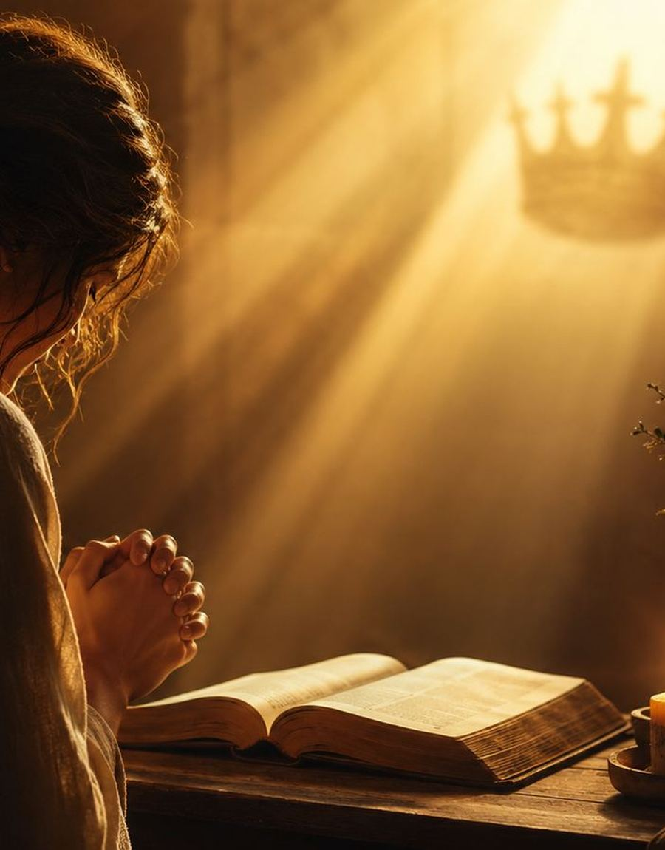
Movement 2: The Savior’s Grace
Adoption comes through Christ
Gospel center
The believer’s royal identity is not self-made. It is received through Christ the Savior.
Teaching caution
Without Christ, “child of the King” could become presumption. In Christ, it becomes worship.
Pastoral invitation
Invite hearers to stop proving their worth and receive the Father’s welcome in the Son.
Prepared for teaching and small group use - hymninfo.com

Slide 9
Movement 3: Adoption and Assurance
From outsider to household member
Estranged
Received
Heir
Romans 8 and Galatians 4 describe a real change of status: the believer is no longer an outsider, but a child and heir through God’s grace.
Assurance is not loud self-confidence. It is the quiet confidence of being named by the Father.
Prepared for teaching and small group use - hymninfo.com

Slide 10

Movement 4: Inheritance and Hope
Present hardship beside future promise
1 PETER 1:4
The inheritance promised in Christ does not fade away.
Hope guards believers from despair when present life feels small.
Hope guards believers from envy when others appear more secure.
Hope turns waiting into faithful worship and service.
Hope keeps the hymn’s royal imagery centered on God’s promise.
Prepared for teaching and small group use - hymninfo.com

Slide 11

Refrain as Congregational Confession
The refrain functions like testimony. The congregation does not merely remember a doctrine; it answers with a sung identity in Christ.
Personal
Communal
Pastoral
I belong to God.
We confess the same grace together.
The overlooked are given dignity.
Prepared for teaching and small group use - hymninfo.com

Slide 12

Theological Themes
What the hymn helps the church teach
Adoption
Assurance
Grace
Welcomed as sons and daughters
The Spirit’s witness
Status received in Christ
Inheritance
Contentment
Testimony
Future secured by God
Earthly lack does not define us
Singing identity together
Prepared for teaching and small group use - hymninfo.com

Slide 13
Literary and Musical Observations
Plain testimony, memorable refrain, steady tune
Language
The hymn uses household, royal, and inheritance imagery rather than abstract theological vocabulary.
Movement
It moves from the Father’s abundance, to the Savior’s work, to personal assurance, to heavenly hope.
Music
BINGHAMTON is a gospel-hymn tune with a refrain that supports congregational testimony.
Performance
Keep the tempo steady and warm. Let the refrain sound confident, not overly sentimental.
Prepared for teaching and small group use - hymninfo.com

Slide 14
Pastoral and Worship Use
Where this hymn serves the church well
Services on assurance, salvation, adoption, testimony, and the Fatherhood of God.
Sunday school lessons on Romans 8, Galatians 4, or 1 John 3.
Pastoral encouragement for people who feel poor, displaced, forgotten, or unworthy.
Congregational singing after a sermon on identity in Christ.
Choir rehearsal reflection before singing gospel-hymn repertory.
Prepared for teaching and small group use - hymninfo.com

Slide 15
Teaching Questions
Questions that move from observation to response
What does the hymn say about God before it says anything about the believer?
How does Romans 8:16-17 explain the hymn’s confidence?
Why is adoption better than merely being tolerated by God?
How can this hymn comfort believers without encouraging materialism?
What false identity do you need to surrender to Christ?
How can the church treat one another as members of God’s household?
Prepared for teaching and small group use - hymninfo.com

Slide 16
Application
Living as a child of the King
Pray from belonging
Begin prayer with the Father’s welcome before listing requests.
Practice contentment
Name one way God has already provided grace enough for today.
Encourage the overlooked
Speak dignity to someone who feels forgotten or unseen.
Serve as family
Let adoption shape humility, generosity, and care for the church.
Prepared for teaching and small group use - hymninfo.com

Slide 17

Suggested Lesson Flow
30 minutes
60 minutes
Read Romans 8:16-17 (5)
Brief background (5)
Four hymn movements (12)
Two discussion questions (5)
Prayer (3)
Opening reflection (8)
Scripture study (12)
Hymn identity and background (10)
Movement-by-movement teaching (15)
Group discussion (10)
Practice and prayer (5)
Prepared for teaching and small group use - hymninfo.com

Slide 18

Closing Summary and Prayer
The hymn teaches believers to receive their deepest identity from the Father’s welcome in Christ: children now, heirs forever, servants with hope.
Father, by your Spirit remind us that we belong to you through Jesus Christ. Free us from envy and fear. Make us humble, grateful, and hopeful children in your house. Amen.
© HymnInfo.com. Free for personal, church, classroom, and small-group teaching use. Please do not sell, repost, or redistribute as downloadable files without permission.
Prepared for teaching and small group use - hymninfo.com

