Slide 1

Awake, My Heart, with Gladness
Easter joy, Christ's victory, and living hope
Paul Gerhardt | translated by John Kelly | Johann Crüger's tune AUF, AUF, MEIN HERZ
Primary Scripture: Colossians 2:15
Prepared for teaching and small group use - hymninfo.com

Slide 2

Teaching Aim
By the end of the session, learners should be able to:
1
2
3
Understand
Feel
Practice
Christ's resurrection as victory over death and hostile powers.
Easter gladness that can speak to fear, grief, and spiritual conflict.
Daily courage grounded in the risen Lord and living hope.
Prepared for teaching and small group use - hymninfo.com

Slide 3
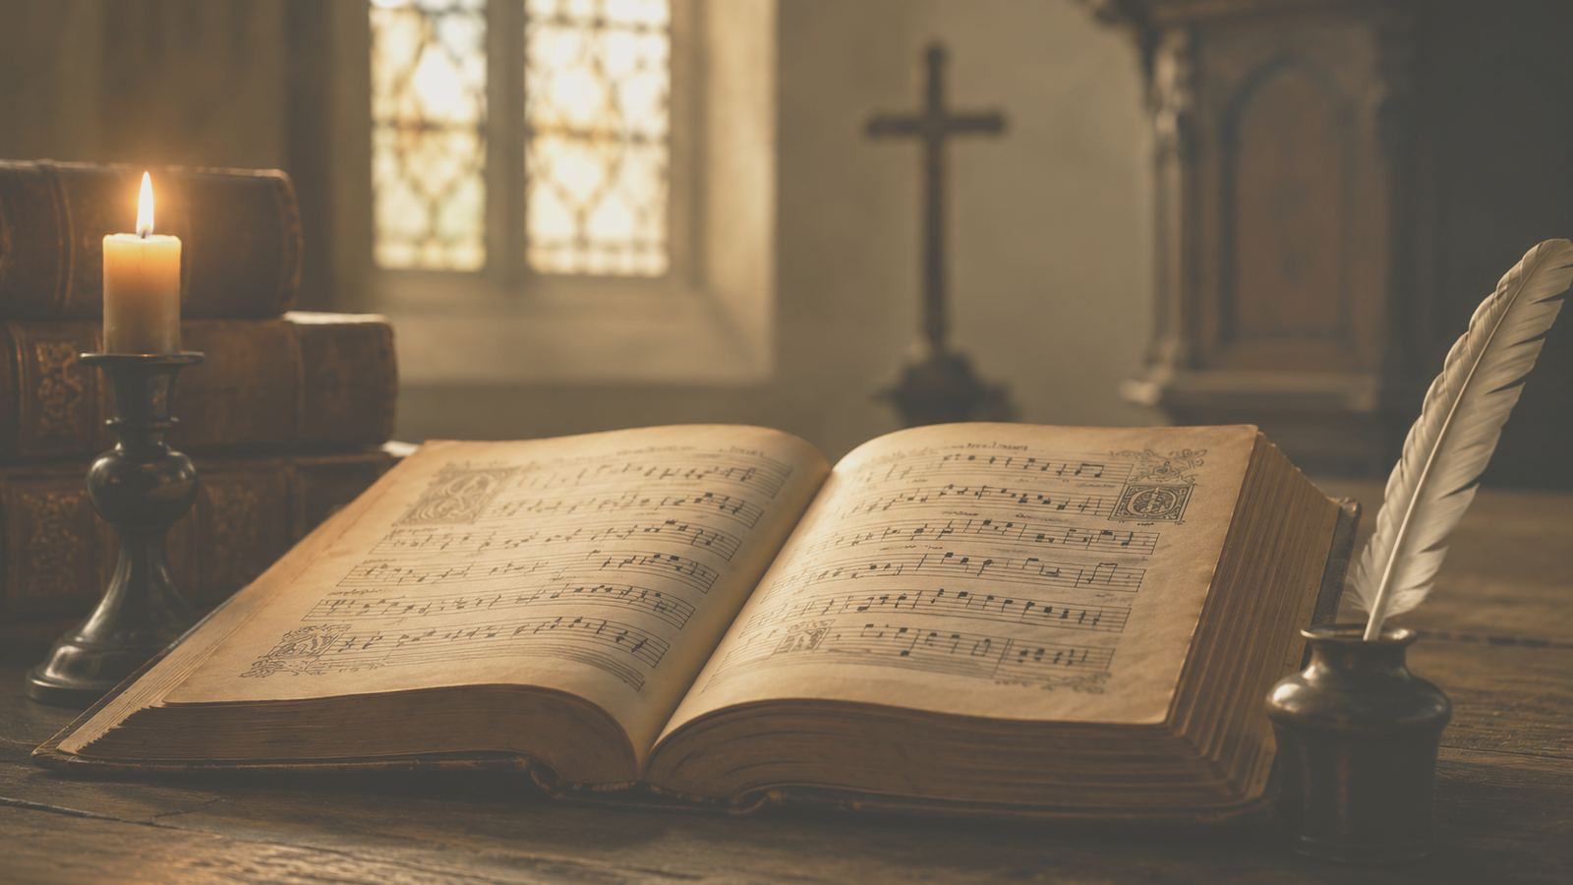
Hymn Identity
ORIGINAL GERMAN
ENGLISH TITLE
Auf, auf, mein Herz, mit Freuden
Awake, My Heart, with Gladness
TEXT
TRANSLATION
Paul Gerhardt, 1647; published 1648
John Kelly, 1867 translation tradition
TUNE
METER
AUF, AUF, MEIN HERZ by Johann Crüger
7.6.7.6.6.6.6.6
Prepared for teaching and small group use - hymninfo.com

Slide 4

A Lutheran Easter Chorale
Gerhardt's text, Crüger's tune, Kelly's English translation tradition
A hymn born from doctrinal praise: Christ lives, death is defeated, and the heart may wake with gladness.
Prepared for teaching and small group use - hymninfo.com

Slide 5
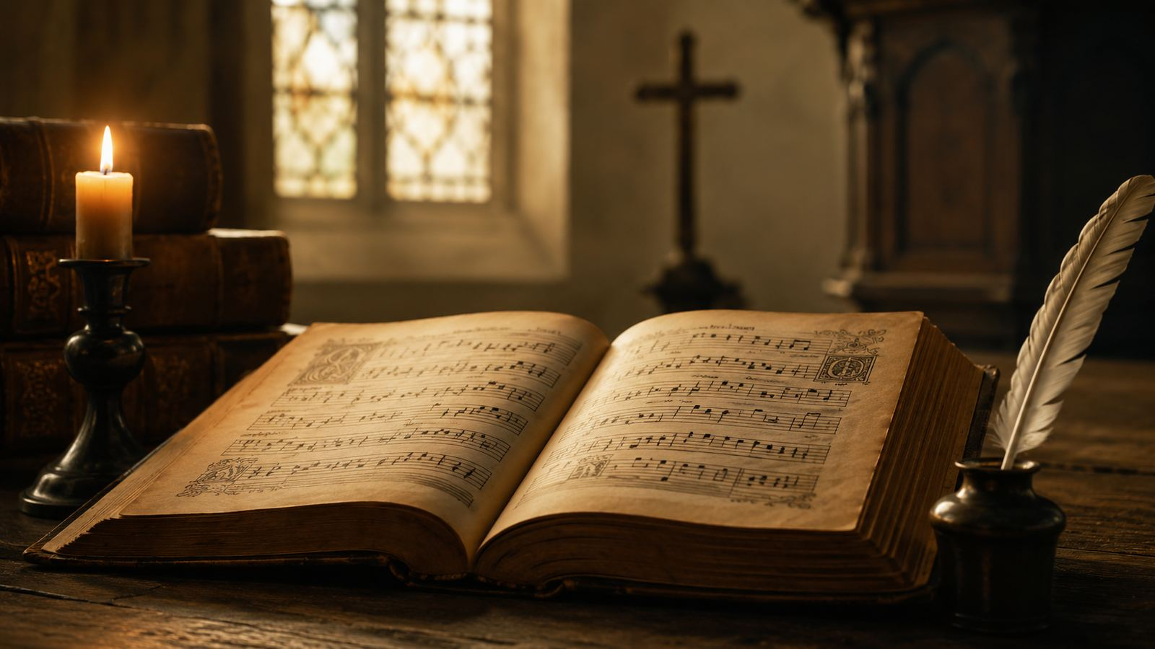
Historical Background
Paul Gerhardt wrote the German Easter text in the seventeenth-century Lutheran chorale tradition.
Johann Crüger's Praxis Pietatis Melica helped bring Gerhardt's hymns into congregational life.
John Kelly translated Gerhardt's hymns into English in the nineteenth century, preserving their original meters.
Modern hymnals often print altered or abbreviated English forms.
Prepared for teaching and small group use - hymninfo.com

Slide 6

Why This Hymn Matters Today
For worship
For grief
It gives Easter joy a strong congregational voice.
It speaks resurrection hope into burial, fear, and sorrow.
For discipleship
For teaching
It turns Easter from a season into daily courage.
It connects Christ's victory with Scripture and assurance.
Prepared for teaching and small group use - hymninfo.com

Slide 7

Biblical Foundation
Christ disarmed the powers and triumphed over them.
Colossians 2:15 gives the hymn its central lens: Easter is victory, not sentiment.
Prepared for teaching and small group use - hymninfo.com

Slide 8
Scripture Map
Colossians 2:15
Romans 6:4
1 Corinthians 15:57
Christ triumphs over hostile powers.
Believers walk in newness of life.
Victory is God's gift in Christ.
1 Peter 1:3
John 11:25
Revelation 1:18
Easter creates living hope.
Jesus is the resurrection and the life.
The risen Christ holds the keys of death.
Prepared for teaching and small group use - hymninfo.com

Slide 9
Hymn Section Study
From awakened joy to final hope
Prepared for teaching and small group use - hymninfo.com

Slide 10

1. The heart awakens
The opening summons the heart to joy because Christ's resurrection has changed everything. Gladness is not forced cheerfulness; it is faith answering Easter truth.
Scripture connection
1 Peter 1:3
Teaching emphasis: preach the truth to the heart until fear gives way to faith.
Prepared for teaching and small group use - hymninfo.com

Slide 11
2. The enemy is defeated
The grave appeared to win, but the resurrection reversed the verdict. Christ's victory exposes the weakness of every power that accuses, enslaves, or terrifies.
Scripture connection
Colossians 2:15
Teaching emphasis: preach the truth to the heart until fear gives way to faith.
Prepared for teaching and small group use - hymninfo.com

Slide 12
3. The believer shares the victory
Christ's triumph becomes the courage of those who trust him. The hymn turns Easter proclamation into personal assurance and baptismal identity.
Scripture connection
Romans 6:4
Teaching emphasis: preach the truth to the heart until fear gives way to faith.
Prepared for teaching and small group use - hymninfo.com

Slide 13
4. Hope reaches final glory
The hymn looks beyond present struggle to the promised crown. Easter joy becomes perseverance because the risen Lord holds authority over death.
Scripture connection
Revelation 1:18
Teaching emphasis: preach the truth to the heart until fear gives way to faith.
Prepared for teaching and small group use - hymninfo.com

Slide 14

Theological Themes
Christ the Victor
Resurrection hope
Assurance
The risen Lord defeats death and hostile powers.
Easter joy rests on a living Savior.
The believer's comfort is grounded in Christ.
New life
Spiritual warfare
Final glory
Baptismal identity becomes daily discipleship.
Fear and accusation are answered by Christ's triumph.
The cross-shaped road ends in resurrection life.
Prepared for teaching and small group use - hymninfo.com

Slide 15
Literary and Musical Observations
Movement
Imagery
The hymn moves from heart-awakening joy to Christ's victory and the believer's final hope.
Battle, burial, triumph, crown, and awakening give Easter a muscular vocabulary.
Tune
Singing
AUF, AUF, MEIN HERZ has short, vigorous phrases suited to bright Easter proclamation.
Keep the tempo confident but not rushed so the doctrinal text is clearly heard.
Prepared for teaching and small group use - hymninfo.com

Slide 16
Pastoral and Worship Use
Easter Day and Easter season
Funerals and services of comfort
Baptismal teaching on Romans 6
Services of assurance and praise
Choir rehearsals focused on chorale singing
Small groups studying resurrection hope
Worship planning note
This hymn works well after the Easter Gospel, during Easter Communion, or as a closing hymn of victory. Let the tune carry the text with energy and clarity.
Prepared for teaching and small group use - hymninfo.com

Slide 17
Suggested Lesson Flow
1
2
3
4
5
Open
Teach
Study
Discuss
Pray
Read Col. 2:15
History and hymn identity
Four hymn movements
Easter courage today
Living hope in Christ
30 minutes: Scripture, hymn background, two key movements, prayer.
60 minutes: Add full section study, discussion table, and worship planning.
Prepared for teaching and small group use - hymninfo.com

Slide 18
Closing Summary and Prayer
Christ is risen. Death is defeated. The heart may awaken with gladness.
Risen Lord Jesus, awaken our hearts with gladness. Teach us to live in your victory, to comfort one another with living hope, and to walk in newness of life until the day when every enemy is finally put under your feet. Amen.
© HymnInfo.com. Free for personal, church, classroom, and small-group teaching use. Please do not sell, repost, or redistribute as downloadable files without permission.
Prepared for teaching and small group use - hymninfo.com

