Slide 1
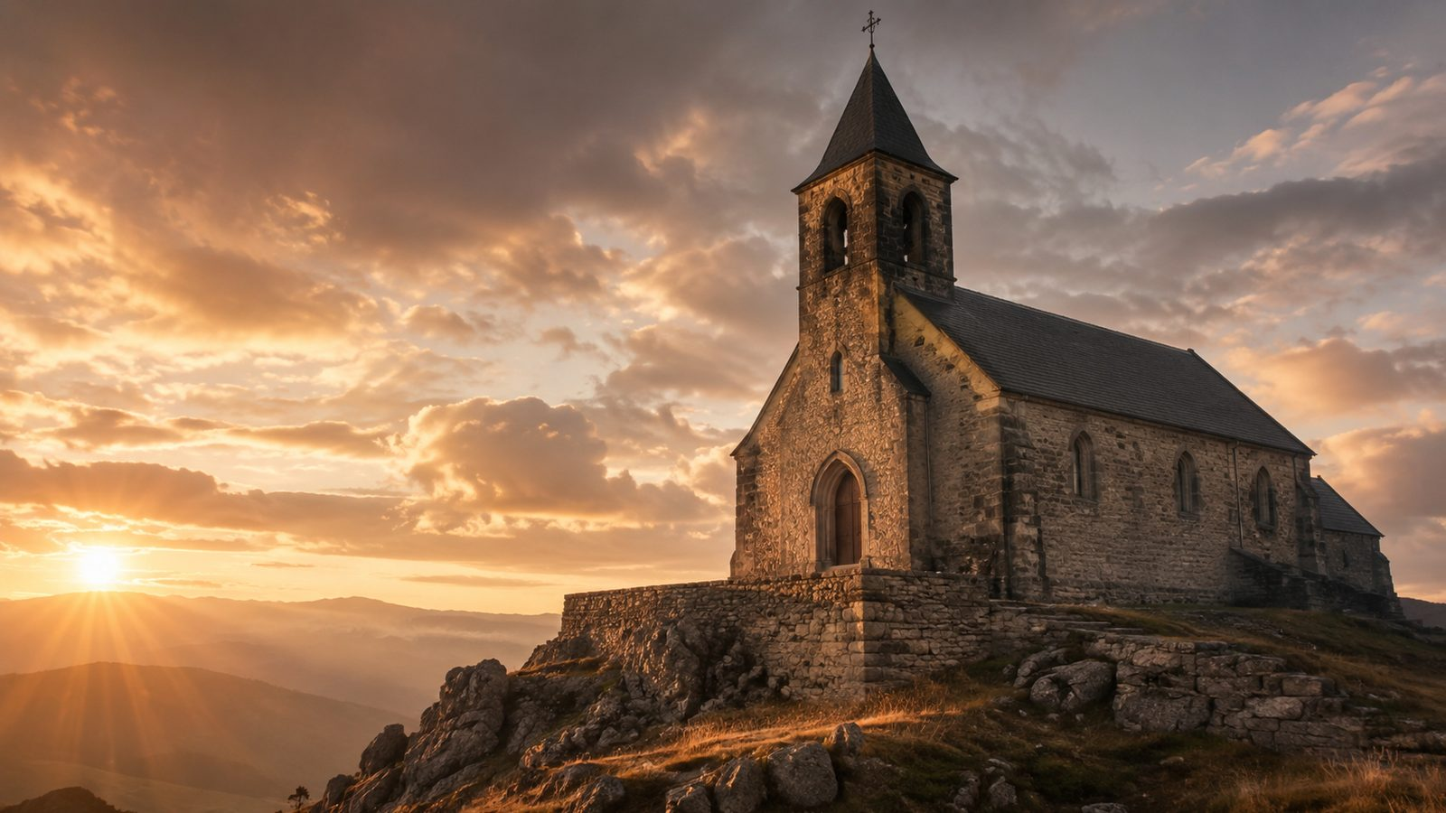
Built on the Rock
Christ, the Church, and the living stones of God
Built on the Rock the Church shall stand
Nikolai Frederik Severin Grundtvig, 1837
Tune: KIRKEN DEN ER ET GAMMELT HUS
Primary Scripture: Matthew 16:18
Prepared for teaching and small group use - hymninfo.com

Slide 2

Teaching Aim
A lesson that moves from foundation to faithful worship
R
H
S
Understand
Feel
Practice
Christ builds and preserves his church; no earthly structure can replace him.
Assurance when congregations face change, weakness, or uncertainty.
Live as living stones: gathered, forgiven, nourished, and sent.
Prepared for teaching and small group use - hymninfo.com

Slide 3
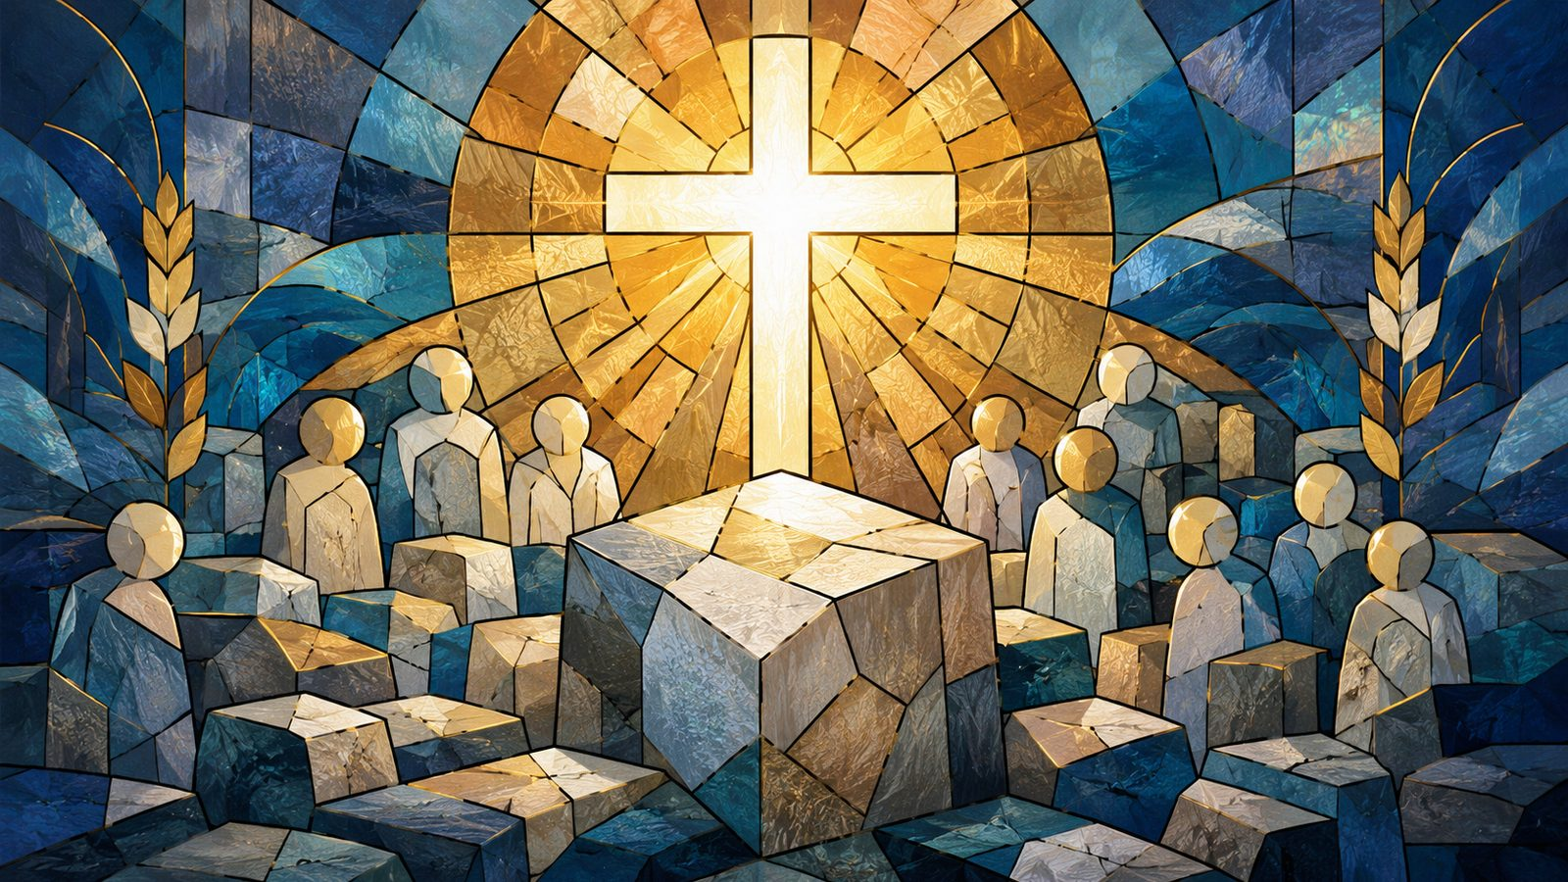
Hymn Identity
A Scandinavian Lutheran hymn of the church
TITLE
FIRST LINE
ORIGINAL LANGUAGE
Built on the Rock
Built on the Rock the Church shall stand
Danish
AUTHOR
TRANSLATOR
COMPOSER
Nikolai Frederik Severin Grundtvig
Carl Døving
Ludvig Mathias Lindeman
TUNE
METER
PUBLISHED
KIRKEN DEN ER ET GAMMELT HUS
8.8.8.8.8.8.8
1837
Prepared for teaching and small group use - hymninfo.com

Slide 4
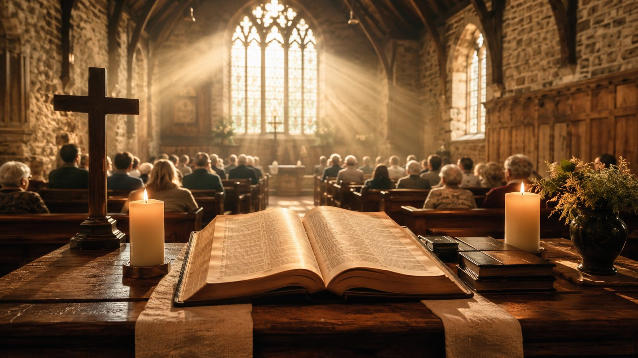
Historical Background
Danish text, Norwegian tune, English singing tradition
Grundtvig wrote the Danish text in 1837 during a renewal of congregational song in Denmark.
Carl Døving helped bring the hymn into English-speaking Lutheran worship.
Lindeman composed the tune for Grundtvig’s text, giving the hymn its sturdy Scandinavian musical voice.
The hymn treats the church as a living people gathered around Christ and his gifts.
Prepared for teaching and small group use - hymninfo.com

Slide 5
The Church Built by Christ
“I will build my assembly…” — Matthew 16:18
Prepared for teaching and small group use - hymninfo.com

Slide 6
Biblical Foundation
Rock, cornerstone, living stones, Spirit-filled temple
Matthew 16:18 gives the central promise: Christ builds, and death will not finally prevail.
Ephesians 2:20 names Christ as cornerstone over the apostolic and prophetic foundation.
1 Peter 2:5 calls believers “living stones” in a spiritual house.
Acts 17:24 and 1 Corinthians 3:16 keep the balance: God is not confined to buildings, yet he dwells with his people by the Spirit.
W
P
♪
Word
People
Praise
Prepared for teaching and small group use - hymninfo.com

Slide 7
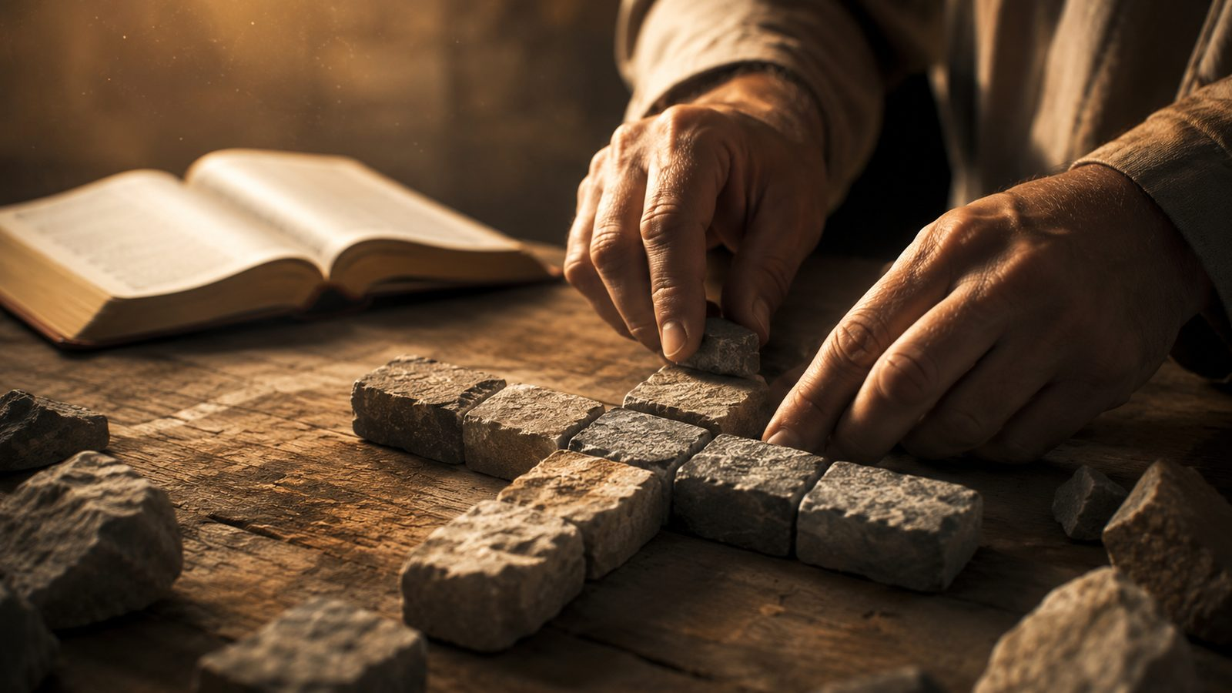
Hymn Movement 1: Christ the Rock
Visible buildings may weaken; Christ does not.
The hymn begins with the church standing on something stronger than stone, timber, or tradition.
Its confidence rests on Christ’s promise, not on institutional survival.
Teaching emphasis: a congregation is safest when its hope is anchored in the Lord who builds it.
Prepared for teaching and small group use - hymninfo.com

Slide 8
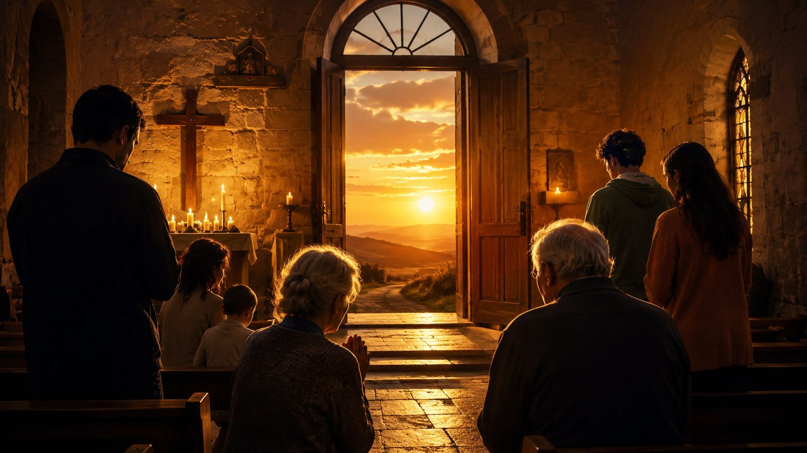
Hymn Movement 2: God Beyond Buildings
A house of worship is a servant, not the foundation.
The hymn refuses to confine God to a sanctuary made by human hands.
A church building can be a treasured place, but it is never the final dwelling of God.
Teaching emphasis: reverence for sacred space must serve worship of the living God.
Prepared for teaching and small group use - hymninfo.com

Slide 9
Hymn Movement 3: Living Stones
Christ gathers people into a dwelling place for God.
Believers themselves are built together as God’s spiritual house.
The church is formed by people joined to Christ, not by architecture alone.
Teaching emphasis: membership in Christ means belonging, serving, forgiving, and being shaped with others.
Prepared for teaching and small group use - hymninfo.com

Slide 10
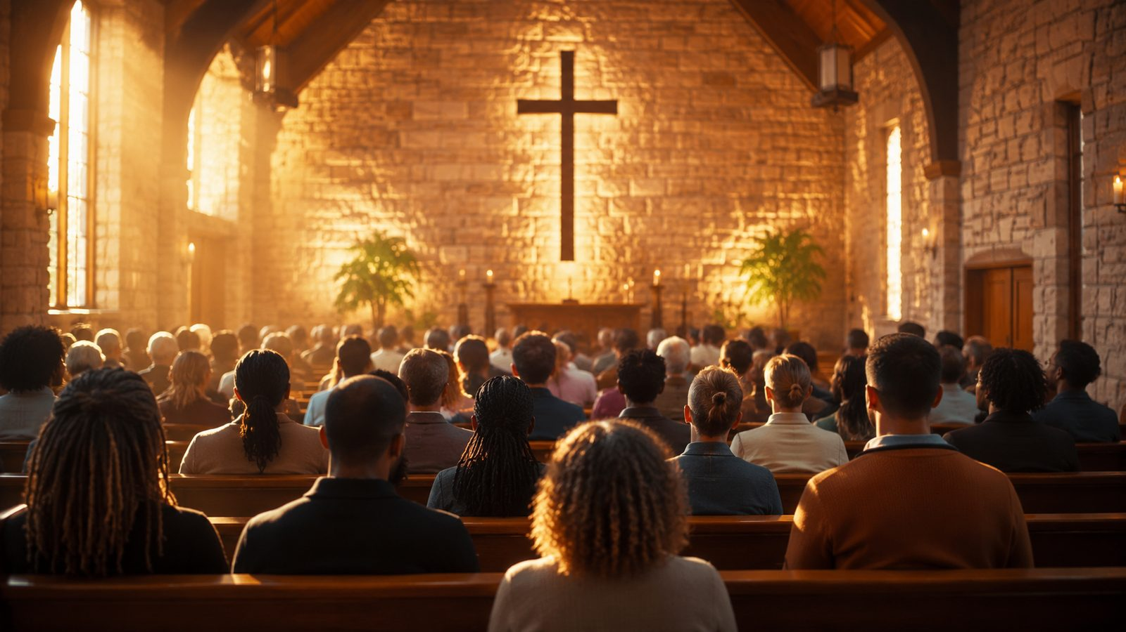
Hymn Movement 4: God’s Gifts in Worship
The church lives by the gifts of Christ.
The hymn turns to the ways Christ sustains his church: Word, prayer, praise, baptismal identity, and the Lord’s Supper.
The gathered congregation receives before it responds.
Teaching emphasis: worship is not religious performance; it is God meeting and strengthening his people.
W
P
♪
Word
People
Praise
Prepared for teaching and small group use - hymninfo.com

Slide 11
Hymn Movement 5: The Communion of Saints
The local assembly sings with the church of every age.
Earthly worship is joined to a larger fellowship across generations.
The congregation on earth is not isolated; it belongs to the one church of Christ.
Teaching emphasis: a small or struggling congregation is still part of the great household of God.
Prepared for teaching and small group use - hymninfo.com

Slide 12
Why This Hymn Matters Today
A hymn for churches that need courage without denial
It comforts congregations facing change, decline, grief, relocation, or rebuilding.
It guards against confusing facilities with the church itself.
It gives a strong worship vocabulary for church anniversaries and dedication services.
It teaches Christian identity through biblical images: rock, cornerstone, temple, and living stones.
Prepared for teaching and small group use - hymninfo.com

Slide 13
Theological Themes
Six truths to teach from the hymn
+
Christ the Rock
+
Living Stones
+
Word and Sacrament
The church rests on the Lord who builds it.
Believers are formed together as God’s house.
Christ gives what the church needs to live.
+
Spirit’s Dwelling
+
Perseverance
+
Communion of Saints
God makes his people his temple.
The gates of death do not defeat Christ’s church.
Earthly worship joins the wider people of God.
Prepared for teaching and small group use - hymninfo.com

Slide 14
Literary and Musical Observations
Text and tune work like architecture: broad, grounded, and communal
Architectural images carry the doctrine: house, rock, stones, foundation, temple.
The hymn’s argument moves from Christ’s promise to the gathered people of God and then toward eternal praise.
The tune has a sturdy, modal character that suits the hymn’s image of firmness.
A steady tempo helps the congregation feel strength without heaviness.
Prepared for teaching and small group use - hymninfo.com

Slide 15
Tune Notes: KIRKEN DEN ER ET GAMMELT HUS
A sturdy Scandinavian tune for a sturdy doctrine
Ludvig Mathias Lindeman composed the tune for Grundtvig’s text and it was published in 1840.
The meter is commonly printed as 8.8.8.8.8.8.8.
Its broad melodic shape supports unison singing, choir leadership, organ, brass, or strong congregational accompaniment.
Teach it patiently if unfamiliar; once learned, it carries the text with confidence.
Prepared for teaching and small group use - hymninfo.com

Slide 16
Pastoral and Worship Use
Use when the congregation needs to remember what the church really is.
Church anniversary or homecoming service
Building dedication, renovation, or relocation
Reformation-themed worship or teaching on the church
Call to worship when the congregation needs courage and unity
Choir rehearsal focused on text, breathing, and strong unison singing
Prepared for teaching and small group use - hymninfo.com

Slide 17
Teaching Questions
For class discussion or choir reflection
What is the difference between a church building and the church itself?
Why does Matthew 16:18 give more comfort than human strength or history can give?
How does 1 Peter 2:5 change the way we think about church membership?
What gifts does Christ use to sustain his gathered people?
How can this hymn serve a congregation facing change or loss?
Prepared for teaching and small group use - hymninfo.com

Slide 18
Application: Live as Living Stones
The hymn moves from doctrine to congregational faithfulness.
Anchor confidence in Christ rather than in facilities, budgets, or popularity.
Show up for worship as part of the house God is building.
Receive the Word with humility and respond with praise.
Practice unity: stones are shaped together, not alone.
Encourage a weary church member with the promise that Christ still builds his church.
Prepared for teaching and small group use - hymninfo.com

Slide 19
Suggested Lesson Flow
Two practical formats for teaching
30 Minutes
60 Minutes
5 min: read Matthew 16:18
7 min: hymn identity and history
10 min: biblical images
5 min: application
3 min: prayer
8 min: opening question and Scripture
12 min: historical context
20 min: hymn movements
12 min: worship and music notes
8 min: discussion and prayer
Prepared for teaching and small group use - hymninfo.com

Slide 20
Choir and Worship Planner Notes
The sound should be firm, steady, and hopeful.
Let the congregation feel the strength of the tune without forcing a fast tempo.
Use choir or brass to support confidence on festival Sundays.
Introduce the hymn by naming its main image: Christ builds the church on himself.
For church anniversaries, pair the hymn with a spoken remembrance of God’s faithfulness across generations.
Prepared for teaching and small group use - hymninfo.com

Slide 21
Closing Summary and Prayer
Christ builds his church; his people live by his gifts.
Lord Jesus Christ, our Rock and Cornerstone, keep your church in the promise of your Word.
Build us together as living stones, strengthen our faith, and teach us to worship with courage, humility, and love.
When visible things weaken, fix our hope on you, the Lord who is the same yesterday, today, and forever. Amen.
Prepared for teaching and small group use - hymninfo.com

Slide 22
Usage Notice
© HymnInfo.com. Free for personal, church, classroom, and small-group teaching use. Please do not sell, repost, or redistribute as downloadable files without permission.
Prepared for teaching and small group use - hymninfo.com

