Slide 1

HYMN STUDY RESOURCE
By Grace I'm Saved
Grace alone through faith in Christ
First line: By grace I'm saved, grace free and boundless
Christian Ludwig Scheidt, 1742
English Lutheran translation tradition: Matthias Loy
Tune: O DASS ICH TAUSEND ZUNGEN HÄTTE
Primary Scripture: Ephesians 2:8-9
Prepared for teaching and small group use - hymninfo.com

Slide 2

Teaching Aim
U
F
P
UNDERSTAND
Salvation rests on God’s gift, not human merit.
FEEL
Receive comfort for a troubled conscience.
PRACTICE
Trust the promise of God and serve from gratitude.
Prepared for teaching and small group use - hymninfo.com

Slide 3


Hymn Identity
Title: By Grace I’m Saved
German first line: Aus Gnaden soll ich selig werden
Author: Christian Ludwig Scheidt (1709–1761)
Translator tradition: Matthias Loy (1828–1915)
Tune: O DASS ICH TAUSEND ZUNGEN HÄTTE
Meter: 9.8.9.8.8.8
Prepared for teaching and small group use - hymninfo.com

Slide 4

Grace Alone
The hymn’s center is not human achievement, but the gift of God in Christ.
Prepared for teaching and small group use - hymninfo.com

Slide 5
Historical Background
Christian Ludwig Scheidt wrote the German text in 1742.
The hymn belongs to the Lutheran song tradition of doctrine sung as confession and comfort.
English-language Lutheran hymnals commonly preserve it through the Matthias Loy translation tradition, with later adjustments in some printings.
The chorale tune name has related forms; worship leaders should check the melody printed in their own hymnal.
Prepared for teaching and small group use - hymninfo.com

Slide 6

Why This Hymn Matters Today
It gives anxious believers a Gospel sentence to sing: salvation is God’s gift.
It dismantles pride in works and despair over weakness at the same time.
It turns confession into comfort, because grace is grounded in Christ rather than in personal performance.
It helps the church teach justification in language that ordinary worshipers can remember.
Prepared for teaching and small group use - hymninfo.com

Slide 7
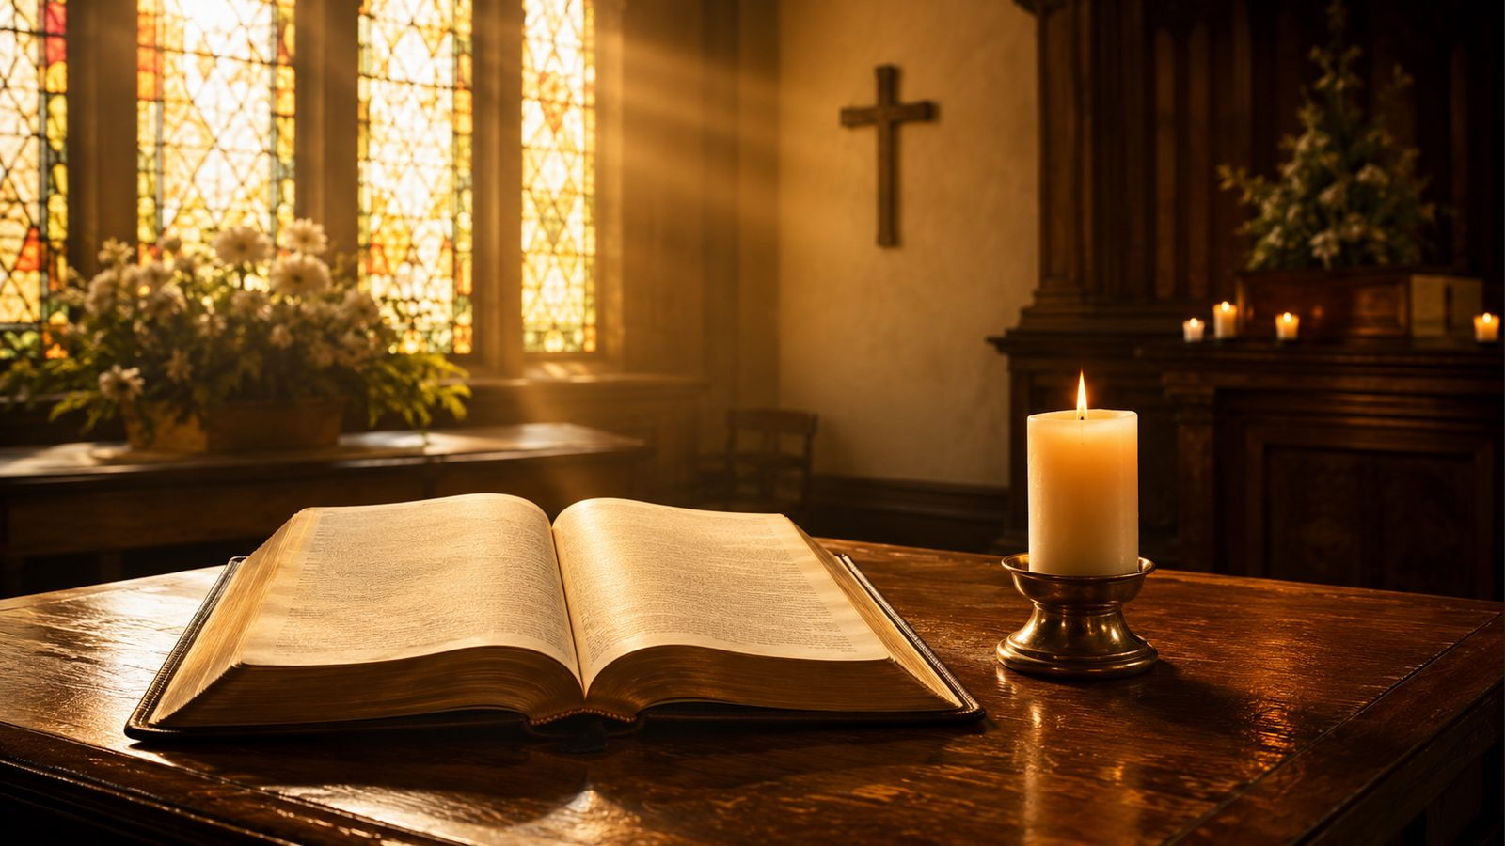
Biblical Foundation
Ephesians 2:8-9
Saved by grace through faith; the gift of God, not works.
Romans 3:23-24
Sinners are justified freely by grace through redemption in Christ.
Titus 3:5
God saves according to mercy, not works of righteousness.
Romans 11:6
Grace and works cannot be rival foundations.
2 Timothy 1:9
Grace is given according to God’s purpose in Christ.
Isaiah 64:6
Human righteousness cannot carry the sinner before God.
Prepared for teaching and small group use - hymninfo.com

Slide 8
The Heart Hears “Grace” First
The hymn begins by making grace the first and decisive word over salvation.
The singer is not asked to climb toward God by worthiness.
Fear and accusation are answered by the promise of God.
Teaching emphasis: assurance begins with God’s action, not self-measurement.
Prepared for teaching and small group use - hymninfo.com

Slide 9
Works Cannot Bear the Weight
The hymn refuses to let human merit become the foundation of peace with God.
Good works matter as fruit, but not as the ground of justification.
Pride and despair both lose their claim when grace stands alone.
Teaching emphasis: salvation is received, then gratitude learns to obey.
Prepared for teaching and small group use - hymninfo.com

Slide 10
Christ Gives Grace Its Foundation
Grace is not vague kindness; it is God’s favor given through the Redeemer.
The cross turns grace from idea into Gospel reality.
The sinner’s confidence rests in Christ’s saving work.
Teaching emphasis: assurance is Christ-centered before it is inwardly felt.
Prepared for teaching and small group use - hymninfo.com

Slide 11
The Word Steadies the Conscience
The hymn repeatedly sends the anxious heart back to what God has spoken.
Feelings rise and fall; the promise of God remains firm.
The Christian conscience is comforted by the Gospel, not by self-persuasion.
Teaching emphasis: faith clings to the Word when the heart is weak.
Prepared for teaching and small group use - hymninfo.com

Slide 12
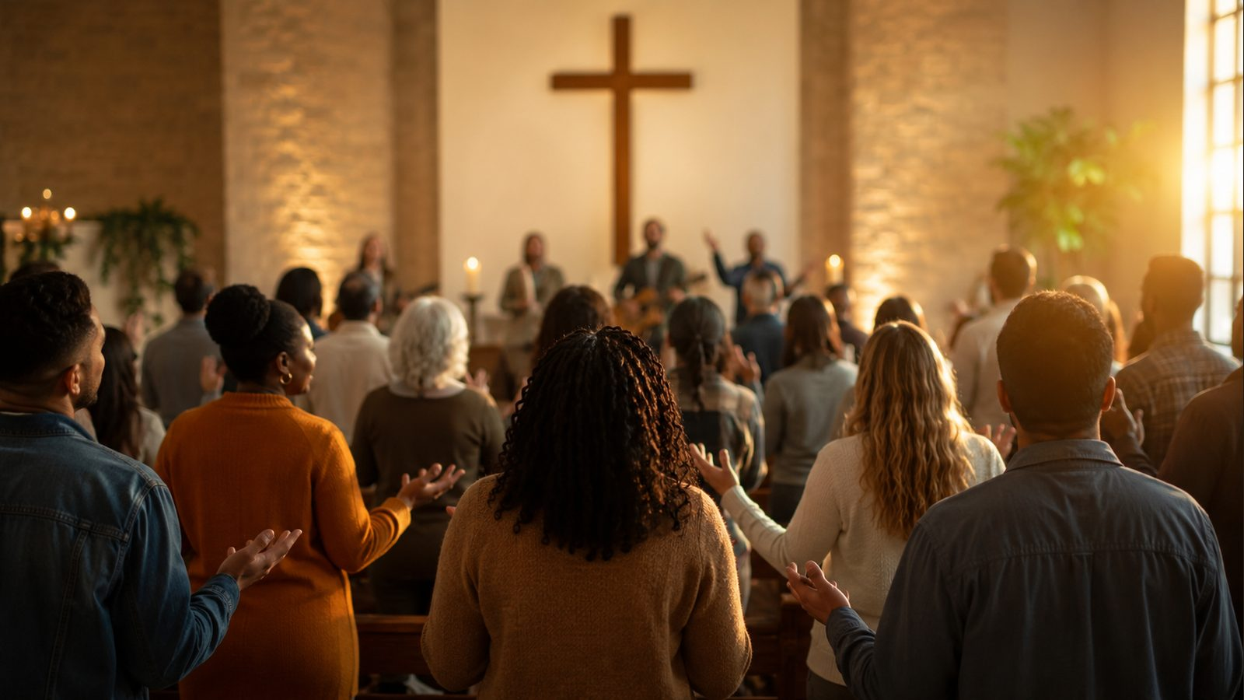
Grace Carries Us Home
The hymn’s assurance stretches from present forgiveness to the promised inheritance.
The grace that saves now also sustains until the end.
Death does not cancel the promise of God in Christ.
Teaching emphasis: Christian hope is grace from beginning to end.
Prepared for teaching and small group use - hymninfo.com

Slide 13
Theological Themes
Grace Alone
God saves as gift, not wage.
Justification
The sinner is received through Christ.
Faith
Faith rests on the promise of God.
Atonement
Grace is grounded in the Redeemer.
Assurance
The conscience is comforted by Gospel truth.
Good Works
Obedience follows grace as grateful fruit.
Prepared for teaching and small group use - hymninfo.com

Slide 14
Literary and Musical Observations
The text uses repetition and direct address to strengthen confidence.
Its argument moves from grace, to Christ, to the conscience, to eternal hope.
The tune is a sturdy chorale: clear, declarative, and well suited for congregational teaching.
A moderate, confident tempo allows the doctrine to be heard rather than rushed.
Prepared for teaching and small group use - hymninfo.com

Slide 15
Pastoral and Worship Use
After confession and absolution, when the Gospel answer should be sung.
During Reformation, justification, or assurance-focused services.
In Bible classes on Ephesians 2, Romans 3, Titus 3, or the doctrine of grace.
With anxious, grieving, or guilt-burdened believers who need to hear Christ’s promise clearly.
As a hymn of praise that teaches while it comforts.
Prepared for teaching and small group use - hymninfo.com

Slide 16

Teaching Questions
What makes grace different from a reward?
Why does the hymn speak so directly to a troubled conscience?
How can good works matter without becoming the basis of salvation?
Where do believers often look for assurance besides Christ?
How does Ephesians 2:8-9 reshape Christian pride and fear?
Prepared for teaching and small group use - hymninfo.com

Slide 17
Suggested Lesson Flow
30 Minutes
60 Minutes
Read Ephesians 2:8-9.
Identify the hymn’s main claim.
Discuss grace and works.
Name one promise to carry this week.
Close in prayer.
Add Romans 3 and Titus 3.
Trace the hymn’s movement from fear to assurance.
Discuss the tune and chorale style.
Apply the hymn pastorally.
Sing or read the final summary together.
Prepared for teaching and small group use - hymninfo.com

Slide 18
Closing Summary and Prayer
Grace is not the believer’s achievement; it is God’s gift in Christ.
The hymn teaches the church to answer sin, fear, and accusation with the promise of the Gospel.
Prayer: Lord Jesus Christ, keep our confidence fixed on your grace. Free us from pride, comfort us in weakness, and teach us to live in grateful obedience. Amen.
© HymnInfo.com. Free for personal, church, classroom, and small-group teaching use. Please do not sell, repost, or redistribute as downloadable files without permission.
Prepared for teaching and small group use - hymninfo.com

