Slide 1
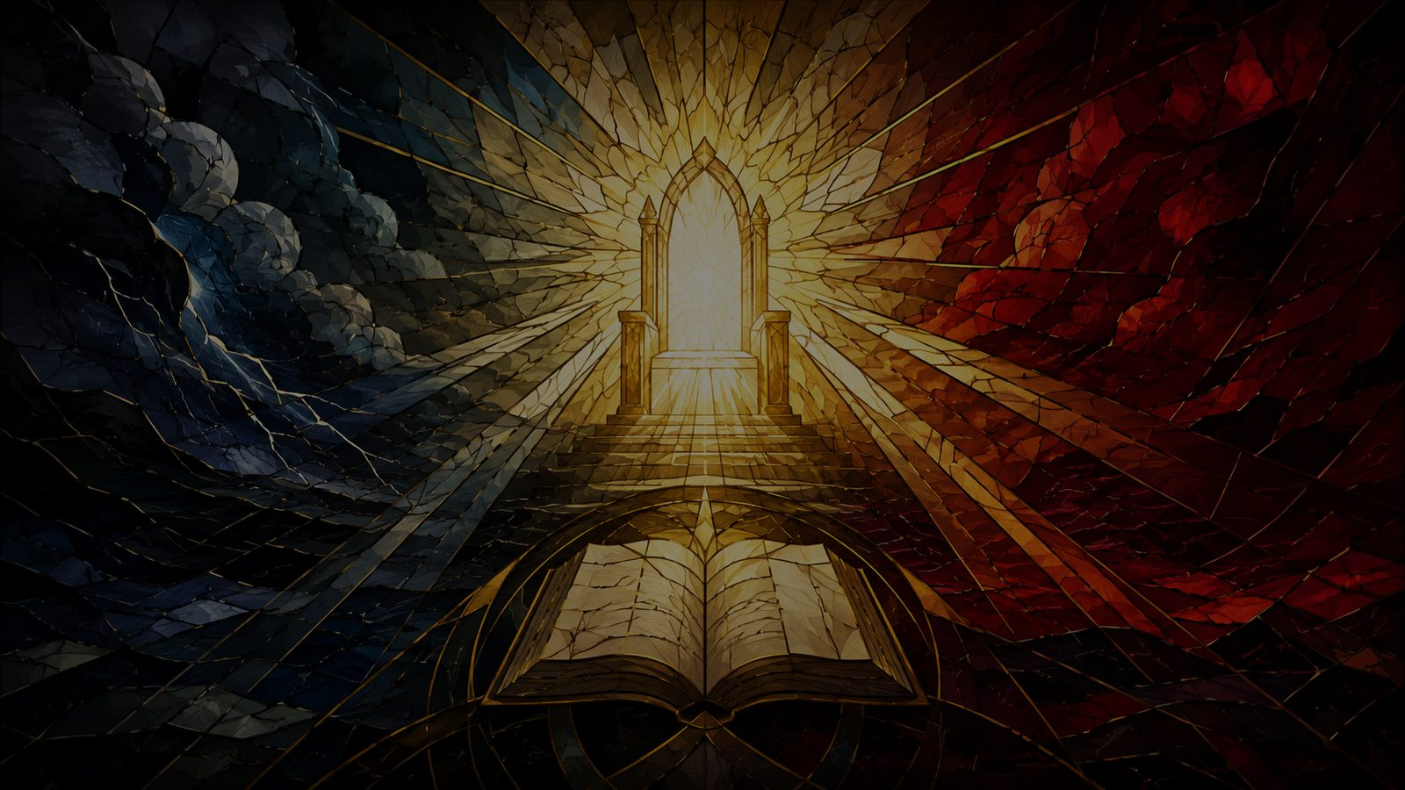
Day of Wrath, O Day of Mourning
A hymn study on final judgment, repentance, and mercy
Latin sequence, 13th century • Irons translation, 1848 • Dykes tune, 1861
Primary Scripture: Zephaniah 1:15
Prepared for teaching and small group use - hymninfo.com
1

Slide 2

Teaching Aim
Lead learners from holy seriousness to Gospel hope.
?
!
→
Understand
Feel
Practice
Final judgment is a biblical doctrine, not a medieval exaggeration.
The hymn should awaken reverence, repentance, and honest need.
Believers respond by confessing sin and trusting Christ’s mercy.
Prepared for teaching and small group use - hymninfo.com
2

Slide 3
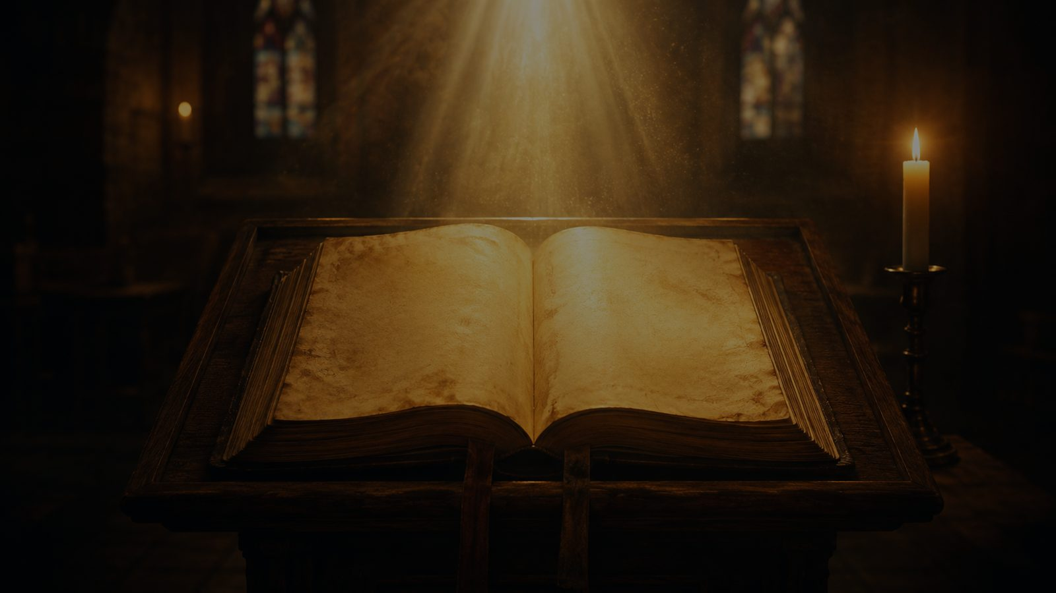
Hymn Identity
A medieval judgment sequence in an English hymn translation.
First line
Day of wrath, O day of mourning
Original language
Latin
Text
Dies irae, traditionally linked with Thomas of Celano
Translation
William Josiah Irons, 1848
Tune
DIES IRAE by John Bacchus Dykes, 1861
Meter
8.8.8
Primary Scripture
Zephaniah 1:15
Prepared for teaching and small group use - hymninfo.com
3

Slide 4
Historical Background
Ancient gravity, careful attribution, Victorian congregational form.
• The Latin Dies irae is one of the best-known medieval texts on final judgment.
• Thomas of Celano is the traditional attribution, though medieval sequence authorship should be handled with care.
• Irons’s English translation gave congregations a metrical way to sing the sequence.
• Dykes’s 1861 tune belongs to Victorian Anglican hymnody and differs from the older chant melody.
Teaching care
Do not use the hymn merely for drama. Use it as a prayer of repentance before the merciful Judge.
Prepared for teaching and small group use - hymninfo.com
4

Slide 5
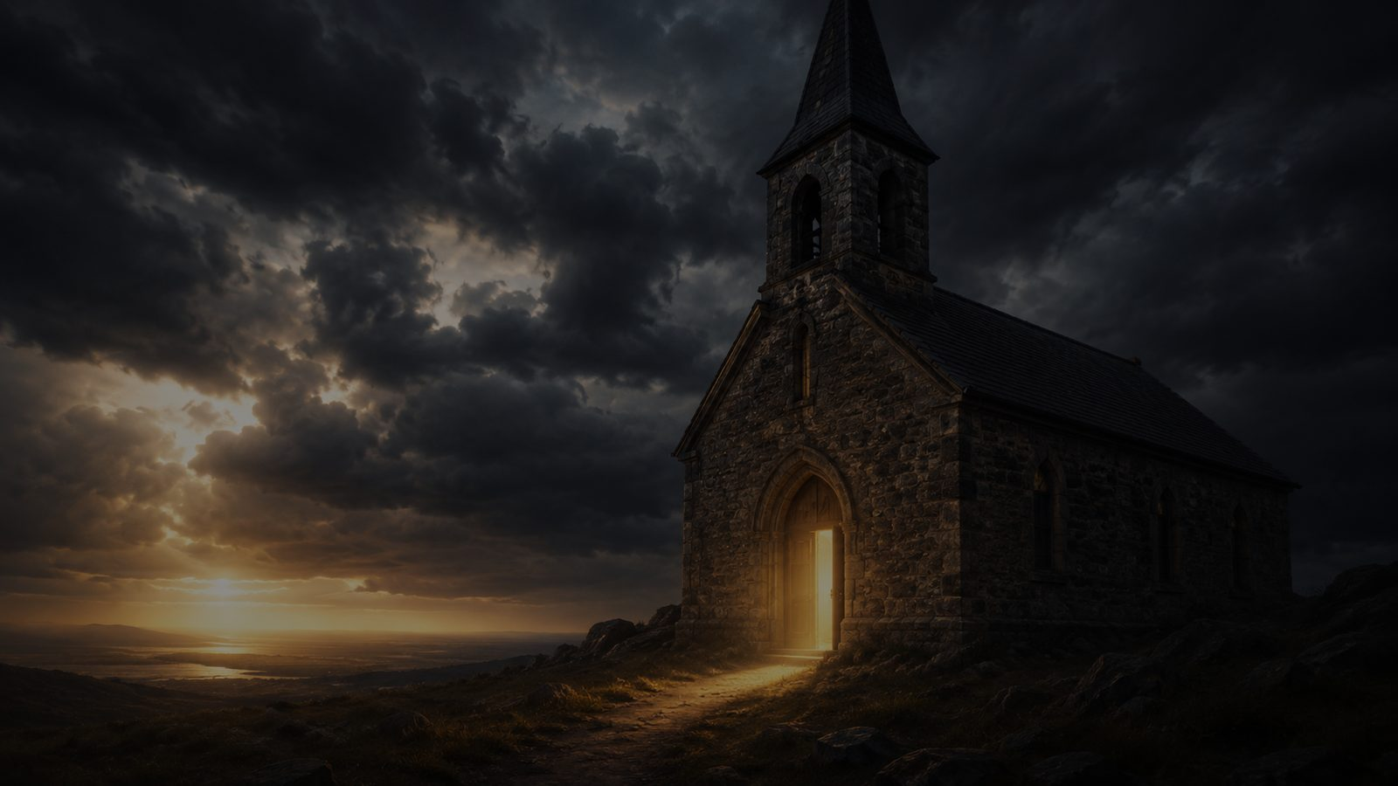
Why This Hymn Matters Today
It restores a biblical seriousness that modern worship often avoids.
• It teaches accountability before Christ without pretending sinners can stand by merit.
• It gives language for confession in seasons of Advent, Lent, and funeral remembrance.
• It helps the church recover holy fear as a companion to Gospel mercy.
• It reminds worshipers that the last word belongs neither to death nor denial, but to God.
Prepared for teaching and small group use - hymninfo.com
5

Slide 6
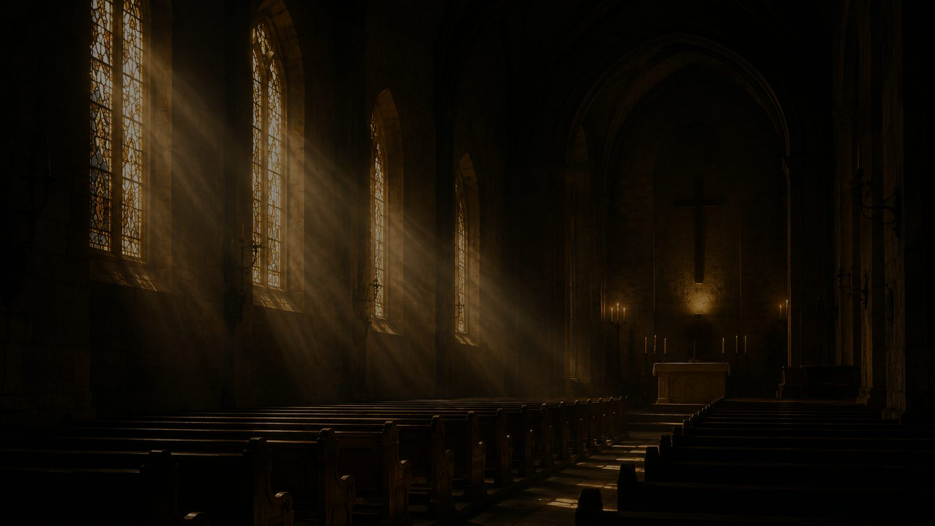
Biblical Foundation
The day of the Lord • the throne of Christ • the plea for mercy
Prepared for teaching and small group use - hymninfo.com
6

Slide 7
Zephaniah 1:15
The prophetic language behind the hymn’s opening force.
“That day is a day of wrath, a day of distress and anguish…”
Teaching emphasis: the hymn does not invent judgment imagery; it receives the weight of prophetic Scripture.
Prepared for teaching and small group use - hymninfo.com
7

Slide 8
Christ the Judge
The nations are gathered before the Son of Man.
• Matthew 25 presents Christ coming in glory with authority over all nations.
• Revelation 20 pictures the dead standing before the throne as the record is opened.
• Christian comfort must not shrink Jesus into sentiment. The Savior is also Lord and Judge.
Prepared for teaching and small group use - hymninfo.com
8

Slide 9
The Opened Record
Judgment reveals what human beings prefer to hide.
The hymn presses the conscience: What answer can sinners give when all is revealed?
This is not morbid curiosity. It is pastoral truthfulness that leads to confession.
Prepared for teaching and small group use - hymninfo.com
9

Slide 10
The Mercy Hinge: Psalm 130
Holy fear becomes Gospel hope when forgiveness is named.
“If you, Yah, kept a record of sins, Lord, who could stand? But there is forgiveness with you…”
• Judgment exposes human need.
• Mercy answers honest repentance.
• The hymn’s prayers should lead hearers to Christ, not despair.
Prepared for teaching and small group use - hymninfo.com
10

Slide 11

Movement of the Hymn
From warning to prayer, from exposure to hope.
1
2
3
4
5
The last day is announced.
The Judge appears.
The record is opened.
The sinner pleads for mercy.
Hope rests in God alone.
Prepared for teaching and small group use - hymninfo.com
11

Slide 12
Theological Themes
The hymn’s weight rests on biblical doctrine.
Final Judgment
Day of the Lord
Repentance
Christ the Judge
Mercy
Resurrection
Prepared for teaching and small group use - hymninfo.com
12

Slide 13
Literary and Musical Observations
Short lines, grave questions, and a tune built for sober prayer.
• The 8.8.8 meter gives each stanza a compact, urgent shape.
• Irons’s translation uses direct address and searching questions to press the conscience.
• Dykes’s tune is a Victorian hymn tune, not the medieval plainchant melody.
• Sing with gravity and restraint; too fast weakens the text, too slow can become oppressive.
Prepared for teaching and small group use - hymninfo.com
13

Slide 14
Pastoral and Worship Use
Use the hymn with Gospel framing and careful leadership.
• Advent: Christ’s return and watchfulness.
• Lent: repentance, confession, and mercy.
• Funerals: honest speech about death, judgment, and hope.
• Teaching settings: final things, accountability, and the mercy of Christ.
• Choir leadership: support unfamiliar tunes with confidence and clarity.
Pastoral caution
Do not use this hymn to frighten for effect. Let Scripture lead to repentance and mercy.
Prepared for teaching and small group use - hymninfo.com
14

Slide 15
Teaching Questions
Move from observation to repentance and trust.
• What images in the hymn point most clearly to final judgment?
• How do Zephaniah 1:15 and Revelation 20:12 explain the solemn tone?
• How does the hymn hold together divine justice and the plea for mercy?
• What should reflection on judgment change in worship and daily life?
Prepared for teaching and small group use - hymninfo.com
15

Slide 16
Suggested Lesson Flow
Two practical options for Sunday school or small group teaching.
30 minutes
60 minutes
• Read Zephaniah 1:15 and Psalm 130:3-4.
• Explain the hymn’s background and tone.
• Discuss the movement from warning to mercy.
• Pray a short prayer of confession and trust.
• Read all supporting Scriptures.
• Teach the hymn movement in five stages.
• Discuss worship use and pastoral caution.
• Invite personal examination and Gospel response.
• Close with Psalm 130 and prayer.
Prepared for teaching and small group use - hymninfo.com
16

Slide 17
Closing Summary and Prayer
The hymn tells the truth: the day of the Lord is coming, the Judge is holy, and sinners cannot stand by merit. Yet it also teaches the heart to pray for mercy and to seek refuge in Christ.
Lord Jesus Christ, merciful Judge and Savior, search us, forgive us, and keep us watchful until the day we stand before you. Amen.
Prepared for teaching and small group use - hymninfo.com
17

Slide 18
Prepared for Church Teaching
© HymnInfo.com. Free for personal, church, classroom, and small-group teaching use. Please do not sell, repost, or redistribute as downloadable files without permission.
Prepared for teaching and small group use - hymninfo.com
Prepared for teaching and small group use - hymninfo.com
18

