Slide 1
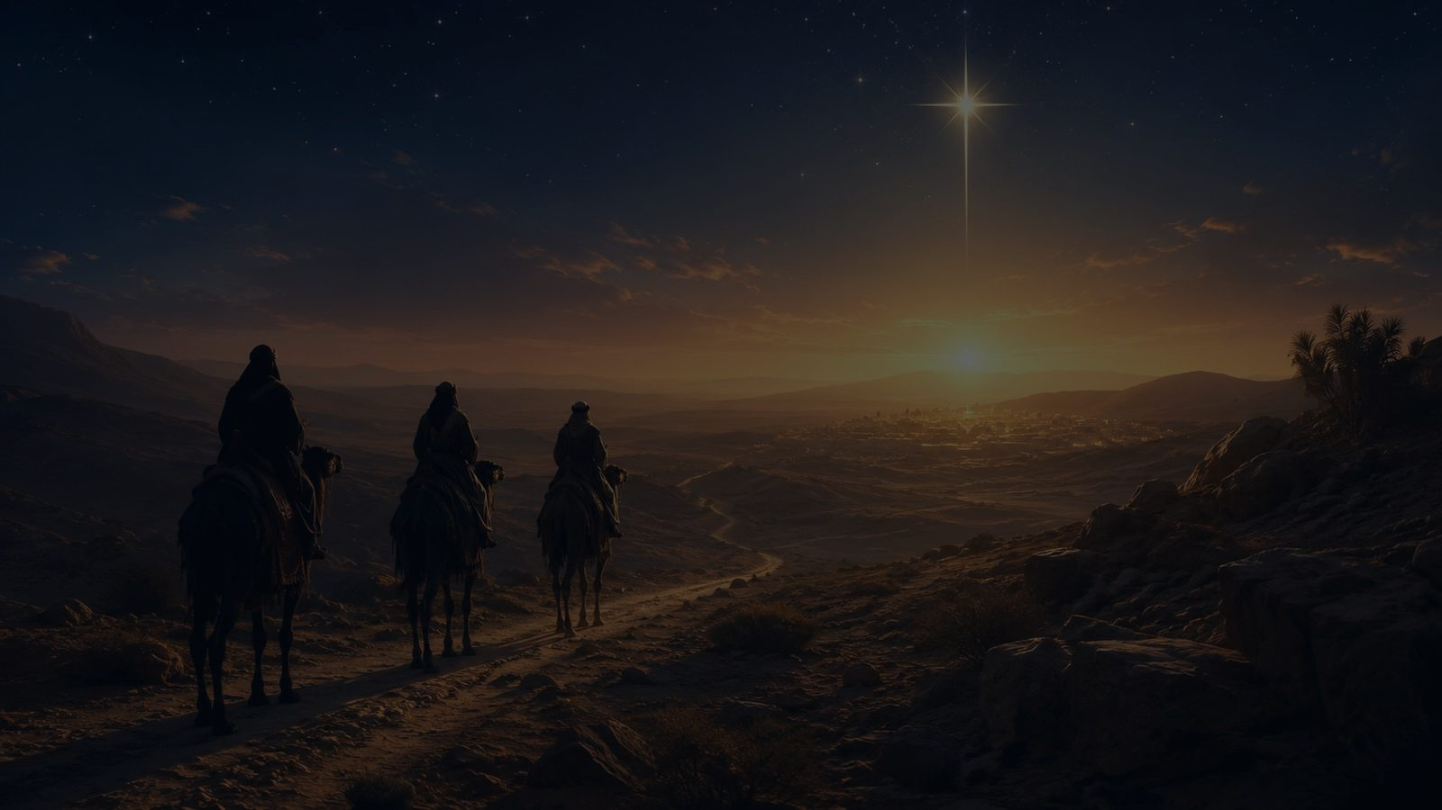
From a Distant Home
An Epiphany hymn study for worship, teaching, and preaching
From a distant home the Savior we come seeking • ISLA DEL ENCANTO • Matthew 2:1-2
Prepared for teaching and small group use - hymninfo.com

Slide 2

Teaching Aim
Help the congregation move from seeking the light to worshiping Christ the King.
✦
✧
✚
Understand
Feel
Practice
Epiphany reveals Christ as Savior and King for all peoples.
The Magi story should awaken joy, humility, and wonder.
Bring worship, obedience, and generous offering to Christ.
Prepared for teaching and small group use - hymninfo.com

Slide 3
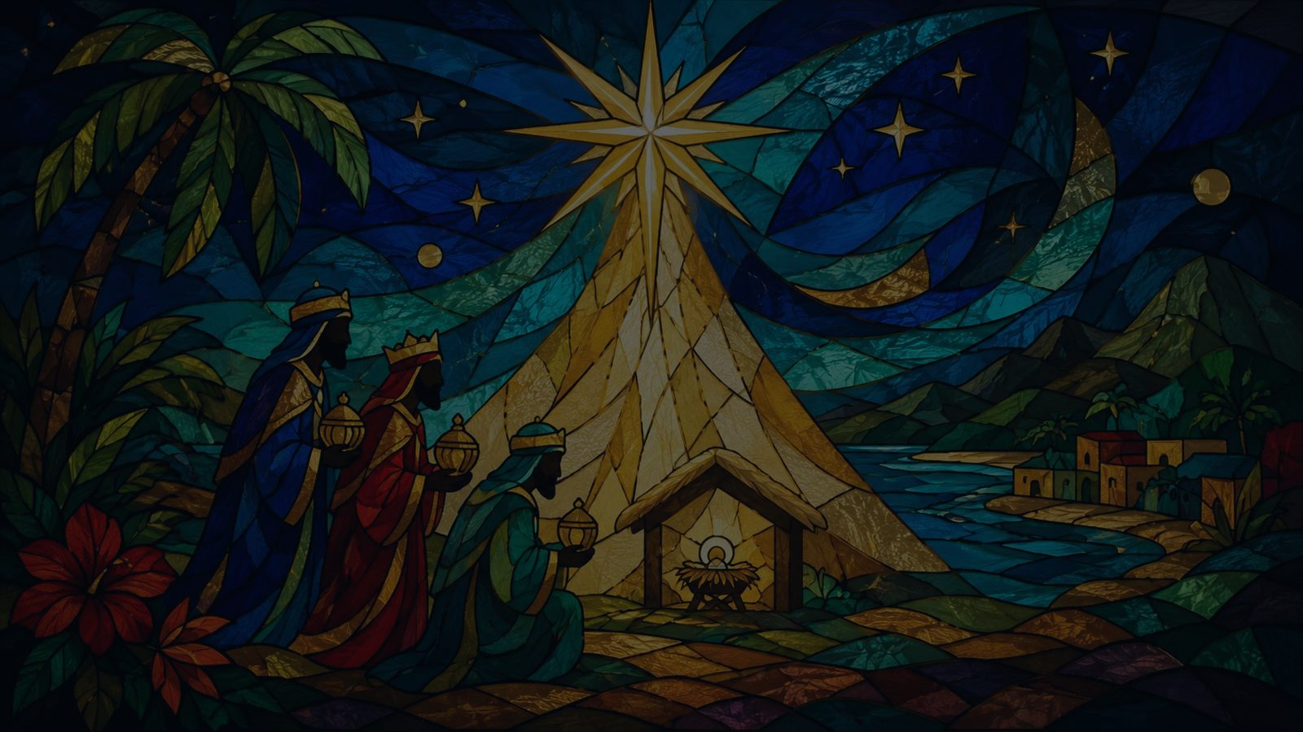
Hymn Identity
A Puerto Rican Epiphany carol carried into English-language congregational song.
Title
From a Distant Home
Spanish title
De Tierra Lejana Venimos
Tune
ISLA DEL ENCANTO
Meter
12.12 with refrain
English adaptation
George K. Evans and Walter Ehret
Publication setting
The International Book of Christmas Carols, 1963; revised 1980
Prepared for teaching and small group use - hymninfo.com

Slide 4
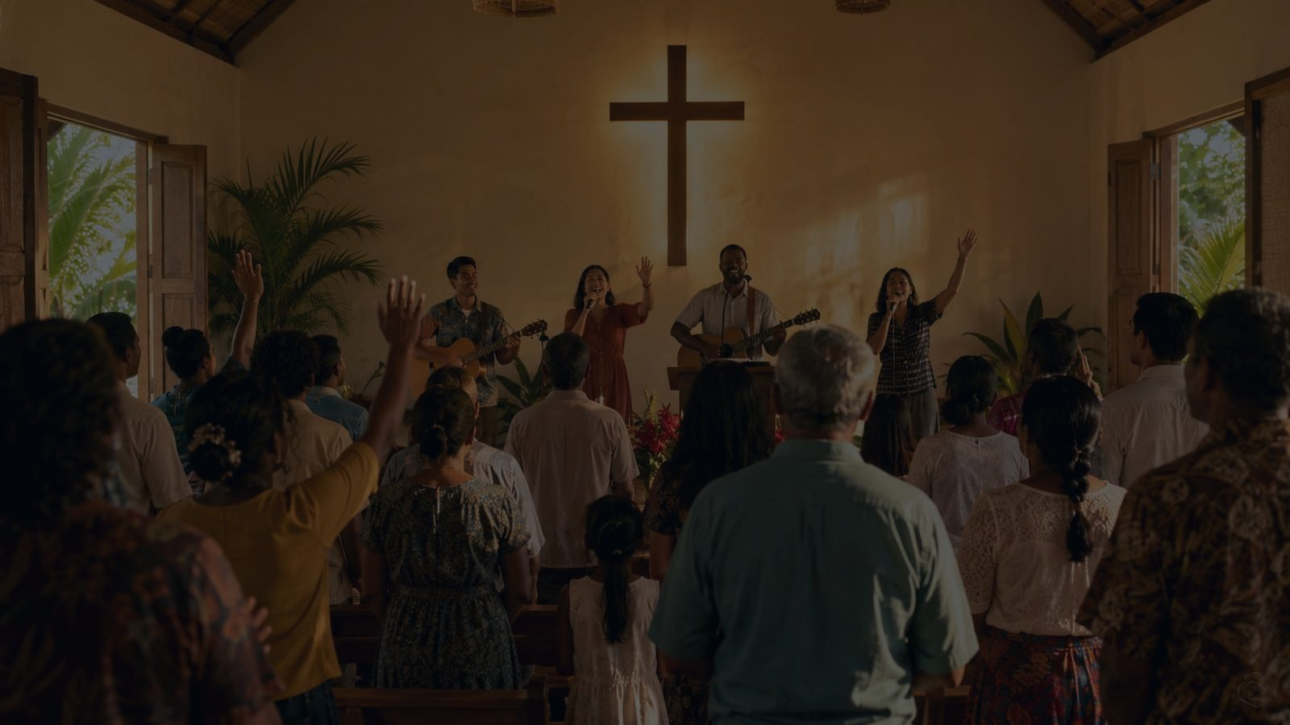
Historical Background
A carol tradition shaped by Spanish-language Christmas and Epiphany song.
The hymn comes from the Puerto Rican carol tradition and is known in Spanish as De Tierra Lejana Venimos.
George K. Evans and Walter Ehret helped bring the carol into English-language worship through a widely used Christmas carol collection.
The tune name ISLA DEL ENCANTO honors Puerto Rico’s beloved “island of enchantment” identity.
Its lively character gives Epiphany a sound of movement, joy, and shared praise.
Prepared for teaching and small group use - hymninfo.com

Slide 5
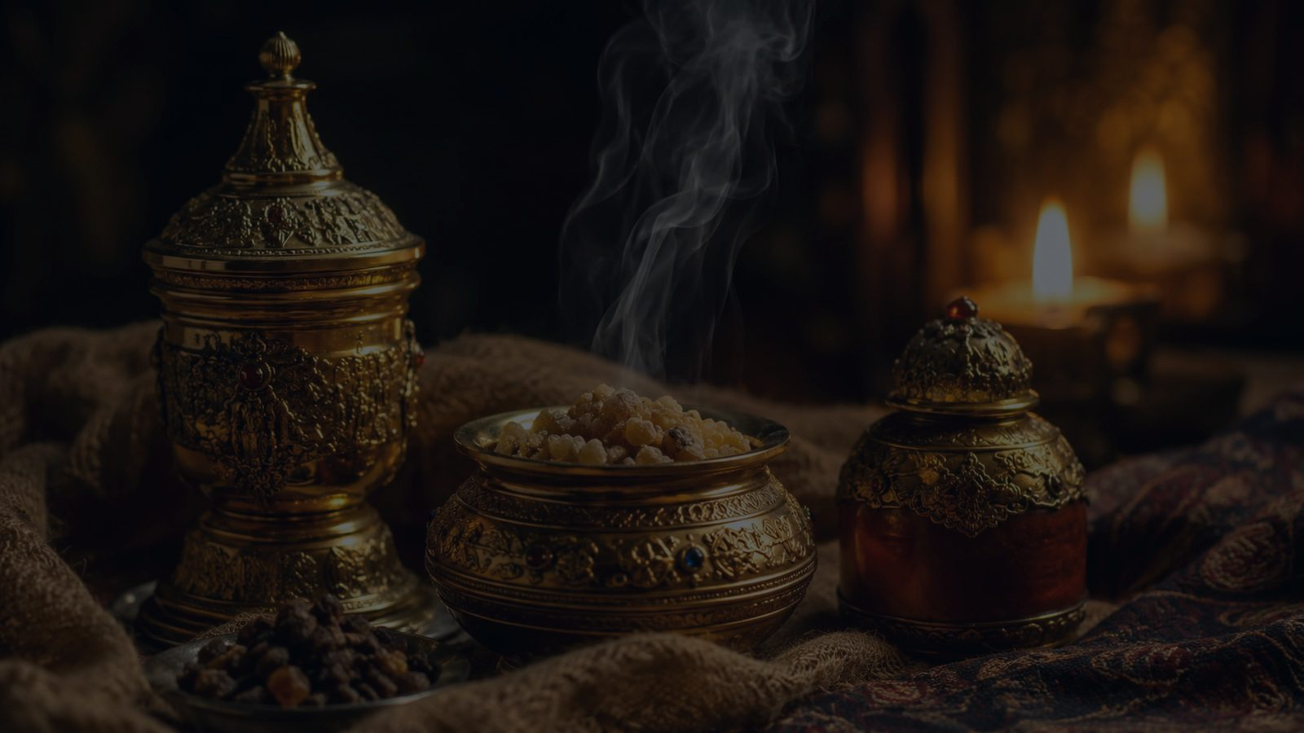
Why This Hymn Matters Today
Epiphany is the Gospel crossing distance.
It teaches worshipers to seek Christ with joyful persistence.
It gives the church a bright musical witness from Puerto Rican Christian song.
It reminds congregations that Christ’s light is not bounded by one people or place.
It joins Christmas wonder to mission, offering, and praise.
Pastoral emphasis
The Magi do not admire the star from a distance. They follow the light until they kneel before Christ.
Prepared for teaching and small group use - hymninfo.com

Slide 6
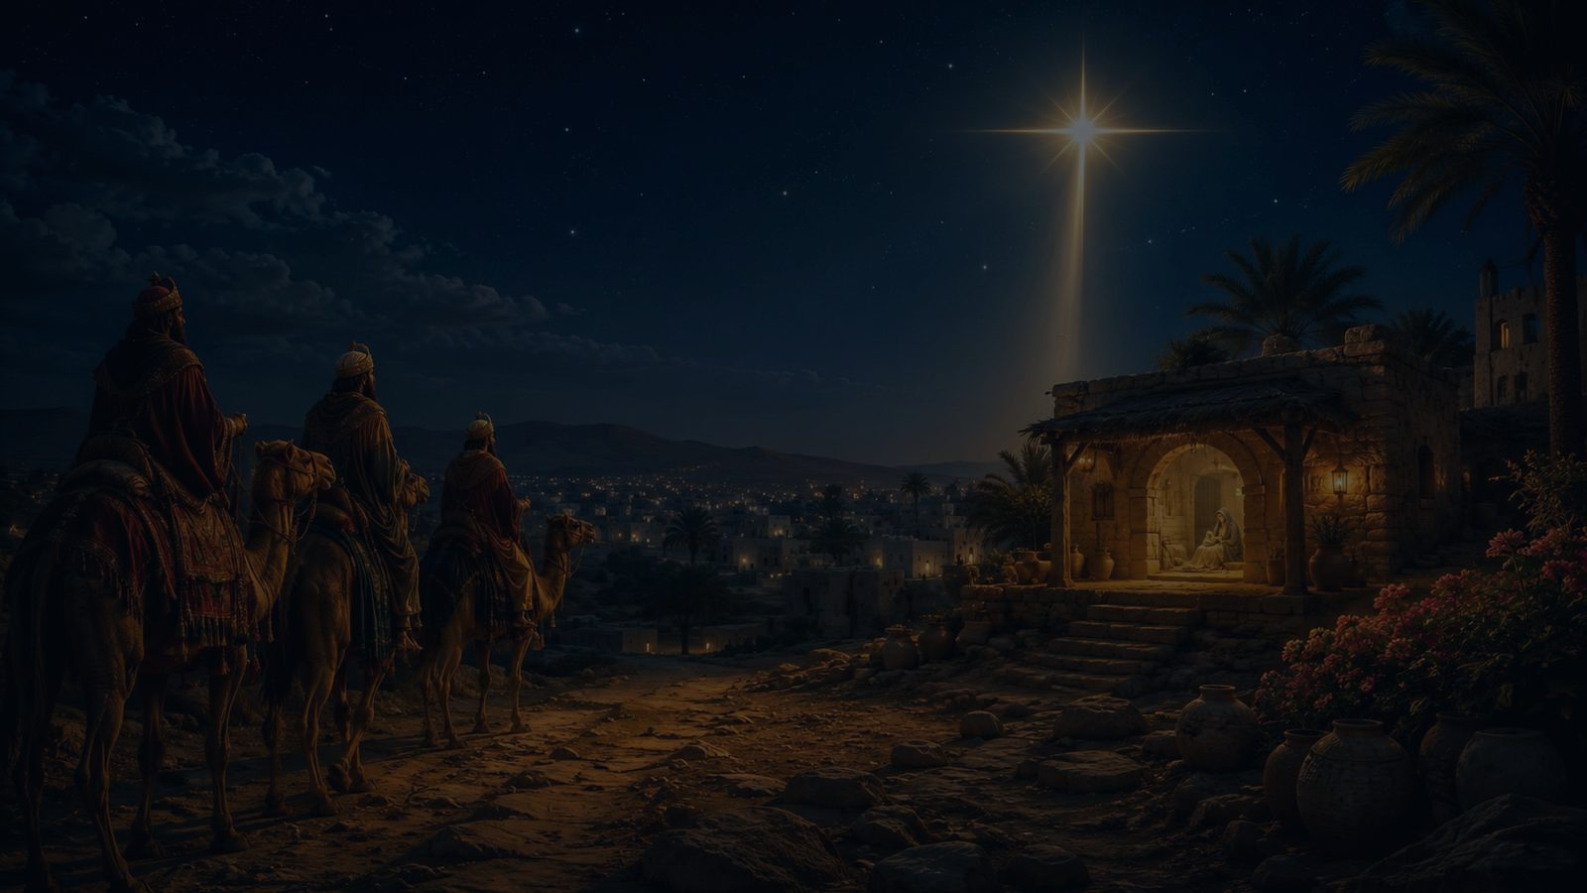
Biblical Foundation
Matthew 2 • Isaiah 60 • Psalm 72 • Luke 2
Prepared for teaching and small group use - hymninfo.com

Slide 7
Scripture Map
The hymn follows the biblical arc from light to worship.
Matthew 2:1-2
The travelers see the star and come to worship the newborn King.
Matthew 2:10-11
Joy leads to kneeling worship and the offering of gifts.
Isaiah 60:1, 6
God’s light rises, and the nations bring praise and treasure.
Psalm 72:10-11
Distant peoples honor the Lord’s anointed King.
Luke 2:14
The birth of Christ brings glory to God and peace on earth.
Prepared for teaching and small group use - hymninfo.com

Slide 8
Hymn Movement 1
A Journey Toward Christ
The hymn begins with distance, travel, and seeking. The star does not end the journey; it guides worshipers to the Savior.
Prepared for teaching and small group use - hymninfo.com

Slide 9
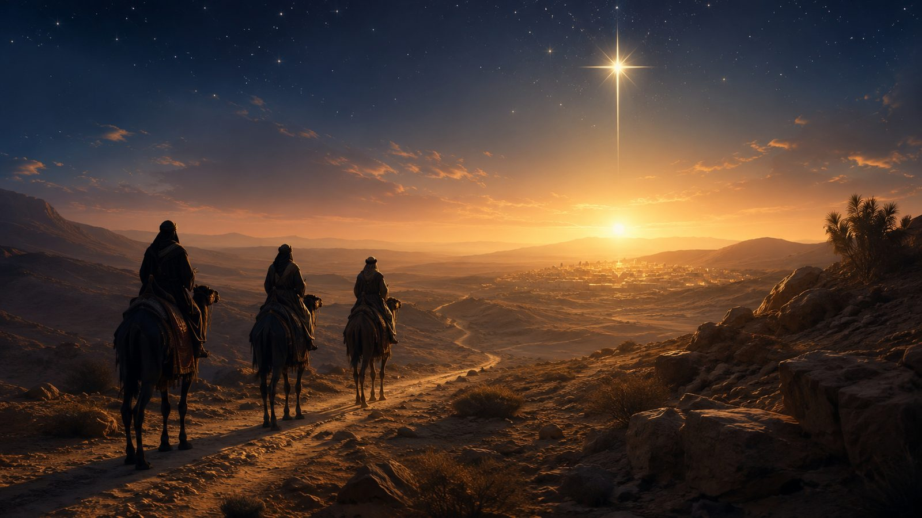
Movement 1: Seeking the Savior
Distance becomes discipleship when the light is followed.
The travelers represent reverent seeking rather than casual curiosity.
Their journey turns longing into action and attention into worship.
Matthew 2 frames the star as a summons to honor the King.
Teaching emphasis: faith often begins with a grace-given light that must be followed.
Prepared for teaching and small group use - hymninfo.com

Slide 10
Movement 2: The Star and the Light
Epiphany is God making Christ known.
Isaiah 60: “your light has come”
Matthew 2: “we saw his star”
Mission: the light draws distant peoples
Main image
The star is a sign of divine mercy. It points beyond itself to the child who is worthy of worship.
Prepared for teaching and small group use - hymninfo.com

Slide 11
Movement 3: The Gifts of the Magi
Gold, frankincense, and myrrh preach Christ’s identity.
Gold
Frankincense
Myrrh
The King is honored.
The Holy One is worshiped.
The Savior’s suffering is foreshadowed.
Prepared for teaching and small group use - hymninfo.com

Slide 12
Refrain-Like Praise
The congregation joins the Magi in worship.
The hymn moves from story to shared praise.
The worshiping church does more than remember the Magi; it joins their posture before Christ.
Joy, peace, and glory belong together because the child is Savior and King.
Prepared for teaching and small group use - hymninfo.com

Slide 13
Theological Themes
Four teaching anchors for the lesson.
Incarnation
Kingship
God’s glory is revealed in the child of Bethlehem.
The nations bow before Christ, the promised King.
Mission
Worship
The Gospel crosses distance, language, and culture.
True seeking ends in kneeling, giving, and praise.
Prepared for teaching and small group use - hymninfo.com

Slide 14
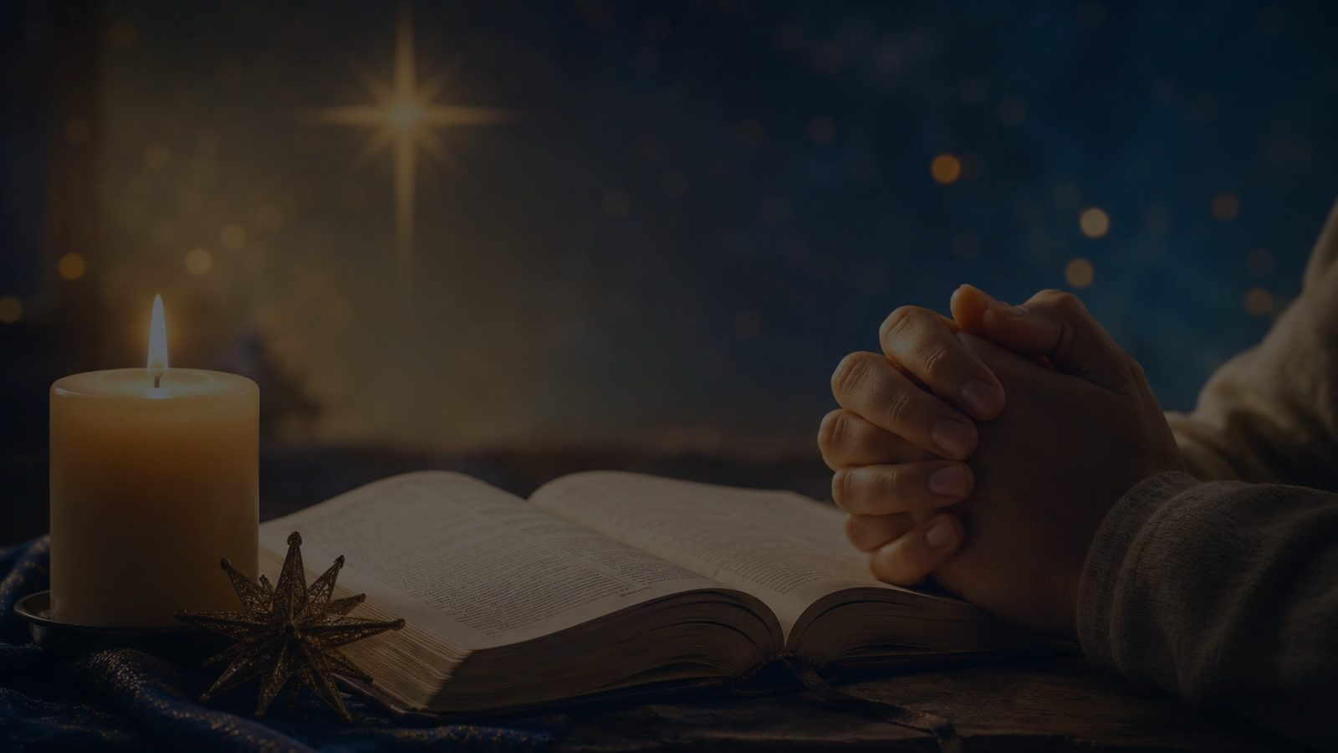
Literary and Musical Observations
A carol of movement, refrain, and bright communal energy.
The thought moves from distant travel to near worship.
The star image gives the hymn a clear visual and spiritual center.
The tune’s lively carol character supports joy without losing reverence.
The refrain structure helps congregations learn and participate quickly.
Bilingual use can strengthen the hymn’s Epiphany witness.
Prepared for teaching and small group use - hymninfo.com

Slide 15
Pastoral and Worship Use
Where this hymn serves the congregation well.
Epiphany Sunday or the weeks following Christmas
Services focused on Christ as light for the nations
Multicultural or bilingual worship gatherings
Children’s or intergenerational teaching on the Magi
Mission emphasis services that begin with worship before service
Prepared for teaching and small group use - hymninfo.com

Slide 16
Teaching Questions
Use these to guide conversation after singing or listening.
1
What does the Magi story teach us about seeking Christ?
2
How does the star image help us understand God’s guidance?
3
Why do the gifts matter for understanding who Jesus is?
4
How does this hymn widen our picture of Christmas and Epiphany?
5
What would it look like for our church to bring Christ our best worship this week?
Prepared for teaching and small group use - hymninfo.com

Slide 17
Application: Bring the Gifts of Faith
The Magi’s gifts invite a whole-life response.
Bring attention: seek Christ before seeking answers elsewhere.
Bring worship: kneel before the King with humility and joy.
Bring generosity: offer time, gifts, and service to Christ’s mission.
Bring peace: carry the light of Christ into divided places.
Prepared for teaching and small group use - hymninfo.com

Slide 18
Suggested Lesson Flow
Two ways to teach the hymn in church settings.
30-minute lesson
60-minute lesson
Read Matthew 2:1-11
Introduce Puerto Rican carol background
Teach the three hymn movements
Discuss one application question
Close with prayer
Open with Isaiah 60 and Matthew 2
Sing or listen twice
Study journey, light, gifts, and praise
Discuss global worship and mission
Plan one congregational response
Prepared for teaching and small group use - hymninfo.com

Slide 19
Closing Prayer
Lord Jesus Christ, Light of the nations, draw our hearts to worship you. Teach us to follow your light, bring our gifts with humility, and carry your peace into the world. Amen.
Prepared for teaching and small group use - hymninfo.com

Slide 20
From a Distant Home
May this hymn lead the church from the star to the Savior, from distance to worship, and from worship to witness.
© HymnInfo.com. Free for personal, church, classroom, and small-group teaching use. Please do not sell, repost, or redistribute as downloadable files without permission.
Prepared for teaching and small group use - hymninfo.com

