Slide 1

Gabriel's Message
An Advent carol of annunciation, grace, and holy obedience
First line: The angel Gabriel from heaven came | English paraphrase: Sabine Baring-Gould | Tune: GABRIEL'S MESSAGE
Prepared for teaching and small group use - hymninfo.com

Slide 2

Teaching Aim
Hear the angelic message, behold Christ, and answer with faithful trust
Understand
The Annunciation announces the incarnation: Jesus is the holy Son of God.
Feel
Let wonder, humility, and reverent joy replace hurried Christmas sentiment.
Practice
Receive God’s word with Mary’s posture of obedient trust.
Prepared for teaching and small group use - hymninfo.com

Slide 3

Hymn Identity
A Basque Annunciation carol for English-speaking worship
Original tradition: Traditional Basque Annunciation carol
This carol is not mainly about angelic spectacle. It is about God’s gracious initiative in sending the Son.
The church sings the Annunciation as Gospel: God comes near, the promise is fulfilled, and faithful obedience is possible.
English paraphrase: Sabine Baring-Gould
Arrangement: Charles Edgar Pettman
Tune: GABRIEL'S MESSAGE
Meter: 10.10.12.10 with refrain
Primary Scripture: Luke 1:28
Prepared for teaching and small group use - hymninfo.com

Slide 4
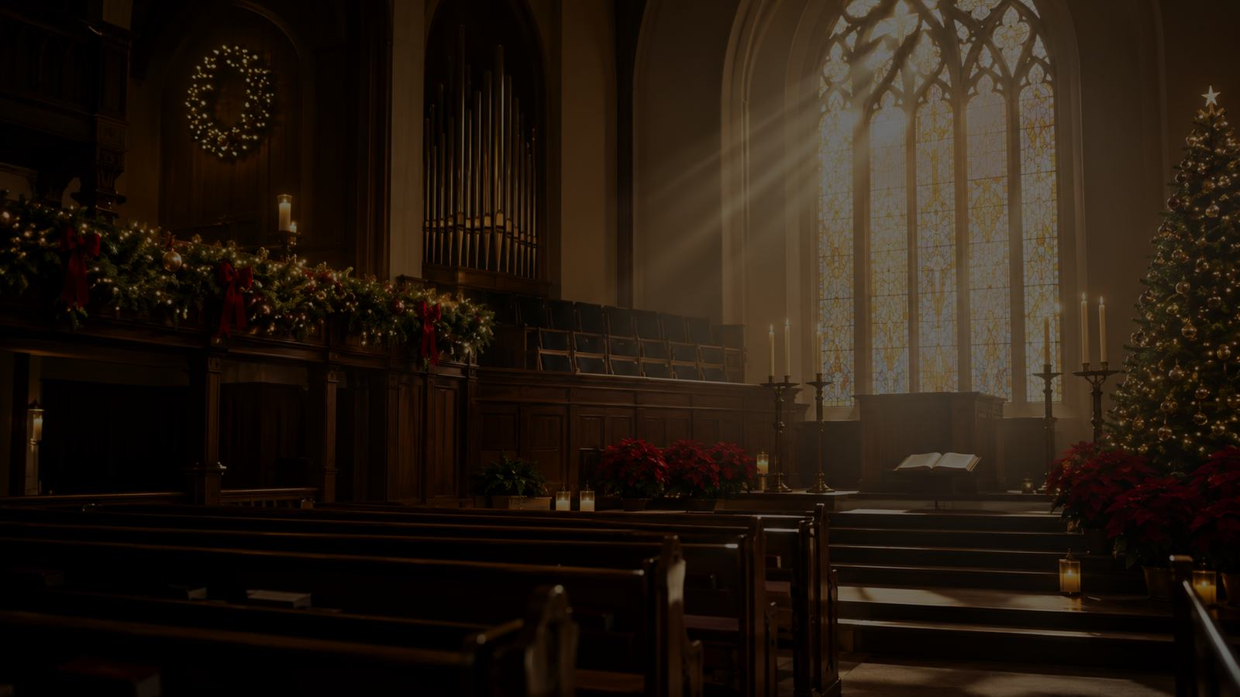
Historical Background
A local carol carrying the universal Gospel story
The carol comes from Basque Christmas and Advent song tradition and retells the Annunciation from Luke 1.
Sabine Baring-Gould shaped the familiar English form for church singing rather than making a strict word-for-word translation.
Charles Edgar Pettman’s arrangement helped establish the melody in English hymnals under the tune title GABRIEL’S MESSAGE.
Prepared for teaching and small group use - hymninfo.com

Slide 5
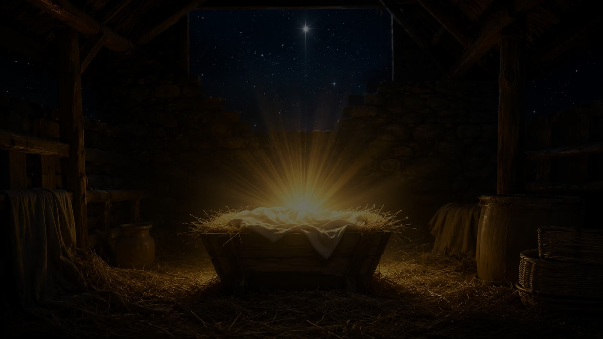
Why This Carol Matters Today
Advent begins with God speaking before we respond
It slows the congregation down long enough to hear the wonder of Luke 1.
It keeps Christmas rooted in the incarnation of the Son of God.
It honors Mary’s faithful response without shifting the center away from Christ.
It shows how a local musical tradition can serve the whole church’s praise.
Prepared for teaching and small group use - hymninfo.com

Slide 6
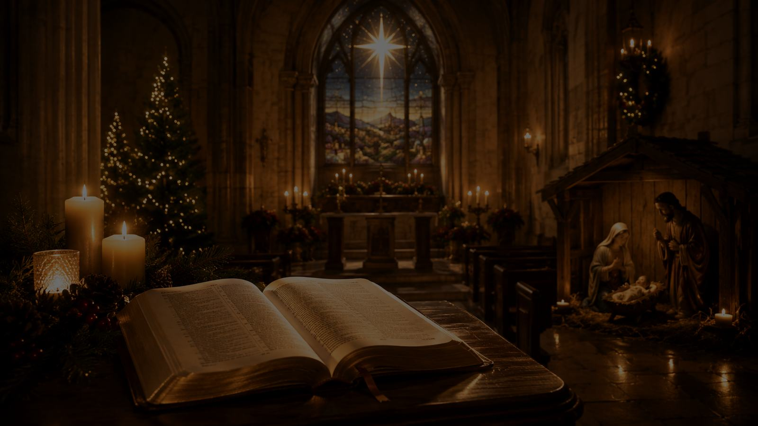
Biblical Foundation
Rejoice, favored one; the Lord is with you
Luke 1:28 gives the greeting of divine favor and the Lord’s presence.
Luke 1:30-35 names the child as Jesus, conceived by the Spirit and called the Son of God.
Luke 1:38 gives Mary’s faithful answer: a servant’s trust in the word of the Lord.
Prepared for teaching and small group use - hymninfo.com

Slide 7
The Message Comes from God
Grace interrupts ordinary life with a promise too great to manufacture.
Prepared for teaching and small group use - hymninfo.com

Slide 8
Hymn Movement 1
A holy interruption
Gabriel’s arrival reminds us that the Gospel begins with God’s initiative, not human search or spiritual achievement.
The Annunciation enters ordinary human life with heaven’s message: God is fulfilling his promise.
Teaching emphasis: Advent is the season of listening before acting.
Prepared for teaching and small group use - hymninfo.com

Slide 9
Hymn Movement 2
Divine favor and holy fear
Mary is addressed by grace before she offers obedience. The greeting is not a reward for achievement but a sign of God’s chosen mercy.
Gabriel’s “do not be afraid” fits the biblical pattern: God’s word often unsettles before it comforts.
Grace before response
Fear met by promise
Favor rooted in God
Prepared for teaching and small group use - hymninfo.com

Slide 10
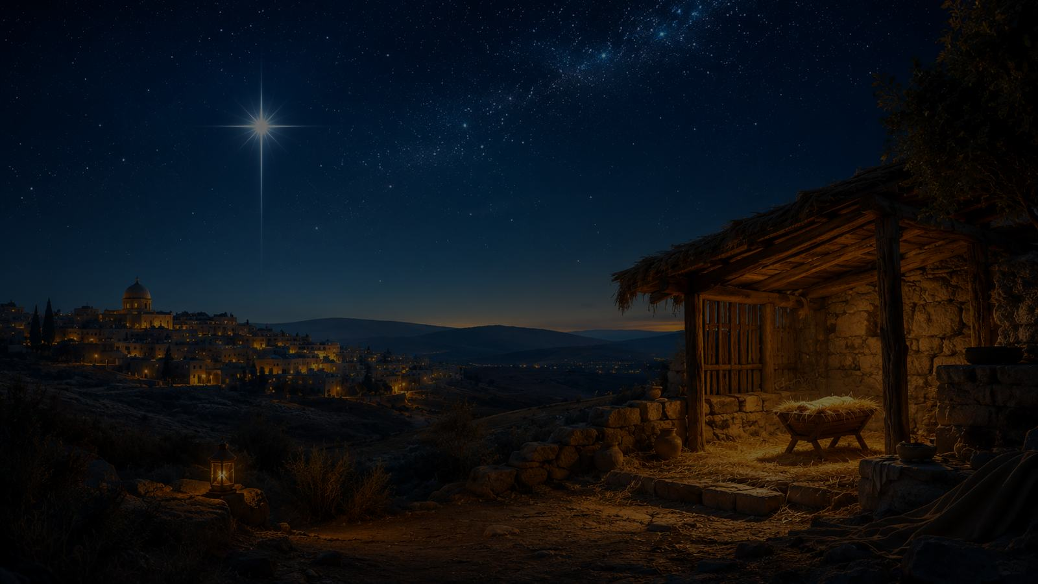
Hymn Movement 3
The child is Jesus, Son of God, Immanuel
The message points beyond birth to identity: the child is holy, sent by God, and given for salvation.
Luke 1 and Matthew 1 teach that Christmas means God with us, not merely God watching from a distance.
Teaching emphasis: the carol’s tenderness rests on strong Christology.
Prepared for teaching and small group use - hymninfo.com

Slide 11

Hymn Movement 4
Mary receives the word of the Lord
Mary’s answer is humble, courageous trust. She does not control the promise; she receives it.
Her obedience is not passive indifference. It is faithful surrender to God’s saving purpose.
Teaching emphasis: Christian faith says yes to God because God has first spoken grace.
Prepared for teaching and small group use - hymninfo.com

Slide 12
Hymn Movement 5
The church turns announcement into praise
The carol moves from Gabriel’s message to congregational confession. What heaven announces, the church sings.
Mary’s praise in Luke 1 shows that the promise of Christ leads not only to obedience but also to worship.
Teaching emphasis: Advent singing is proclamation shaped as praise.
Prepared for teaching and small group use - hymninfo.com

Slide 13
Theological Themes
Six threads for teaching and discussion
Incarnation
The Son of God comes in human life.
Grace
God acts before human response.
Obedience
Faith receives and answers the word.
Mary
A servant honored by God’s calling.
Emmanuel
God is with us in Christ.
Praise
The message becomes worship.
Prepared for teaching and small group use - hymninfo.com

Slide 14
Literary and Musical Observations
A folk-carol shape carrying biblical drama
The carol retells a biblical scene with clarity and reverence rather than heavy explanation.
Its repeated praise gives the Annunciation a congregational voice.
The Basque melody has a graceful, modal character that suits Advent mystery.
A steady tempo helps the longer lines remain prayerful and singable.
Prepared for teaching and small group use - hymninfo.com

Slide 15
Pastoral and Worship Use
Where this carol serves the church
Advent
• Fourth Sunday of Advent
• Annunciation reading
• Lessons and carols
Teaching
• Luke 1 Bible study
• Mary’s faithful response
• Incarnation doctrine
Music
• Choir anthem
• Congregational carol
• Simple accompaniment
Prepared for teaching and small group use - hymninfo.com

Slide 16
Teaching Questions
For class discussion or choir reflection
What does Gabriel’s greeting teach about grace and God’s presence?
How does the carol keep Mary’s obedience connected to Christ’s identity?
Why does the Annunciation belong in Advent preparation, not only Christmas celebration?
What would it mean for our congregation to receive God’s word with Mary’s humility?
Prepared for teaching and small group use - hymninfo.com

Slide 17
Suggested Lesson Flow
Two ready-to-use options
30 minutes
Read Luke 1:26-38
Introduce the carol background
Discuss grace, fear, promise, and response
Close with prayerful application
60 minutes
Sing or listen to the carol
Trace the biblical story in Luke 1
Study each hymn movement
Discuss worship and discipleship uses
Pray for humble obedience
Prepared for teaching and small group use - hymninfo.com

Slide 18
Closing Prayer
Lord God, who sent your messenger to Mary and gave your Son for the life of the world, make us attentive to your word, humble in our trust, and joyful in our praise. Let Christ be formed in our worship, our obedience, and our witness. Amen.
© HymnInfo.com. Free for personal, church, classroom, and small-group teaching use. Please do not sell, repost, or redistribute as downloadable files without permission.
Prepared for teaching and small group use - hymninfo.com

