Slide 1

His Gifts
A hymn study on grace, gratitude, and faithful service
Brian J. Dumont • SIMPLE GIFTS • James 1:17
Prepared for teaching and small group use - hymninfo.com

Slide 2

Teaching Aim
Receive God’s gifts with faith, gratitude, and purposeful obedience
1
2
3
Understand
Feel
Practice
God is the giver of creation, grace, salvation, and eternal life.
Humble gratitude for mercy that cannot be earned.
Turn received grace into praise, stewardship, and good works.
Prepared for teaching and small group use - hymninfo.com

Slide 3


Hymn Identity
A modern Thanksgiving text joined to a well-known American melody
Title
His Gifts
First line
It's His gift, this creation, all the glory we see
Writer and setting
Brian J. Dumont, 2011
Tune
SIMPLE GIFTS, Joseph Brackett Jr., 1848
Meter
7.6.11.11.11.8.11.9.10
Primary Scripture
James 1:17
Prepared for teaching and small group use - hymninfo.com

Slide 4


Historical Background
A contemporary hymn using the Shaker tune SIMPLE GIFTS
Brian J. Dumont wrote His Gifts in 2011 and published it through the Open Hymnal Project.
The melody SIMPLE GIFTS is generally credited to Shaker elder Joseph Brackett Jr. and dated 1848.
The familiar tune helps carry a Christian text about creation, grace, salvation, and thankful service.
The hymn should be distinguished from the original Shaker song and from other later uses of the same tune.
Prepared for teaching and small group use - hymninfo.com

Slide 5
Every Good Gift
James 1:17 frames the hymn’s grateful theology.
Prepared for teaching and small group use - hymninfo.com

Slide 6
Biblical Foundation
The gift language of Scripture shapes the whole hymn
James 1:17
Giver
Ephesians 2:8-10
Grace
Every good gift comes from the Father of lights.
Salvation is gift, and grace forms people for good works.
Romans 6:23
Life
John 4:10
Living Water
Eternal life is the gift of God in Christ Jesus.
Christ gives what thirsty sinners cannot supply.
Prepared for teaching and small group use - hymninfo.com

Slide 7

Creation as Gift
The hymn begins by receiving the visible world as grace
Creation is not merely scenery; it is received from the hand of God.
Gratitude begins when we stop treating life as possession and start receiving it as gift.
The Father of lights gives without change, shadow, or rival claim.
Prepared for teaching and small group use - hymninfo.com

Slide 8
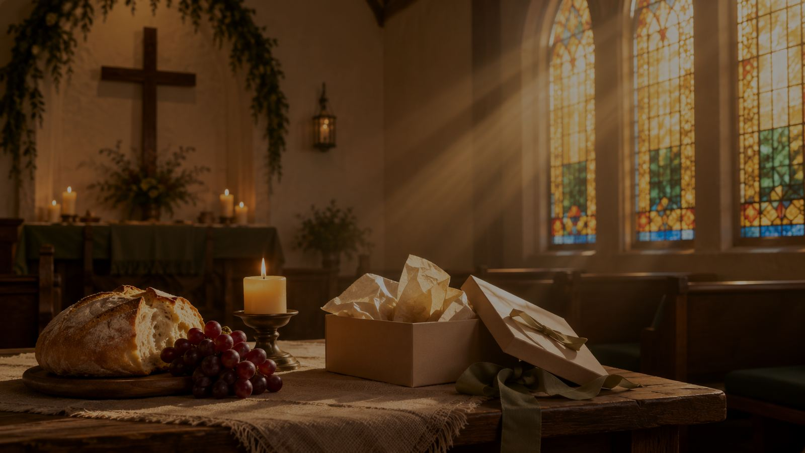
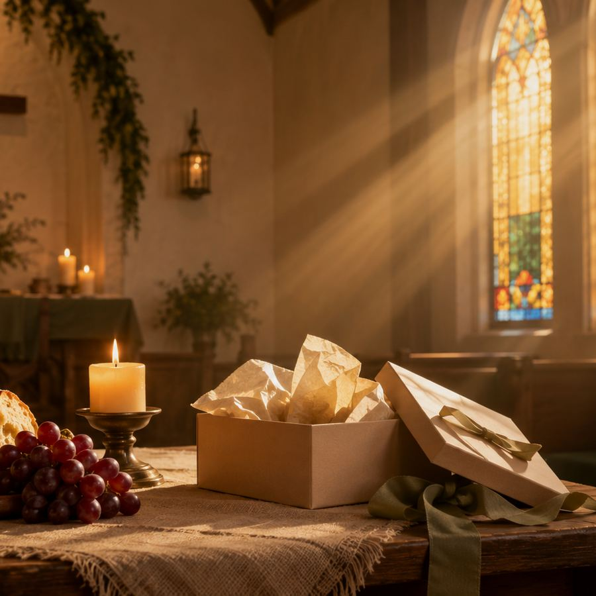
Grace in Christ
God’s greatest gifts are not earned by the strong
The hymn moves from created blessing to saving grace.
Ephesians 2 teaches that salvation is God’s gift, not a wage for effort.
Titus 3 points to mercy, renewal, and the Holy Spirit’s work.
Christian thanksgiving is therefore Gospel-shaped, not merely seasonal.
Prepared for teaching and small group use - hymninfo.com

Slide 9
The Gift of Eternal Life
Romans 6:23 names life in Christ as God’s free gift
The hymn’s thanksgiving does not end with bread, sunlight, or daily provision. It reaches toward the gift sinners cannot purchase: eternal life in Christ Jesus our Lord.
Teaching emphasis: let the congregation name both ordinary blessings and saving mercies, while keeping Christ at the center.
Prepared for teaching and small group use - hymninfo.com

Slide 10
From Gift to Good Works
Grace creates thankful people who walk in prepared service
1
2
3
4
Receive
Give Thanks
Walk
Serve
God gives first.
Gratitude answers grace.
Good works follow salvation.
Gifts become mercy for others.
Prepared for teaching and small group use - hymninfo.com

Slide 11
Theological Themes
Six truths to teach from the hymn
Creation
Grace
Christ
The world is received, not owned.
Salvation is gift, not merit.
God’s gifts are fulfilled in the Son.
Renewal
Gratitude
Stewardship
Mercy makes new life possible.
Thanksgiving becomes a way of life.
Received gifts become faithful service.
Prepared for teaching and small group use - hymninfo.com

Slide 12
Literary and Musical Observations
A familiar melody carries a clear theology of gift
The text moves from creation to Christ, then from grace to thankful living.
Its repeated gift-language makes gratitude the central thread.
SIMPLE GIFTS has a memorable, folk-like contour that encourages congregational confidence.
Keep the tune buoyant and reverent so it serves the text rather than becoming merely nostalgic.
Prepared for teaching and small group use - hymninfo.com

Slide 13
Pastoral and Worship Use
Where this hymn can serve the church well
Thanksgiving
Connect harvest and daily provision with saving grace.
Stewardship
Ask how received gifts become service.
Assurance
Remind believers that salvation rests on grace.
Creation Care
Receive the visible world as gift and responsibility.
Communion Setting
Frame bread and cup in gratitude for Christ.
Family Worship
Teach children and adults to name God’s gifts together.
Prepared for teaching and small group use - hymninfo.com

Slide 14
Teaching Questions
Move from observation to response
1
What gifts from God does the hymn help us notice beyond material blessings?
2
How does James 1:17 deepen ordinary thanksgiving?
3
Why does Ephesians 2:8-10 keep gratitude from becoming self-congratulation?
4
How should the gift of grace shape the way a church serves its community?
5
Which gift of God do you need to receive with fresh humility this week?
Prepared for teaching and small group use - hymninfo.com

Slide 15
Suggested Lesson Flow
Two ways to teach the hymn
30-minute study
60-minute study
5 min — introduce hymn and tune
8 min — read James 1:17 and Ephesians 2:8-10
10 min — discuss gift, grace, and gratitude
7 min — application and prayer
10 min — opening reflection
15 min — hymn background and tune history
15 min — Scripture work in pairs
12 min — theology and worship use
8 min — commitments and prayer
Prepared for teaching and small group use - hymninfo.com

Slide 16
Application
Receive, thank, and serve
1
2
3
Receive
Thank
Serve
Name gifts you usually overlook.
Turn recognition into spoken praise.
Offer what you have received for another person’s good.
Prepared for teaching and small group use - hymninfo.com

Slide 17
Closing Summary and Prayer
God gives creation, grace, salvation, and the strength to serve. The proper response is humble faith, daily gratitude, and a life offered back to the Giver.
Father of lights, open our hands to receive your gifts with humility. Teach us to trust your grace in Christ and to walk in the good works you have prepared. Amen.
Prepared for teaching and small group use - hymninfo.com

Slide 18
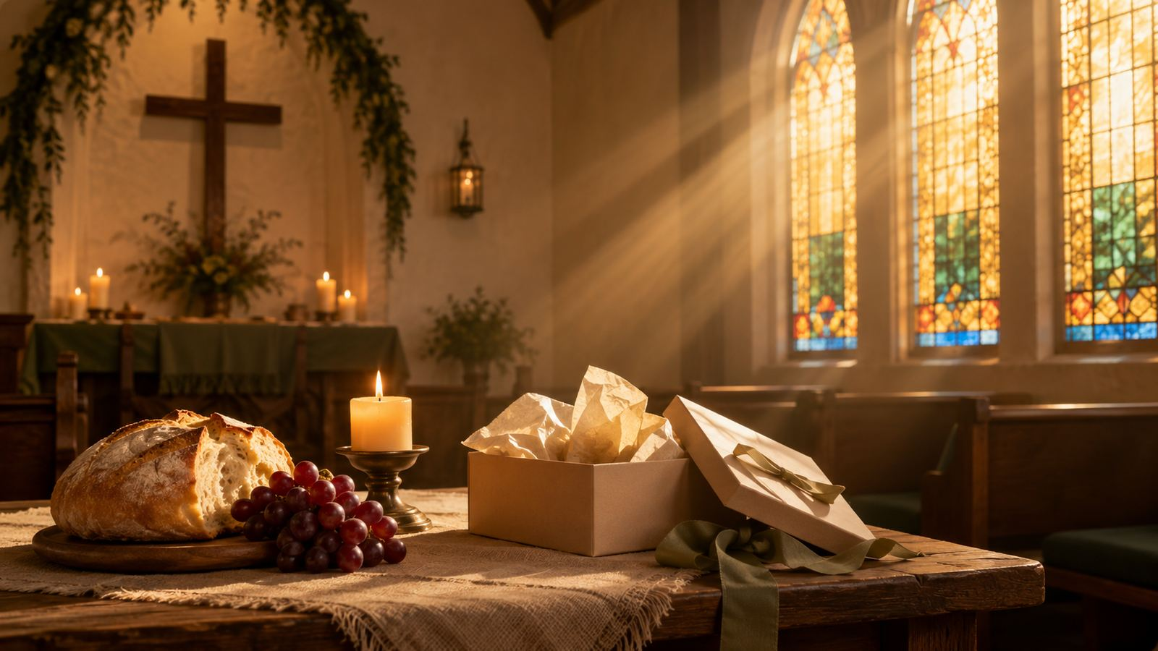
For Teaching Use
© HymnInfo.com. Free for personal, church, classroom, and small-group teaching use. Please do not sell, repost, or redistribute as downloadable files without permission.
Prepared for teaching and small group use - hymninfo.com

