Slide 1
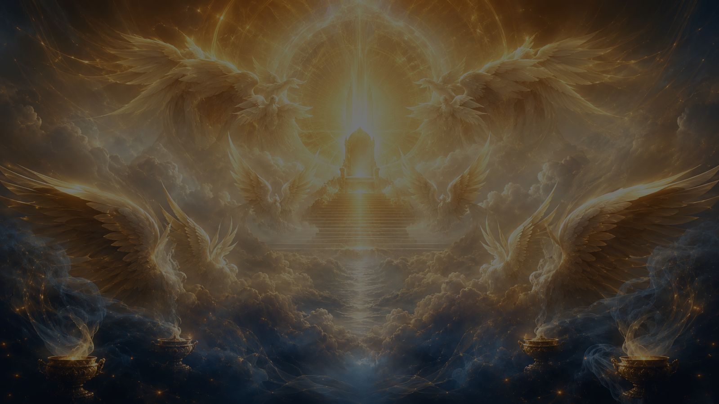
Isaiah, Mighty Seer, in Days of Old
Isaiah, mighty seer, in days of old
Martin Luther • 1526 • Isaiah 6:3
A hymn study on holiness, heavenly worship, and the Sanctus
Prepared for teaching and small group use - hymninfo.com

Slide 2
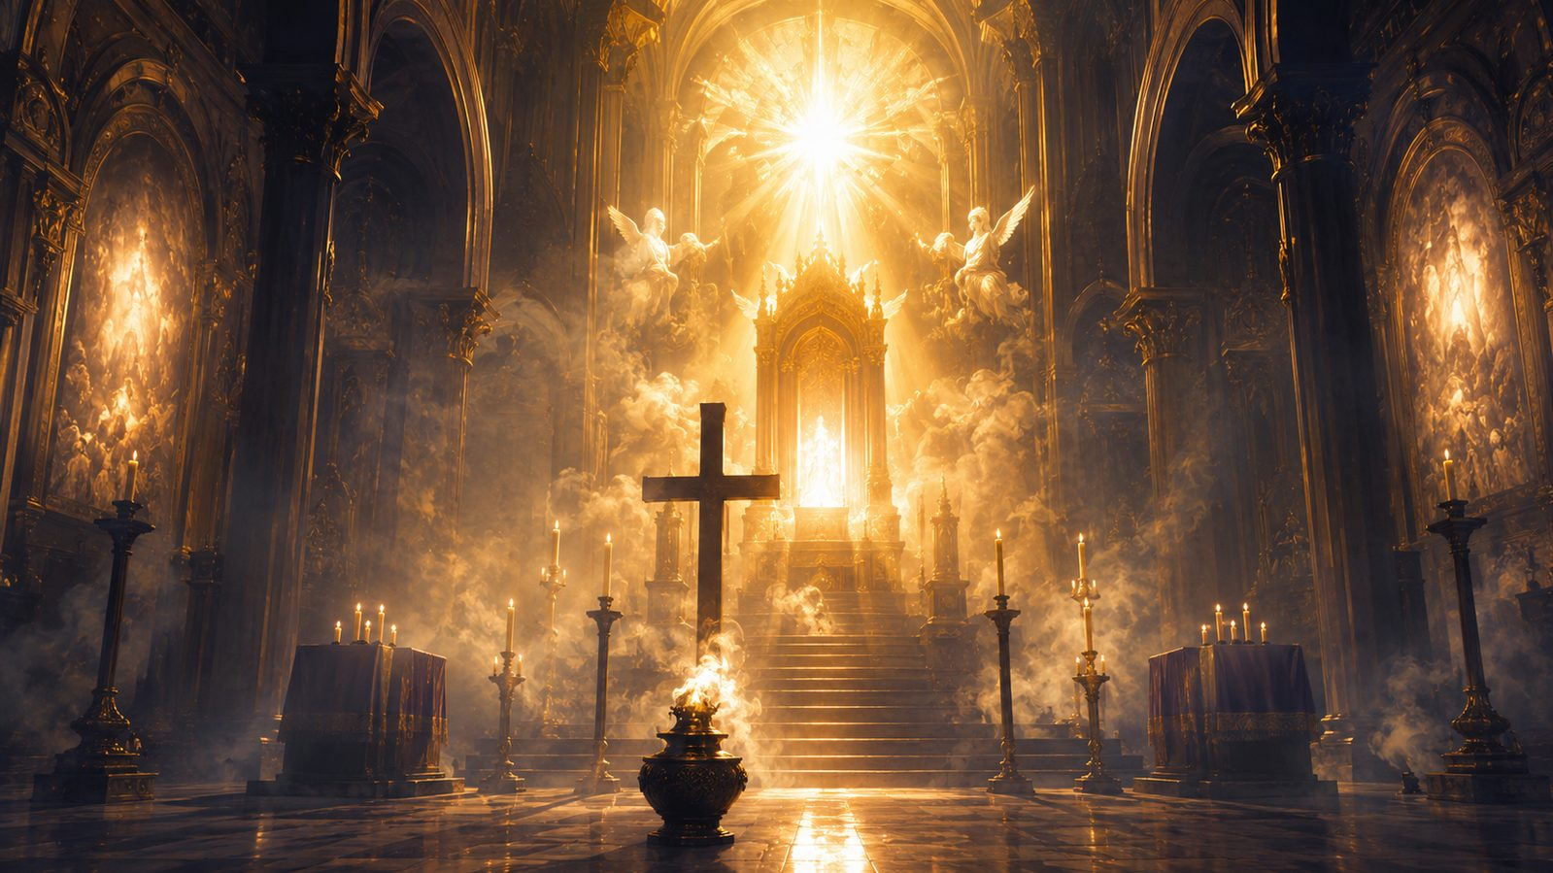
Teaching Aim
Understand • Feel • Practice
☼
Understand
✦
Feel
✚
Practice
Luther’s hymn retells Isaiah 6 so the congregation can sing the biblical roots of the Sanctus.
Worship should carry reverence, wonder, and Gospel confidence before the holy Lord.
Join the praise of heaven, approach Communion humbly, and let holiness reshape daily life.
Prepared for teaching and small group use - hymninfo.com

Slide 3
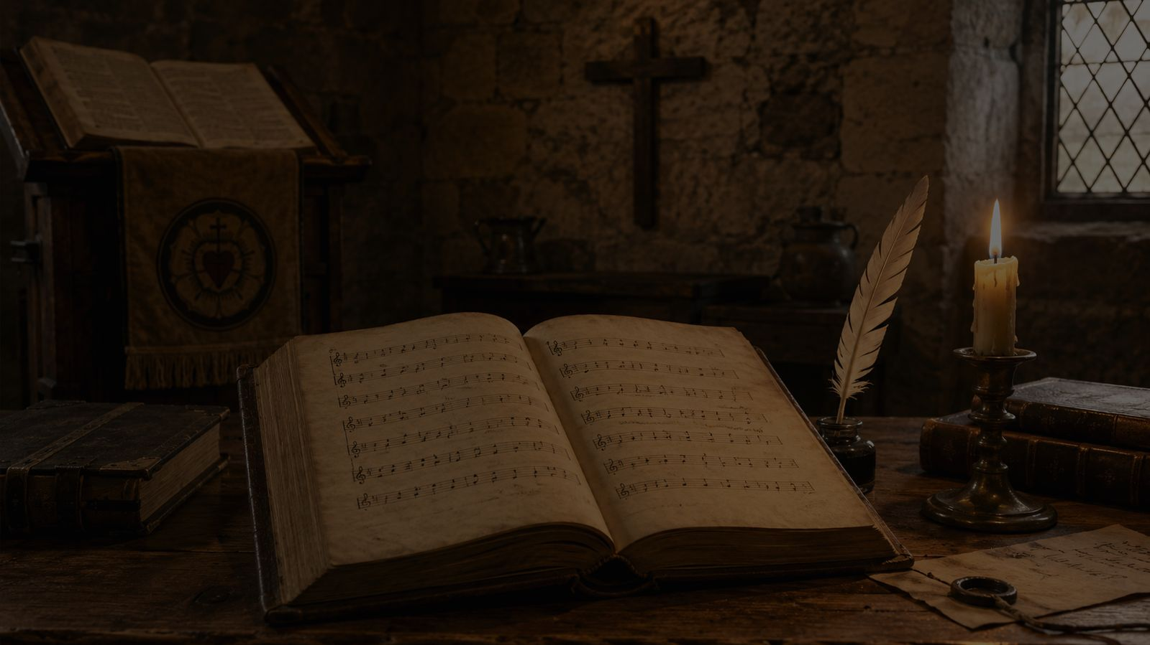
Hymn Identity
The German Sanctus in congregational song
Title
Isaiah, Mighty Seer, in Days of Old
Original title
Jesaia, dem Propheten, das geschah
Writer and tune
Martin Luther, 1526
Tune
JESAIA, DEM PROPHETEN
Meter
10s. 16 lines
Primary Scripture
Isaiah 6:3
Prepared for teaching and small group use - hymninfo.com

Slide 4
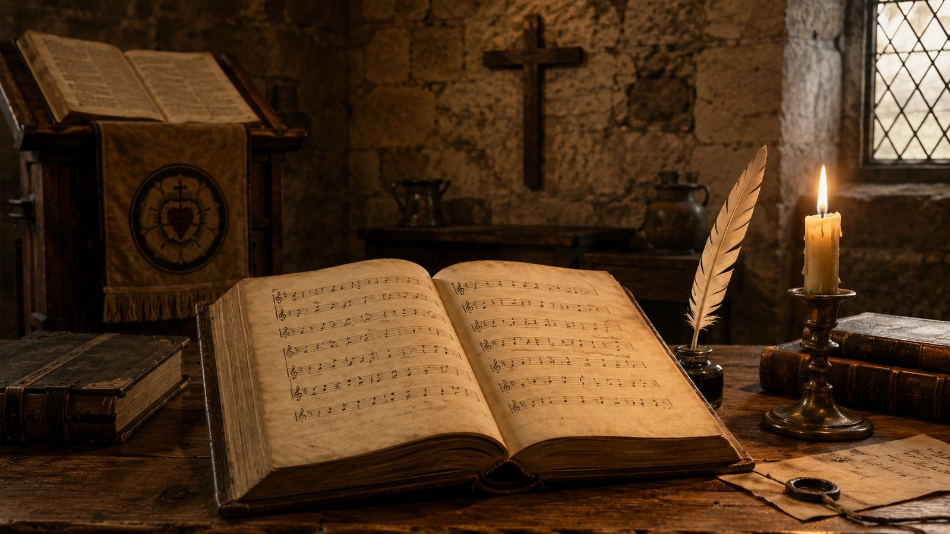
Historical Background
Luther’s 1526 Deutsche Messe
Written as a German Sanctus for Luther’s vernacular service order.
Retells Isaiah 6:1-4 instead of merely translating a short liturgical text.
Gives the congregation Scripture-shaped praise at a central moment of worship.
Later English Lutheran hymnals preserve the hymn in adapted translation traditions.
Teaching emphasis
This is not simply a “hymn about Isaiah.” It is worship teaching the church how to sing with the angels before the holy Lord.
The hymn joins Scripture, liturgy, and congregational song.
Prepared for teaching and small group use - hymninfo.com

Slide 5
Biblical Foundation
Isaiah’s vision and the church’s Sanctus
Prepared for teaching and small group use - hymninfo.com

Slide 6
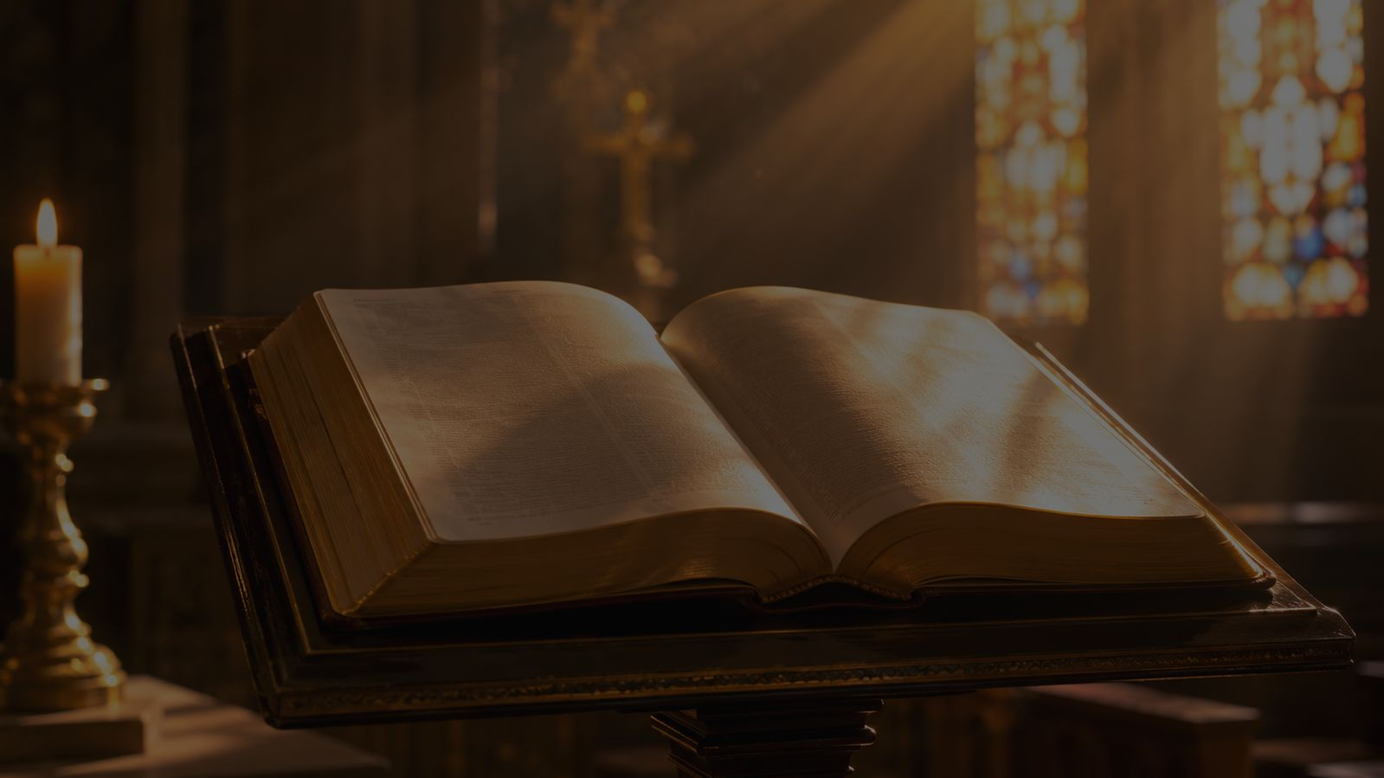
Biblical Foundation
Isaiah 6:1-4; Revelation 4:8; Matthew 21:9
Isaiah sees the Lord enthroned and lifted up.
The seraphim worship with awe before His holiness.
The temple trembles; the house is filled with smoke.
Revelation shows this praise continuing before God’s throne.
Hosanna language connects the holy Lord with Christ’s saving coming.
“Holy, holy, holy, is Yahweh of Armies! The whole earth is full of his glory!”
Isaiah 6:3
Prepared for teaching and small group use - hymninfo.com

Slide 7
Why This Hymn Matters Today
A corrective to shallow worship
Pastoral value
Worship value
Doctrinal value
Choir use
It restores reverence without making God seem distant from mercy.
It teaches the congregation to join heavenly praise, not simply fill time.
It anchors praise in God’s holiness, glory, and Christ’s coming.
It rewards careful leadership and strong textual delivery.
The hymn helps worshipers remember: the church does not create holy praise; it receives and joins it.
Prepared for teaching and small group use - hymninfo.com

Slide 8
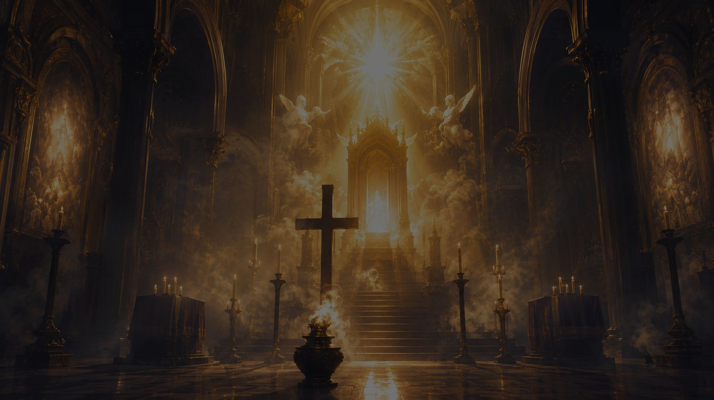
Hymn Movement
From vision to congregational praise
Prepared for teaching and small group use - hymninfo.com

Slide 9
The Lord Enthroned
Isaiah 6:1
The hymn begins by placing Isaiah inside the temple vision. Worship starts with God’s revealed majesty, not with human taste or mood.
HOLY
✦ ✦ ✦
Earthly worship joins heavenly praise.
Teaching focus
Let the hymn train the whole congregation in biblical reverence.
Prepared for teaching and small group use - hymninfo.com

Slide 10
The Seraphim in Awe
Isaiah 6:2
Their covered faces and feet teach reverence. Even heavenly beings worship with humility before the holy Lord.
HOLY
✦ ✦ ✦
Earthly worship joins heavenly praise.
Teaching focus
Let the hymn train the whole congregation in biblical reverence.
Prepared for teaching and small group use - hymninfo.com

Slide 11
The Holy Cry
Isaiah 6:3
The heart of the hymn is the threefold acclamation of holiness and the confession that God’s glory fills the earth.
HOLY
✦ ✦ ✦
Earthly worship joins heavenly praise.
Teaching focus
Let the hymn train the whole congregation in biblical reverence.
Prepared for teaching and small group use - hymninfo.com

Slide 12
The Shaking House
Isaiah 6:4
The thresholds tremble and smoke fills the sanctuary. God’s presence is powerful, holy, and never casual.
HOLY
✦ ✦ ✦
Earthly worship joins heavenly praise.
Teaching focus
Let the hymn train the whole congregation in biblical reverence.
Prepared for teaching and small group use - hymninfo.com

Slide 13
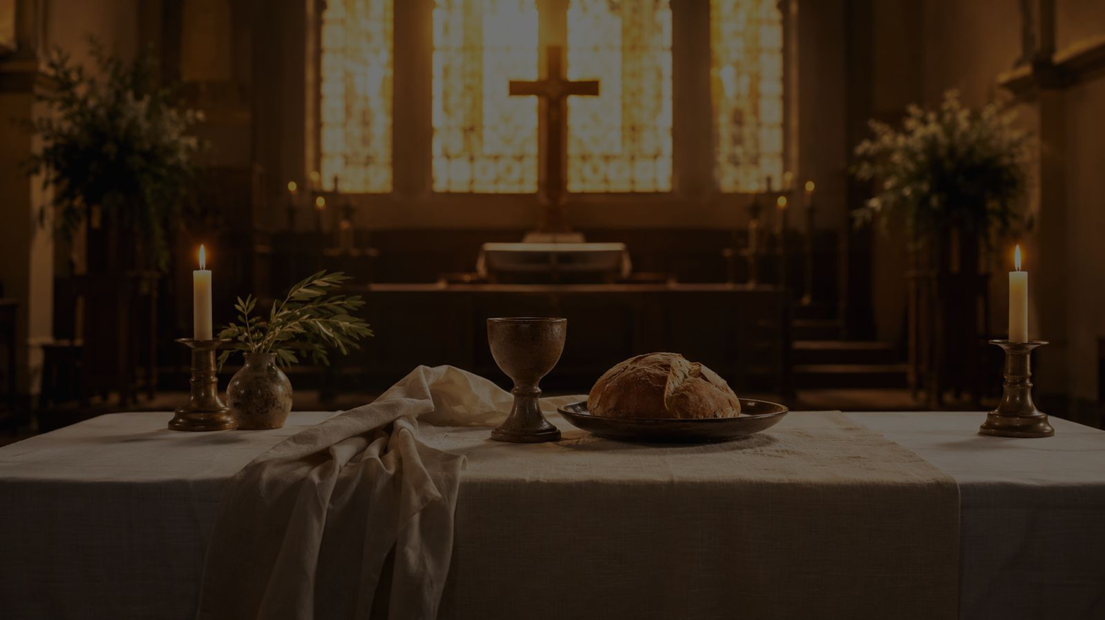
The Church Joins the Song
Matthew 21:9
In its worship setting, the hymn joins the Sanctus with the church’s welcome of the Lord who comes in mercy.
HOLY
✦ ✦ ✦
Earthly worship joins heavenly praise.
Teaching focus
Let the hymn train the whole congregation in biblical reverence.
Prepared for teaching and small group use - hymninfo.com

Slide 14
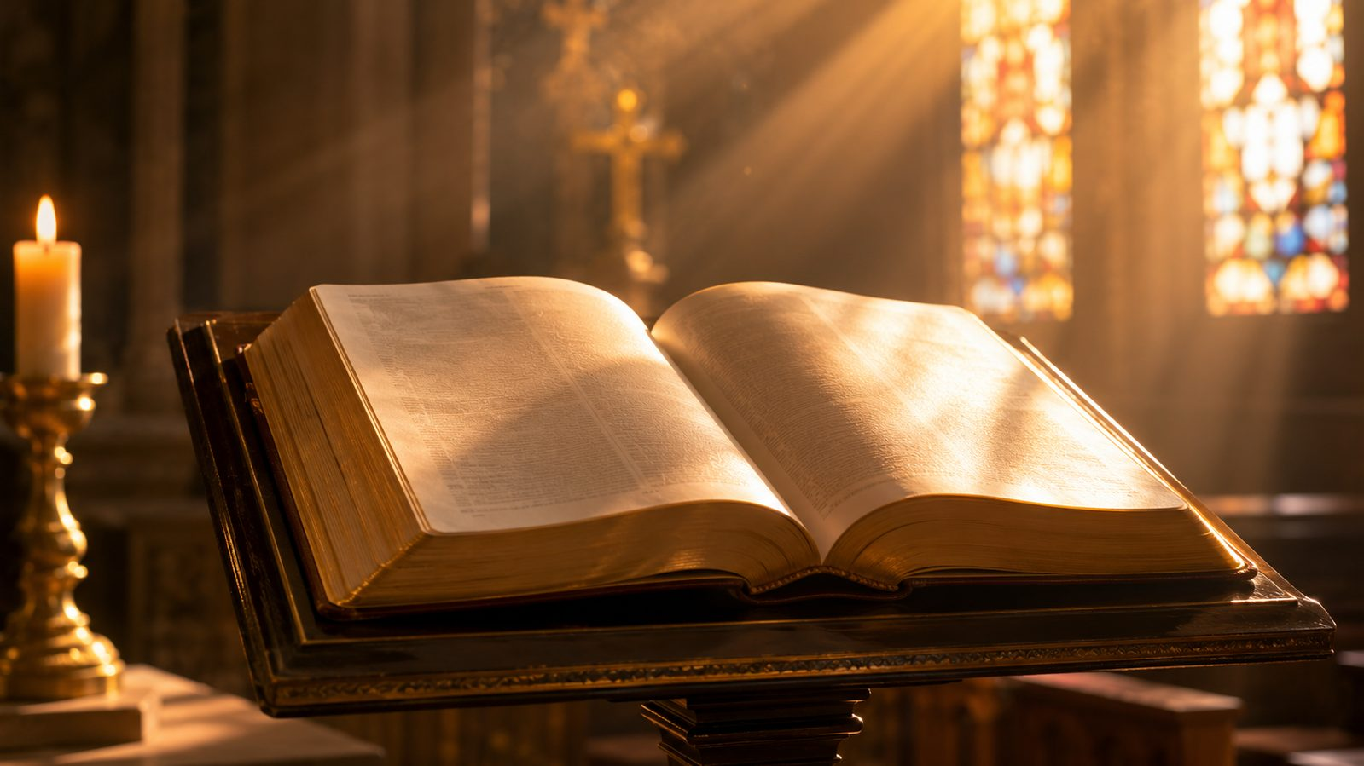
Theological Themes
What the hymn teaches the church to confess
✦
Holiness
✦
Glory
✦
Heavenly worship
God is utterly set apart and worthy of awe.
The whole earth belongs under His majesty.
The church joins a greater song.
✦
Trinity
✦
Communion
✦
Scripture-shaped liturgy
The threefold holy cry carries rich Christian resonance.
Reverent praise prepares hearts for holy mercy.
Biblical vision forms congregational song.
Prepared for teaching and small group use - hymninfo.com

Slide 15
Literary and Musical Observations
A long-form chorale for a throne-room vision
The text moves as a narrative vision rather than a compact stanza hymn.
The meter is unusual: often described as 10s with sixteen lines.
The tune requires confident leadership, clear phrasing, and steady pace.
Choir or cantor support can help a congregation learn the shape.
Music serves the vision
The melody is not background decoration. It carries Isaiah’s vision into the congregation’s mouth.
Prepared for teaching and small group use - hymninfo.com

Slide 16
Pastoral and Worship Use
Where this hymn serves the church well
✚
Communion
✚
Trinity
✚
Epiphany
Before or within the Sanctus setting
A vision of the holy Lord
Glory revealed and adored
✚
Call to worship
✚
Choir teaching
✚
Advent
Awe before the Lord
Careful liturgical formation
The Lord who comes in mercy
Prepared for teaching and small group use - hymninfo.com

Slide 17
Teaching Questions
For class, rehearsal, or worship planning
What does Isaiah’s vision teach us about God before it teaches us about ourselves?
How does the hymn connect earthly worship with heavenly worship?
What difference does reverence make when receiving Communion?
How can a congregation sing “Holy” with both awe and joy?
What musical leadership is needed for an unusual chorale like this?
Prepared for teaching and small group use - hymninfo.com

Slide 18
Application
Responding to the holy Lord
✦
Recover awe
✦
Prepare for the table
Let Scripture enlarge your view of God before worship begins.
Approach Communion with repentance, reverence, and Gospel trust.
✦
Sing with the church
✦
Carry glory outward
Remember that congregational praise joins the song of heaven.
Leave worship seeing ordinary life under God’s majesty.
Prepared for teaching and small group use - hymninfo.com

Slide 19
Suggested Lesson Flow
Two ready-to-use teaching plans
30-minute plan
60-minute plan
1. Read Isaiah 6:1-4
2. Introduce Luther’s German Sanctus
3. Trace the hymn movement
4. Discuss worship and reverence
5. Close with prayer
1. Opening reflection
2. Historical setting
3. Scripture study
4. Hymn movement
5. Musical/worship notes
6. Application for Communion and congregational song
Prepared for teaching and small group use - hymninfo.com

Slide 20
Closing Summary and Prayer
The holy Lord is enthroned. Heaven sings. The earth is full of His glory. In Christ, the church joins the song with reverence and joy.
Holy Lord, gather our praise into the worship of heaven. Teach us awe, give us mercy in Christ, and make our song faithful, humble, and glad. Amen.
Prepared for teaching and small group use - hymninfo.com

Slide 21
For Teaching Use
© HymnInfo.com. Free for personal, church, classroom, and small-group teaching use. Please do not sell, repost, or redistribute as downloadable files without permission.
Prepared for teaching and small group use - hymninfo.com

