Slide 1

PSALM 78 • GENERATIONAL FAITH
Let Children Hear the Mighty Deeds
Let children hear the mighty deeds
Isaac Watts • LEA • James Lea Summers
1719 • Common Meter • Psalm 78:4
A hymn study on telling the next generation the works, promises, and ways of God.
Prepared for teaching and small group use - hymninfo.com
1

Slide 2
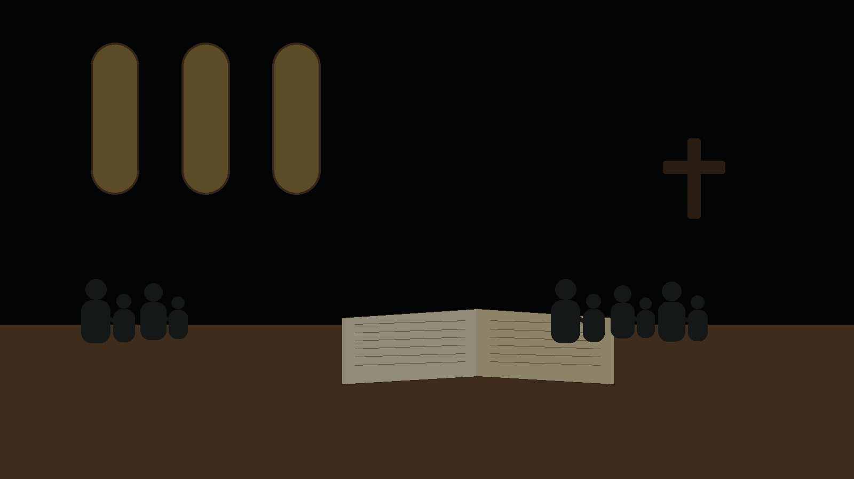
Teaching Aim
✓
♥
→
Understand
Feel
Practice
Psalm 78 calls the whole community to rehearse God's mighty deeds.
A holy urgency: the children among us must hear the truth with tenderness and clarity.
Build habits that pass Scripture-shaped hope from one generation to the next.
Prepared for teaching and small group use - hymninfo.com
2

Slide 3
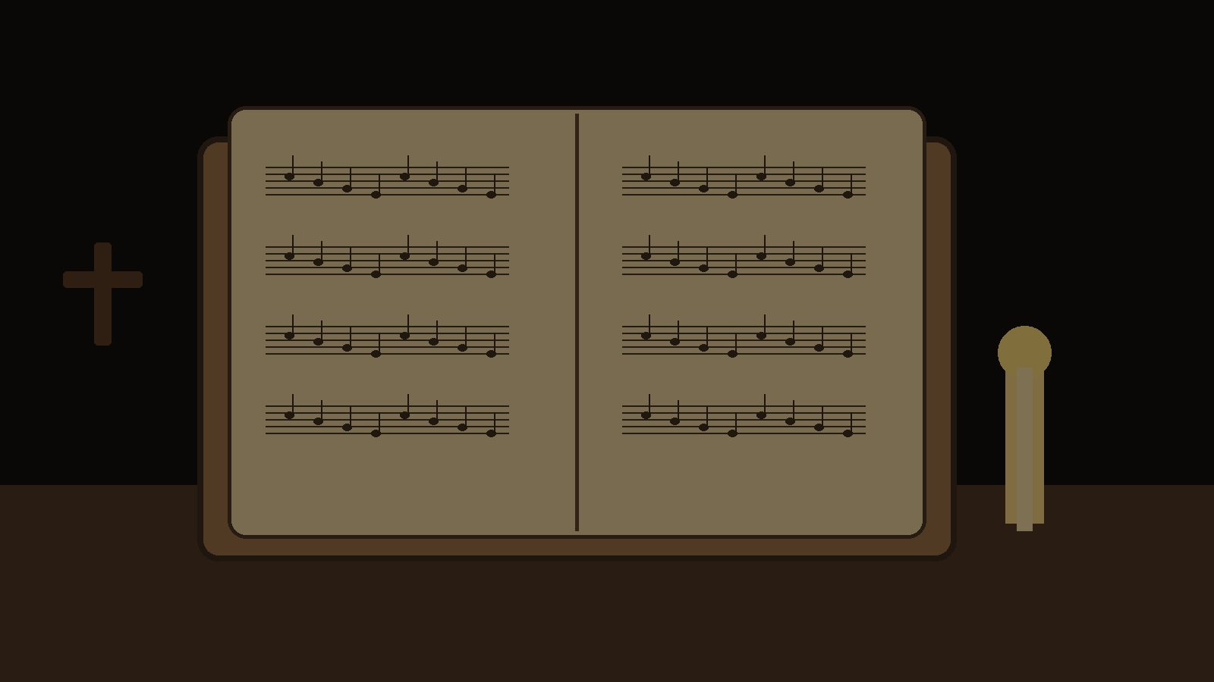
Hymn Identity
TITLE
FIRST LINE
Let Children Hear the Mighty Deeds
Let children hear the mighty deeds
TEXT
TUNE
Isaac Watts, 1719
LEA
COMPOSER
METER
James Lea Summers
Common Meter
SCRIPTURE
PURPOSE
Psalm 78:4-7
Teaching God's mighty deeds to children
Prepared for teaching and small group use - hymninfo.com
3

Slide 4
Historical Background
Watts rendered Psalm 78 for congregational singing in 1719.
The hymn belongs to the English metrical psalm tradition.
Its concern is covenant memory: God's works must be told, sung, and trusted.
LEA is a later common-meter tune by James Lea Summers, documented with this text in early twentieth-century Lutheran hymnals.
Watts did not treat children as a sentimental subject. He treated the next generation as hearers who must learn the mighty deeds, testimony, hope, and commands of God.
Prepared for teaching and small group use - hymninfo.com
4

Slide 5

Why This Hymn Matters Today
For parents
For churches
It gives language for household discipleship and faithful remembrance.
It calls the whole congregation to teach, model, and repeat the story of God's grace.
For teachers
For children
It keeps Christian education centered on God's works, not merely morals or activities.
It tells them they belong among the hearers of God's Word and promises.
Prepared for teaching and small group use - hymninfo.com
5

Slide 6

Biblical Foundation
Psalm 78:4
“We will not hide them from their children, telling to the generation to come the praises of Yahweh, his strength, and his wondrous deeds that he has done.”
The hymn sings this command as a congregational promise: the story of God must be placed in the ears, memory, and hope of children.
Prepared for teaching and small group use - hymninfo.com
6

Slide 7
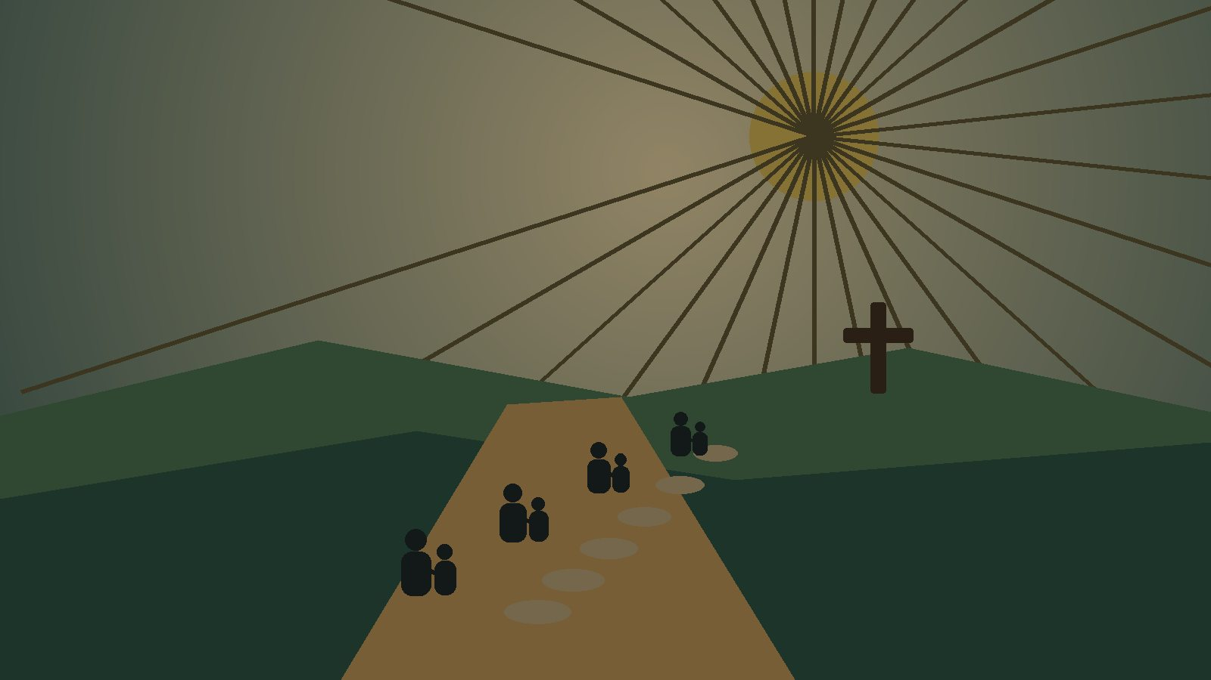
Scripture Echoes
Psalm 78:5-7
Children are taught so they may know, hope, remember, and obey.
Deuteronomy 4:9
What the older generation has seen must not depart from the heart.
Ephesians 6:4
Christian nurture belongs to ordinary households and faithful instruction.
Prepared for teaching and small group use - hymninfo.com
7

Slide 8
HYMN MOVEMENT 1
Let the children hear
The hymn begins with an open summons. Children are not placed at the edge of worship; they are named as hearers of God's mighty works.
Teaching emphasis
Begin with the child as a real disciple in formation.
Prepared for teaching and small group use - hymninfo.com
8

Slide 9
HYMN MOVEMENT 2
Tell what God has done
The church does not pass on vague religious ideals. It tells the praises, strength, and wondrous deeds of the Lord.
Teaching emphasis
Name the works of God before giving moral applications.
Prepared for teaching and small group use - hymninfo.com
9

Slide 10
HYMN MOVEMENT 3
Every generation becomes a witness
Parents teach children, and children grow into witnesses for those who come after them. Faithful memory becomes faithful testimony.
Teaching emphasis
Make testimony normal, humble, and repeatable.
Prepared for teaching and small group use - hymninfo.com
10

Slide 11
HYMN MOVEMENT 4
Hope, remembrance, obedience
The goal is more than information. Psalm 78 aims at children setting their hope in God, remembering his works, and walking in his commands.
Teaching emphasis
Measure teaching by hope in God, not mere retention.
Prepared for teaching and small group use - hymninfo.com
11

Slide 12
Theological Themes
•
Remembrance
→
Covenant nurture
☆
Hope
God's works must be rehearsed.
Children belong among the hearers.
The goal is trust in God.
✓
Obedience
⊕
Community
✦
Mission
Teaching bears fruit in faithful living.
The whole church carries the story.
Every generation becomes a messenger.
Prepared for teaching and small group use - hymninfo.com
12

Slide 13
Literary and Musical Observations
The text is a compact metrical psalm paraphrase in common meter.
Its movement is communal: we tell, children hear, future generations hope.
The imagery is direct rather than decorative; the force rests on memory, testimony, and obedience.
LEA gives the words a simple musical frame; it should be sung clearly, without rushing.
Common meter serves teaching well: it is memorable, flexible, and well suited for psalm paraphrase.
Prepared for teaching and small group use - hymninfo.com
13

Slide 14
Pastoral and Worship Use
Christian education Sunday
Baptism or covenant promises
Confirmation or catechism teaching
Family worship emphasis
Thanksgiving for God's works
Mission across generations
Prepared for teaching and small group use - hymninfo.com
14

Slide 15
Teaching Questions
1
What mighty deeds of God must children hear again and again?
2
How does Psalm 78 define the goal of Christian teaching?
3
What happens when a church forgets to tell its story faithfully?
4
How can older believers speak truthfully without sounding self-focused?
5
What habit could help your household or class practice remembrance this week?
Prepared for teaching and small group use - hymninfo.com
15

Slide 16
Practice This Week
Tell
Share one specific work of God with a younger believer.
Read
Pray through Psalm 78:4-7 and ask what your church must remember.
Ask
Invite a child or student to name a Bible story that gives hope.
Build
Create one repeatable family or classroom practice of testimony.
Prepared for teaching and small group use - hymninfo.com
16

Slide 17
Suggested Lesson Flow
30 minutes
60 minutes
1. Read Psalm 78:4-7
1. Begin with family or church memory stories
2. Introduce Watts, LEA, and the hymn purpose
2. Study Psalm 78 with Deuteronomy 4:9
3. Discuss the four hymn movements
3. Work through hymn movement cards
4. Choose one weekly practice
4. Plan a class or household testimony habit
5. Close in prayer for children and teachers
Prepared for teaching and small group use - hymninfo.com
17

Slide 18

Closing Summary and Prayer
God gives each generation his mighty deeds as a trust, not a private treasure. The church teaches so children may hope in him, remember his works, and walk in his ways.
Lord, make us faithful tellers of your works. Give our children ears to hear, hearts to hope, and lives shaped by your Word. Amen.
© HymnInfo.com. Free for personal, church, classroom, and small-group teaching use. Please do not sell, repost, or redistribute as downloadable files without permission.
Prepared for teaching and small group use - hymninfo.com
18

