Slide 1
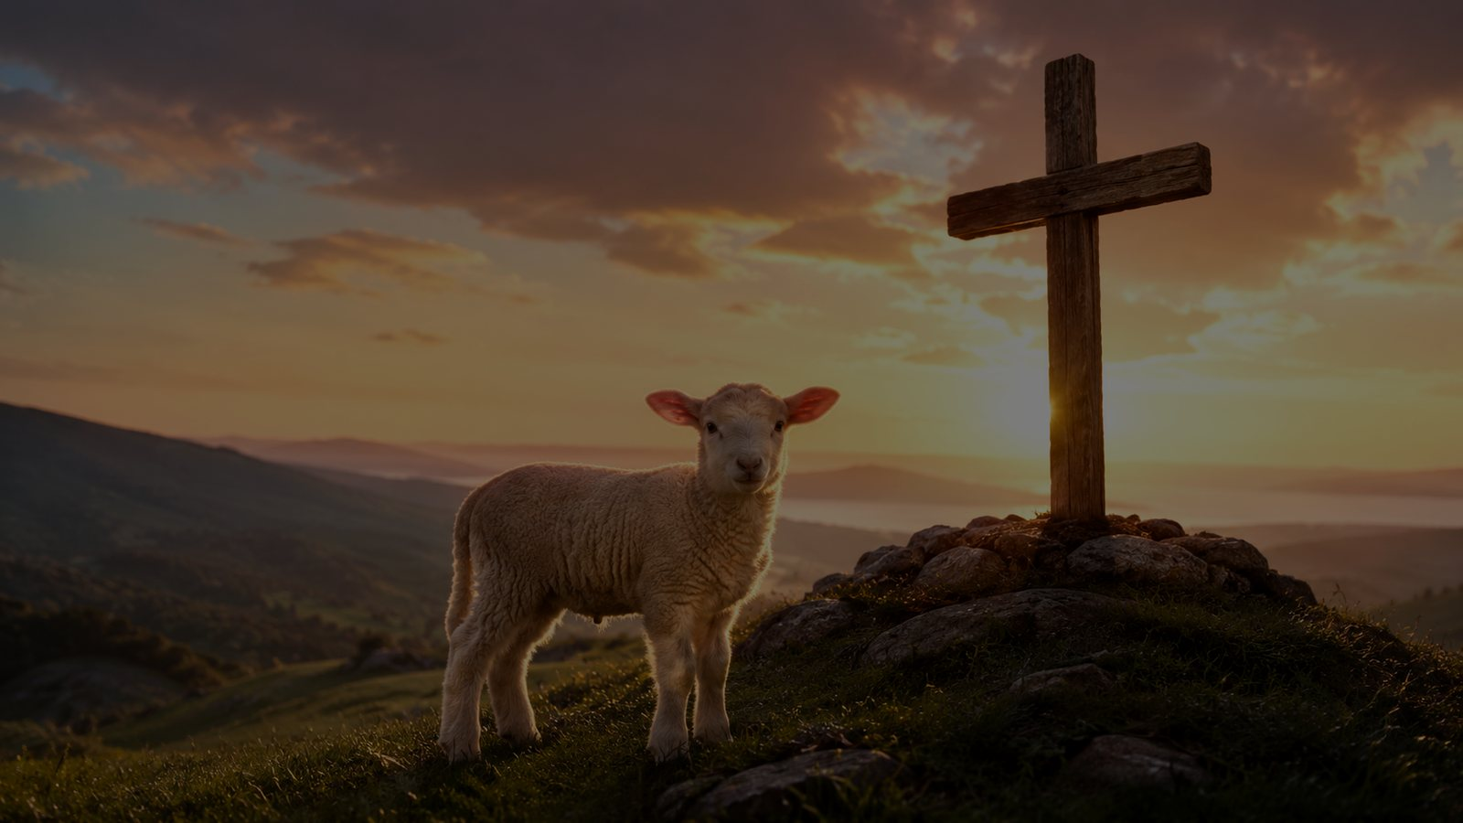
None Other Lamb
“None other Lamb, none other name”
• Christina Georgina Rossetti (1830-1894)
• Tune: ROSSETTI • 8.10.10.4
• Primary Scripture: Psalm 73:25
Prepared for teaching and small group use - hymninfo.com

Slide 2
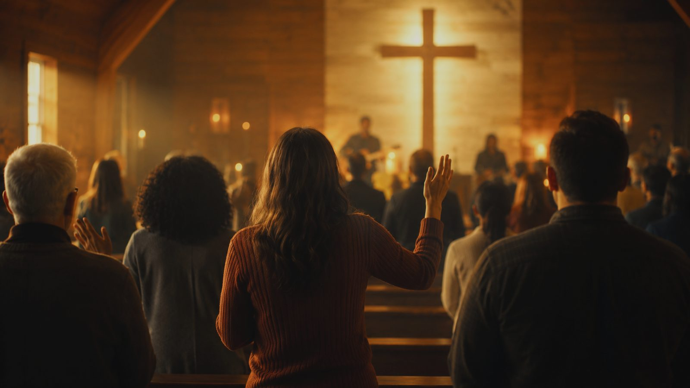
Teaching Aim
Understand • Feel • Practice
Understand
Feel
Practice
Christ is the only Lamb, saving Name, refuge, and home for sinners.
A holy honesty about weak faith, joined to confidence in Christ's sufficiency.
Pray from need, rest in the Lamb, and turn from rival hopes.
Prepared for teaching and small group use - hymninfo.com

Slide 3

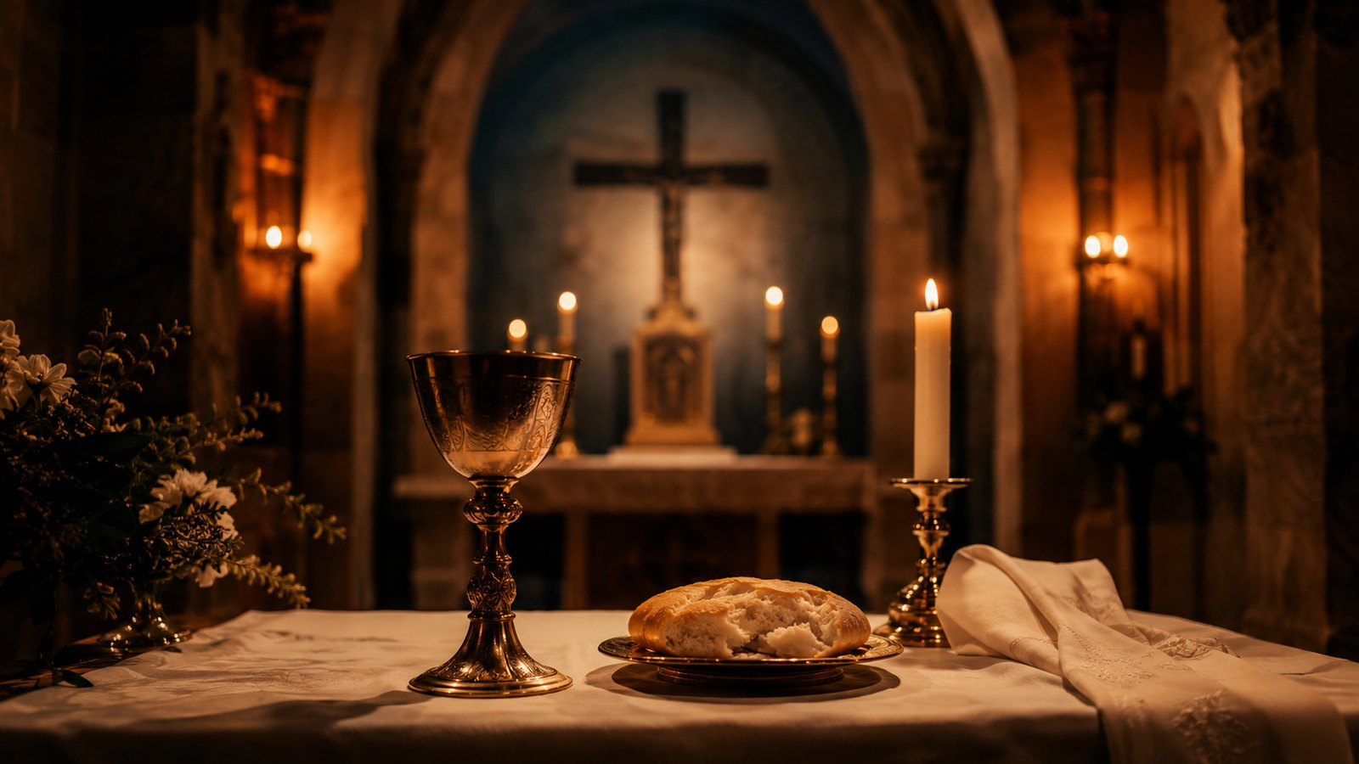
Hymn Identity
A compact prayer of Christ-centered assurance
Title
None Other Lamb
First line
None other Lamb, none other name
Author
Christina Georgina Rossetti (1830-1894)
Tune
ROSSETTI, William Jeater, 1907
Meter
8.10.10.4
Primary text
Psalm 73:25
Prepared for teaching and small group use - hymninfo.com

Slide 4


Historical Background
Rossetti’s devotional text and Jeater’s prayerful tune
• Christina Rossetti first printed the text in 1892 in a devotional meditation on Revelation.
• The hymn later entered hymnals as a brief confession of exclusive trust in Christ.
• William Jeater composed ROSSETTI in 1907, a tune suited to the text’s quiet intensity.
• Its short final line gives each stanza a concentrated prayer-like landing.
Prepared for teaching and small group use - hymninfo.com

Slide 5

Why This Hymn Matters Today
A prayer for believers who need Christ more than confidence
Pastoral value
Worship value
Teaching value
It gives weak faith honest language without leaving the soul in weakness.
It centers confession and assurance on Christ the Lamb, not on human readiness.
It helps the church connect Psalm 73, Acts 4, John 1, and Revelation 5.
The hymn is not a triumphant speech from a strong soul. It is a Gospel prayer from a needy soul: Christ alone is enough.
Prepared for teaching and small group use - hymninfo.com

Slide 6
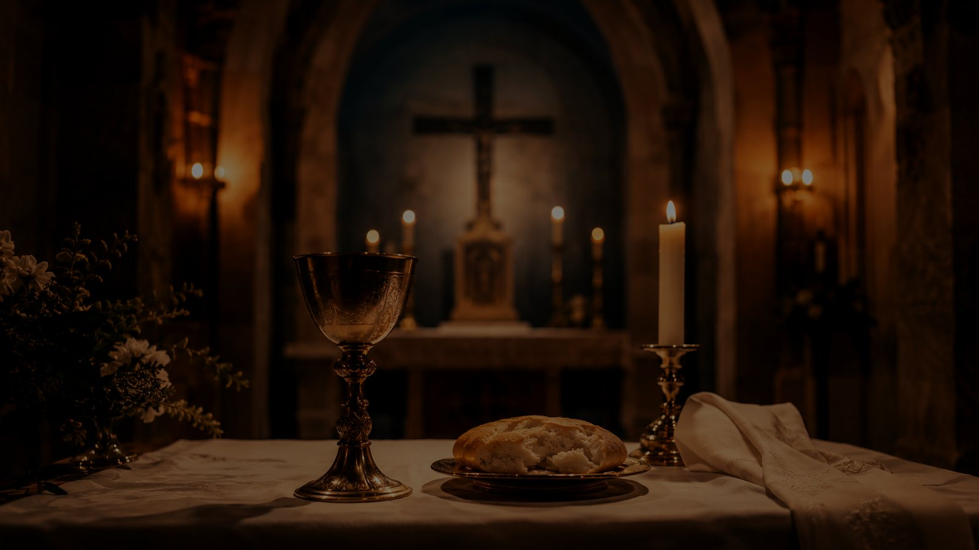
Biblical Foundation
The heart’s portion, the saving Name, and the Lamb of God
Psalm 73:25-26
Acts 4:12
God remains the heart’s portion when flesh and heart fail.
There is no other saving name.
John 1:29
Revelation 5:6
Jesus is the Lamb of God who bears sin.
The slain Lamb stands at the center of heaven’s worship.
John 6:68
There is nowhere better to go than Christ.
Prepared for teaching and small group use - hymninfo.com

Slide 7
The Only Lamb
The hymn begins by narrowing every hope to Christ.
Prepared for teaching and small group use - hymninfo.com

Slide 8
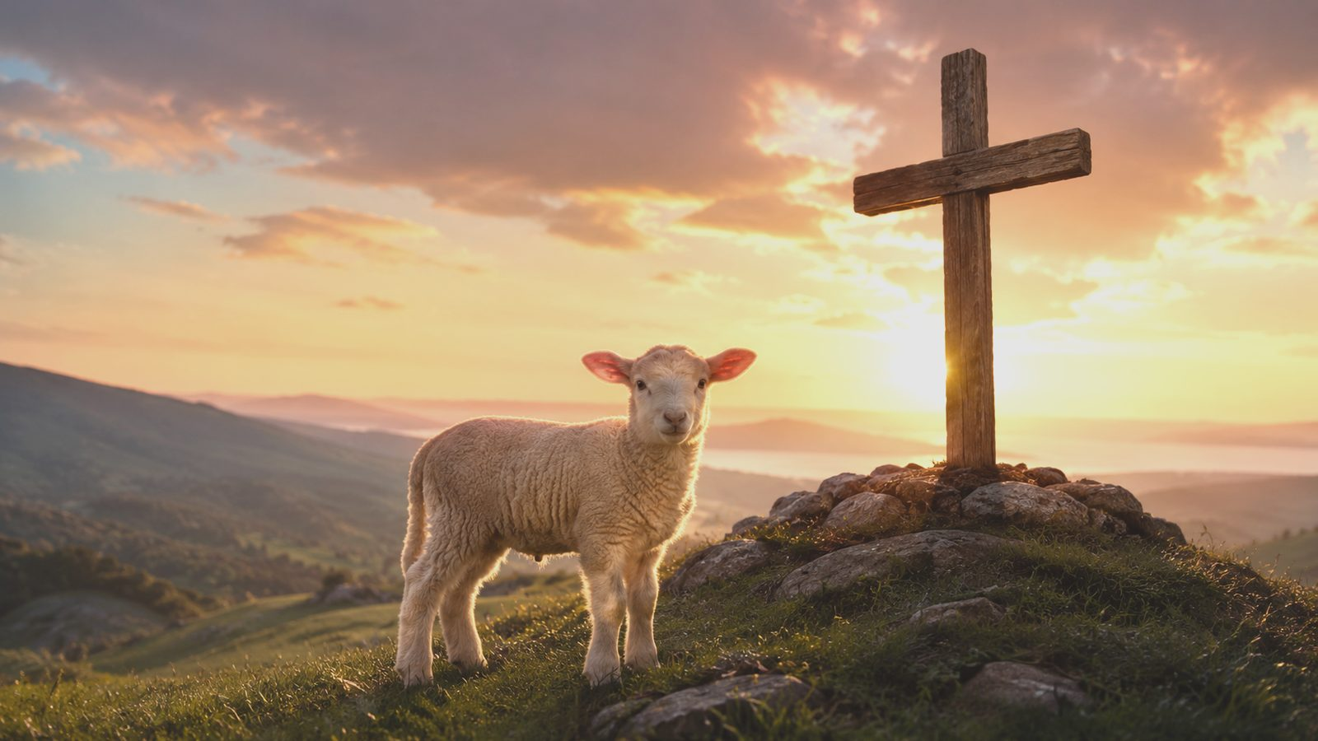
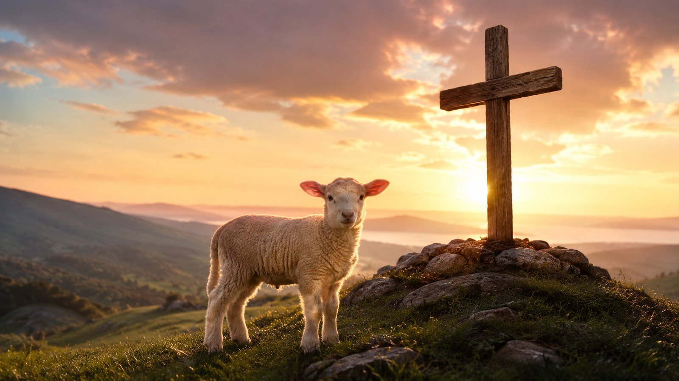
Movement 1: Exclusive Trust
No rival savior, no second refuge
• The opening confession names Christ as the only Lamb and only saving Name.
• The singer turns away from every competing ground of safety.
• Acts 4:12 gives this confession its apostolic clarity.
Prepared for teaching and small group use - hymninfo.com

Slide 9
Movement 2: Weak Faith Brought to Christ
The hymn does not pretend the soul is strong
• Rossetti gives words to low faith, cold love, and inward poverty.
• The weakness of the believer does not cancel the sufficiency of Christ.
• Psalm 73:26 teaches the failing heart to rest in God as its portion.
Prepared for teaching and small group use - hymninfo.com

Slide 10
Movement 3: The Lamb Who Saves
Sacrifice, mercy, and heavenly victory
John 1:29
Revelation 5:6
The hymn’s prayer
The Lamb of God takes away sin, not merely guilt-feeling.
The slain Lamb stands alive in the center of worship.
Weak faith is carried by the Savior’s finished work.
The Lamb is gentle toward sinners and mighty over sin.
Prepared for teaching and small group use - hymninfo.com

Slide 11
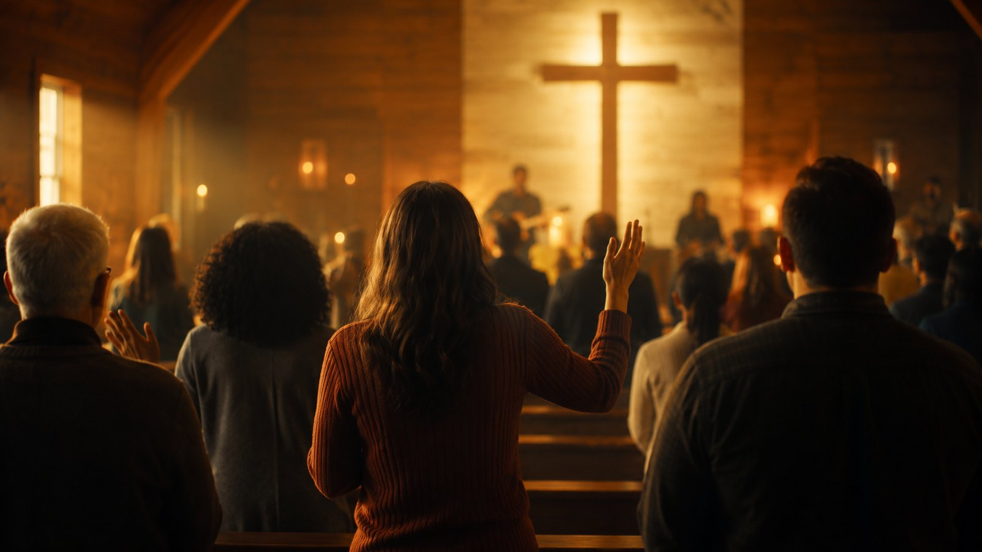
Movement 4: Refuge and Home
Christ is not only help on the way; he is the destination
• The hymn gathers longing, homelessness, and hope into Christ.
• John 6:68 gives the believer’s question: “To whom would we go?”
• Assurance rests in Christ’s sufficiency, not the believer’s inner steadiness.
Prepared for teaching and small group use - hymninfo.com

Slide 12

Theological Themes
What the hymn teaches the church to confess
Christ alone
Lamb of God
Assurance
No other name saves.
Christ bears sin and receives worship.
Security rests outside the self.
Refuge
Longing
Hope
The weak soul has a real shelter.
Desire is re-centered on Christ.
The Savior is also the soul’s home.
Prepared for teaching and small group use - hymninfo.com

Slide 13
Literary and Musical Observations
Brief lines, deep prayer, quiet intensity
• The repeated “none other” pattern creates a disciplined confession of Christ alone.
• The hymn moves from poverty of spirit to Christ’s sufficiency.
• ROSSETTI’s 8.10.10.4 shape gives the final short line room to settle.
• Sing with restraint; let the prayer breathe.
Prepared for teaching and small group use - hymninfo.com

Slide 14
Pastoral and Worship Use
Where the hymn serves the church
Lent and Holy Week
Communion
A meditation on the Lamb who bears sin.
A prayer of dependence before receiving grace.
Confession and Assurance
Pastoral care
A clear turn from guilt to Christ.
Language for low faith, grief, and spiritual weariness.
Prepared for teaching and small group use - hymninfo.com

Slide 15
Teaching Questions
Move from observation to worship
• What titles or images for Christ stand at the center of this hymn?
• How do Psalm 73:25 and Acts 4:12 explain its “none other” confession?
• What does the hymn teach about weak faith and Christ’s sufficiency?
• How does Revelation 5 help us see the Lamb as both slain and victorious?
• Where do you most need to confess Christ as refuge, hope, and home?
Prepared for teaching and small group use - hymninfo.com

Slide 16

Application
Practicing Christ-centered dependence
Pray honestly
Reject rival hopes
Return to Scripture
Come to the Table
Name weakness without hiding.
Ask what you trust when afraid.
Pray Psalm 73 and Revelation 5.
Receive grace with needy faith.
Prepared for teaching and small group use - hymninfo.com

Slide 17
Suggested Lesson Flow
Two options for church teaching
30-minute plan
60-minute plan
• Read Psalm 73:25-26
• Introduce Rossetti and the hymn
• Trace the three main movements
• Discuss one question
• Close with prayer
• Read Psalm 73, John 1, Revelation 5
• Study background and tune
• Walk through stanza movement
• Apply to Communion and assurance
• Pray for Christ-centered trust
Prepared for teaching and small group use - hymninfo.com

Slide 18
Closing Summary and Prayer
Christ is the Lamb, the saving Name, the refuge of weak faith, and the soul’s final home.
Lamb of God, turn our hearts from every false refuge. Be our portion, our hope, our life, and our home. Amen.
© HymnInfo.com. Free for personal, church, classroom, and small-group teaching use. Please do not sell, repost, or redistribute as downloadable files without permission.
Prepared for teaching and small group use - hymninfo.com

