Slide 1
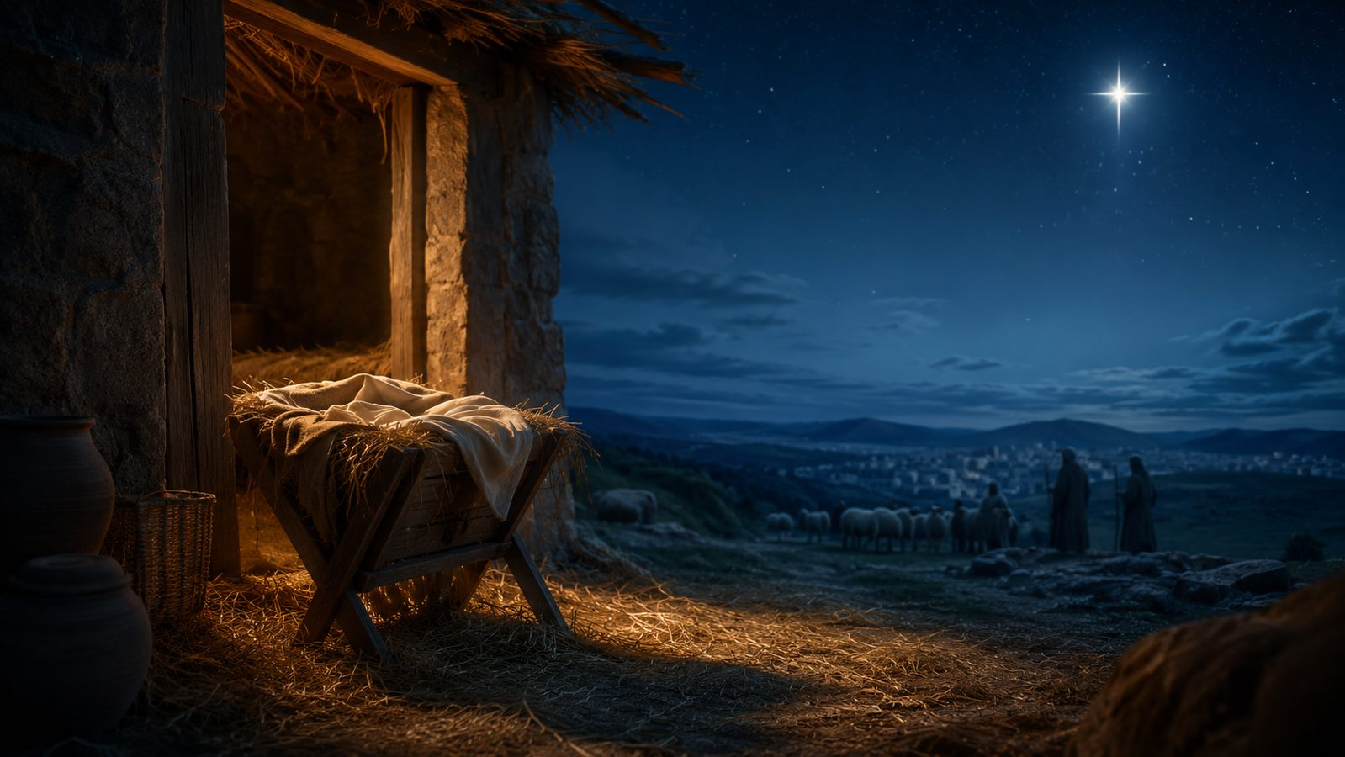
Angels From the
Realms of Glory
A Christmas and Epiphany hymn study
First line: “Angels from the realms of glory”
Words: James Montgomery, 1816
Tune often used: REGENT SQUARE, Henry Thomas Smart
Primary Scripture: Luke 2:10-14
Prepared for teaching and small group use - hymninfo.com

Slide 2
Teaching Aim
A hymn study for Christmas, Epiphany, worship planning, and congregational discipleship.
Understand
Feel
Practice
the Nativity as revelation of divine glory
the hymn’s movement from proclamation to adoration
how Christmas and Epiphany belong together
awe before the incarnate Christ
joy in good news for all people
confidence that Jesus is worthy of worship
sing Christmas as worship, not nostalgia
connect Scripture and song in teaching
respond with witness and reverent praise
Prepared for teaching and small group use - hymninfo.com

Slide 3
Hymn Identity
Key facts for teaching and worship planning.
Text
Tune and Use
Title: Angels From the Realms of Glory
First printed in 1816
Author: James Montgomery
Early title: The Nativity
Later title: Good Tidings of Great Joy to All People
Common tune: REGENT SQUARE
Composer: Henry Thomas Smart
Meter commonly indexed as 8.7.8.7.8.7
Strong festival character
Useful for Christmas and Epiphany
Prepared for teaching and small group use - hymninfo.com

Slide 4
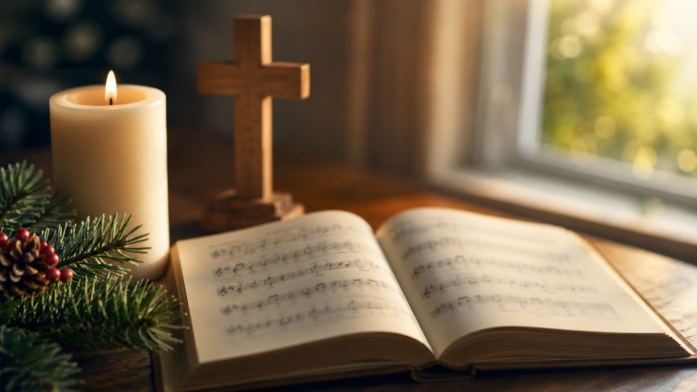
Historical Background
James Montgomery and the rise of a Christmas hymn.
Montgomery was a Scottish-born Moravian poet, hymn writer, and newspaper editor in Sheffield.
The text was first printed on Christmas Eve, 1816, in the Sheffield Iris.
Early hymnals soon carried the hymn into public worship.
The later REGENT SQUARE pairing gave the hymn a confident festival sound.
Prepared for teaching and small group use - hymninfo.com

Slide 5
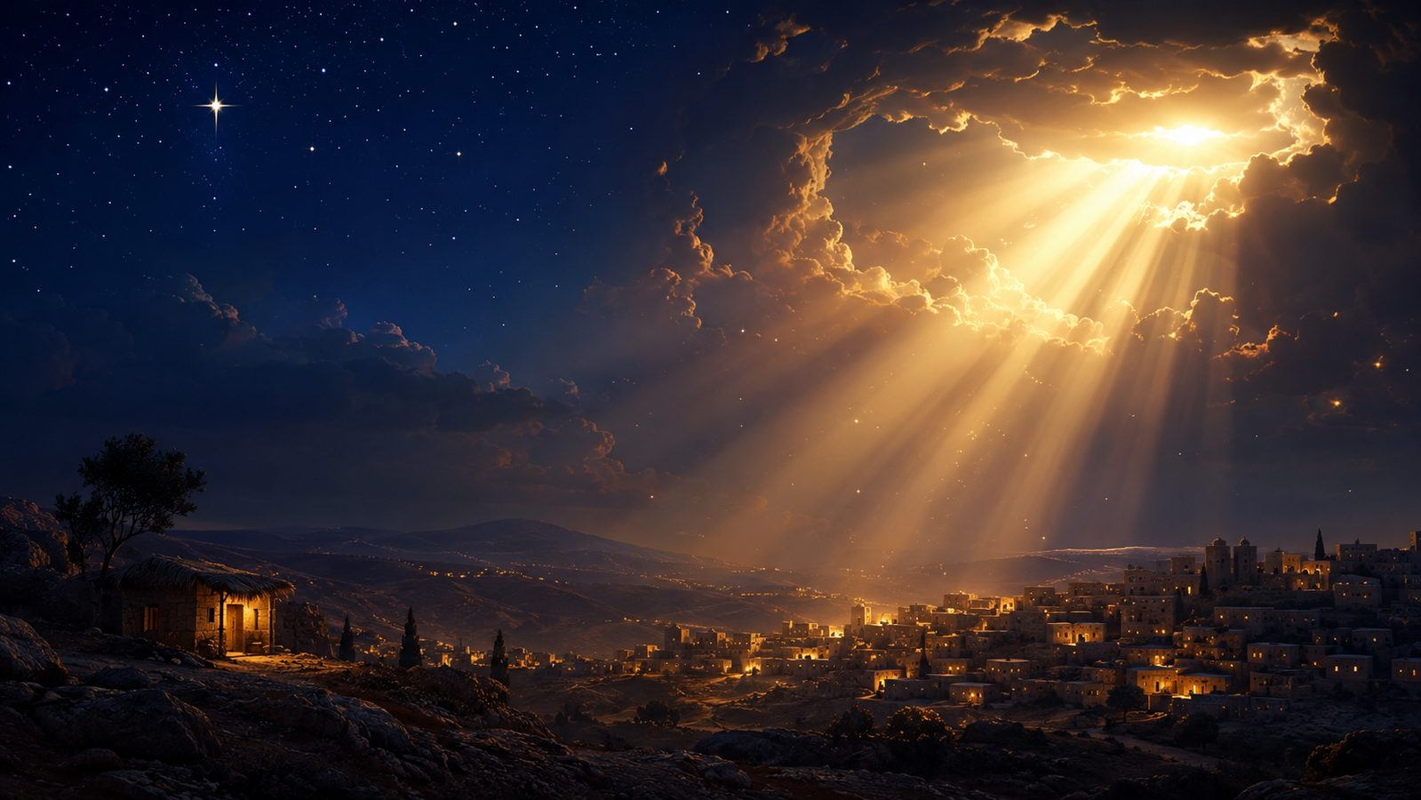
Christmas as Revelation
The hymn treats Bethlehem as the appearing of divine glory.
“A Savior, who is Christ the Lord.”
Luke 2:11
Christmas is more than tenderness; it is the unveiling of the Lord’s saving presence.
The song moves worshipers from seeing the manger to adoring the King.
The invitation is not only to remember, but to worship.
Prepared for teaching and small group use - hymninfo.com

Slide 6
Biblical Foundation
Primary passages that shape the hymn’s central message.
Luke 2:10-14
Matthew 2:11
John 1:14
Good news of great joy; glory to God in the highest.
The visitors from the east fall down and worship the child.
The Word became flesh and lived among us, full of grace and truth.
Supporting passages: Isaiah 9:6; Revelation 5:12
Prepared for teaching and small group use - hymninfo.com

Slide 7
Scripture Map
How the biblical story becomes congregational praise.
Announcement
Adoration
Incarnation
Heavenly Worship
Luke 2
Matthew 2
John 1
Revelation 5
Good news breaks into ordinary night.
The nations recognize the King.
The Word comes among us.
The Lamb receives glory.
The hymn’s repeated call gathers these passages into one response: worship Christ.
Prepared for teaching and small group use - hymninfo.com

Slide 8
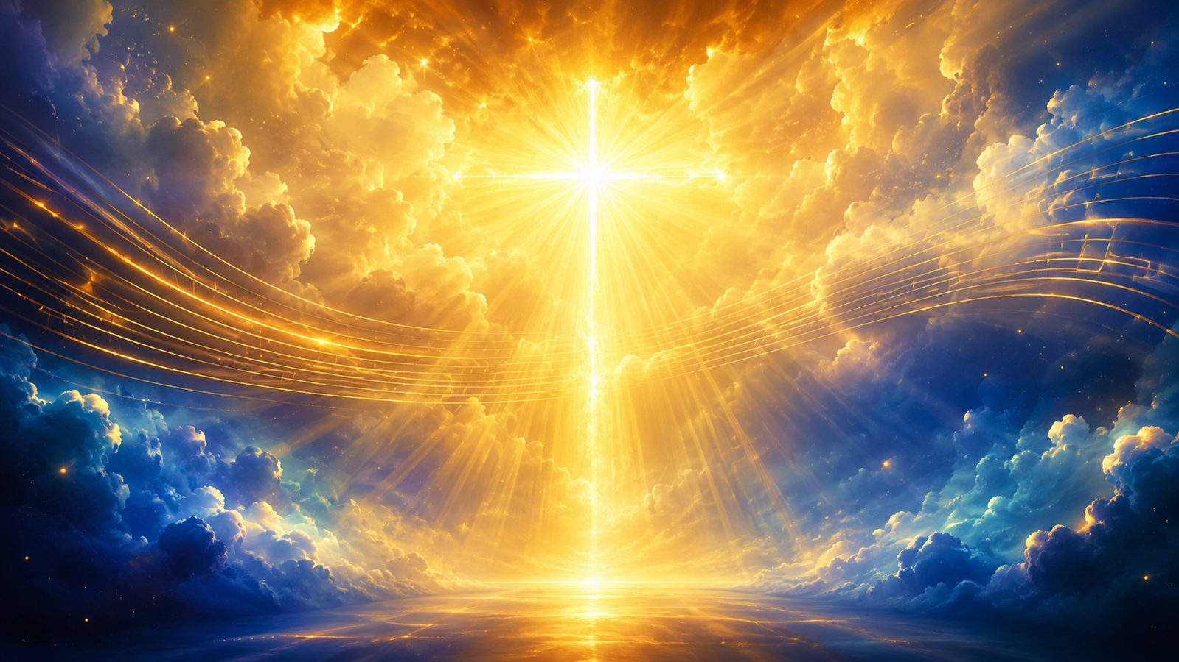
Stanza Movement
A sequence of witnesses summoned to worship.
Angels proclaim: heaven announces the Savior’s birth.
Shepherds witness: ordinary workers receive and share good news.
Sages seek: the nations come to honor the King.
Saints watch: the church waits, hopes, and worships before the Lord.
Prepared for teaching and small group use - hymninfo.com

Slide 9
Stanza Study: Angels
Heaven announces what earth must hear.
The opening summons begins in heaven, with angelic messengers proclaiming the birth of Messiah.
The angels are not the object of worship; they direct attention to Christ.
Teaching emphasis: true Christmas worship listens to the announcement and turns toward the newborn King.
Prepared for teaching and small group use - hymninfo.com

Slide 10
Stanza Study: Shepherds
Good news comes into ordinary work and watchfulness.
The shepherds represent humble witnesses in the fields at night.
The hymn follows Luke 2 by placing ordinary people at the center of the first Christmas proclamation.
Teaching emphasis: the gospel reaches people in their daily calling and invites immediate worship.
Prepared for teaching and small group use - hymninfo.com

Slide 11
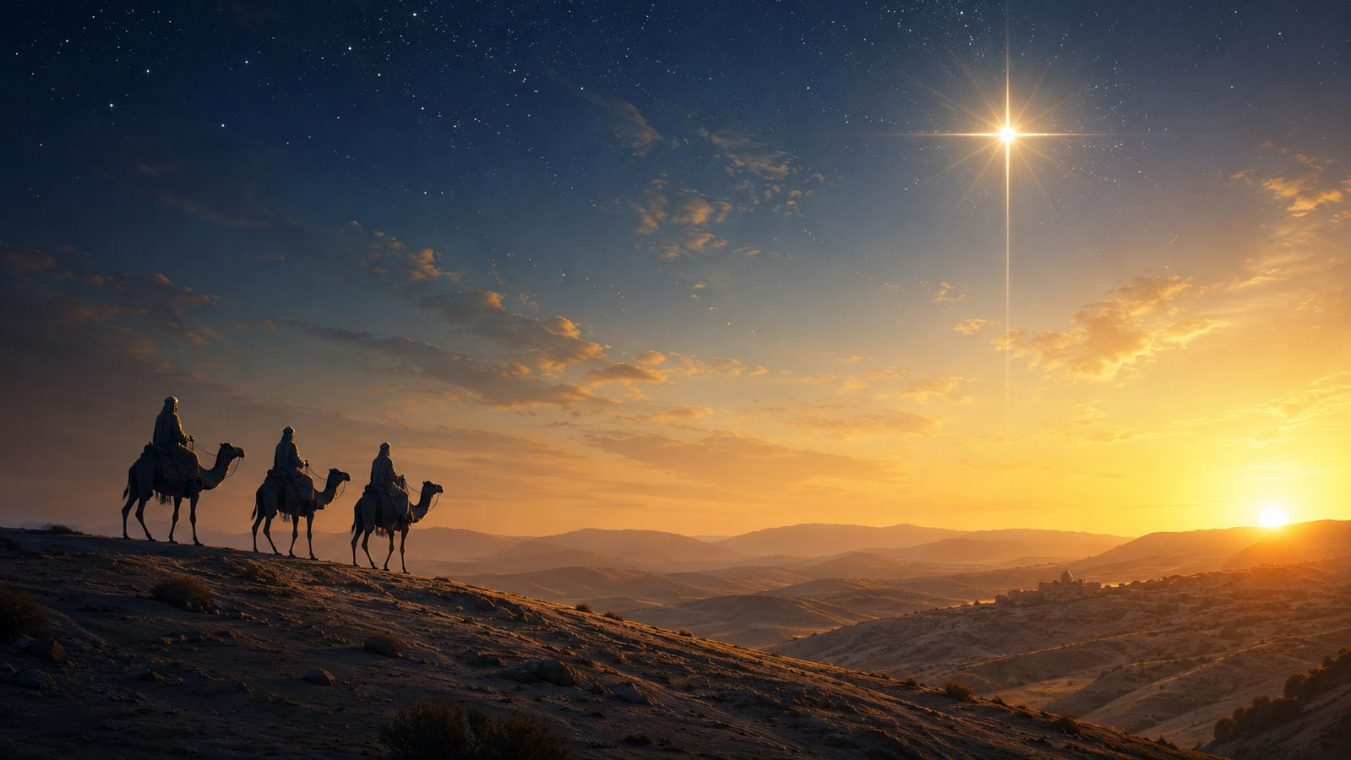
Stanza Study: Sages
The nations are drawn to the King.
The sages point toward Epiphany: Christ is revealed beyond one nation and one place.
Their journey expresses seeking, humility, and costly adoration.
Teaching emphasis: worship of Christ is the proper response of every people and every nation.
Prepared for teaching and small group use - hymninfo.com

Slide 12
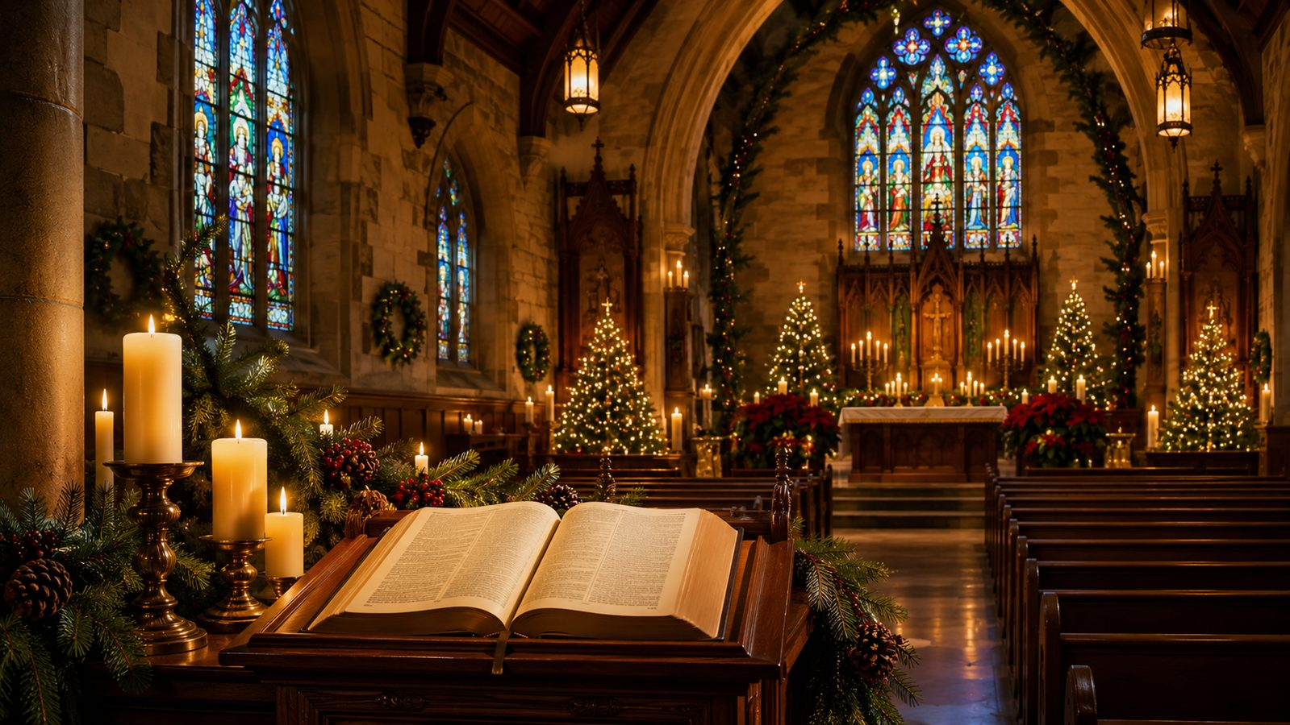
Stanza Study: Saints
The church waits before the Lord in hope and reverence.
The later movement widens the song from Nativity witnesses to the worshiping community.
Waiting before the Lord is not passive; it is alert, reverent, and hope-filled.
Teaching emphasis: Christmas worship trains the church to watch for Christ and adore him.
Prepared for teaching and small group use - hymninfo.com

Slide 13
The Refrain: Come and Worship
A repeated call that turns every witness toward Christ.
“Come and worship” is more than a musical refrain; it is the hymn’s theological center.
The refrain gathers angels, shepherds, sages, and saints into one act of adoration.
It names Christ as the focus of Christmas worship.
It gives the congregation a simple, repeatable response to the good news.
Prepared for teaching and small group use - hymninfo.com

Slide 14
Theological Themes
Doctrines and worship themes genuinely present in the hymn.
Incarnation
Adoration
Kingship
The Word comes in human flesh.
The fitting response is worship.
The child is Christ the Lord.
Mission
Epiphany
Hope
Good news is proclaimed to all.
The nations are summoned to Christ.
The church watches in faith.
Prepared for teaching and small group use - hymninfo.com

Slide 15
Literary and Musical Observations
How text and tune shape the congregation’s response.
Text
Tune
Addressed invitations give the hymn movement and urgency.
Each stanza names a witness and directs that witness to Christ.
The repeated call makes doctrine singable.
REGENT SQUARE gives the text a broad festival character.
Its confident shape supports processional and congregational singing.
Clear tempo and strong accompaniment help the refrain land with conviction.
Prepared for teaching and small group use - hymninfo.com

Slide 16
Pastoral and Worship Use
Where the hymn serves the church well.
Opening hymn for Christmas Eve or Christmas Day worship
Processional or congregational hymn for Epiphany
Carol service bridge from Nativity story to worship response
Choir-led introduction that invites the congregation to join
Teaching hymn for incarnation, kingship, and adoration
Prepared for teaching and small group use - hymninfo.com

Slide 17
Teaching Questions
Discussion prompts for Sunday school, choir rehearsal, or small groups.
How does the hymn connect the biblical Nativity story with worship today?
Why does the birth of Christ call for adoration rather than only admiration?
What do Luke 2 and Matthew 2 teach about proclamation and response?
How does REGENT SQUARE shape the congregation’s experience of the text?
How can Christmas worship become a witness to Christ’s kingship and glory?
Prepared for teaching and small group use - hymninfo.com

Slide 18
Application
Worship that becomes witness.
Receive the announcement: Christ has come for the salvation of his people.
Respond with worship: make adoration the center of Christmas devotion.
Welcome the nations: rejoice that the King is worthy of global praise.
Bear witness: let festive worship become faithful testimony.
Prepared for teaching and small group use - hymninfo.com

Slide 19
Suggested Lesson Flow
Two options for teaching the hymn.
30-Minute Plan
60-Minute Plan
Read Luke 2:10-14
Introduce Montgomery and the hymn
Trace the four witness groups
Discuss one application question
Sing or pray the refrain
Read Luke 2, Matthew 2, John 1:14
Study each stanza movement
Compare Christmas and Epiphany themes
Discuss worship and witness
Plan a service use or devotional response
Prepared for teaching and small group use - hymninfo.com

Slide 20
Closing Summary and Prayer
The child of Bethlehem is worthy of worship.
Summary
Angels From the Realms of Glory turns the Nativity into a living summons: hear the good news, come with faith, and worship Christ the newborn King.
Prayer
Lord Jesus Christ, receive our adoration. Teach us to hear the good news with joy, to worship you with reverence, and to carry the light of your coming into the world. Amen.
© HymnInfo.com. Free for personal, church, classroom, and small-group teaching use. Please do not sell, repost, or redistribute as downloadable files without permission.
Prepared for teaching and small group use - hymninfo.com

