Slide 1
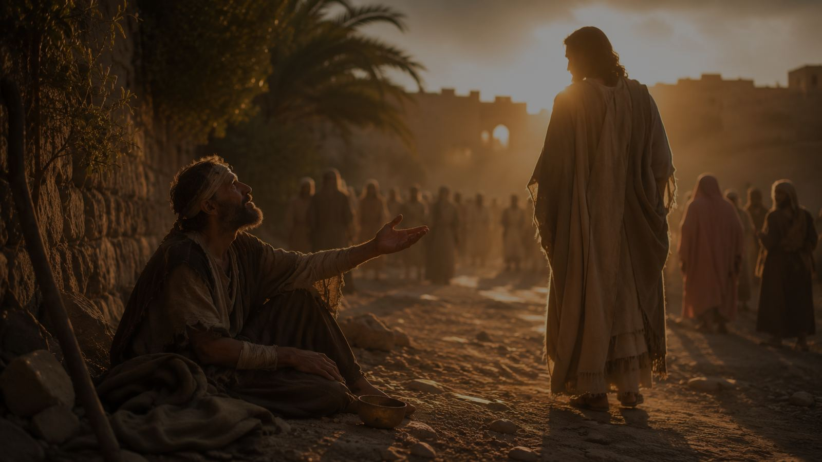
Blind Bartimaeus
Blind Bartimaeus at the gates • Henry Wadsworth Longfellow • FILLMORE • Mark 10:52
Prepared for teaching and small group use - hymninfo.com

Slide 2
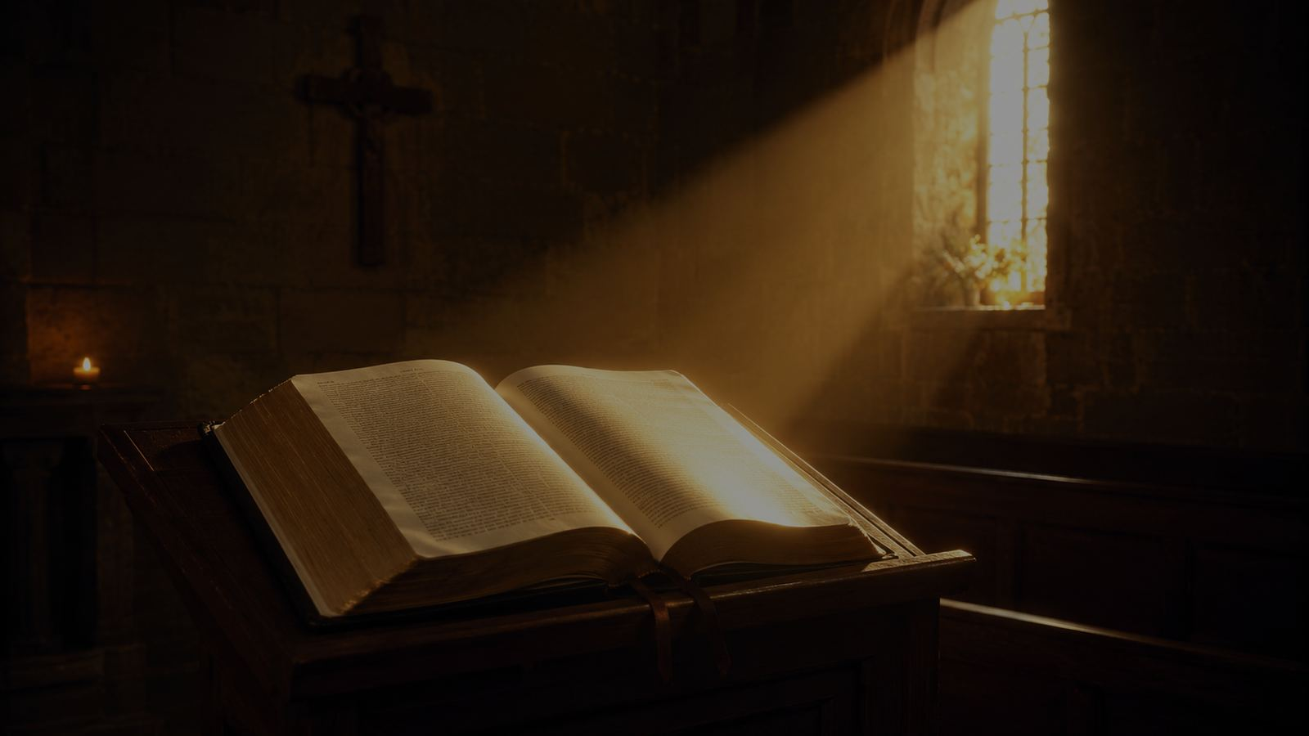
Teaching Aim
What learners should understand, feel, and practice
1
2
3
Understand
Feel
Practice
Jesus hears the cry for mercy and restores sight.
The courage of faith that refuses to be silenced.
Move from receiving mercy to following Christ on the way.
Prepared for teaching and small group use - hymninfo.com

Slide 3
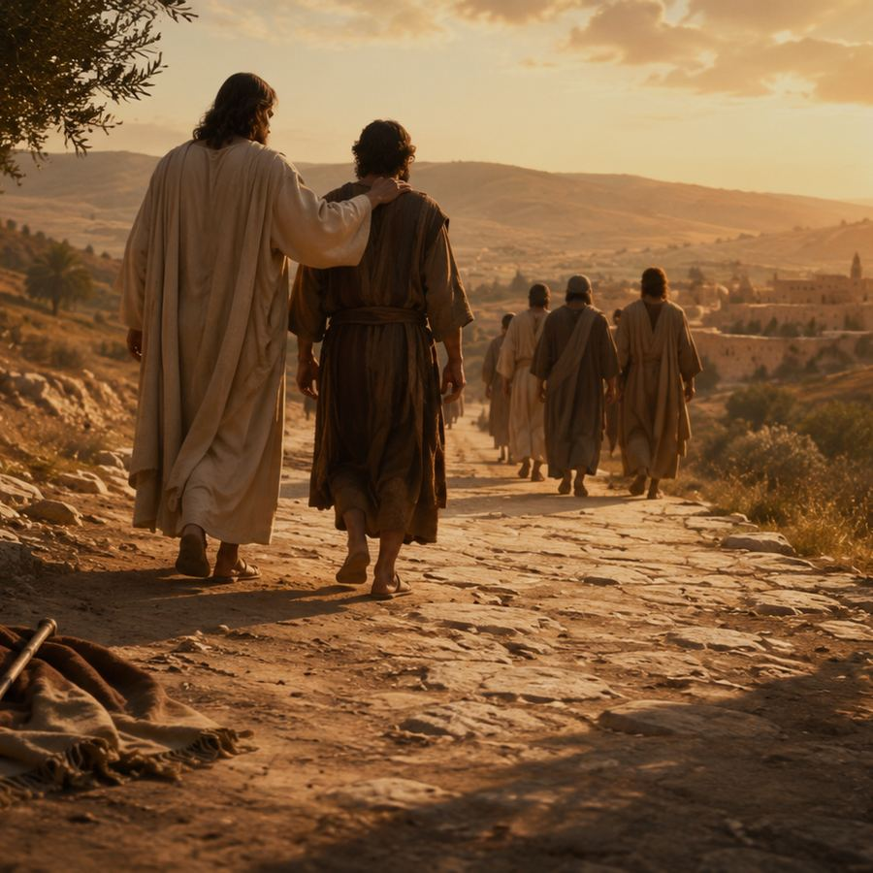
Hymn Identity
A poem from the Gospel story, later shaped for congregational song
First line
Blind Bartimaeus at the gates
Author
Henry Wadsworth Longfellow (1807-1882)
Tune
FILLMORE by Jeremiah Ingalls (1764-1838)
Meter
8.8.8.8.8.8
Primary passage
Mark 10:46-52, especially Mark 10:52
Prepared for teaching and small group use - hymninfo.com

Slide 4
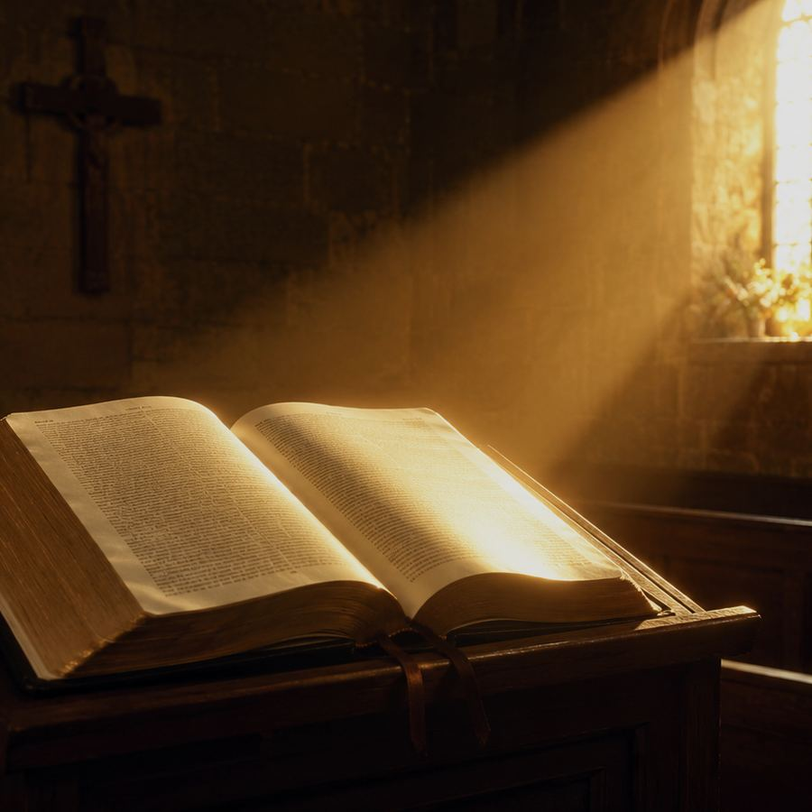
Historical Background
Longfellow’s biblical poem and an early American hymn tune
Longfellow wrote Blind Bartimeus as a poem based on Mark 10:46-52.
Later hymn settings adapted the poem for English-speaking congregations.
FILLMORE is a separate early American tune by Jeremiah Ingalls, known from the American psalmody tradition.
Prepared for teaching and small group use - hymninfo.com

Slide 5
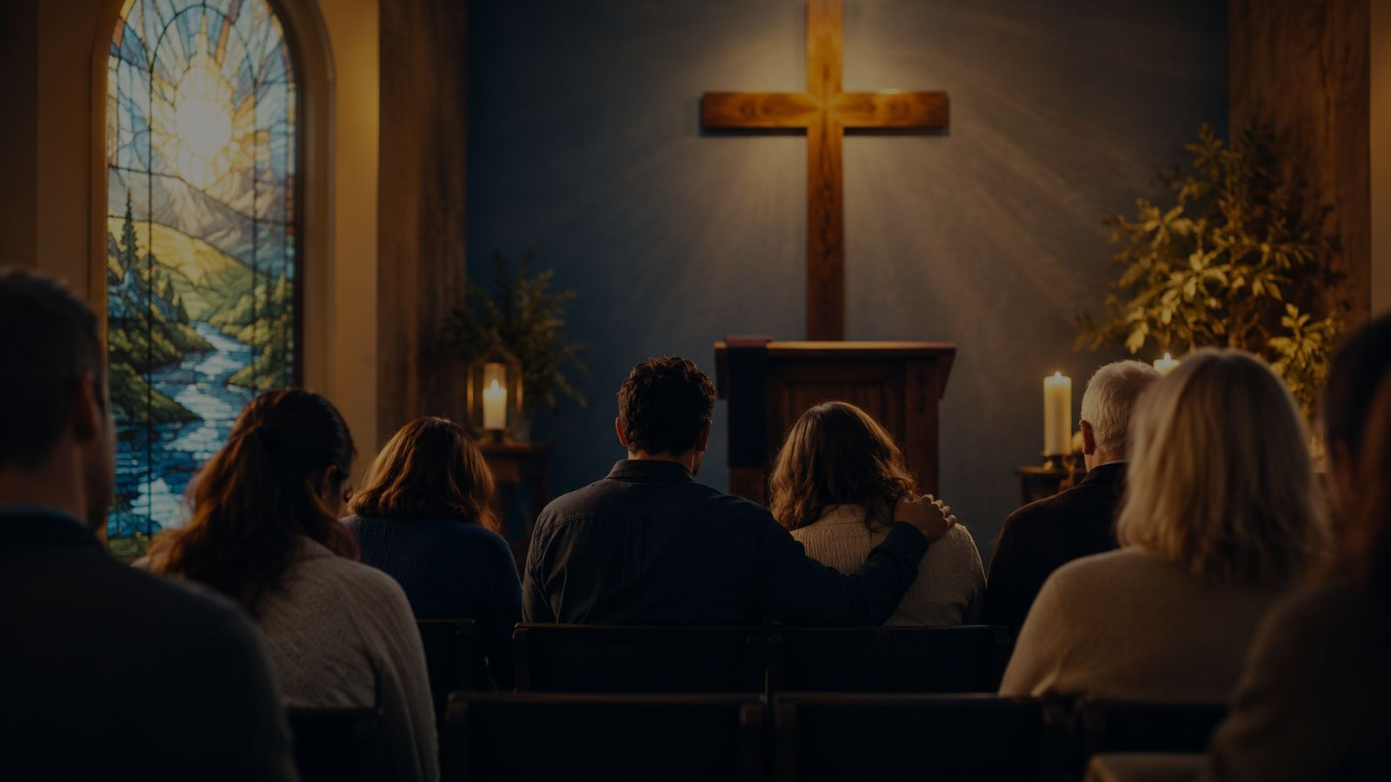
Why This Hymn Matters Today
A clear song for mercy, prayer, healing, and discipleship
Pastoral
Worship
It gives language to people who feel pushed to the edge of the crowd.
It lets the church retell a Gospel scene in song.
Teaching
Discipleship
It connects physical healing with the larger biblical theme of Christ’s light.
It ends not with sight alone, but with following Jesus.
Prepared for teaching and small group use - hymninfo.com

Slide 6
Biblical Foundation
“Your faith has made you well.” — Mark 10:52
Prepared for teaching and small group use - hymninfo.com

Slide 7
The Gospel Movement
From cry to call, from sight to discipleship
1
2
3
4
He hears
He stops
He heals
He follows
Mark 10:47 — Bartimaeus cries for mercy.
Mark 10:49 — Jesus calls the man others tried to silence.
Mark 10:52 — sight is restored by mercy and faith.
The healed man joins Jesus on the way.
Prepared for teaching and small group use - hymninfo.com

Slide 8
Hymn-Section Study
Teaching the story without losing its pastoral tenderness
Prepared for teaching and small group use - hymninfo.com

Slide 9
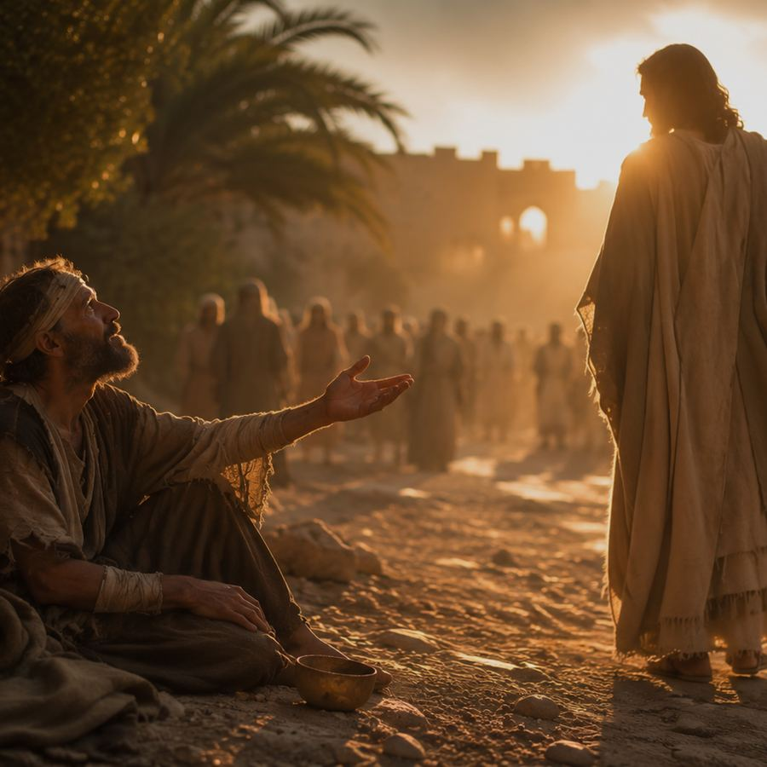
Section 1: At the Gate
Need, vulnerability, and the nearness of Jesus
The scene begins at the edge of public attention.
Bartimaeus has need he cannot repair by his own strength.
The hymn draws listeners into the mercy of Christ before it draws lessons from the man.
Prepared for teaching and small group use - hymninfo.com

Slide 10
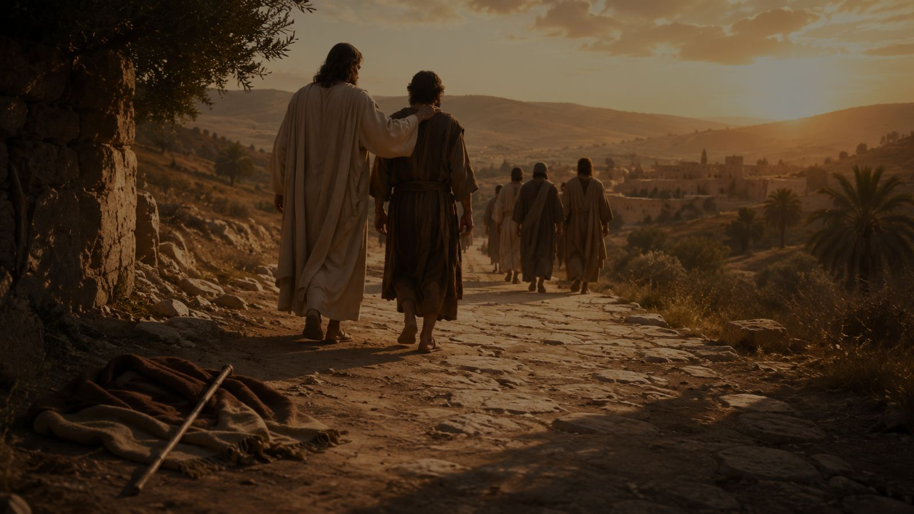
Section 2: The Cry for Mercy
Faith speaks when Jesus passes by
Bartimaeus names Jesus as Son of David.
His prayer is short, direct, and full of dependence.
Persistent faith may continue even when nearby voices discourage it.
Prepared for teaching and small group use - hymninfo.com

Slide 11
Section 3: Jesus Stands Still
The Savior hears the one the crowd would silence
Teaching emphasis
Christ’s compassion interrupts the crowd’s momentum.
The call of Jesus restores dignity before the healing is complete.
The church should echo Christ’s summons, not the crowd’s silencing.
Prepared for teaching and small group use - hymninfo.com

Slide 12
Section 4: Sight and the Way
Healing becomes discipleship
Mark’s account ends with following, not spectacle.
Sight is restored so the man may walk with Jesus.
Christian witness moves from mercy received to obedience practiced.
Prepared for teaching and small group use - hymninfo.com

Slide 13
Theological Themes
Four truths for teaching and worship
Mercy
Faith
Jesus hears desperate prayer.
Trust responds to Christ’s nearness.
Light
Discipleship
God opens eyes and hearts.
Grace leads us onto the way.
Prepared for teaching and small group use - hymninfo.com

Slide 14
Literary and Musical Observations
Narrative clarity with a sturdy early American tune
The text retells a Gospel scene rather than arguing abstractly.
The tune FILLMORE has a plain, vigorous character suited to narrative singing.
A steady tempo helps the story unfold without becoming heavy.
Prepared for teaching and small group use - hymninfo.com

Slide 15
Pastoral and Worship Use
Mercy, healing, prayer, and spiritual sight
Read Mark 10:46-52 before singing or teaching.
Use in services focused on Christ’s mercy, persistent prayer, healing, or discipleship.
Speak carefully about physical blindness; emphasize Christ’s compassion and God’s gift of spiritual light.
Invite testimony: Where has Christ stopped for you? Where is he calling you to follow?
Prepared for teaching and small group use - hymninfo.com

Slide 16
Teaching Questions
Questions that move from text to life
What details show Bartimaeus’s need and persistence?
Why is Mark 10:52 central to the whole hymn?
How does Jesus’ call challenge the crowd’s response?
What does this story teach about mercy, faith, and following Jesus?
Where do we need to cry out for mercy and then walk in obedience?
Prepared for teaching and small group use - hymninfo.com

Slide 17
Suggested Lesson Flow
Two practical teaching plans
30 minutes
60 minutes
Read Mark 10:46-52
Teach the hymn identity and story movement
Discuss mercy, faith, and following Jesus
Close with prayer for spiritual sight
Open with reflection and Scripture
Teach history, text, and tune
Work through each hymn section
Discuss pastoral application and worship use
Pray for courage to cry out and follow
Prepared for teaching and small group use - hymninfo.com

Slide 18
Closing Prayer
Lord Jesus, Son of David, have mercy on us. Open our eyes to your glory, steady our faith when others discourage us, and teach us to follow you on the way. Amen.
© HymnInfo.com. Free for personal, church, classroom, and small-group teaching use. Please do not sell, repost, or redistribute as downloadable files without permission.
Prepared for teaching and small group use - hymninfo.com

