Slide 1
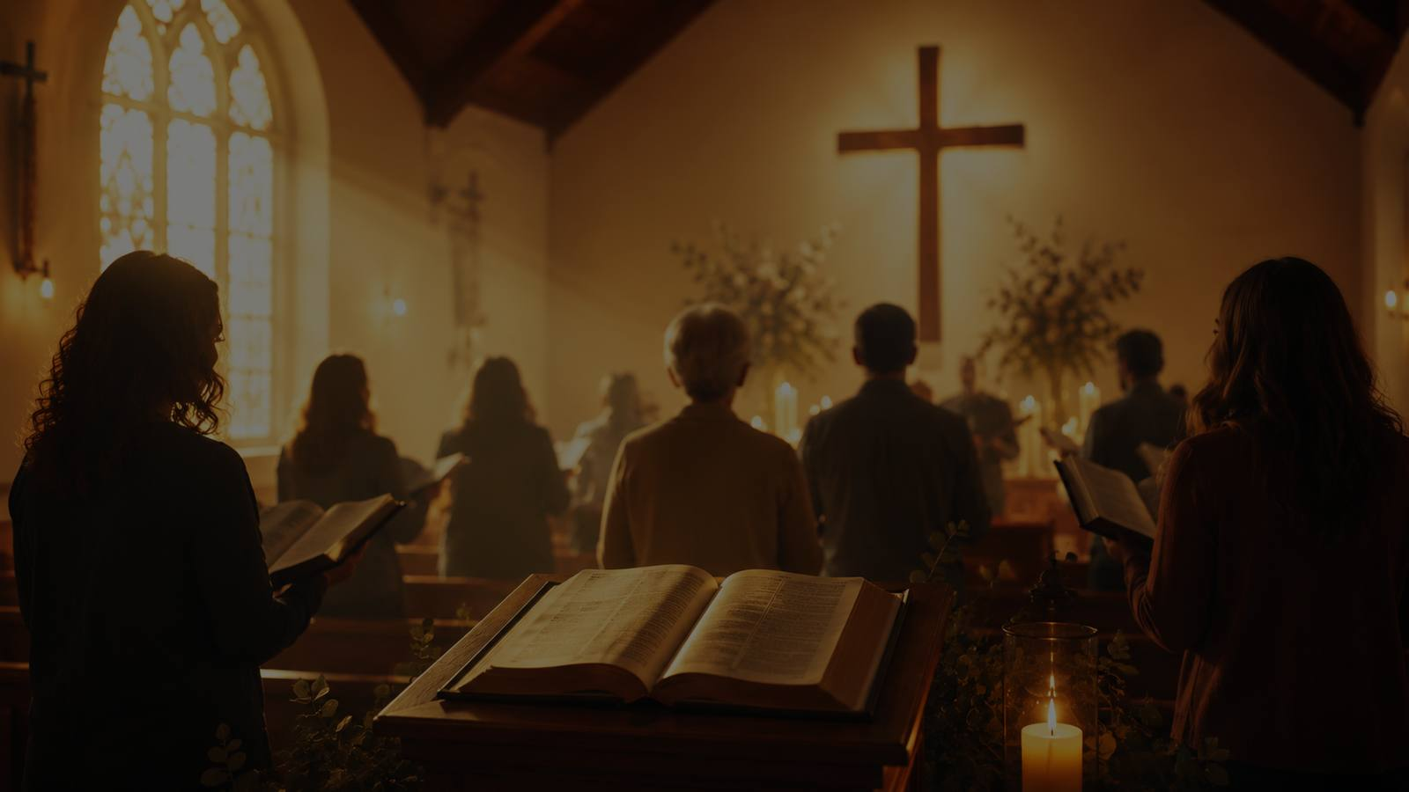
I Heard the Voice
of Jesus Say
A hymn study on Christ’s gracious invitation: rest, living water, and light
Horatius Bonar, 1846 • commonly sung to KINGSFOLD
Primary Scripture: Matthew 11:28-30
Prepared for teaching and small group use - hymninfo.com

Slide 2
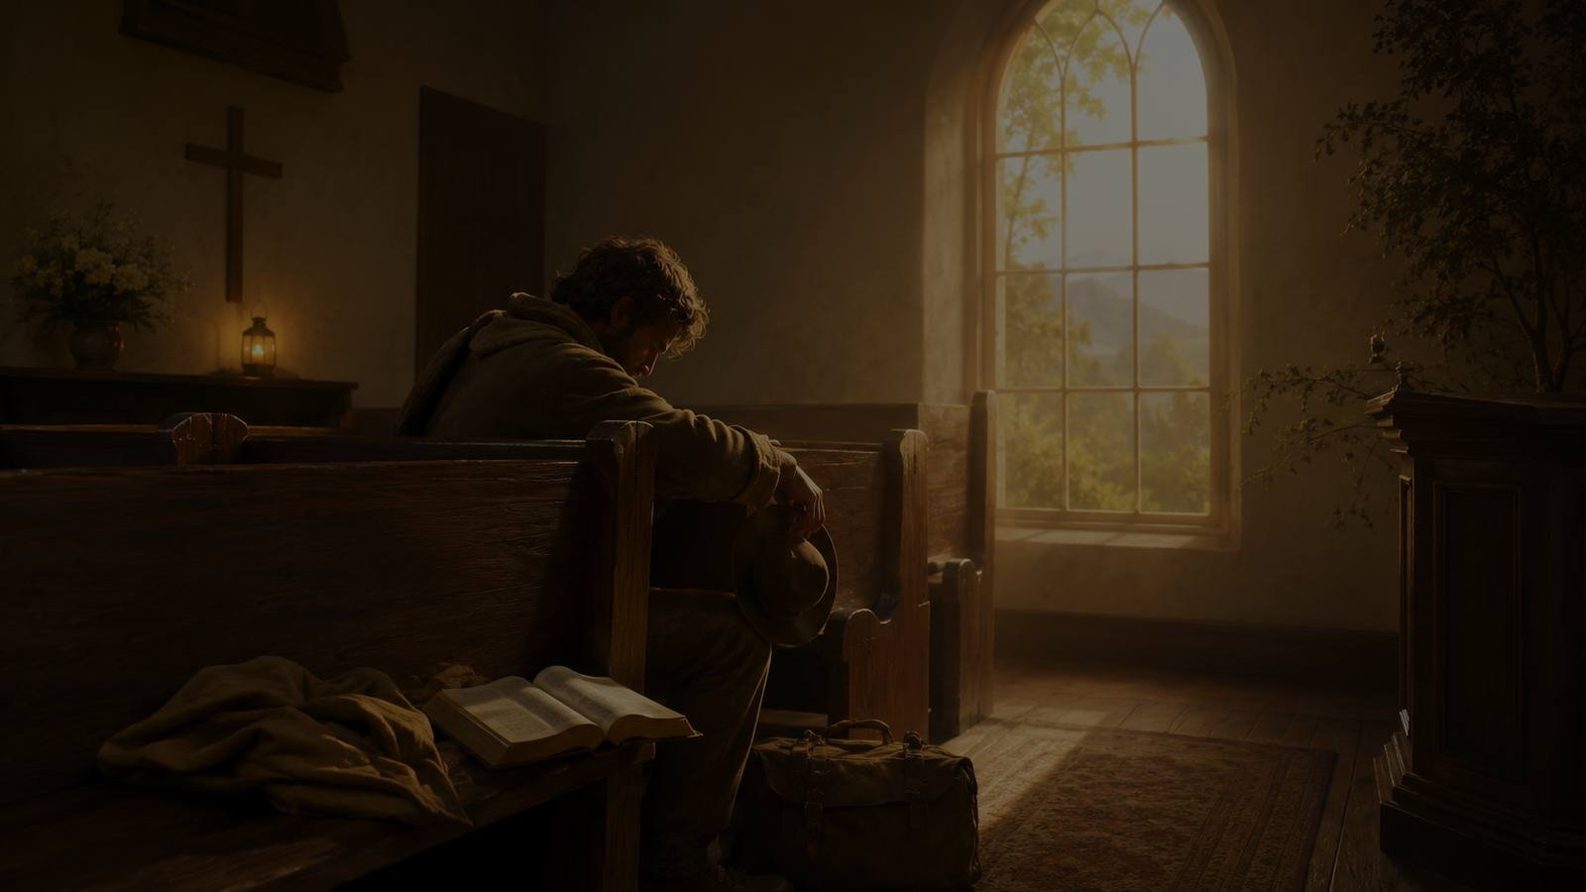
Teaching Aim
Lead learners to hear Christ’s invitation and answer it in faith.
1
Understand
2
Feel
3
Practice
Bonar’s hymn gathers three biblical promises of Jesus: rest, living water, and light.
Let the hymn’s pastoral warmth speak to weariness, thirst, and spiritual darkness.
Respond to Christ’s voice through prayer, trust, and daily walking in his light.
Prepared for teaching and small group use - hymninfo.com

Slide 3

Hymn Identity
Title: I Heard the Voice of Jesus Say
First line: I heard the voice of Jesus say
Writer: Horatius Bonar
Year: 1846
Tune commonly used: KINGSFOLD
Form: a personal testimony shaped by the words of Jesus
Main images: rest, water, and light
Pastoral tone: gentle invitation and faithful response
Prepared for teaching and small group use - hymninfo.com

Slide 4
Historical Background
Horatius Bonar
Scottish Presbyterian minister, theologian, and hymn writer. Bonar’s hymns often serve the same pastoral work as his preaching: making Christ’s promise plain and personal.
Published in 1846, the hymn reflects a nineteenth-century evangelical concern for direct gospel invitation and heartfelt response.
A hymn shaped like testimony
Christ speaks.
The soul comes.
Grace changes the way forward.
Prepared for teaching and small group use - hymninfo.com

Slide 5

Why This Hymn Matters Today
It gives weary people words for coming to Christ honestly.
It teaches the gospel as gift before it teaches discipleship as response.
It helps a congregation sing both invitation and testimony.
It turns three familiar biblical images into a simple path of faith.
Hear
Come
Walk
Prepared for teaching and small group use - hymninfo.com

Slide 6
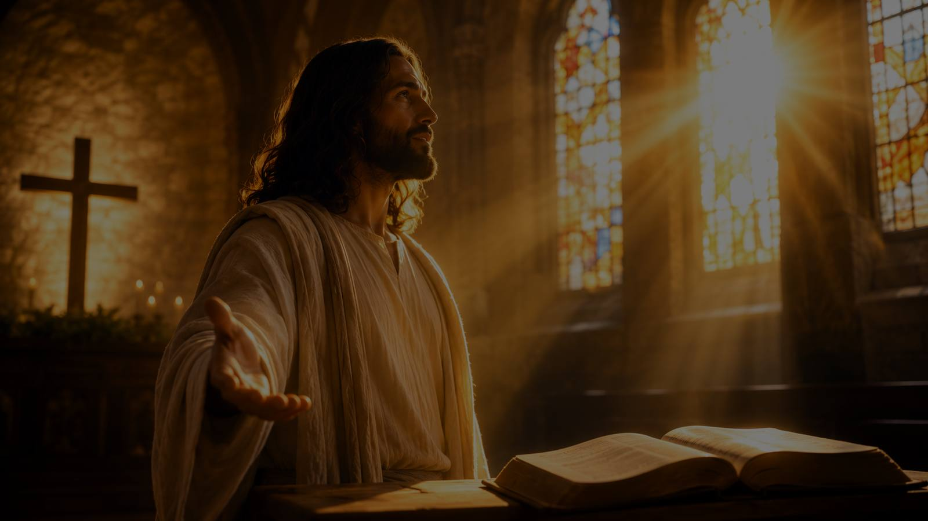
Biblical Foundation
R
Rest
W
Living Water
L
Light
Matthew 11:28-30 — Jesus calls the weary to himself and gives rest for the soul.
John 4:13-14 and Isaiah 55:1-3 — Christ gives life that satisfies deepest thirst.
John 8:12 — the one who follows Jesus has the light of life.
Revelation 22:17 gathers the invitation: the thirsty are called to come and receive freely.
Prepared for teaching and small group use - hymninfo.com

Slide 7
Rest for the Weary
“Come to me, all you who labor and are heavily burdened...”
Prepared for teaching and small group use - hymninfo.com

Slide 8
Hymn Section 1: The Weary Come
The hymn begins with a burdened person hearing the merciful call of Jesus.
Rest is not portrayed as escape from discipleship, but as life yoked to the gentle Savior.
Teaching emphasis: Christ receives the weary before they have made themselves whole.
Matthew 11:28-30
Come to Christ
with the whole weight
of the soul.
Prepared for teaching and small group use - hymninfo.com

Slide 9
Living Water for the Thirsty
Christ gives life that becomes a well within the believer.
Prepared for teaching and small group use - hymninfo.com

Slide 10
Hymn Section 2: The Thirsty Drink
The hymn turns from weariness to thirst — a deeper hunger for life with God.
John 4 shows Jesus offering more than momentary relief; he gives life that springs up to eternity.
Teaching emphasis: the gospel satisfies what ordinary wells cannot reach.
John 4:13-14
Prepared for teaching and small group use - hymninfo.com

Slide 11

Light for the Darkened Path
Jesus is not merely a guide; he is the light of the world.
Prepared for teaching and small group use - hymninfo.com

Slide 12
Hymn Section 3: The Darkened Walk
The hymn’s final movement answers darkness with the person of Christ.
The believer looks to Jesus and then walks in the light he gives.
Teaching emphasis: Christian hope becomes a daily path of trust and obedience.
John 8:12
Walk in the light of life.
Prepared for teaching and small group use - hymninfo.com

Slide 13
Theological Themes
G
Grace
F
Faith
C
Conversion
Christ calls before the sinner can heal himself.
The proper answer is to come, drink, and look to Jesus.
The hymn speaks as testimony: need met by Christ.
R
Rest
W
Renewal
L
Guidance
The Savior gives rest for burdened souls.
Living water revives what human effort cannot satisfy.
Christ’s light becomes the believer’s path.
Prepared for teaching and small group use - hymninfo.com

Slide 14
Literary and Musical Observations
Movement of Thought
Music and Congregation
Jesus speaks
The soul answers
Grace gives a new condition
The testimony becomes worship
KINGSFOLD gives the hymn a reflective, folk-like strength.
The gentle melody supports quiet invitation more than display.
Best sung with a tempo that allows the words to breathe.
Prepared for teaching and small group use - hymninfo.com

Slide 15
Pastoral and Worship Use
Invitation or response after the sermon
Services focused on renewal, assurance, or discipleship
Quiet moments of prayer, confession, or pastoral care
Choir meditation with congregational refrain-style participation
Teaching settings where Scripture and testimony are held together
Invitation
Prayer
Response
Prepared for teaching and small group use - hymninfo.com

Slide 16
Teaching Questions
What does it mean to hear the voice of Jesus through Scripture today?
Why does Jesus’ promise of rest matter for people who feel spiritually tired?
How does living water describe grace better than self-improvement?
What darkness does Christ’s light expose and heal?
How can the church sing this hymn as both witness and invitation?
Prepared for teaching and small group use - hymninfo.com

Slide 17
Suggested Lesson Flow
1
2
3
4
5
Read
Hear
Study
Apply
Pray
Matthew 11:28-30
Sing or listen reflectively
Rest • Water • Light
Name the response of faith
Close with surrender
30 minutes: Scripture, one hymn section, discussion.
60 minutes: Scripture, all three movements, musical observation, prayerful response.
Prepared for teaching and small group use - hymninfo.com

Slide 18
Closing Summary and Prayer
Christ speaks to weary, thirsty, and darkened people. The faithful response is simple and life-changing: come to him, receive from him, and walk with him.
Lord Jesus, call us again by your Word. Give rest to the weary, living water to the thirsty, and light to those who walk in darkness. Amen.
© HymnInfo.com. Free for personal, church, classroom, and small-group teaching use. Please do not sell, repost, or redistribute as downloadable files without permission.
Prepared for teaching and small group use - hymninfo.com

