Slide 1
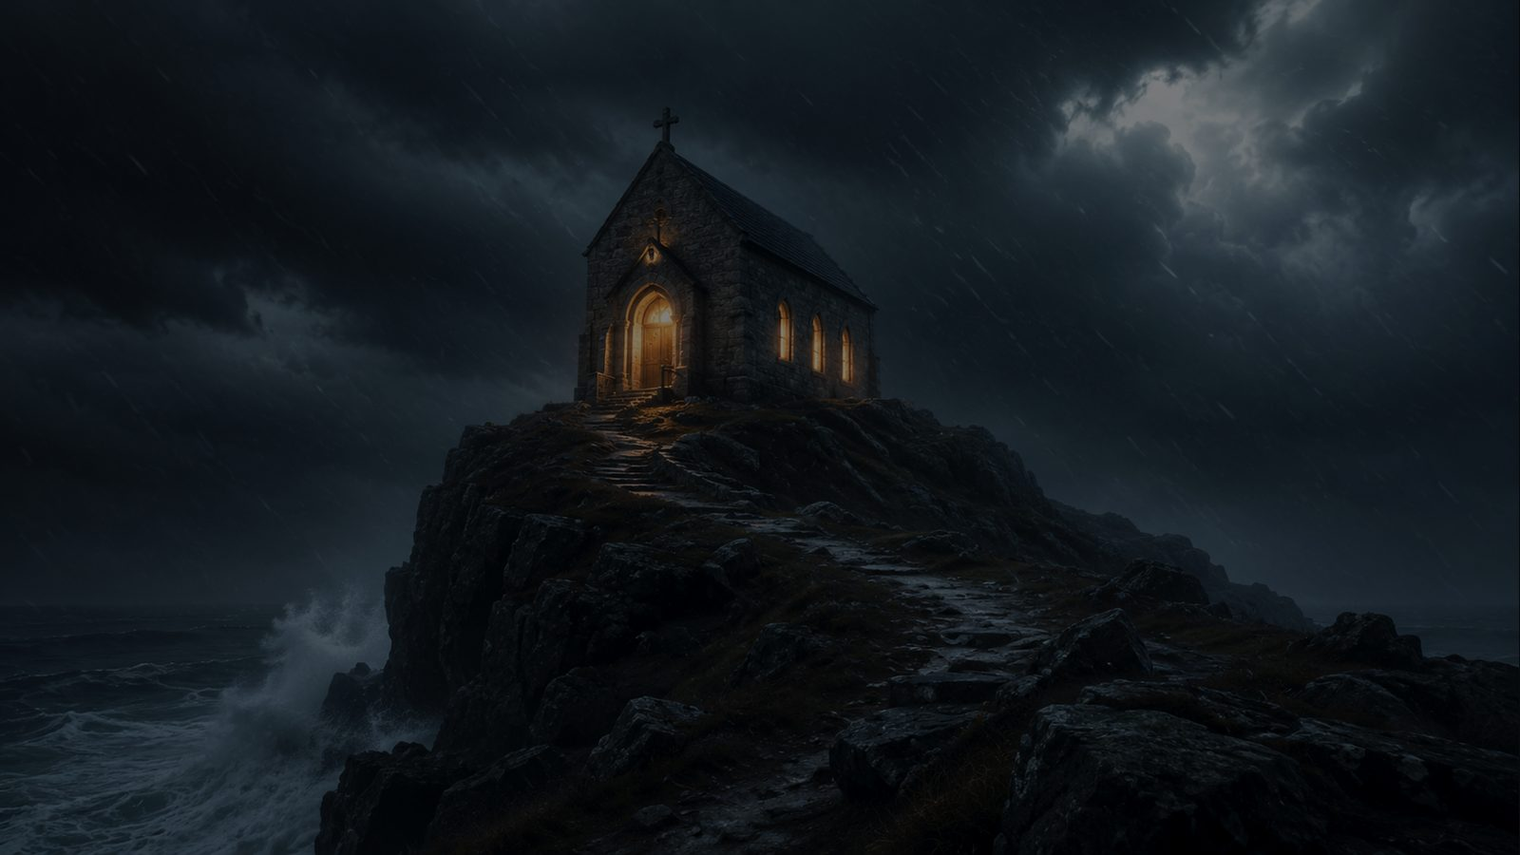
The Solid Rock
My hope is built on nothing less · Edward Mote · SOLID ROCK · 1 Corinthians 3:11
Prepared for teaching and small group use - hymninfo.com

Slide 2
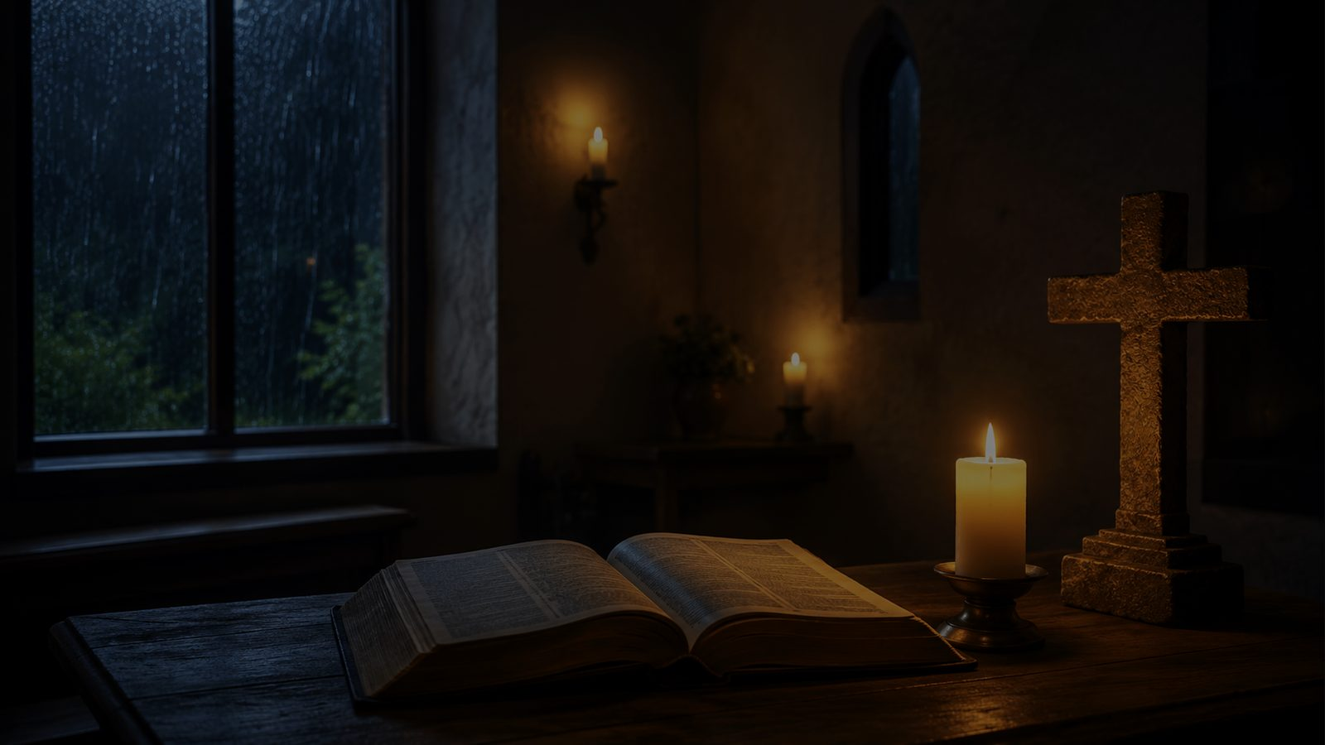
Teaching Aim
Understand the hymn, trust the Savior, practice steady hope
UNDERSTAND
FEEL
PRACTICE
Christ is the only foundation God has laid.
Assurance can remain even when storms come.
Build daily life on Christ’s word and grace.
Prepared for teaching and small group use - hymninfo.com

Slide 3
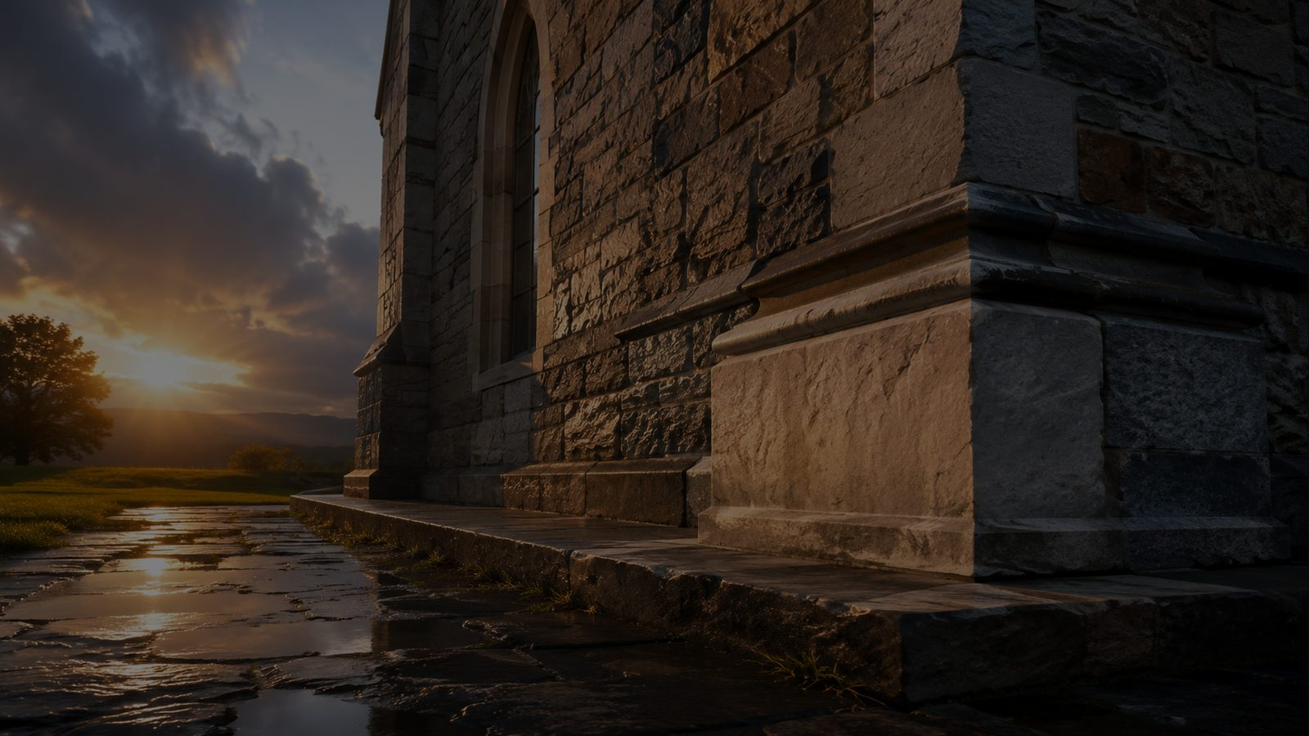
Hymn Identity
A congregational confession of assurance in Christ
• Title: The Solid Rock
• First line: My hope is built on nothing less
• Text: Edward Mote, 1834
• Tune: SOLID ROCK, William B. Bradbury, 1863
• Meter: Long Meter with refrain
• Central Scripture: 1 Corinthians 3:11
“On Christ the solid Rock I stand”
Prepared for teaching and small group use - hymninfo.com

Slide 4
Historical Background
A nineteenth-century hymn shaped by evangelical assurance
• Edward Mote was an English Baptist minister and hymn writer.
• He wrote the hymn in 1834; it was later printed in his 1836 collection.
• Mote’s text directs confidence away from personal merit and toward Christ’s righteousness.
• Bradbury’s sturdy tune helped the refrain lodge in congregational memory.
Prepared for teaching and small group use - hymninfo.com

Slide 5

Why This Hymn Matters Today
It teaches the church how to sing assurance without pretending life is easy
• It speaks to anxious hearts looking for security.
• It helps worshipers confess that good gifts cannot become ultimate foundations.
• It names storms without surrendering to them.
• It gives language for faith when visible circumstances are unclear.
• It reminds believers that assurance rests in Christ’s completed work.
• It prepares the church to stand before God in Christ.
Prepared for teaching and small group use - hymninfo.com

Slide 6
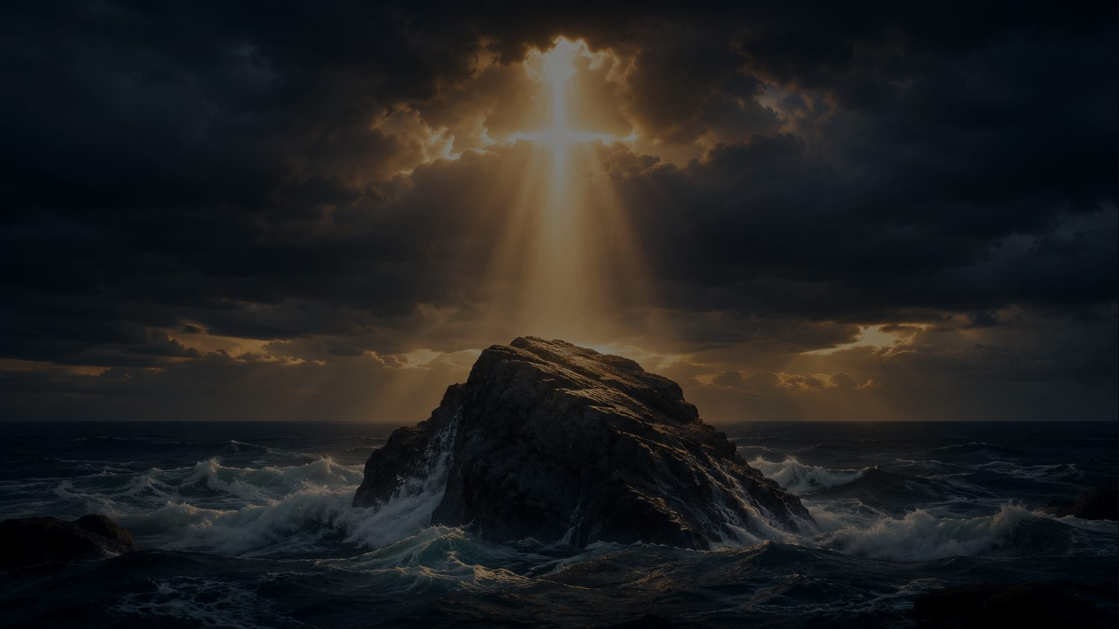
Biblical Foundation
The rock, the cornerstone, and the anchor of hope
1 Corinthians 3:11
For no one can lay any other foundation than that which has been laid, which is Jesus Christ.
• Matthew 7: the house stands because it is built on rock.
• Isaiah 28: God lays a precious, tested cornerstone.
• Hebrews 6: hope in God’s promise anchors the soul.
Prepared for teaching and small group use - hymninfo.com

Slide 7
Built on Christ
The opening confession of the hymn
Hope does not begin with the strength of faith, but with the Savior who is trusted.
Prepared for teaching and small group use - hymninfo.com

Slide 8
Section Study 1
The foundation of Christian hope
• The hymn begins by refusing every foundation except Jesus Christ.
• The singer does not trust a “sweet frame” of feeling, confidence, or spiritual mood.
• Teaching emphasis: assurance is grounded in Christ’s righteousness, not in the believer’s performance.
Prepared for teaching and small group use - hymninfo.com

Slide 9
The Refrain
Rock and sand give the congregation a clear spiritual contrast
• Christ is stable; every rival ground is unstable.
• The refrain works as confession, warning, and encouragement.
• Ask learners: What “sand” do respectable people still try to stand on?
Christ holds when every other ground gives way.
Prepared for teaching and small group use - hymninfo.com

Slide 10
Section Study 2
Grace when darkness veils the face of Christ
• The hymn does not deny seasons of hiddenness, fear, or difficulty.
• The believer rests on unchanging grace when visible comfort is absent.
• Teaching emphasis: Christian assurance is not the same as emotional certainty.
Prepared for teaching and small group use - hymninfo.com

Slide 11
Section Study 3
Covenant support in the overwhelming flood
• The hymn names God’s oath, covenant, and Christ’s blood as the believer’s support.
• The soul may feel as if everything is giving way, yet Christ remains hope and stay.
• Teaching emphasis: God’s promise is stronger than our strongest fear.
Prepared for teaching and small group use - hymninfo.com

Slide 12

Section Study 4
Ready for Christ’s appearing
• The hymn ends before the throne and the return of Christ.
• The believer’s final confidence is being found in him.
• Teaching emphasis: we stand faultless only in the righteousness of the Savior.
Prepared for teaching and small group use - hymninfo.com

Slide 13
Theological Themes
Four truths to teach clearly
• Justification: hope rests on Christ’s righteousness.
• Perseverance: faith is tested by storms, yet sustained by grace.
• Assurance: salvation does not rest on fluctuating feelings.
• Eschatology: Christian hope looks toward the coming of Christ.
Prepared for teaching and small group use - hymninfo.com

Slide 14
Literary and Musical Observations
A simple structure carries a strong confession
• The repeated rock/sand contrast makes the hymn easy to remember.
• Storm imagery gives emotional honesty without despair.
• Bradbury’s tune gives the refrain a firm, declarative shape.
• Strong accompaniment should support the text’s confidence, not rush it.
Prepared for teaching and small group use - hymninfo.com

Slide 15
Pastoral and Worship Use
Where the hymn serves the church well
• Assurance after confession and pardon.
• Services focused on faith, perseverance, or Christ as cornerstone.
• Funerals and pastoral-care settings where hope needs biblical grounding.
• Sermons from Matthew 7, 1 Corinthians 3, Isaiah 28, or Hebrews 6.
• Choir rehearsals where text meaning deepens congregational singing.
Prepared for teaching and small group use - hymninfo.com

Slide 16
Teaching Questions
Use these to lead discussion
• What foundations compete with Christ in ordinary life?
• How does the wise-builder passage sharpen the hymn’s message?
• What kind of storm are you tempted to treat as stronger than grace?
• How does the hymn teach assurance without encouraging pride?
• Why is being found in Christ better than proving ourselves?
Prepared for teaching and small group use - hymninfo.com

Slide 17
Suggested Lesson Flow
Two practical ways to teach the hymn
30 MINUTES
60 MINUTES
• Read 1 Corinthians 3:11 and Matthew 7:24-25.
• Add historical background and tune notes.
• Teach the hymn’s identity and central image.
• Study each hymn section with Scripture.
• Discuss one storm and one false foundation.
• Use the theological themes as a summary.
• Close with prayer for steady hope.
• Invite testimony, application, and pastoral prayer.
Prepared for teaching and small group use - hymninfo.com

Slide 18
Closing Prayer
Christ our Rock, keep us standing on your grace
Lord Jesus Christ, our foundation and hope, rescue us from every false confidence. Teach us to stand on your righteousness, rest in your grace, and endure every storm by your faithful promise. Amen.
© HymnInfo.com. Free for personal, church, classroom, and small-group teaching use. Please do not sell, repost, or redistribute as downloadable files without permission.
Prepared for teaching and small group use - hymninfo.com

